Slide 1
PHYE-413 – Generic Electives 6 (A6):
Advanced Sensor Technology

Slide 2
Chapter 1 : Sensor Materials and and Sensor Matrix
Mahendra D. Shirsat
Professor
Department of Physics
Dr. Babasaheb Ambedkar Marathwada University,
Aurangabad (MS)-431 004
Email: mdshirsat@gmail.com

Slide 3

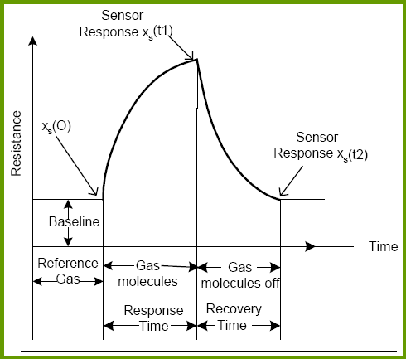
Ideal chemiresistive Sensor
A device, after exposure to a chemical/biological compound or mixture of chemical/biological compounds, alters one or more of its properties (e.g. mass, resistance, or capacitance) in a way that can be measured and quantified directly or indirectly.
An example of gas sensor response

Slide 4
Ideal Sensor - requisites
Sensor
Highly sensitive & selective
Precise & Accurate
Lower Detection limit
Portable
Low power consum-ption
Mass fabrication
Durable
Lower Recovery Time

Slide 5

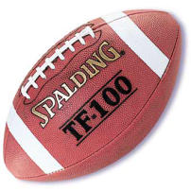
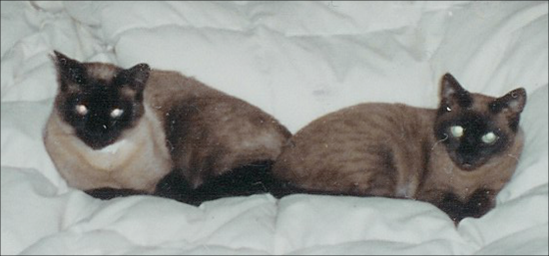

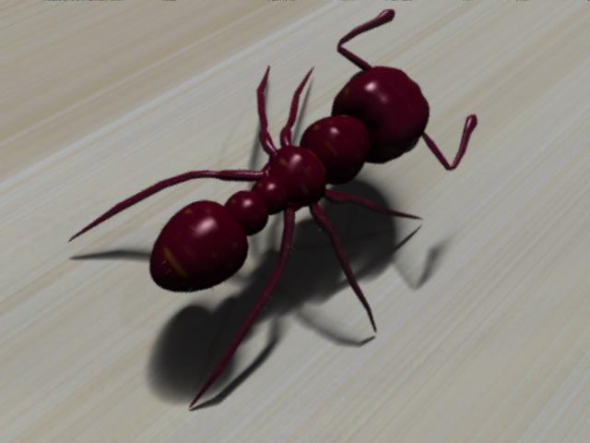

Nano Scale
School Girl
= 4 feet
= 1.219 meters
= 1.219 billion nanometers
Cat
= 1 ft. tall
= 0.3048 meter
= 304.8 million nanometers
11 inches wide
Ant
= about 5 millimeters
= 5 million nanometers
Human Hair
= 10 µm wide on average
= 10,000 nanometers
DNA
= 2.5 nanometers wide
10 Hydrogen Atoms
(side by side)
= 1 nanometer

Slide 6
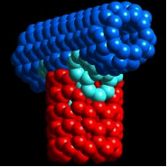
What is Nanotechnology ?
Nanotechnology is the creation of USEFUL / FUNCTIONAL materials, devices and systems (of any useful size) by manipulation of matter on the nanometer length scale and exploitation of novel phenomena and properties which arise because of the nanometer length scale:
• Physical
• Chemical
• Electrical
• Mechanical
• Optical
• Magnetic
Nanometer
• One billionth (10⁻⁹) of a meter
• Proteins ~ 1-20 nm
• Diameter of human hair ~ 10 µm
Notes:
3

Slide 7
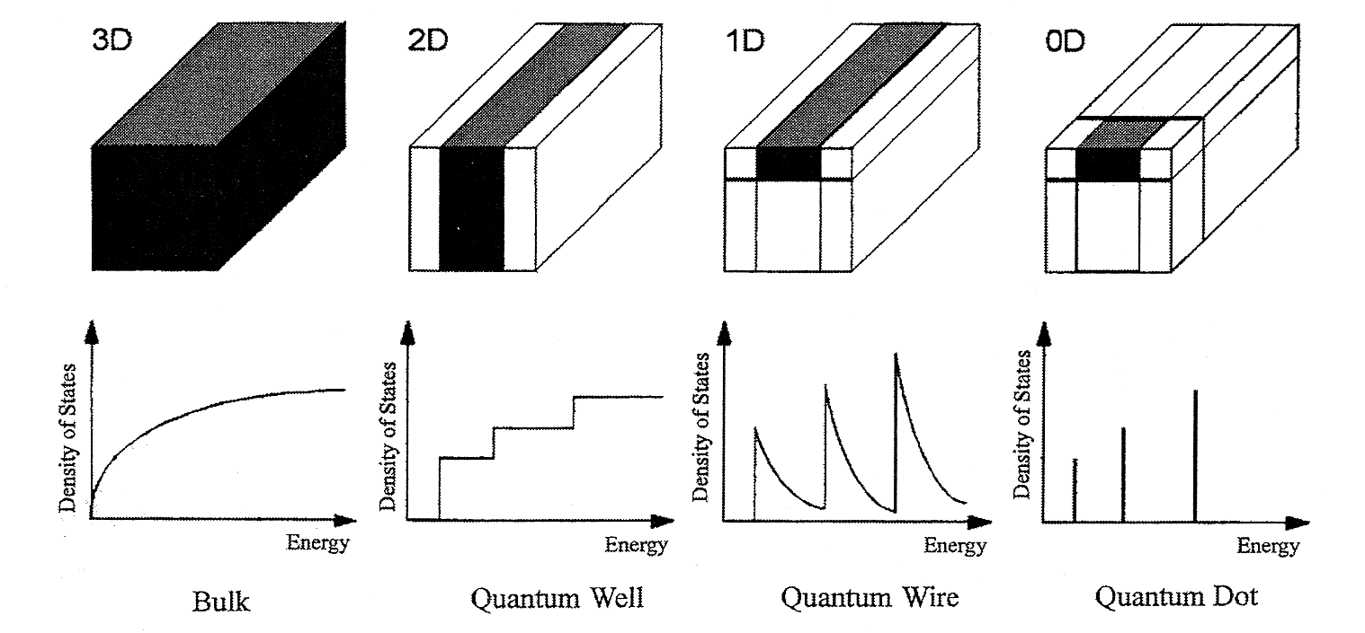
3D
2D
1D
0D
Source: Nanoscale Materials in Chemistry, Wiley, 2001
• If a bulk metal is made thinner and thinner, until the electrons can move only in two dimensions (instead of 3), then it is “2D quantum confinement.”
• Next level is ‘quantum wire
• Ultimately ‘quantum dot’

Slide 8


What is special about Nanoscale ?
Nanomaterials have a large surface area for a given volume.
• Size-dependent properties
• Surface to volume ratio
- A 3 nm iron particle has 50% atoms on the surface
- A 10 nm particle 20% on the surface
- A 30 nm particle only 5% on the surface

Slide 9

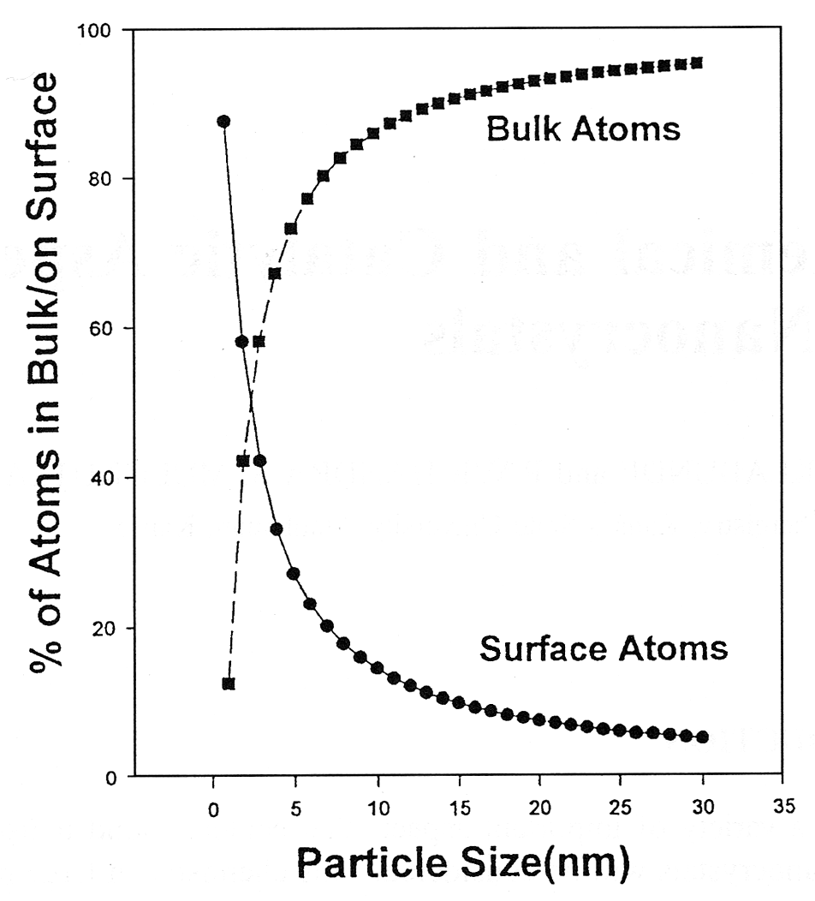
Surface to Bulk Atom Ratio

Slide 10
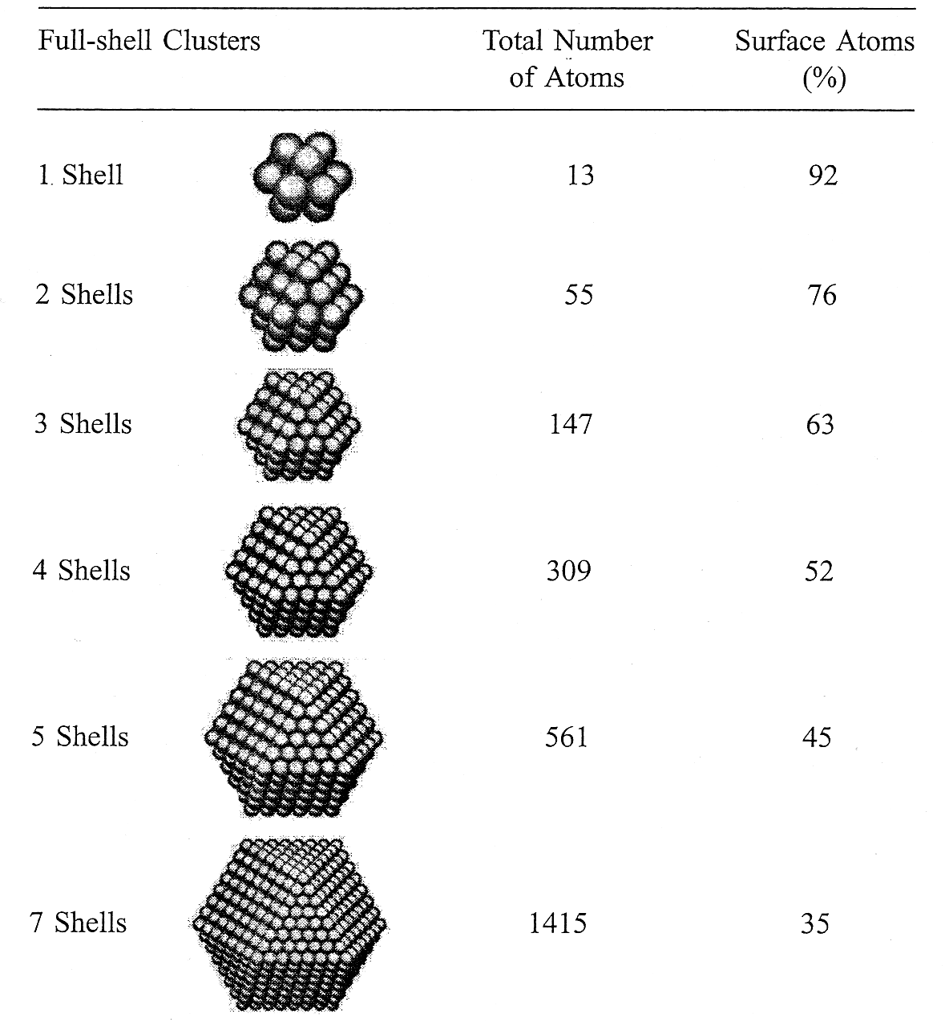
Percentage of Surface Atoms

Slide 11
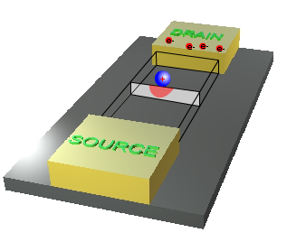
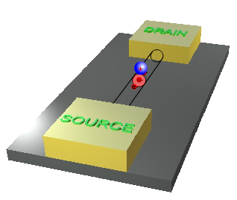
Importance of 1D Structure
Thin film based Field Effect Transistor
Nanowire based Field Effect Transistor
Divergence in current causes the attenuation in the signal (ΔR) leading to lesser sensitivity.
Charge depletion/addition area covers almost the entire cross-sectional area. Current shows maximum change leading to maximum sensitivity.

Slide 12
Importance of size dependent Properties for sensing applications
• In materials where strong chemical bonding is present, delocalization of valence electrons can be extensive. The extent of delocalization can vary with the size of the system.
• Structure also changes with size.
• The above two changes can lead to different physical and chemical
properties, depending on size
- Optical properties
- Bandgap
- Melting point
- Specific heat
- Surface reactivity

Slide 13
Why Nano-Sensor ?
Nano Sensor
Surface to Volume Ratio
Response Time
Lower Detection limit
Multi-analyte Sensing
Recovery Time
Minituri-zation
Durable
Low Power consumption

Slide 14

Promising Sensing Materials
PORPHYRINS(free base and metal substituted)
Carbon Nanotubes
Organic Conducting Polymers
Metal nanoparticles
However, SELECTIVITY altogether has remained an unresolved and yet most challenging mystery for gas sensors.

Slide 15
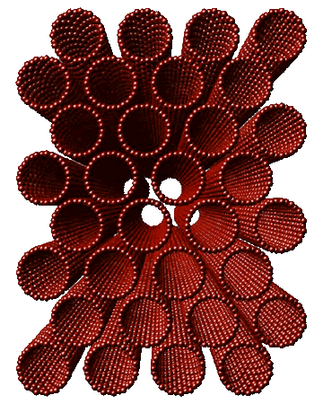
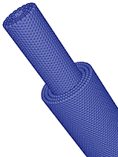
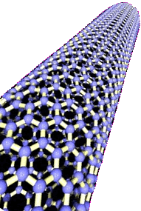
Carbon Nanotubes
Discovered in 1991 by Iijima
Unique material properties
Nearly one-dimensional structures
Single- and multi-walled

Slide 16
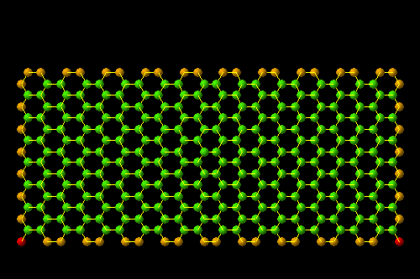
Rolling - up of Graphene Sheet ( Zig Zag Structure)
Single walled Carbon Nanotubes

Slide 17
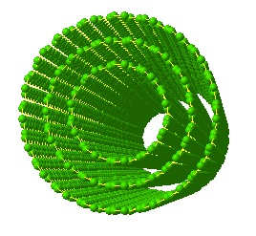
Multi walled Carbon Nanotube
Three graphene sheets stacked co-axially

Slide 18

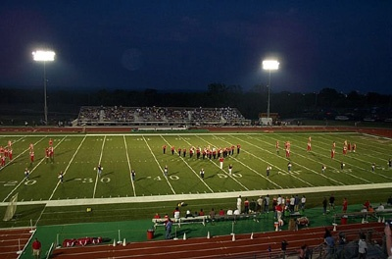
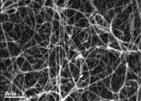
Interesting Properties of Carbon Nanotubes
• CNT is extraordinarily strong: 100 times stronger than steel, but weighs only 1/6th.
• CNT can be metallic (like metals)
or semiconducting (like silicon in
the computer chip).
• Large surface area: 4 gm of
material has the same surface area
of a football field
• High electrical conductivity
• High thermal conductivity
4 grams

Slide 19
Advantageous Aspects CNT as Gas Sensor
C
C
C
C
C
C
C
C
Graphene sheet
Carbon Nanotube
Due to the curvature of carbon graphene sheet in nanotubes, the electron clouds are distorted and a rich π - electron conjugation forms outside the tube making the surface of CNT electrochemically active.
High aspect ratio of CNTs enable them to act as molecular wires.
Excellent thermal, mechanical and electrical properties for harsh environmental conditions.
Ting Zhang et al Nanotechnology 19 (2008)
CNT + Gas ----------- CNT^{δe} Gas ^{δ+} or CNT^{δ+} Gas ^{δe}

Slide 20
Disadvantages of Pristine CNT Sensor
Poor Recovery (due to high specific surface area contribution of CNTs in binding of the analytes. )
Poor Selectivity (due to limited transduction mechanism employed )
Dearth of efficient methodology for incorporation of CNTs in sensor matrix.
Recovery:
UV light exposure for 2-3 hours, (2) High temperature exposure for 15-20 min.
Deshusses et al; 2008, NANOTECHNOLOGY 19, 332001
Star et al; 2008, ANGEWANDTE CHEMIE INT. ED., 47
Chen et al; 2008, J. NANOPART .RES., 10.
WAY OUTs
Dai et al;2000, SCIENCE, 287
Not feasible for mobile sensing applications.
Selectivity:
Affinity towards specific analyte can be inculcated by decorating CNTs with
Metal / Metal-oxide Nanoparticles.
Binding sites in CNTs altogether remains exposed to analytes.
Gabriel et al; 2006, J. PHYS. CHEM. B, 110.

Slide 21
WAY OUTs (Our Approach)
1) Functionalization of SWNTs (Non-Covalent)
  Enable to functionalize SWNTs with analyte specific entities ( Selectivity).
  Especially non-covalent functionalization enables to wrap up the entire SWNT surface while retaining its surface activity.
2) AC dielectrophoretic Alignment of SWNTs between microfabricated electrodes
  Ensures well defined pathway for charge carriers during signal transduction.

Slide 22

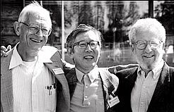
Organic Conducting Polymers
Exhibit electrical, electronic, magnetic and optical properties of metals or semiconductors while retaining the attractive mechanical properties and processing advantages
Can be synthesized by aplenty facile routes
Conductivity can be modulated over 15-orders of magnitude
Applicable as conductometric, potentiometric, amperometric and voltammetric transducers and as active layers of FETs
However …..
(i) Low electrochemical activity (ii) Hysteresis

Slide 23

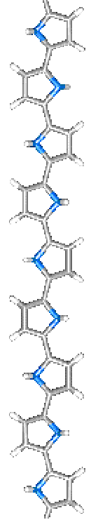
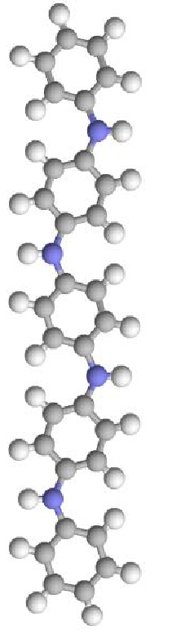
Organic Conducting Polymers
Au, Cu
10⁶
METALS
Fe
Mg
10⁴
Doped Polyaniline
In, Sn
10²
10⁰
Ge
SEMICONDUCTORS
10⁻²
10⁻⁴
S
INCREASING DOPANT LEVELS
10⁻⁶
10⁻⁸
Glass
10⁻¹⁰
Polyaniline
Diamond
10⁻¹²
INSULATORS
Nylon
10⁻¹⁴
Quartz
10⁻¹⁶
PANI
PPY
(S/cm)

Slide 24
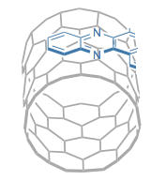
Why Conducting Polymers ?
Conducting polymer
The ability of Conducting Polymers to maintain intimate contact with the SWNT sidewall is due to π-π stacking between the SWNT and aromatic Conducting Polymers.
C
C
C
C
C
C
C
C
C
High density π _{CP} - π _{SWNT} delocalization
Single Wall Carbon Nanotube

Slide 25
Why Organic Conducting Polymers ?
During Polymerization, different supporting electrolytes can be employed to tune the affinity of the Conducting Polymer for particular analytes
Conducting polymer does not allow to analyte to get direct contact with SWNTs which helps in betterment of the recovery characteristics of the sensor

Slide 26
Electrochemical Functionalization
SWNTs
+
Conducting Polymer
Electrochemical
Functionalization
Enhanced-
Sensitivity
Selectivity
Response time
Advantages:
Low cost
Site-specific non-covalent functionalization
Simple and high manufacturability
High throughput
Ability to functionalize various materials
Ability to tailor the morphology, material and electrical properties
Fabrication of high density nanosensor arrays

Slide 27
Metalloporphyrins
Porphyrin and metallo-porphyrin compounds represents a large family of functional molecular material with high chemical, thermal and environmental stability.
The porphyrin basic blocks (Peripheral group and Central metal) that constitutes the macrocyclic skeleton can be combined together to produce a large manifold of sensors.
Almost all metals present in the periodic table can be coordinated to porphyrins.
A wide range of different substituent can be introduced at their peripheral positions.

Slide 28
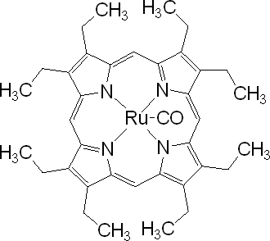
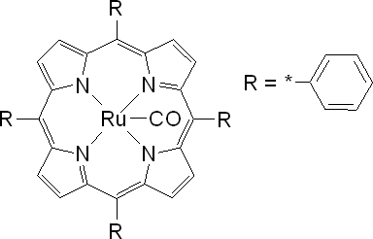
Metalloporphyrins
Octaethyl porphyrin with ruthenium(II) carbonyl at the centre
The coordinated metal plays an important role and the selectivity could be modified by changing the central metal.
Tetraphenyl porphyrin with ruthenium(II) carbonyl at the centre
The peripheral substitution influences the electronic distribution of the π aromatic system which is responsible for deciding the selectivity.

Slide 29
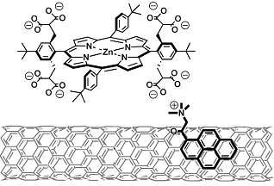
Metalloporphyrins: Special Features
The ability of porphyrins to maintain intimate contact with the CNT sidewall is due to π-π stacking between the CNT and aromatic porphyrin. This enhances the probability of π_{metalloporphyrin}- π_{CNT} delocalization.
[ Star et al; 2007, J. PHYS. CHEM. C, 111 ]

Slide 30
Interaction of Gas Analyte and Hybrid Structure
Metalloporphyrins are well known electron donors. They donate electrons to SWNTs in hybrid configurations. [Star et al; 2007, J. PHYS. CHEM. C, 111 ]
On interaction with the synthesized hybrid structure, the analyte acts as the axial ligands to the central metal ion and transferring of electrons in between central metal ion and / or peripheral rings takes place in accordance to the oxidizing / reducing nature of the gas.
This ultimately enhances / reduces the overall electron donating effect of metalloporphyrins and leads to a device characteristics that is consistence with inclusion / removal of electrons from the metalloporphyrin membrane. [ Gruner et al; 204, ADV. MATER., 16]
In addition to above upon physical adsorption of the analyte at the metalloporphyrin site causes geometric deformations in the porphyrin layer leading to possible scattering sites in SWNT, thereby causing change in overall conductance of the device.

Slide 31
List of Porphyrins and probable Analytes
Name of the Porphyrins | Probable Analyte
M –OEP ( Metallo- Octaethyl Porphyrins) e.g Ru, Mn, Fe, Zn etc | Acetone, Ethanol, Methanol, Propanol
M – TPP ( Metallo – Tetraphenylporphyrins ) e.g Rh TPP, Co TPP, Mn TPP, Zn TPP | Ethanol, Methanol, Triethylamine, Ethylenediamine, Propanol, Acetic acid, Hexane, 4- aminophenol
M-TMHPP ( Metallo- Tetra Methoxy-Hydroxyphenyl Porphyrins) e.g Mn, Fe, Co, Ni etc | Ethanol, Methanol, Isobutyl Alcohol, Acetic acid, Ammonia, Ethanol
M- TBPP ( Metallo- Tetra Butyloxyphenyl Porphyrins and THPP ( Metallo – Tetra Hepthyloxyphenyl Porphyrins) e.g Zn | Acetic Acid, Cyclopentane, Toluene, Benzene, Triethylamine, n-Butylamine
Tetra (N-methyl-4-pyridino)porphyrins | Formaldehyde, Acetaldehyde
M-PP ( Metallo – Protoporphyrins ) e.g. Co PP, Cu PP, Zn PP, Ni PP | Triethylamine, Acetic acid, Ethanol, Toluene

Slide 32
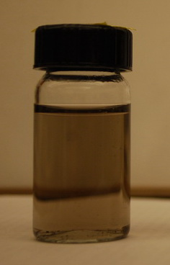
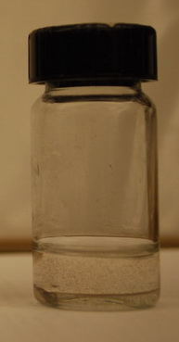
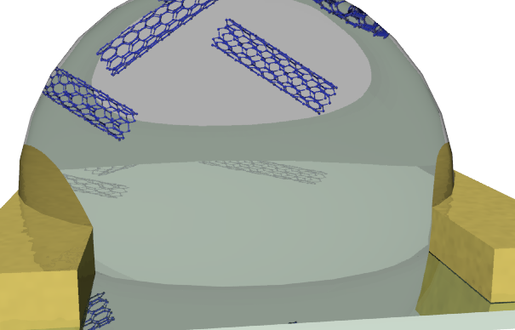
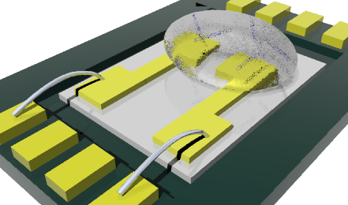
Sensor Fabrication Technologies
Preparation of SWNTs suspension in DMF (Dimethylformamide)
Sonication
&
Centrifugation
Supernatant will have to be decanted to have fine suspension SWNTs
AC dielectrophoretic alignment of SWNTs (to bridge 3 μm gap between two gold microelectrodes on Si / SiO2 substrate )
0.1 μL SWNTs suspension in DMF
AC Dielectrophoretic alignment setup
Notes:
32
It starts from sensor fabrication. 1st, 3 um gap gold electrodes were microfabricated by standard lithography. TO insulate the substrate, 100 nm thick SiO2 was developed on silicon wafer by chemical vapor deposition. After photolithographically defining the electrode area, 20 nm Cr adhesion layer & 180 nm Au layer were e-beam evaporated. Electrodes were finally defined using lift-off techniques. Only for FET study we used 300 nm thick SiO2 and highly doped Si substrate.
2nd, 10 ug/ml SWNTs-COOH solution was prepare by suspending P-3 SWNTs in DMF. Sonicate for 90 mins and followed by centrifuged 90 mins with the speed of 31,000 G. Supernatane was then taken and ready to be used for CNT assembly

Slide 33
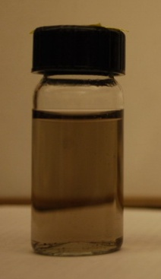
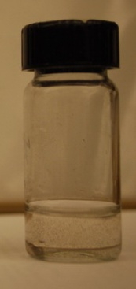
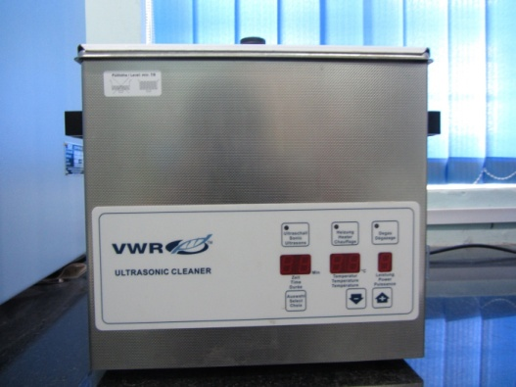
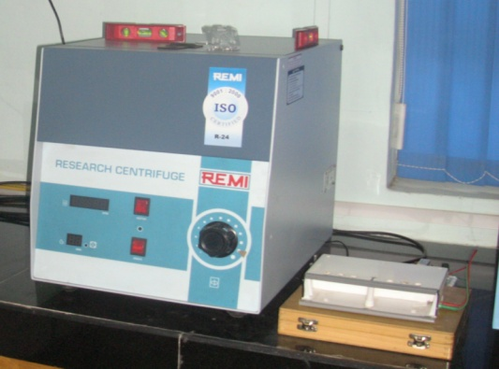
Synthesis of P (NMP) functionalized aligned SWNTs structures
Preparation of suspension of SWNTs
COOH-SWNTs were ultrasonically dispersed in N-N dimethyl formamide at a concentration of 0.01 mgmL⁻¹ followed by a centrifugation at 14000 RPM for 90 min.
90 min. sonication
&
90 min. centrifugation
at 14,000 RPM

Slide 34
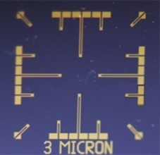
Substrate
3 μm
Au -180nm
Cr - 20nm
SiO2 - 300nm
Cross Sectional View
Si - 525μm
The Au microelectrodes were photolithographically patterned on Si/SiO2 wafers (having 3 µm gap between two electrodes)
3 μm

Slide 35
AC Dielectrophoretic alignment of SWNTs
Aligned conditions : 0.36 AC V + 4 MHz

Slide 36
Dielectrophoretic Alignment
+ + + + + + + +
- - - - - - - -
- - - - - - - - - - - -
- - - -
++ + + + +
+ + + + + + + + + +
+ + + +
+ + + + + + + + + + +
- -
- - - - - - - - - - - - - - -
+ + + + + + + +
- - - - - - - -

Slide 37
Alignment of SWNTs structures
A 0.1 µl drop of final decanted suspension was placed on top of Au electrodes
Dielectrophoretic alignment of SWNTs was carried out by applying 1 V_{RMS} at 4 MHz frequency between electrodes
SWNTs Suspension
Aligned SWNTs
Devices were annealed at 300⁰C for 1 hr under a reduced atmosphere (continuous flow of 5% H₂ in N₂)

Slide 38
Dielectrophoretic Alignment
+ + + + + + + +
- - - - - - - -
- - - - - - - - - - - -
- - - -
++ + + + +
+ + + + + + + + + +
+ + + +
+ + + + + + + + + + +
- -
- - - - - - - - - - - - - - -
+ + + + + + + +
- - - - - - - -

Slide 39
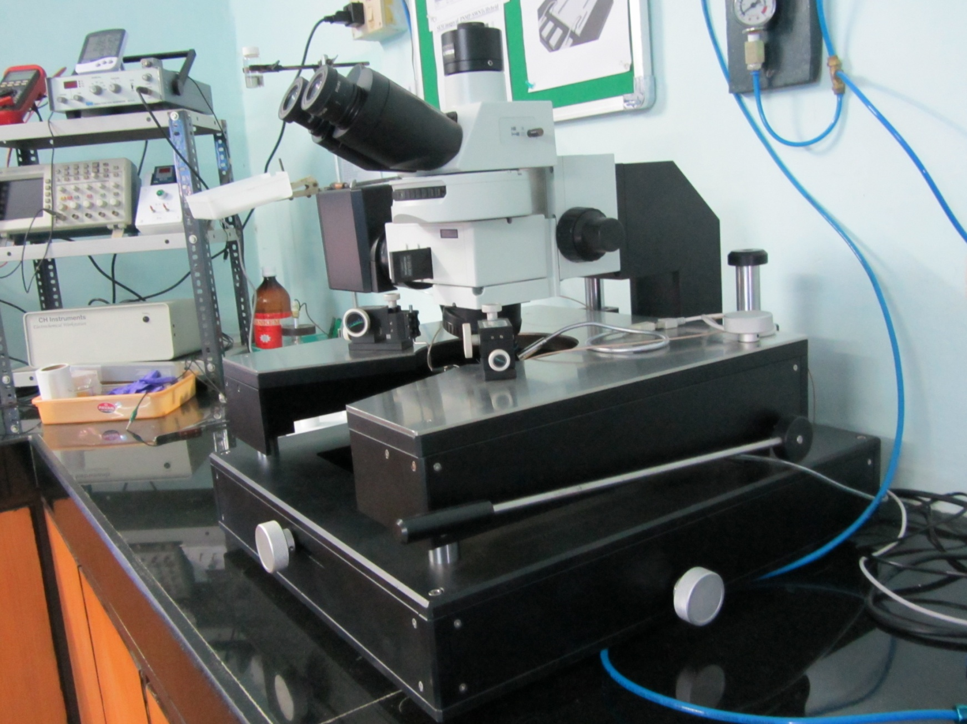
Ecopia EPS1000 Probe Station

Slide 40
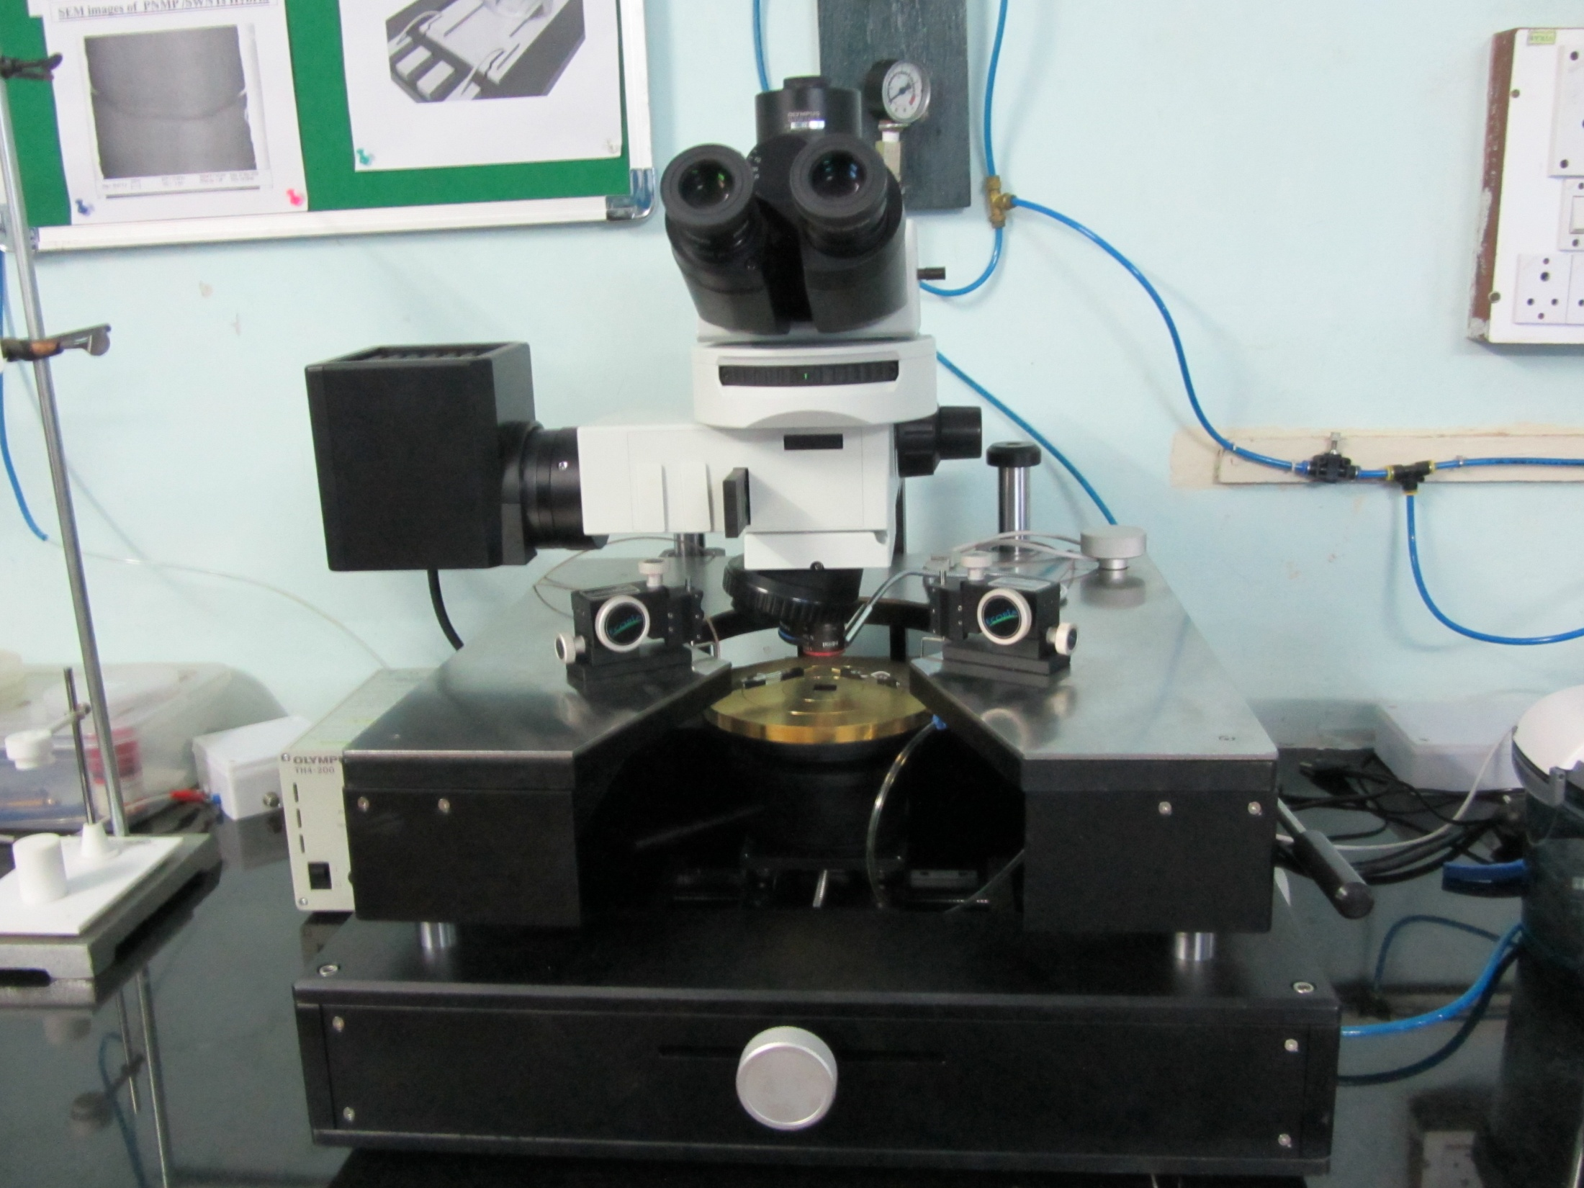

Slide 41
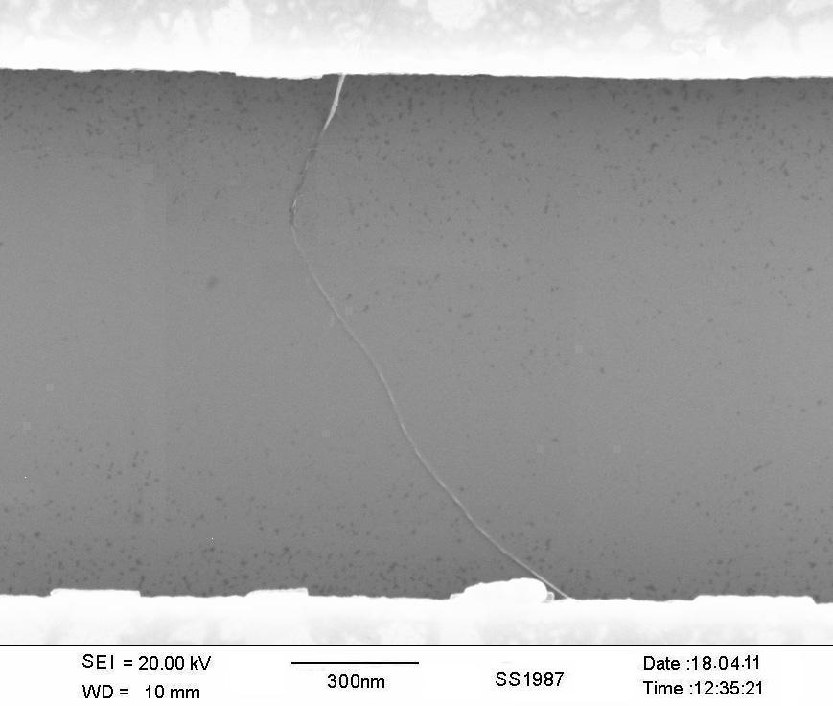
AC Dielectrophoretic Alignment of SWNTs (contd..)
9 nm
SEM image of Aligned bare SWNTs

Slide 42
Surface Modification of SWNTs by OCP
NMP 0.05M
NaNO₃ 0.05M
HPLC water
Monomer Solution
2 μL drop of monomer soln. on pre aligned SWNTs (between Au fingertips)
Charge Controlled Potentiostatic Deposition (+0.7V against Ag/AgCl ref. Electrode)
Deposition Charge was varied for 01 μC, 03 μC & 05 μC
Monomer Soln

Slide 43
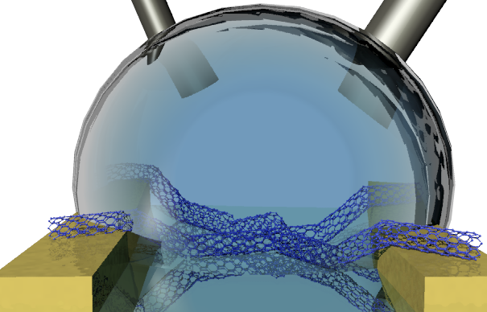
Surface modification of SWNTs by OCP ( contd..)
C.E
(Stainless steel)
R.E
(Ag/AgCl)
Supporting electrolyte
+
Monomer
W.E
W.E
Conditions: E = 1 V, C = 0.12 mC at room temperature

Slide 44
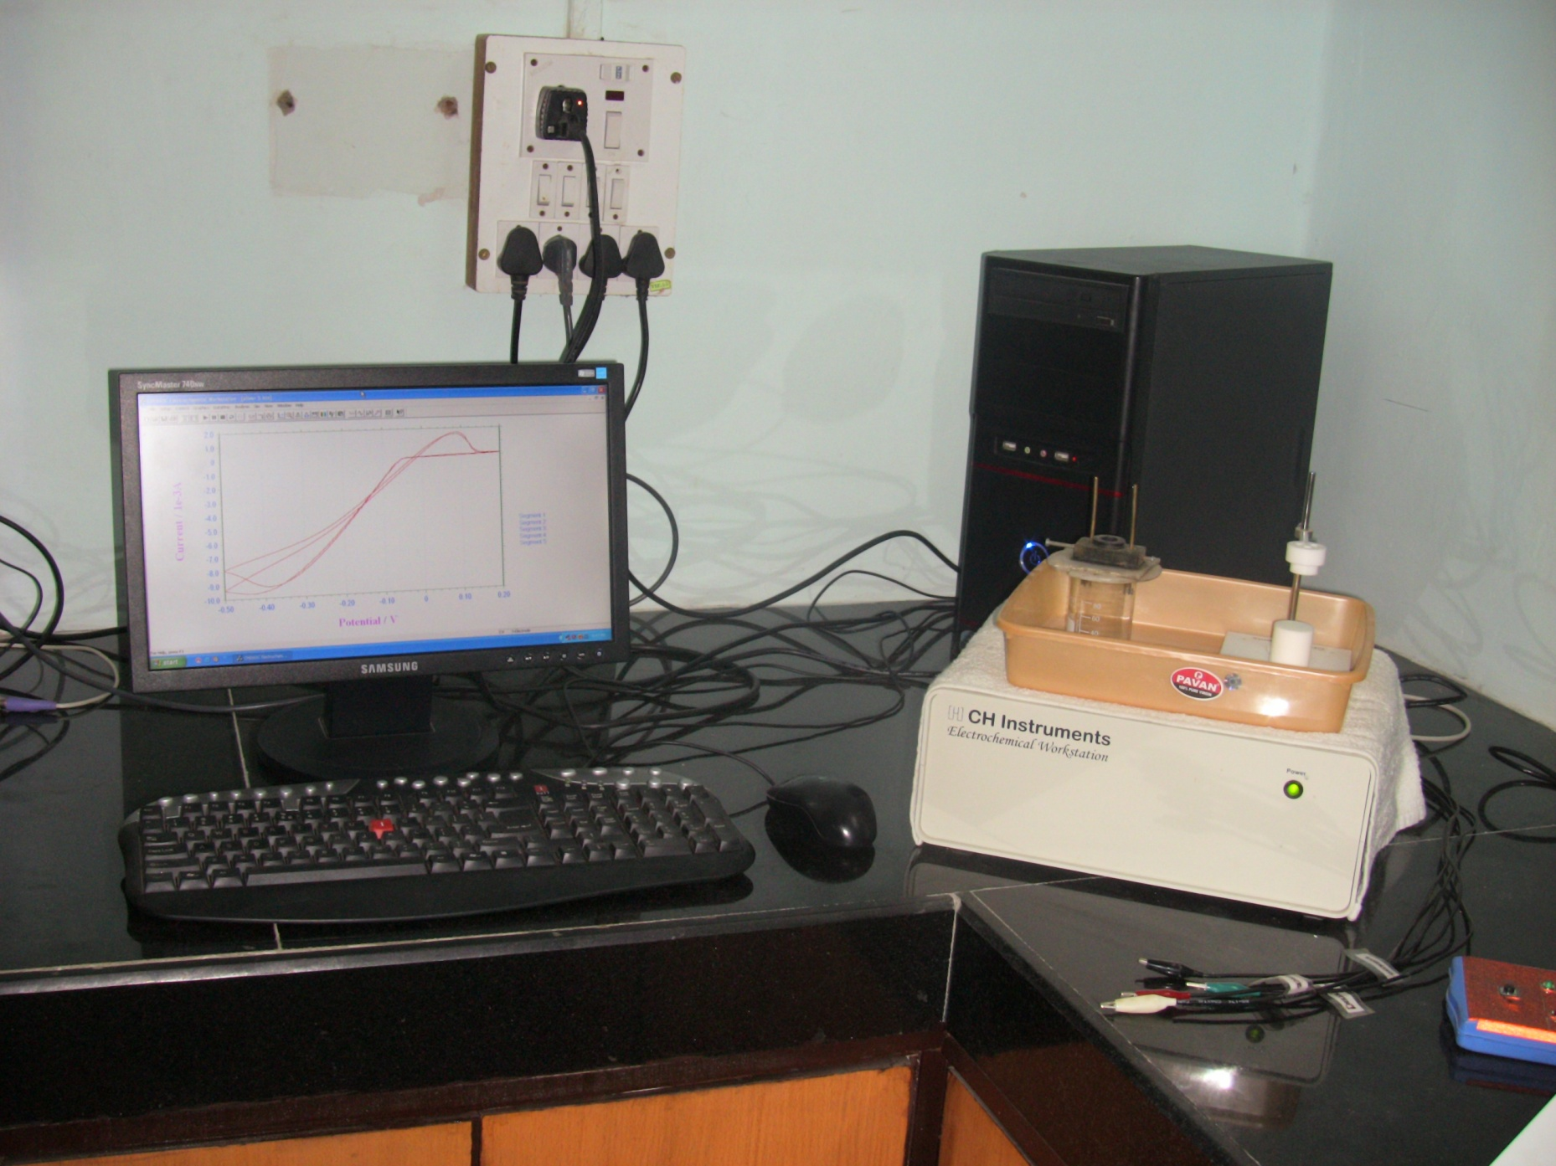

Slide 45
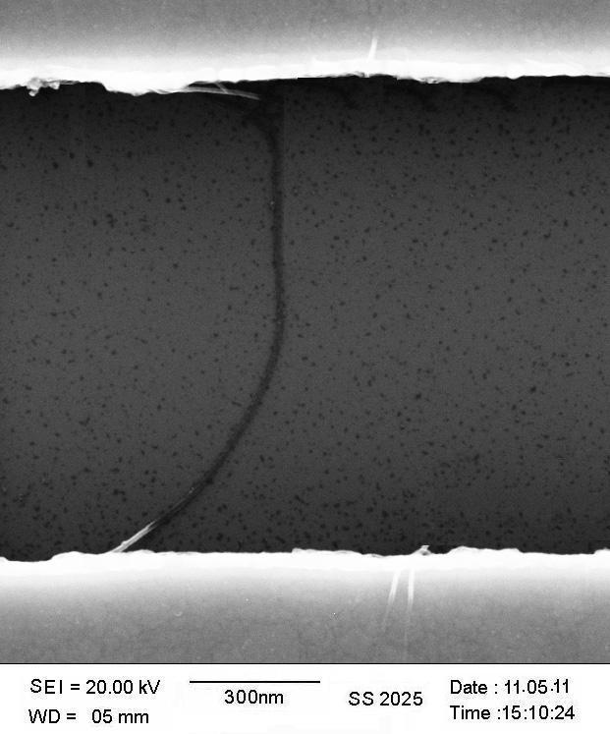
OCP modified Aligned SWNTs
20 nm
SEM image of 1 μC Charged deposited P(NMP) functionalized SWNT
One step galvanostatic deposition

Slide 46
Electrochemical Characterization
Cyclic Voltammogram of Bare SWNTs and 1 μC Charged deposited P(NMP) functionalized SWNTs (3rd cycle)

Slide 47
Results & Discussion (Contd…)
Room Temperature Electrical (I/V) Measurements

Slide 48
Results & Discussion (Contd…)
Room Temperature FET Measurements

Slide 49
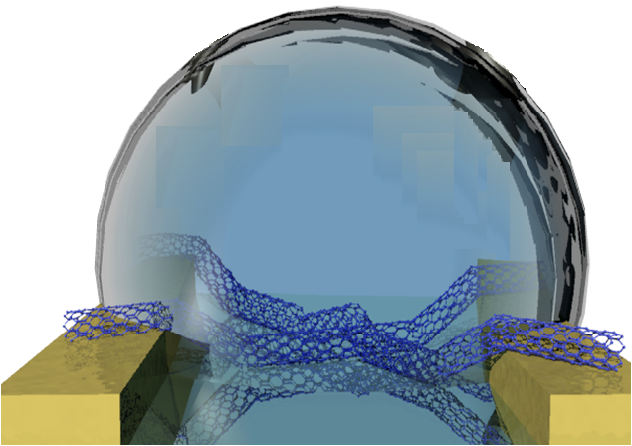
Solid Casting of Metalloporphyrins on Aligned SWNTs ( Non Covalent Functionalization of SWNTs )
Metalloporphyrin Solution

Slide 50
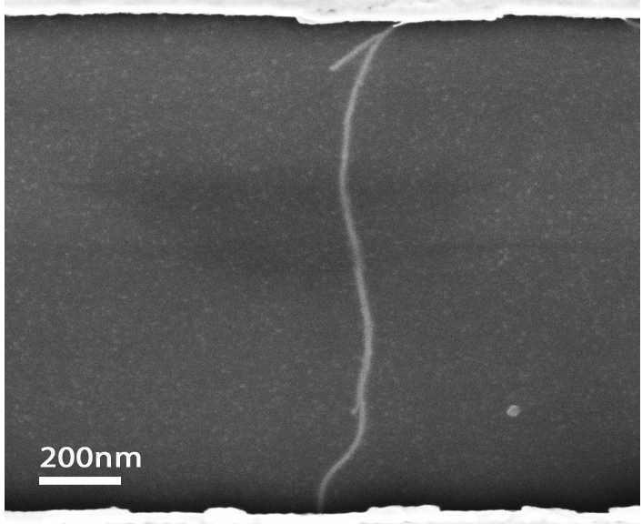
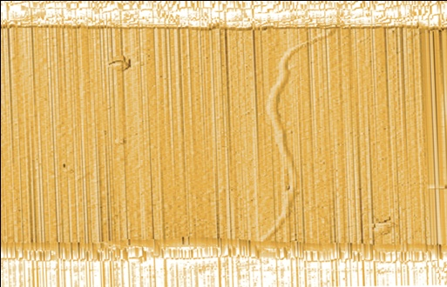
Nanosensor array based on Porphyrin functionalised SWNTs
Porphyrin : A porphyrin is a heterocyclic macrocycle consisting of four pyrrole rings connected through methane bridges
(a)
(b)
(c)
(d)
Figure (a) SEM image of Ru OEP functionalised SWNT ; (b) AFM image Ru OEP functionalised SWNT ; (c) Energy dispersive X-ray analysis (EDAX) spectrum Ru OEP functionalised SWNT ; (d) Height distribution histogram of bare and Ru OEP functionalised SWNTs
( f )
(e)
Figure (e) Transient response of methyl ethyl ketone (SWNT \ OEP : octaethyl porphyrins functionalised SWNT); ( f) histogram showing comparison of responses of bare and free base and metal substituted functionalised devices towards acetone, methanol, ethanol, DCM, MEK and water vapor.
.
ACS Physical Chemistry C

Slide 51
FET measurement of Bare SWNT and Ru OEP functionalised SWNT device a) I_{DS}- V_{DS} curve ( at V_{GS} = 0 V) b) I_{DS} – V_{GS} curve
(atV_{DS}=-1V).
(a)
(b)

Slide 52
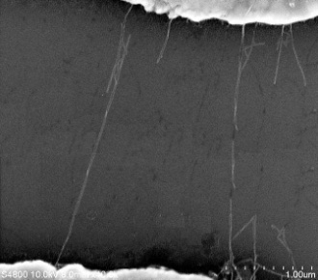

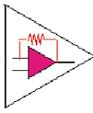
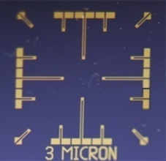
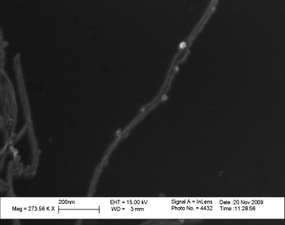
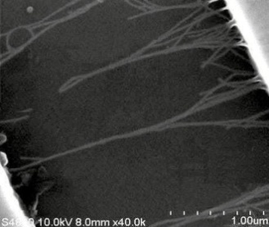
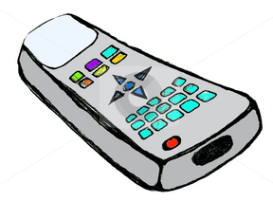
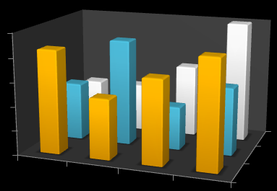
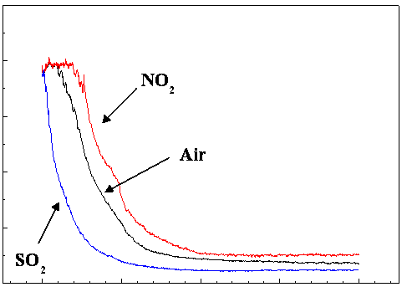

Hierarchy towards final objective (simplified)
3 µm apart Au fingertips on Si/SiO2
AC dielectrophorectic alignment
Aligned SWNTs
Electrochemical functionalization
Tailoring of Metal nanoparticles
Con. Polymer func. SWNTs
Design of hardware
Multianalyte sensor platform
Validation of sensors under individual and complex atmosphere
CHEMFET & CHEMIRESISTOR
Sensing Gadget

Slide 53
Electrochemical Circuit
Electrochemical workstation
Counter
electrode
Working
Electrode
Reference
electrode
Electrolyte Solution
(02 µL deoxygenated)

Slide 54



Three electrode Set-up & Instrumentation
CE
(Platinum wire)
RE
(Chlorinated Ag/AgCl wire)
WE
Electrolyte solution

Slide 55
Schematic of the Gas Sensing Setup
CARRIER
MFC 2 (MC 200; Alicat)
SENS. CHAMBER
TO EXHAUST
MFC 1 (MC 200; Alicat)
ANALYTE
Keithley 2400 SMU

Slide 56

Indigenously Developed Dynamic Gas Sensing System

Slide 57


Slide 58


Any Questions / Queries ?

