Slide 1
Chapter 3 :
Integrated Circuit Manufacturing Techniques for Sensors
Dr. M. D. Shirsat,
Professor,
Department of Physics,
Dr. Babasaheb Ambedkar Marathwada University, Aurangabad (MS)

Slide 2
Lithography :
Lithography comes from two Greek words, viz. “lithos” which means stone and graphein which means write.
Lithography means : “ writing a pattern on stone”
Photolithography :
When light is being used to write a pattern on a substrate it is call Photolithography
A light sensitive photoresist is spun onto the wafer forming a thin layer on the surface.
The resist is then selectively exposed by shining light through a mask which contains the pattern information for the particular being fabricated.
The resist is then developed which completes the pattern transfer from the mask to the wafer.

Slide 3
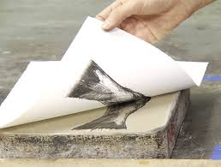
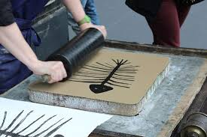
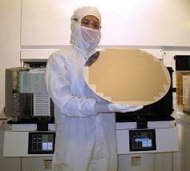
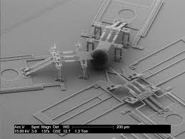
Lithography
Lithography is the most complicated, expensive, and critical process of modern IC manufacturing.
Lithography transforms complex circuit diagrams into pattern which are define on the wafer in a succession of exposure and processing steps to form a number of superimposed layers of insulator, conductor, and semiconductors materials.
Typically 8-25 lithography steps and several hundred processing steps between exposure are required to fabricate a packed IC.
The minimum feature size i. e., the minimum line width or line to line separation that can be printed on the surface, control the number of circuits that can be placed on the chip and has a direct impact on circuit speed. The evolution of IC is therefore closely linked to the evolution of lithographic tools.

Slide 4
Types of Lithography
Photolithography (Optical, UV, EUV)
E-beam/ion-beam/Neutral atomic beam lithography
X-ray lithography
Interference lithography
Scanning Probe
Voltage pulse
CVD
Local electrodeposition
Dip-pen

Slide 5
Types of Lithography

Slide 6
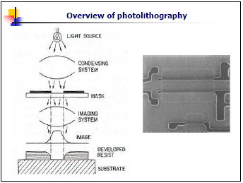

Slide 7
Overview of photolithography (ctnd.)
Lithography consists of patterning substrate by
employing the interaction of beams of photons or
particles with materials.
Photolithography is widely used in the integrated
circuits (ICs) manufacturing.
The process of IC manufacturing consists of a
series of 10-20 steps or more, called mask layers
where layers of materials coated with resists are
patterned then transferred onto the material layer.

Slide 8
Overview of photolithography (ctnd.)
A photolithography system consists of a light source, a mask, and a optical projection system.
Photoresists are radiation sensitive materials that usually consist of a photo-sensitive compound, a polymeric backbone, and a solvent.
Resists can be classified upon their solubility after exposure into: positive resists (solubility of exposed area increases) and negative resists (solubility of exposed area decreases).

Slide 9
Photolithography
Move to EUV (Various Light sources)
Source | Name | Wavelength (nm) | Application feature size (nm)
Mercury lamp | G-line | 436 | 500
 | H-line | 405
 | I-line | 365 | 350 to 250
Excimer Laser | XeF | 351
 | XeCl | 308
 | KrF | 248 (DUV) | 250 to 130
 | ArF | 193 | 150 to 70
Fluorine laser | F₂ | 157 | < 100
Notes:
EUV: Extreme ultraviolet lithography

Slide 10
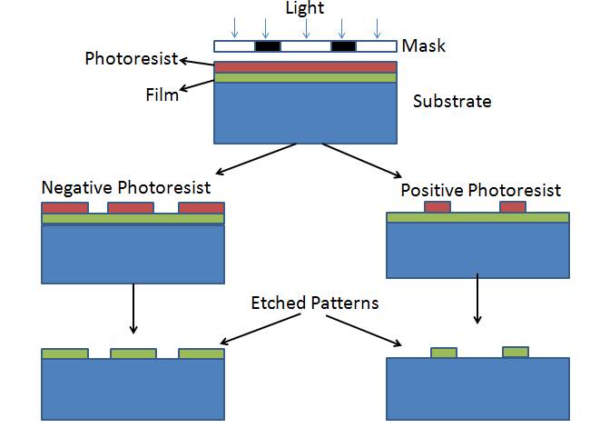
Types of Photoresist
Positive Photoresist
Negative Photoresist

Slide 11
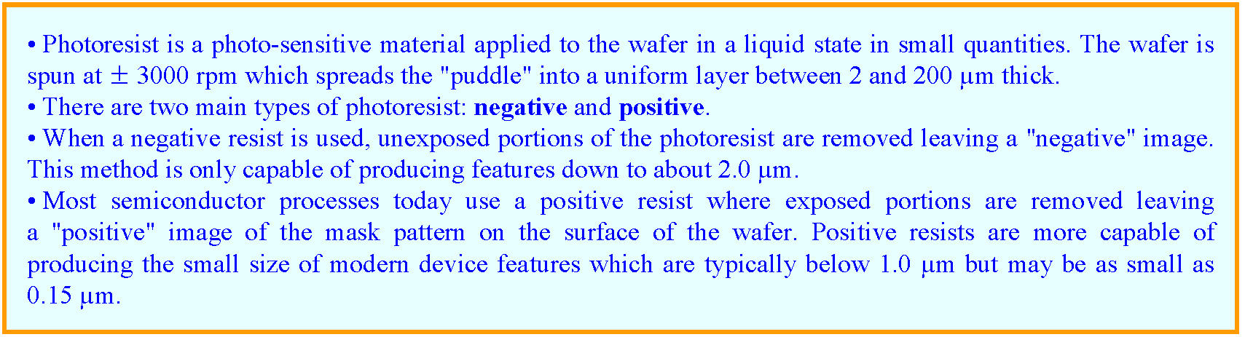
Types of Photoresist
Positive Photoresist
Negative Photoresist

Slide 12
Photoresist
Negative Photoresist
Becomes insoluble after exposure
When developed, the unexposed parts dissolved.
Cheaper
Positive Photoresist
Becomes soluble after exposure
When developed, the exposed parts dissolved
Better resolution

Slide 13
Negative and Positive Photoresists
Photoresist
Substrate
UV light
Mask/reticle
Photoresist
Exposure
Substrate
Negative Photoresist
Substrate
After Development
Positive Photoresist
Substrate

Slide 15
Basic Photo-Lithography Processes
Resist Coating
Surface preparation
Spin coating
Soft bake (pre-bake)
Exposure
Alignment
Exposure
Development
Development
Hard bake (post-bake)
Stripping
Pattern Transfer
Etching
Lift off/deposition

Slide 16
Substrate Cleaning
Particularly troublesome grease, oil or wax stains
2-5 min ultrasonic bath in trichloroethylene (TCE)
or trichloroethane (TCA), 65-75ºC (carcinogenic)
Standard grease removal
2-5 min ultrasonic bath in acetone
2-5 min ultrasonic bath in methanol
2-5 min ultrasonic bath in D.I. H₂O
Repeat the first three steps 3 times
30 sec rinse under free flowing D.I. H₂O
Oxide and other material removal
5 min H₂O:H₂O₂:NH₃OH 4:1:1 70-80ºC (cleaning Ge)
30 sec 50% HF (Glass or SiO2)
D.I. H₂O 3 rinses
5 min H₂O:H₂O₂:HCl 5:1:1 70-80ºC
D.I. H₂O 3 rinses
Spin dry (wafer) / N₂ blow dry

Slide 17
Spin Coating -A

Slide 18
Softbake
Remove the resist solvent
Convection Oven
90-100 ºC, 15-20 min
removal starts at surface
solvent trapping
Conduction (hotplate)
75-85ºC, 40-60 sec
removal starts at bottom
uniform heating

Slide 19
Wafer Exposure Systems
Contact printing is capable of high resolution but has unacceptable defect densities. Inexpensive, diffraction effects are minimize.
• Proximity printing cannot easily print features below a few μm (except for x-ray systems). Poor resolution due to diffraction effects, required 1 X mask.
• Projection printing provides high resolution and low defect densities and \ dominates today.
• Typical projection systems use reduction optics (2X - 5X), step and repeat or step and scan mechanical systems, print ∼ 50 wafers/hour and cost $5 - 10M.

Slide 20
Wafer Exposure Systems
Exposure
Contact
Printer
Proximity
Printer
Projection
Printer

Slide 21
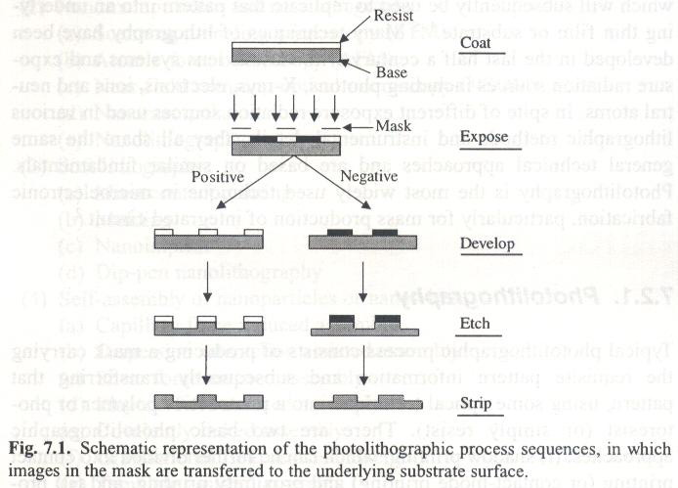
Basic lithography processes

Slide 23
Hardbake
Stabilize the developed resist for subsequent processes
Can make removal very difficult
Remove residual solvent
Not necessary for lift-off
Temperature/time can change the profile

Slide 24
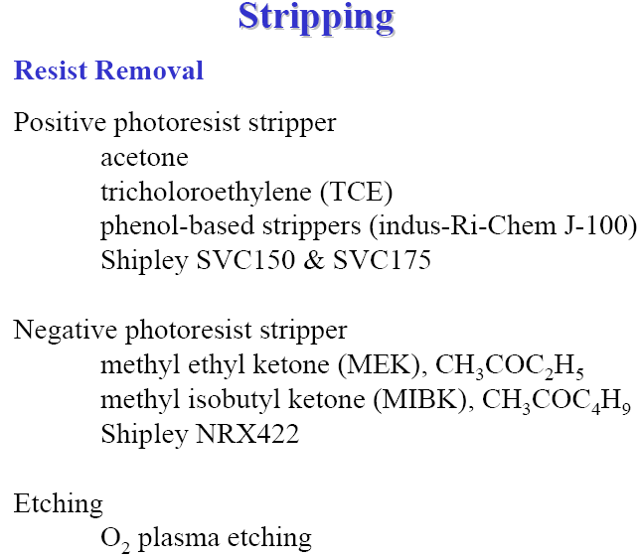

Slide 26
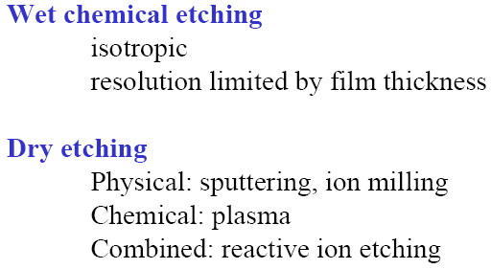

Slide 27
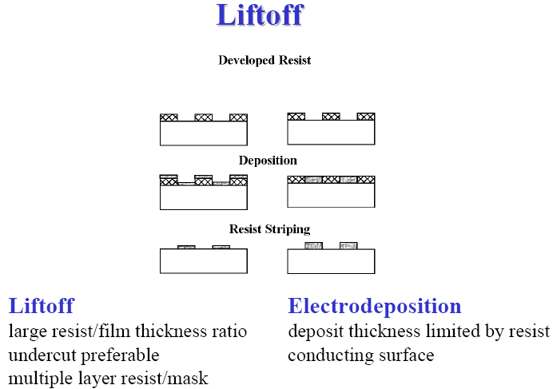

Slide 28
Pattern generation Processes
Etching:
Wet Etching
Dry etching
2) Lift off technique
Table: Wet Etching Vs. Dry Etching

Slide 30
Details of Materials and Chemicals to be used
Instruments:
Name | Spin Coater | Hot Plate | Mask Aligner | Box Coater
Purpose | Photoresist Coating | Baking | UV Exposure | Cr and Au coating
Silicon Wafer:
Type | Doping | Orientation | Resistivity
P | Boron | 100

Slide 31
Details of Materials and Chemicals to be used
Chemicals & Consumables:
Name | Acetone, 2-Propanol, OR H2SO4 and H2O2 (3:1) DI Water | AZ 5214 E Photoresist | AZ 400 K Developer | AZ 100 Remover | methoxy-propyl acetate (PGMEA) | Twizzers, Tissue papers, Adhesive tape, beakers, glass container, etc.
Purpose | Cleaning of Wafer and accessories | Photoresist | Development | Stripping of Photoresist | Solvent for Photoresist | Other necessary
Solvent if necessary | NA | Methoxy-propyl acetate (PGMEA) | DI Water | Ready to use or 1:1 mixt. With water is possible | NA | NA
Precautions | Avoid skin, eye contact, inhalation

Slide 32
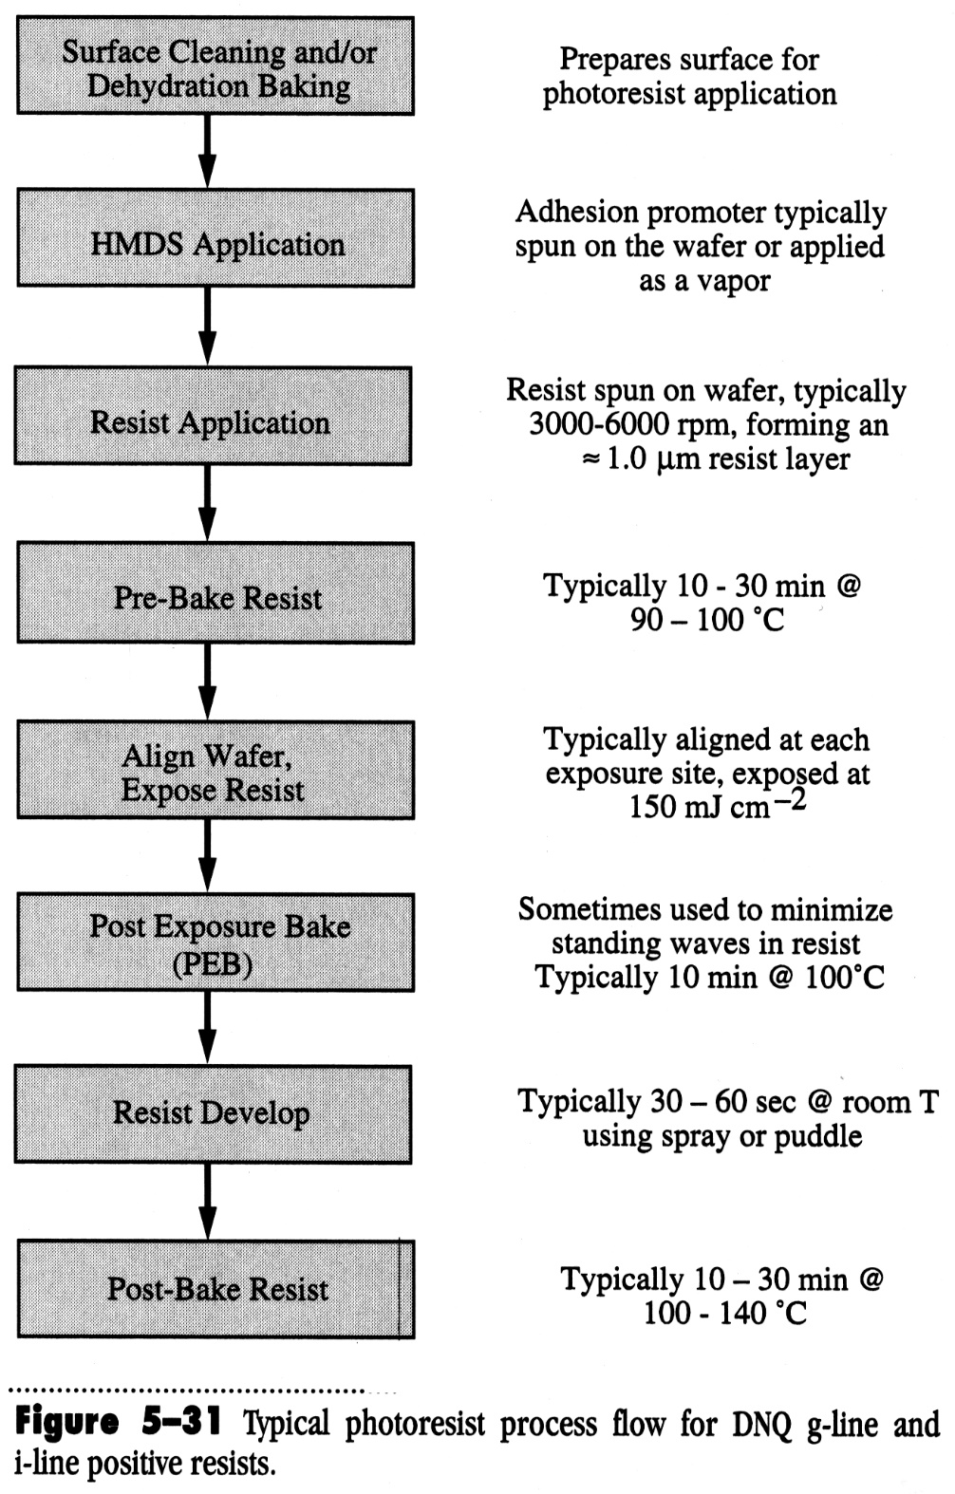

Slide 33
Summary
Basic steps of Photolithography (Lift off technique)
Wafer Cleaning:
  Pirhana Cleaning (for 10 min.) OR Acetone
  Chemicals required: sulfuric acid (H₂SO₄) (3 part) and hydrogen peroxide (H₂O₂) (1 part) (Ratio 3:1)
  Note:Piranha solution cleans by dissolving organic contaminants, and a large amount of contaminant will cause violent bubbling and a release of gas that can cause an explosion
2) Dehydration bake:
above 100ºC -250⁰C for 10 minutes of wafers for removal of H₂O.
A two-step cleaning process with acetone, followed by isopropyl alcohol, has the same effect.
3) Photoresist coating:
Materials:
Image Reversal Photoresist ( AZ 5214 E Photoresist )
Standard Thickness: 1.4 micrometer
Speed: 4000 rpm for 40 secs
Notes:
G line (436 nm), h line (405 nm) and I line (365 nm)

Slide 34
Basic steps of Photolithography (Lift off tehnique)
4) Softbake (Prebake): 110ºC for 50 seconds
5) Exposure to broadband and monochromatic h- and i-line
6) Reversal Bake : 120°C, 2 min., hotplate (most critical step)
7) Flood exposure: > 200 mJ/cm² (uncritical)
Notes:
G line (436 nm), h line (405 nm) and I line (365 nm)

Slide 35
Basic steps of Photolithography (Lift off tehnique)
8) Development: AZ 400 K Developer
9) Postbake: 120°C, 50s hotplate (optional)
10) Cr deposition (20nm) in Box coater by e-beam
11) Au deposition (180nm) by thermally
11) Lift off Remover Chemicals: AZ 100 Remover, conc.
Notes:
G line (436 nm), h line (405 nm) and I line (365 nm)

