Slide 1
PHYE-411 – Generic Electives 4 (A4):
Fundamentals of Sensors

Slide 2
Chapter 2 : Sensor and Sensor Characteristics
Mahendra D. Shirsat
Professor and Head
Department of Physics
Dr. Babasaheb Ambedkar Marathwada University,
Aurangabad (MS)-431 004
Email: mdshirsat@gmail.com

Slide 3
Multidisciplinary Nature of Sensor
.
Physics
Electrode Materials
Optics,
Semiconductors
Chemistry
Synthesis Bioreceptor
Polymers
Immobilization
Electronics
Optoelectronics,
Data Processing,
Control
Instrumentation
Portable,
Microinstrumentation
Sensor
Market Opportunity
In-vitro,
In-vivo,
Implantable
Mathematics
Mathematical Modelling
Computer Science
Simulation
Biology
Receptor Technology,
Biorecognition Molecules

Slide 4
Sensors, Signals and System
What is Sensor ?
A device that responds to a physical stimulus
Heat
Light
Sound
Pressure
Motion
Flow
Produces a measurable corresponding electrical signal

Slide 5
What is a transducer ?
A device which converts one form of energy to another
Sensors
Actuators
Physical Parameter
Electrical Input
Electrical Output
Physical Output

Slide 6
Transducer converts one form of energy to other
Transducer
Other form of Energy
One form of Energy
Sensor is an transducer providing an electrical output
Sensors
Mechanical Energy
Electrical Energy

Slide 7
Transducers
Transducer
  a device that converts a primary form of energy into a corresponding signal with a different energy form
    Primary Energy Forms: mechanical, thermal, electromagnetic, optical, chemical, etc.
  take form of a sensor or an actuator
Sensor (e.g., thermometer)
  a device that detects/measures a signal or stimulus
  acquires information from the “real world”
Actuator (e.g., heater)
  a device that generates a signal or stimulus
real
world
sensor
intelligent
feedback
system
actuator

Slide 8
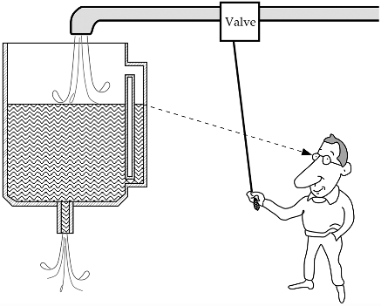
Fig. 1.1. Level-control system. A sight tube and operator’s eye form a sensor (a device which converts information into electrical signal).

Slide 9
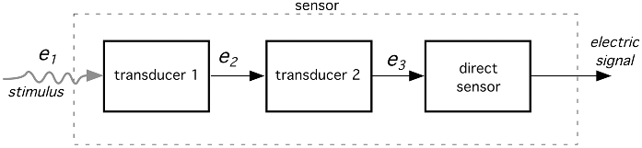
Fig. 1.2. A sensor may incorporate several transducers. e1, e2, and so on are various types of energy. Note that the last part is a direct sensor.

Slide 10
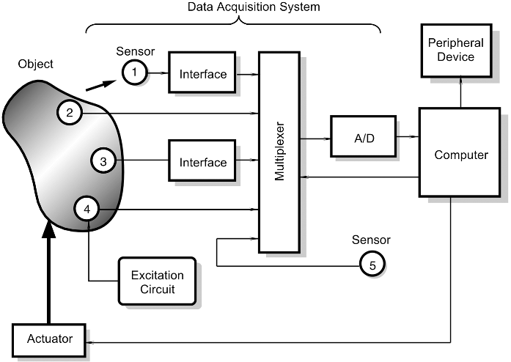
Fig. 1.3. Positions of sensors in a data acquisition system. Sensor 1 is noncontact, sensors 2
and 3 are passive, sensor 4 is active, and sensor 5 is internal to a data acquisition system.

Slide 11
Sensor Systems
Typically interested in electronic sensor
  convert desired parameter into electrically measurable signal
General Electronic Sensor
  primary transducer: changes “real world” parameter into electrical signal
  secondary transducer: converts electrical signal into analog or digital values
Typical Electronic Sensor System
real
world
primary
transducer
analog
signal
secondary
transducer
usable
values
sensor
input
signal
(measurand)
microcontroller
signal processing
communication
sensor
sensor data
analog/digital
network
display

Slide 12
Example Electronic Sensor Systems
Components vary with application
  digital sensor within an instrument
    microcontroller
      signal timing
      data storage
  analog sensor analyzed by a PC
    multiple sensors displayed over internet
sensor
µC
signal timing
memory
keypad
sensor
display
handheld instrument
sensor interface
A/D, communication
signal processing
e.g., RS232
PC
sensor
comm. card
internet
sensor bus
PC
sensor bus
sensor
sensor
processor
processor
comm.
comm.
comm. card

Slide 13
Primary Transducers
Conventional Transducers
  large, but generally reliable, based on older technology
  thermocouple: temperature difference
  compass (magnetic): direction
Microelectronic Sensors
  millimeter sized, highly sensitive, less robust
  photodiode/phototransistor: photon energy (light)
    infrared detectors, proximity/intrusion alarms
  piezoresisitve pressure sensor: air/fluid pressure
  microaccelerometers: vibration, ∆-velocity (car crash)
  chemical senors: O₂, CO₂, Cl, Nitrates (explosives)
  DNA arrays: match DNA sequences

Slide 14
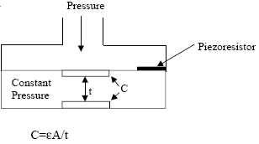
Example Primary Transducers
Light Sensor
  photoconductor
    light → ΔR
  photodiode
    light → ΔI
  membrane pressure sensor
    resistive (pressure → Δ R)
    capacitive (pressure → ΔC)

Slide 15
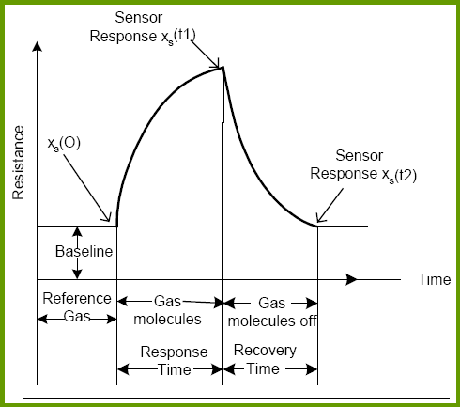
Ideal Sensor Curve and Ideal Sensor Requisite
Highly sensitive and selective detection
Very precise and accurate measurements
Small, portable and easy to use: no need of expert personnel
Needs small sample volume
Low power consumption
Minimum Response and Recovery time
Lower detection limit

Slide 16
Classification of Sensors
Passive and Active Sensors
Passive Sensors
Passive sensor don’t need any additional energy source and input energy will be directly converted into out put energy e.g. thermocouple, a photodiode, and a piezoelectric sensor.
Most of passive sensors are direct sensors as we defined them earlier.

Slide 17
Active Sensors
The active sensors require external power for their operation, which is called an excitation signal. That signal is modified by the sensor to produce the output signal.
The active sensors sometimes are called parametric because their own properties change in response to an external effect and these properties can be subsequently converted into electric signals.
It can be stated that a sensor’s parameter modulates the excitation signal and that modulation carries information of the measured value.
For example, a thermistor is a temperature-sensitive resistor. It does not generate any electric signal, but by passing an electric current through it (excitation signal), its resistance can be measured by detecting variations in current and/or voltage across the thermistor.
These variations (presented in ohms) directly relate to temperature
through a known function.

Slide 18
Another example of an active sensor is a resistive strain gauge in which electrical resistance relates to a strain.
To measure the resistance of a sensor, electric current must be applied to it from an external power source.
Depending on the selected reference, sensors can be classified into absolute and relative.
An absolute sensor detects a stimulus in reference to an absolute physical scale that is independent on the measurement conditions, whereas a relative sensor produces a signal that relates to some special case.
An example of an absolute sensor is a thermistor: a temperature-sensitive resistor. Its electrical resistance directly relates to the absolute temperature scale of Kelvin.

Slide 19
Another very popular temperature sensor—a thermocouple—is a relative sensor. It produces an electric voltage that is function of a temperature gradient across the thermocouple wires. Thus, a thermocouple output signal cannot be related to any particular temperature without referencing to a known baseline.
Another example of the absolute and relative sensors is a pressure sensor.
An absolute-pressure sensor produces signal in reference to vacuum—an absolute zero on a pressure scale.
A relative-pressure sensor produces signal with respect to a selected baseline that is not zero pressure (e.g., to the atmospheric pressure).

Slide 20
Classification of Sensors on Conversion Mechanism
Amperometric :
Amperometric devices detect changes in current.
They measures current generated when electrons are exchanged between a biological system and an electrode
Conductometric:
Conductometric devices detect changes in conductivity between two electrodes.

Slide 21
Capacitive:
The biorecognition reaction causes a changes in the dielectric constant of the medium in the vicinity of the bioreceptor.
Optical:
  The biorecognition reaction causes changes in the characteristics of light.
  Usually, an optical fiber is used for guiding the light signals from the source to the detector.

Slide 22
Classification of Sensors based on Stimulus
Chemical Sensor
Physical Sensor
Temperature
Pressure
Flow
Displacement
PH
Gas
Glucose
Urea

Slide 23
Table 1.4. Conversion Phenomena
Physical Chemical
Thermoelectric Chemical transformation
Photoelectric Physical transformation
Photomagnetic Electrochemical process
Magnetoelectric Spectroscopy
Electromagnetic Other
Thermoelastic Biological
Electroelastic Biochemical transformation
Thermomagnetic Physical transformation
Thermooptic Effect on test organism
Photoelastic Spectroscopy
Other Other

Slide 24
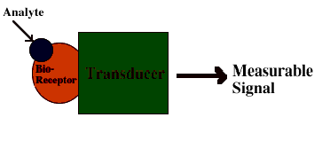
What Is a Biosensor ?
Biosensor = Bio-receptor + transducer
The bioreceptor is a biomolecule that recognizes the target analyte. Ex enzymes, antibodies, nucleic acids.
The transducer converts the recognition event into a measurable signal.
Analyte
Measurable
Signal
Transducer

Slide 25
Gas-Sensor
A device, after exposure to a gaseous element/compound or mixture of gaseous elements/compounds, alters one or more of its properties (e.g. mass, resistance, or capacitance) in a way that can be measured and quantified directly or indirectly

Slide 26
Gas Sensor Overview
Gas/Analytes
Dynamic range
Δ(Property) / Property
Sensitivity
Chemical reaction
(e.g., protonation)
Concentration of analyte
Sensitive layer
Transducer
Interface circuitry
Response signal
(e.g., Voltage)
Notes:
26
Some of you here now may wonder what really is gas sensor? Gas sensor is a sensing device that interacts with gaseous chemical compound and then changes its electrical property in term of resistance, or current, to the output signals that can be quantified directly or in directly. Basically, it consists of two important parts: a sensitive layer and a transducer.
Sensitive layer will recognized the analyte gas & transducer will transfer the property change of the sensing element to measurable signal.
An ideal gas sensor should have low detection limit, high sensitivity, high selectivity, fast response time, and wide dynamic range meaning that it can detect analyte in a large conc. region with high sensitivity.
There are several catagories of chemical gas sensor determining from their sensing and transduciton mechanisms.

Slide 27


Sensing Mechanism
-
Electron donating molecules (e.g. NH₃)
e⁻
R
Sensing layer
-
-
-
-
Time
-
+
+
+
+
+
Notes:
27
The mechnism behide this sensor is protonation & deprotonation.
Because ammonia is electron donation, when absorbed into polymer, it takes proton from PANI become amonium. This is called deprotonation leading to decrease in hole density & increase in electrical resistance as showed in here. Not only the senstitivity we obtain from the elctrical signal change but also the reaponse time
The meachanisim and how resistance changes when exposed to ammonia are the same for ChemFET configuration

Slide 28
Gas Sensor Modalities
  ChemFET
  Chemiresistor
  Amperometric
  Thermistor
  Optodes
  Piezoelectric crystal
Notes:
28
For example gas causes change in resistance with/without current modulation or gas causes change in current, heat generation, optical property & resonant frequency.
Those sensors I have mentioned are classify as solid state sensors whose advantages are good sensitivity, cheap & manufacturable fabrication, & long life expectancy. However, there are some challenges such as high temperature operation for metal oxide sensor, cross selectivity in other words, there is no sensor selective to just one analyte, and complex fabrication. Currently, chemFET & chemiresistor are of our particular interest. So, let take look a little bit to see how they work start from ChemFET based gas sensor
As of focusing on chemFET & chemiresitor, let take a few minutes to take a look a little bit more in detail to see how they work. Start from chemFET,

Slide 29
Transfer Function
An ideal or theoretical output–stimulus relationship exists for every sensor.
If the sensor is ideally designed and fabricated with ideal materials by ideal workers using ideal tools, the output of such a sensor would always represent the true value of the stimulus.
The ideal function may be stated in the form of a table of values, a graph, or a mathematical equation.
An ideal (theoretical) output–stimulus relationship is characterized by the so-called transfer function.
This function establishes dependence between the electrical signal S produced by the sensor and the stimulus s : S =f (s).

Slide 30
That function may be a simple linear connection or a nonlinear dependence, (e.g., logarithmic, exponential, or power function).
In many cases, the relationship is unidimensional (i.e., the output versus one input stimulus). A unidimensional linear relationship is represented by the equation
S =a +bs,
where a is the intercept (i.e., the output signal at zero input signal) and b is the slope, which is sometimes called sensitivity. s is one of the characteristics of the output electric signal used by the data acquisition devices as the sensor’s output.
It may be amplitude, frequency, or phase, depending on the sensor properties.
Logarithmic function: S =a +b ln s.
Exponential function: S =a e^{ks} .
Power function: S =a₀ +a₁s^{k},
where k is a constant number.

Slide 31
Span (Full-Scale Input)
A dynamic range of stimuli which may be converted by a sensor is called a span
or an input full scale (FS).
It represents the highest possible input value that can be applied to the sensor without causing an unacceptably large inaccuracy.
For the sensors with a very broad and nonlinear response characteristic, a dynamic range of the input stimuli is often expressed in decibels, which is a logarithmic measure of ratios of either power or force (voltage).
Dynamic range
Δ(Property) / Property
Sensitivity
Concentration of analyte

Slide 32
Full-Scale Output
Full-scale output (FSO) is the algebraic difference between the electrical output signals measured with maximum input stimulus and the lowest input stimulus applied.
This must include all deviations from the ideal transfer function. For instance, the FSO output in Fig. 2.2A is represented by SFS.

Slide 33
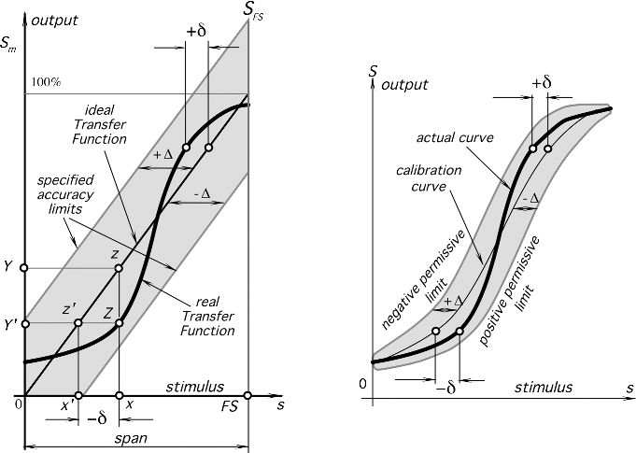
Fig. 2.2. Transfer function (A) and accuracy limits (B). Error is specified in terms of input value.

Slide 34
Accuracy
A very important characteristic of a sensor is accuracy which really means inaccuracy.
Inaccuracy is measured as a highest deviation of a value represented by the sensor from the ideal or true value at its input.
The true value is attributed to the object of measurement and accepted as having a specified uncertainty.
The deviation can be described as a difference between the value which is computed
from the output voltage and the actual input value.
For example, a linear displacement sensor ideally should generate 1 mV per 1-mm displacement; that is, its transfer function is linear with a slope (sensitivity) b=1 mV/mm.
However, in the experiment, a displacement of s =10 mm produced an output of S =10.5 mV.
This extra 0.5 mm is an erroneous deviation in the measurement, or error. Therefore, in a 10-mm range, the sensor’s absolute inaccuracy is 0.5 mm, or in the relative terms, inaccuracy is (0.5mm/10mm)×100%=5%.

Slide 35
Calibration
If the sensor’s manufacturer’s tolerances and tolerances of the interface (signal conditioning) circuit are broader than the required system accuracy, a calibration is required.
For example, we need to measure temperature with an accuracy ± 5⁰C
however, an available sensor is rated as having an accuracy of ― ± 1⁰C
Does it mean that the sensor can not be used ?
No, it can, but that particular sensor needs to be calibrated; that is, its individual transfer function needs to be found during calibration.
Calibration means the determination of specific variables that describe the overall transfer function.
Overall means of the entire circuit, including the sensor, the interface circuit, and the A/D converter
The mathematical model of the transfer function should be known before calibration.

Slide 36
If the model is linear , S =a +bs,
then the calibration should determine variables a and b;
If it is exponential , S =a e^{ks} .
variables a and k should be determined; and so on.
Let us consider a simple linear transfer function. Because a minimum of two points are required to define a straight line, at least a two-point calibration is required.
For example, if one uses a forward-biased semiconductor p-n junction for temperature measurement, with a high degree of accuracy its transfer function (temperature is the input and voltage is the output) can be considered linear:
v =a +bt. ------------------------ ( 1)
To determine constants a and b, such a sensor should be subjected to two temperatures
(t1 and t2) and two corresponding output voltages (v1 and v2) will be registered.
Then, after substituting these values into Eq. ( 1), we arrive at
v1 =a +bt1, and v2= a+ bt2

Slide 37
and the constants are computed as
b= (v1 −v2 ) / ( t1 −t2) and a =v1 −bt1.
To compute the temperature from the output voltage, a measured voltage is inserted into an inversed equation
t = (v −a ) / b
In some fortunate cases, one of the constants may be specified with a sufficient
accuracy so that no calibration of that particular constant may be needed.
In the same p-n-junction temperature sensor, the slope b is usually a very consistent value for a given lot and type of semiconductor.
For example, a value of b=− 0.002268 V/◦C was determined to be consistent for a selected type of the diode, then a single-point calibration is needed to find out a as a =v1 +0.002268t1.

Slide 38
Sensor Calibration
Sensors can exhibit non-ideal effects
  offset: nominal output ≠ nominal parameter value
  nonlinearity: output not linear with parameter changes
  cross parameter sensitivity: secondary output variation with, e.g., temperature
Calibration = adjusting output to match parameter
  analog signal conditioning
  look-up table
  digital calibration
    T = a + bV +cV²,
      T= temperature; V=sensor voltage;
      a,b,c = calibration coefficients
Compensation
  remove secondary sensitivities
  must have sensitivities characterized
  can remove with polynomial evaluation
    P = a + bV + cT + dVT + e V², where P=pressure, T=temperature
linear
T1
non-linear
T2
offset
T3

Slide 39
Calibration Error
The calibration error is inaccuracy permitted by a manufacturer when a sensor is calibrated in the factory. This error is of a systematic nature, meaning that it is added to all possible real transfer functions. It shifts the accuracy of transduction for each stimulus point by a constant. This error is not necessarily uniform over the range and may change depending on the type of error in the calibration.
For example, let us consider a two-point calibration of a real linear transfer function (thick line in Fig. 2.3: Next slide.

Slide 40
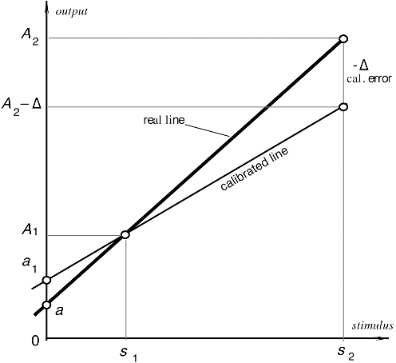
To determine the slope and the intercept of the function, two stimuli, s1 and s2, are applied to the sensor. The sensor responds with two corresponding output signals A1 and A2. The first response was measured absolutely accurately.
However, the higher signal was measured with error − Δ. This results in errors in the slope and intercept calculation. A new intercept, a1, will differ from the real intercept, a, by
δa =a1 −a = Δ / s2 −s1
and the slope will be calculated with error:
δb= − Δ/s2 −s1
,

Slide 41
Hysteresis
A hysteresis error is a deviation of the sensor’s output at a specified point of the input signal when it is approached from the opposite directions (Fig. 2.4). For example, a displacement sensor when the object moves from left to right at a certain point produces a voltage which differs by 20 mV from that when the object moves from right to left. If the sensitivity of the sensor is 10 mV/mm, the hysteresis error in terms of displacement units is 2 mm. Typical causes for hysteresis are friction and structural changes in the materials.

Slide 42
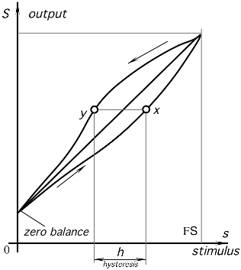
Fig. 2.4. Transfer function with hysteresis.

Slide 43
Nonlinearity
Nonlinearity error is specified for sensors whose transfer function may be approximated by a straight line. A nonlinearity is a maximum deviation (L) of a real transfer function from the approximation straight line. The term “linearity” actually means “nonlinearity.”
When more than one calibration run is made, the worst linearity seen during any one calibration cycle should be stated. Usually, it is specified either in percent of span or in terms of measured value (e.g, ◦C). “Linearity,” when not accompanied by a statement explaining what sort of straight line it is referring to, is meaningless. There are several ways to specify a nonlinearity, depending how the line is superimposed on the transfer function.

Slide 44
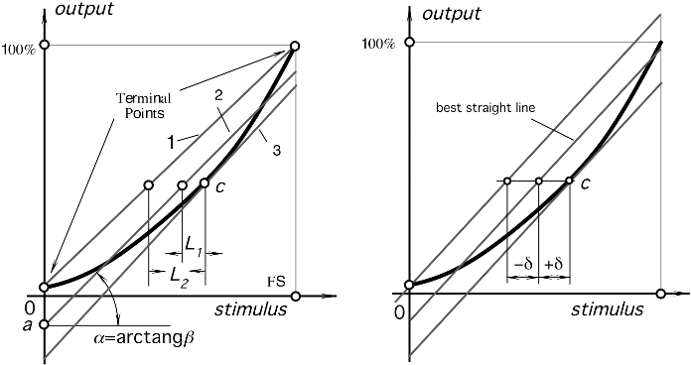
One way is to use terminal points (Fig. 2.5); that is, to determine output values at the smallest and highest stimulus values and to draw a straight line through these two points (line 1). Here, near the terminal points, the nonlinearity error is the smallest and it is higher somewhere in between.
Fig. 2.5. Linear approximations of a nonlinear transfer function

Slide 45
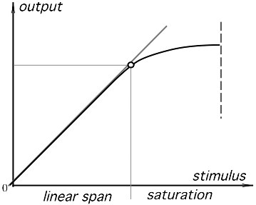
Saturation
Every sensor has its operating limits. Even if it is considered linear, at some levels
of the input stimuli, its output signal no longer will be responsive. A further increase in stimulus does not produce a desirable output. It is said that the sensor exhibits a span-end nonlinearity or saturation (Fig. 2.6).
Fig. 2.6. Transfer function with saturation.

Slide 46
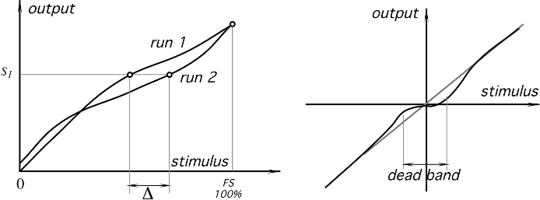
Repeatability
A repeatability ( reproducibility) error is caused by the inability of a sensor to represent the same value under identical conditions. It is expressed as the maximum difference between output readings as determined by two calibrating cycles (Fig. 2.7A), unless otherwise specified. It is usually represented as % of FS:
δr = Δ / FS ×100%.
Possible sources of the repeatability error may be thermal noise, build up charge, material plasticity, and so forth.
Fig. 2.7. (A) The repeatability error. The same output signal S1 corresponds to two different input signals. (B) The dead-band zone in a transfer function

Slide 47
Dead Band
The dead band is the insensitivity of a sensor in a specific range of input signals (Fig. 2.7B). In that range, the output may remain near a certain value (often zero) over an entire dead-band zone.
Resolution
Resolution describes the smallest increments of stimulus which can be sensed. When a stimulus continuously varies over the range, the output signals of some sensors will not be perfectly smooth, even under the no-noise conditions. The output may change in small steps. This is typical for potentiometric transducers, occupancy infrared detectors with grid masks, and other sensors where the output signal change is enabled only upon a certain degree of stimulus variation. In addition, any signal converted into a digital format is broken into small steps, where a number is assigned to each step. The magnitude of the input variation which results in the output smallest step is specified as resolution under specified conditions (if any).

Slide 48

Let The Nature Play Supreme
Thank You

