Slide 1
Unit III :Integrated circuit manufacturing techniques for Sensors
Presented by : Prof. M.D.Shirsat

Slide 2



INTRODUCTION
Introduction

Slide 3
INTRODUCTION
Microfabrication, micromachining, or micromanufacturing is comprised of the
use of a set of manufacturing tools, mostly based on electronic integrated
circuit (IC) and thick-film (hybrid) manufacturing technologies, which are often
enhanced or modified for building devices such as sensors, actuators, and other
microcomponents and microsystems.
In figure 3.1, typical processes involved in making a three-dimensional
microstructure are schematically represented.
In what follows, each of these steps is described in detail.
those processes that make biosensor construction different from IC manufacture. Both micromachining and microelectronic fabrication begin with lithography: the
technique used to transfer copies of a master pattern onto the surface of a solid
material such as a silicon wafer.
The most widely used form of lithography is photolithography.

Slide 5
IC Fabrication
e-Beam or Photo
EDA PR Chip
Photolithography
Mask or Reticle
Ion Implant
Etch
EDA: Electronic Design Automation
PR: Photoresist

Slide 6
Photolithography Requirements
High Resolution
High PR Sensitivity
Precision Alignment
Precise Process Parameters Control
Low Defect Density

Slide 7
Photolithography Process
Basic Steps of Photolithography
Photoresist coating
Alignment and exposure
Development

Slide 8
Basic Steps, Old Technology
Wafer clean
Dehydration bake
Spin coating primer and PR
Soft bake
Alignment and exposure
Development
Pattern inspection
Hard bake
PR coating
Development

Slide 9
Basic Steps, Advanced Technology
Wafer clean
Pre-bake and primer coating
Photoresist spin coating
Soft bake
Alignment and exposure
Post exposure bake
Development
Hard bake
Pattern inspection
PR coating
Track-stepper integrated system
Development

Slide 10
Wafer Clean
Gate Oxide
Polysilicon
STI
USG
P-Well

Slide 11
Pre-bake and Primer Vapor
Primer
Polysilicon
STI
USG
P-Well

Slide 12
Photoresist Coating
Primer
Photoresist
Polysilicon
STI
USG
P-Well

Slide 13
Soft Bake
Photoresist
Polysilicon
STI
USG
P-Well

Slide 14
Alignment and Exposure
Gate Mask
Photoresist
Polysilicon
STI
USG
P-Well

Slide 15
Post Exposure Bake
Photoresist
Polysilicon
STI
USG
P-Well

Slide 16
Development
PR
Polysilicon
STI
USG
P-Well

Slide 17
Hard Bake
PR
Polysilicon
STI
USG
P-Well

Slide 18
Pattern Inspection
PR
Polysilicon
STI
USG
P-Well

Slide 19
PHOTOLITHOGRAPHY
Masks
A photomask is a nearly optically flat glass (transparent to near UV) or quartz plate (transparent to deep UV) with a metal absorber pattern printed on one side.
The metal pattern is typically a 0.1 𝝁m thick chromium layer.
The metal absorber pattern on a photomask is opaque to ultraviolet radiation, whereas glass or quartz is transparent.

Slide 20
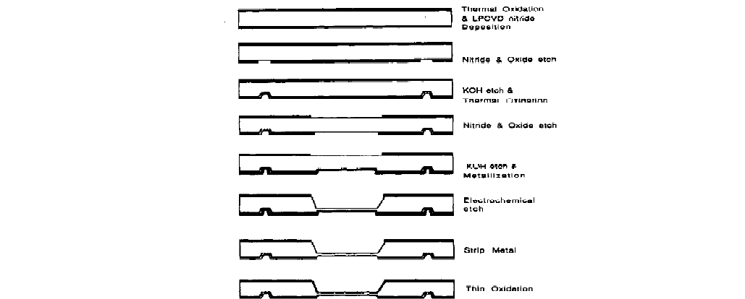
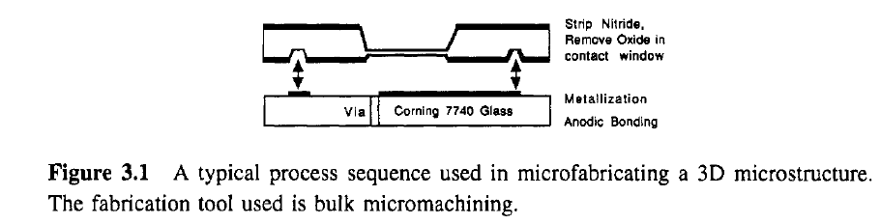

Slide 21
The fabrication tool used is bulk micromachining.
A typical process sequence used in microfabricating a 3D microstructure.
Such a photomask is placed in direct contact with or near a photoresist-coated surface, and the wafer is exposed to ultraviolet radiation.
This procedure results in a 1:1 image transfer of the entire mask into the silicon wafer.
The masks that make direct physical contact (also referred to as ‘hard contact’) to the substrate are called ‘contact masks’ and they provide a sharper image transfer than the non-contact, proximity masks (also referred to as ‘softcontact’ masks) which are raised 10-20 𝝁m above the wafer.
A disadvantage of the contact masks is that they degrade faster through wear, but they offer higher resolution.
Contact mask and proximity mask printing are collectively known as shadow printing.
In projection printing, the photomask is imaged one to one or reduced five to 10 times by a high-resolution lens system and then projected by stepping or scanning that image over the resist.
In the latter case, mask lifetime is only limited by operator handling rather than by substrate contact.

Slide 22
Mask alignment
A major cause of product failure is poor alignment between the image being projected and the pre-existing patterns on the wafer.
The pattern registration capability is the degree to which the pattern being printed 'fits' relative to mask alignment marks and to the previously printed patterns.
Alignment or registration marks such as optical Vernier patterns are created on the different levels to be aligned.
Generally, the collective misalignment should not exceed a quarter of the minimum feature size.
Alignment errors are only one part of the total device ground rule tolerances.
Typical mask errors range from 0.1 to 0.3 𝝁m, etch errors from 0.2 to 0.4 𝝁 m, and alignment errors from 0.2 to 0.5 𝝁 m.
Thus the tolerances of current lithography equipment lie in the range of 0.5-0.8 𝝁 m [l].
For the next generation of submicrometer ground rules, a fourfold reduction
in alignment and other errors will be necessary.
Almost every type of mask aligner-contact/proximity, projection scanner, and step and repeat-is used for some of the lithography steps in the fabrication of state of the art integrated circuitry today.

Slide 24
Spinning resist
Typically, the first step in photolithography, with Si as the substrate, is to grow a thin layer of oxide on the wafer surface by heating it to between 900 and 11.50 "C in a humidified oxygen stream.
Dry oxygen also works but steam is faster.
The oxide layer will then be patterned and serve as a mask for subsequent etching or implantation of the base silicon wafer.
As the first step in the lithography process itself, a thin layer of an organic polymer sensitive to ultraviolet radiation, a photoresist, is deposited on the oxide surface.
The photoresist is dispensed from a viscous solution of the polymer onto the wafer lying on a wafer platen in a resist spinner.

Slide 25
The wafer is then spun at high speeds between 1500 rpm and
8000 rpm depending on the viscosity and the required film thickness, to ake a uniform film.
The resist film's uniformity across a single substrate and from
substrate to substrate must be within +-15 nm (for a 1.5 𝝁m film that is+-I%)
in order to ensure reproducible linewidths and development times in subsequent steps.
The coating thickness of these thin glassy films depends on the chemical
resistance required for image transfer and the fineness of the lines and spaces to be resolved.
For silicon ICs the resist thickness can be between 0.5 and 2 𝝁m
after baking.
For microfabricated structures, thicknesses up to 1 mm are used in the deep-x-ray lithography-based LIGA technique (see below).
In the latter case, techniques such as casting or in situ polymerization of the resist are employed.

Slide 26
Applications of Photolithography
Main application: IC patterning process
Other applications: Printed electronic board, nameplate, printer plate, and etc.

Slide 27
Exposure and development
Exposure
Before the coated wafers are exposed, they undergo a mild
bake (called a soft bake) in order to remove the solvent of the resist and to
suppress mechanical stress.
Once the wafers are soft baked, they are transferred
to some type of illumination or exposure system.
In the simplest case, an
exposure system is a UV lamp illuminating the resist-coated wafer through
a mask without any lenses in between.
The purpose of the illumination system
is to deliver light to the wafer with the proper intensity, directionality, spectral
characteristics, and uniformity across the wafer so as to transfer (also print) the
mask image as perfectly as possible onto the resist in the form of a latent image.

Slide 28
In photolithography, wavelengths of the light source, used for flood exposure of the resist-coated wafer, range from deep ultraviolet (DUV) i.e. 150-300 nm to near UV i.e. 350-500 nm.
In the near UV, one typically uses the g (436 nm) or i line (365 nm) of a mercury lamp.
At shorter wavelengths light sources are less intense and optics are less .
Consequently a higher-sensitivity resist or an unconventional DUV source producing a very high flux of DUW radiation must be used to obtain a high throughput of printed wafers.
An example is a KrF excimer laser with a short wavelength of 249 nm and a power of 10-20 W at that wavelength.

Slide 29
Development
Development transforms the latent image into an image
in the resist which will serve as a mask for further additive and subtractive steps, During the development process, selective dissolving of the resist takes place.
Two main technologies are available for development:
wet development, widely used in industry,
and dry development, mostly in the exploratory stage.

Slide 30
Wet development by solvents can be based on three different types of exposure inducedchange:
(i) variation in molecular weight of the polymers (by crosslinking or by chain scission)
(ii) reactivity change, or (iii) polarity change of the polymer.
There are two major types of wet-developing system, i.e. immersion and spray developers.
In immersion developing, cassette-loaded wafers are batch
immersed for a timed period in a bath of developer and agitated at a specific temperature.
In spray development, fresh developing solution is directed across wafer surfaces by fan-type sprayers.
The use of solvents may lead to a swelling of the resist and a lack of adhesion of the resist to the substrate.
These problems may be solved by dry developing which is either based on a vapor phase process
or a plasma process (usually an oxygen plasma).

Slide 31
Resist tone
There are two main categories of photoresist:
positive tone and negative tone.
Upon exposure, the photochemical reaction weakens the positive resist, and
the exposed region becomes more soluble in developing solutions by approximately
an order of magnitude.
The weakening occurs due to a rupture or scission of the main and side polymer chains.
The photochemical reaction has the opposite effect on negative resists.
It strengthens the polymer by random crosslinking of main chains or pendent side chains,
and the resist becomes less soluble.
Exposure and development sequences for negative and positive resists
are shown in figure 3.2(a).
In a UV exposure, not all of the photons strike the resist film in an orthogonal
fashion.
Scattering e.g. at the substratehesist interface causes a broadening of the
exposed region.
The scattered radiation profiles for positive and negative resists
are shown in figure 3.2(b).

Slide 33
Critical dimension (CD) and resolution (R)
A lithographic system’s practical resolution, R, can be determined by line width
measurement made with devices such as a scanning electron microscope.
Correct feature size must be maintained within a wafer and from wafer to wafer because
device performance depends on the absolute size of the patterned structures.
The term critical dimension (CD) refers to a specific feature size and is a measure
of the practical resolution of a lithographic process.
In the shadow printing mode (contact and proximity), optical lithography has
a resolution with limits set by such factors as diffraction of light at the edge of
opaque features in the mask, alignment of wafer to mask, non-uniformities in
wafer flatness, and debris between mask and wafer.
Diffraction causes the image of a perfectly delineated edge to become blurred or diffused.

Slide 34
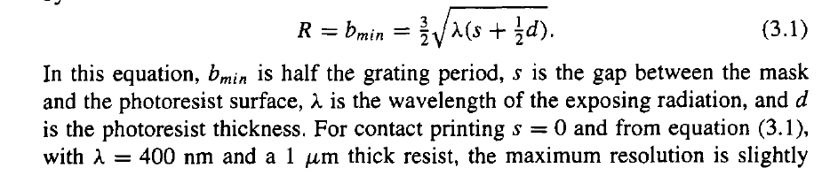
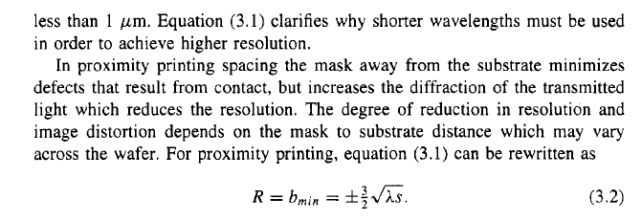
The theoretical resolution (also called R), i.e. minimum resolved feature size (bmino)f a grating mask (with 2b as the grating period) imaged on a conventional resist, is given by

Slide 36
Resist stripping
Wet stripping
After exposure, the wafers are rinsed in a developing
solution or sprayed with a spray developer to remove either the exposed areas
(positive tone) or the unexposed areas of the photoresist (negative tone), leaving
a pattern of bare and photoresist-coated oxide on the wafer surface.
Typically, the next process step after development is to bake the resist at a higher temperature than that used for the soft bake.
This second bake, also called the hard bake, improves the hardness and interfacial adhesion of the resist weakened by developer penetration or by swelling.

Slide 37
Improved hardness increases the resistance of the photoresist to the subsequent etching process.
The wafers are then placed in a solution of HF, which attacks the oxide but not the photoresist or the
underlying silicon.
The photoresist protects the oxide areas it covers thereby transferring the mask pattern on the oxide layer. Once the exposed oxide has been etched away, the remaining photoresist can be stripped off in a number
of ways.
A strong acid such as HzS04 or an acid-oxidant combination such as
Cr203-H2S04 can be used. Other commonly used liquid strippers are organic
solvent strippers and alkaline strippers with or without oxidants

Slide 38
Dry stripping
There are a few variations of dry stripping in terms of the composition of the plasma, but the basic mechanism is for the plasma to react with the organic photoresist after which the gaseous products formed are pumped away.
Oxygen in its molecular form is commonly used for this process.
Plasma stripping (also called ashing) has become more and more popular as it
poses fewer disposal problems with toxic, flammable, or otherwise dangerous
chemicals and does not lose potency over time.
Wet-stripping baths lose potency with use, causing stripping rates to change with time due to accumulation of reaction products and contamination.
Also liquid phase surface tension and mass transport tend to make hotoresist removal difficult and uneven in wet stripping baths.
Dry stripping is more controllable than liquid stripping, less corrosive
with respect to metal features on the wafer, and, most importantly, under the
right conditions, it leaves a cleaner surface.
The oxide itself serves as a mask in subsequent processing steps.

Slide 39
SUBTRACTIVE TECHNIQUES
Lithography steps are followed by a number of subtractive and additive processes, transferring the lithography patterns into ICs or 3D micromachines.
In subtractive processes material is removed from the device under construction, usually very selectively, through the use of a resist or other mask pattern (e.g. an oxide or a nitride).

Slide 40
Dry etching
Dry-etching techniques, in general, are methods by which a solid state surface is etched physically by ion bombardment or hemically by a chemical reaction with a reactive species at the surface or combined physical and chemical mechanisms.
Under chemical methods, one distinguishes between wet etching (solvent, vapor, electrochemical) and dry etching in the gas phase.
Depending on the mechanism, isotropic or anisotropic (directional) etch profiles are obtained.

Slide 41
Physical etching: sputtering or ion etching.
Simple ion bombardment of a surface with inert ions such as argon ions is referred to as ion etching or sputter etching.
In the simplest case of ion sputtering, the substrates to be etched are laid on the cathode (target) of a discharge reactor. When ions of sufficient energy impinge vertically on a surface, momentum transfer (sputtering) causes bond breakage and ballistic material ejection, throwing the bombarded material across the reactor to an opposing collecting surface.
A low pressure and a long mean free path are required for material to leave the vicinity of the sputtered surface without being backscattered and redeposited.
It is the kinetic energy of the incoming particles that largely dictates which events are most likely to take place i.e. physisorption, surface damage, substrate heating, reflection,
sputtering, or ion implantation.

Slide 43
At energies below 5 eV, incoming particles are either reflected or physisorbed.
At energies between 5 and 10 eV surface migration and surface damage results.
At energies greater than 10 eV substrate heating, surface damage, and material ejection, i.e sputtering or ion etching, takes place.
At yet higher energies greater than 10 keV ion implantation, i.e. doping,
takes place (see below).
In short, with physical etching, ion etching, or sputtering, ions such as argon ions are accelerated in an electrical field towards the substrate where etching is purely impact controlled. Both DC and rf plasma can be used depending on the system.
Sputtering is inherently unselective because the ion energy required
to eject material is large compared to differences in surface bond energies and
chemical reactivity.
The method is also slow compared to other etching means with etch rates limited to several hundreds of Angstroms per minute compared to thousands of Angstroms per minute and higher with chemical and ion- ted
etching.

Slide 45
Etching projiles for physical etching
The ideal result in dry or wet etching is the exact transfer of the mask pattern to the substrate, with no distortion of the critical dimensions (CDs).
Isotropic etching (dry or wet) always enlarges features and thus distorts the CDs.
Chemical anisotropic etching is crystallographic and, as a consequence, critical dimensions can be maintained only if features are strategically aligned along certain lattice planes (see below).
With sputtering, the anisotropy is controllable by the plasma conditions.
Sputtering is far from ideal for high-aspect-ratio etching or for the creation of vertical walls. Ion sputtering indeed exhibits a tendency to develop a facet on the mask edge at the angle of maximum etch rate.
This corner facetting is shown in figure 3.6.

Slide 47
Dry chemical etching
In reactive plasma etching, reactive neutral chemical species such as chlorine or fluorine atoms and molecular species generated in the plasma diffuse to the substrate where they form volatile products with the layer to be removed.
The plasma is present only as a means to supply the gaseous, reactive etchant species.
Consequently, if the feed gas were itself reactive enough no plasma would be needed.
The surface is etched almost exclusively by chemically active, neutral species formed in the plasma.
At pressures of greater than 10-3 Torr, the neutrals strike the surface at random
angles, leading to isotropic, rounded features.
This dry-chemical-etching regime can be established by operating at voltages low enough to prevent high-energy ions which can impinge on the sample and sputter the surface.
The reaction products, volatile gases, are removed by a vacuum system.
This volatility aspect is a major difference with the sputtering case where the fragments are ejected billiard-ball-wise and often redeposited close by.
The different popular reactor configurations for plasma etching are barrel
etcher, downstream stripper, and parallel reactor.

Slide 48
Physical-chemical etching
The most useful plasma etching is neither entirely chemical nor physical.
By adding a physical component to a purely chemical etching mechanism, the shortcomings of both sputter-based and purely chemical dry-etching processes can be surmounted. One example of chemicalphysical etching is reactive ion beam etching (RIBE), a rather exceptional case where ions are reactive and etch the surface directly.
An important negative characteristic of all types of dry etching is the dependence of etch rate and uniformity on wafer loading.
This is the result of the gas phase etchant being depleted by reaction at the surface of the substrate material.

Slide 49
Wet etching
Wet etching is the selective removal of layers using chemical solutions.
The nature of the resulting features is determined by such parameters as temperature, composition, agitation, orientation of the single crystal, size of etching feature, and level of accumulations in the bath itself.
Wet etching can be done either isotropically or anisotropically depending on the composition of the bath and the material to be etched.

Slide 50
1 Anisotropic and isotropic etching
Anisotropic etching is possible with crystalline silicon due to its non-equivalent orientations in its diamond cubic structure.
The most common orientations used in the IC industry are the (100) or (111) orientation; in micromachining (1 10) wafers are used quite often as well.
Certain chemicals, typically alkaline types, will etch away crystalline silicon at different rates depending on the orientation of the exposed crystal plane.

Slide 51
Isotropic etchants are so strong that the activation barriers associated with etching the different Si planes are not differentiated as they are with the anisotropic etchants: all planes etch equally fast.
The most commonly used isotropic etchant is a mixture of HF and nitric acids, sometimes with acetic acid added as a diluent (HNA etchants).

Slide 52
2 Etch stop techniques.
In many cases it is desirable to stop etching in silicon when a certain cavity depth or a certain membrane thickness is reached.
Moreover one wants thicknesses to be uniform and reproducible. Non-uniformity in resulting devices due to non-uniformity of the silicon wafer thickness can be quite high. Taper of double-polished wafers can be as high as 40 𝝁m!
Even with the highest wafer quality, the wafer taper is still around 2 𝝁m.
The most widely used etch stop technique is based on the fact that anisotropic
etchants, especially ethylene diamine pyrocathechol (EDP), do not attack heavily boron- (p⁺-) doped layers, This allows the fabrication of structures such as beams and diaphragms with a level of control not possible before.

Slide 53
Comparison of dry- and wet-etch techniques
The popularity of dry etching stems from a variety of advantages over wet-etching methods:
fewer disposal problems
better process control
Less corrosion of metal features in the structure
less undercutting and broadening of photoresist features
Also, with the current trend towards submicrometer
geometries, surface tension might preclude a wet etchant from reaching down between submicrometer photoresist features whereas dry etching excludes any problem of that nature.

Slide 54
However, many problems with and concerns about dry etching
need solving, such as the low etch rate
relatively low selectivity
high sensitivity to operating parameters.
In the latter case anisotropic etching of Si results in atomically smooth planes and atomically sharp edges, properties impossible to obtain with dry etching.
Much more R&D is required to come up with new dry-etching schemes that would come close to these performances. In surface micromachining, with processes more similar to the ones used in the IC industry, both isotropic wet etchants and anisotropic dry etchants are used

Slide 56

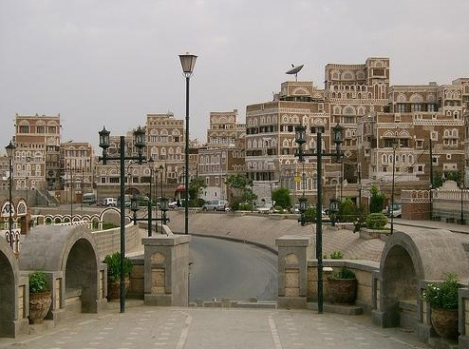
Thank You Very Much
Maamon Omar Ahmed Farea

