Slide 1
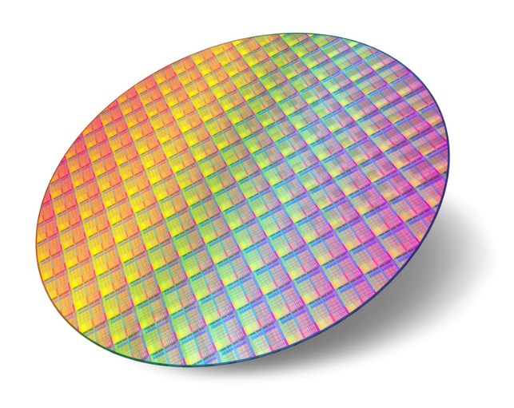
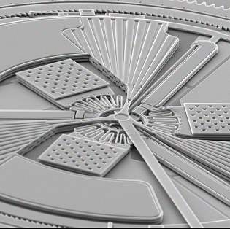

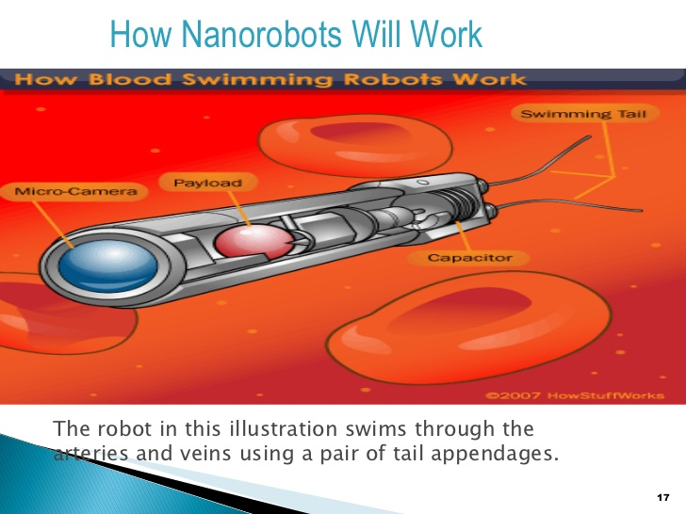
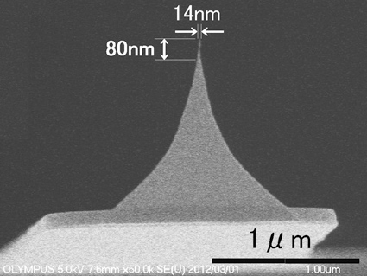
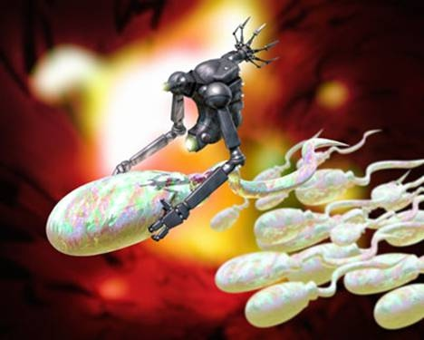
Lithography
Notes:
Prof.M.D.Shirsat

Slide 2
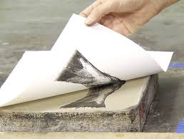
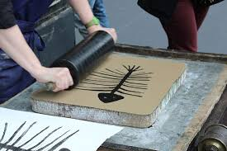
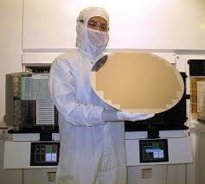
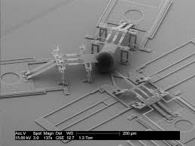
Basics of Lithography
Lithography (from Ancient Greek lithos, meaning "stone", and, graphein, meaning "to write") is a method of printing originally based on the immiscibility of oil and water. The printing is from a stone (lithographic limestone) or a metal plate with a smooth surface.
Lithography is the most complicated, expensive, and critical process of modern IC manufacturing.
Typically 8-25 lithography steps and several hundred processing steps between exposure are required to fabricate a packed IC.
The minimum feature size i. e., the minimum line width or line to line separation that can be printed on the surface, control the number of circuits that can be placed on the chip and has a direct impact on circuit speed. The evolution of IC is therefore closely linked to the evolution of lithographic tools

Slide 3
Types of Lithography
Photolithography (optical, UV, EUV)
E-beam/ion-beam/Neutral atomic beam lithography
X-ray lithography
Interference lithography
Scanning Probe
Voltage pulse
CVD
Local electrodeposition
Dip-pen
Step Growth
Soft Lithography
Nanoimprint
Self-Assembly
Nanotemplates
  Diblock copolymer
  Sphere
  Alumina membrane
  Nanochannel glass
  Nuclear-track etched membrane

Slide 4
Types of Lithography

Slide 5
Photolithography
Move to EUV (Various Light sources)
Source | Name | Wavelength (nm) | Application feature size (nm)
Mercury lamp | G-line | 436 | 500
 | H-line | 405
 | I-line | 365 | 350 to 250
Excimer Laser | XeF | 351
 | XeCl | 308
 | KrF | 248 (DUV) | 250 to 130
 | ArF | 193 | 150 to 70
Fluorine laser | F₂ | 157 | < 100
Notes:
EUV: Extreme ultraviolet lithography

Slide 6
Contd…
Wafer Exposure Systems:
Contact printing is capable of high resolution but has unacceptable defect densities. Inexpensive, diffraction effects are minimize.
Proximity printing cannot easily print features below a few μm (except for x-ray systems). Poor resolution due to diffraction effects, required 1 X mask.
Projection printing provides high resolution and low defect densities and \ dominates today.
Typical projection systems use reduction optics (2X - 5X), step and repeat or step and scan mechanical systems, print ∼ 50 wafers/hour and cost $5 - 10M.
Notes:
EUV: Extreme ultraviolet lithography

Slide 7
Contd…
Notes:
EUV: Extreme ultraviolet lithography

Slide 8
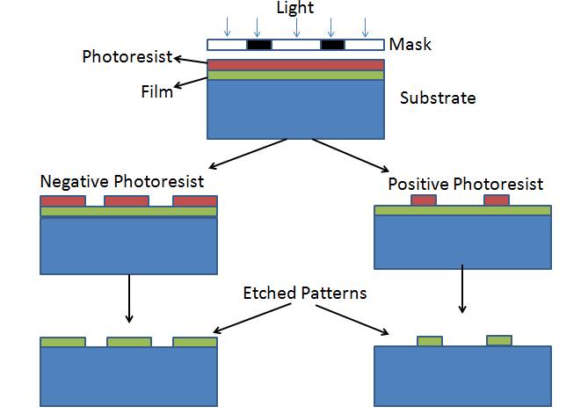
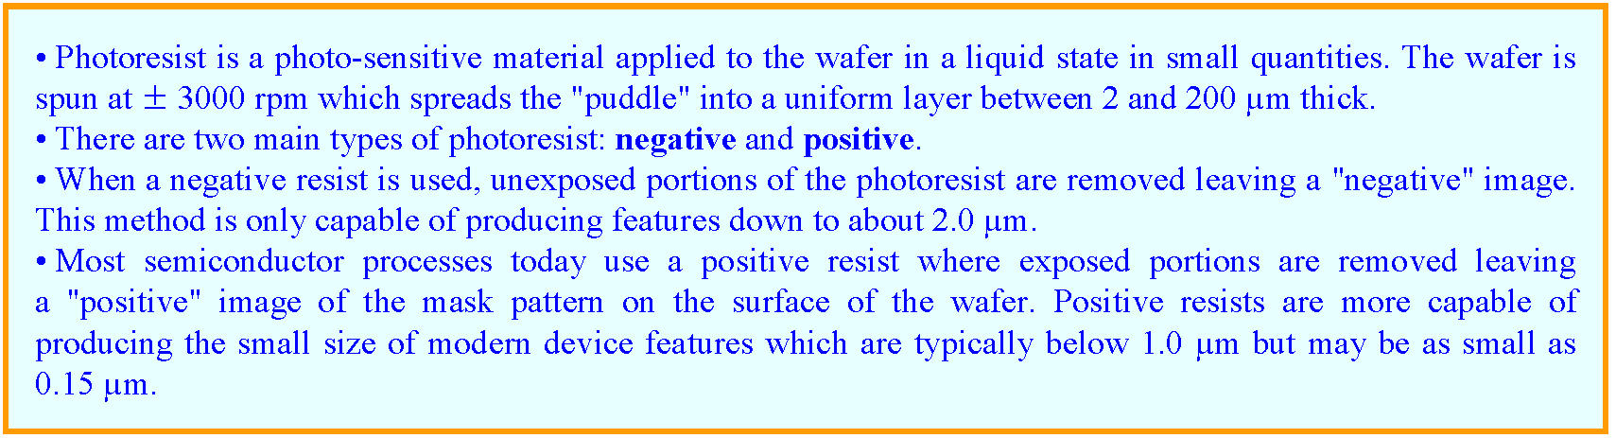
Contd…
Types of Photoresist
Positive Photoresist
Negative Photoresist
Notes:
EUV: Extreme ultraviolet lithography

Slide 9
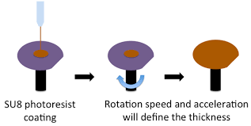
Basic steps of Photolithography (Lift off technique)
Wafer Cleaning:
  Pirhana Cleaning (for 10 min.) OR Acetone
  Chemicals required: sulfuric acid (H₂SO₄) (3 part) and hydrogen peroxide (H₂O₂) (1 part) (Ratio 3:1)
  Note:Piranha solution cleans by dissolving organic contaminants, and a large amount of contaminant will cause violent bubbling and a release of gas that can cause an explosion
2) Dehydration bake:
above 100ºC -250⁰C for 10 minutes of wafers for removal of H2O.
A two-step cleaning process with acetone, followed by isopropyl alcohol, has the same effect.
3) Photoresist coating: Positive or Negative photoresist by spin coating
4) Softbake (prebake): Removal of solvent molecules to dry the wafer
5) Exposure (Through Mask): Transfers desired pattern on the wafer
6) Development: In Developer
7) Postbake: 120°C, 50s hotplate (optional)
11) Metal deposition:
i) Cr deposition (20nm) in Box coater by e-beam
ii) Au deposition (180nm) by thermally
12) Lift off
Remover Chemicals: AZ 100 Remover, conc.
Notes:
G line (436 nm), h line (405 nm) and I line (365 nm)

Slide 10
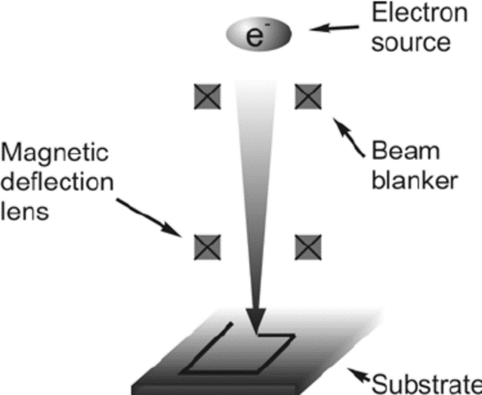
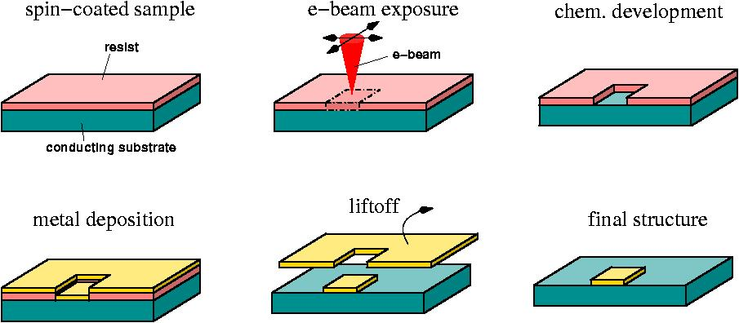
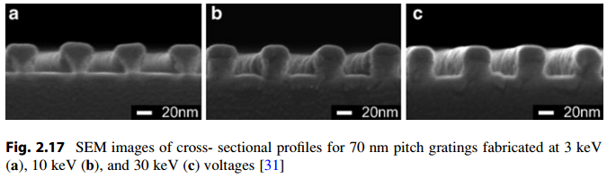
E - beam lithography
Highly focused electron beam is exposed to a resist material that modifies the solubility of the resist for development
Allows accuracy down to as small as 10nm dimensions
Nanoscale design is done on computers and the pattern is written on a chip using highly precise mechanical devices
Goals of EBL writing are highly accurate and reliable pattern writing
Advantages
Better resolution
Direct writing, no mask needed
Arbitrary size, shape, order
Disadvantages
Serial process
slow, small area
Compatibility
conducting, no high T process

Slide 11
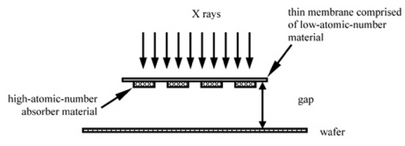
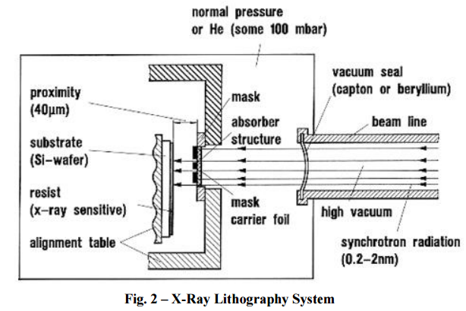
X - Ray lithography
Parallel Proximity Printing
X-Ray lithography uses ultra thin masks ( <2 micro)
X-Rays pass directly through mask and onto wafer
Shorter wavelength than UV (0.4-4nm)
Challenges of X-Ray Lithography
The thin masks are prone to deform due to small stresses
Masks deformation is huge in XRL because of the direct mapping
X-Rays cannot be focused through a lens

Slide 12
Comparison of various Lithography Techniques
Technique | Source | Form | Disadvantages | Advantages
Photolithography | UV Light | Projection Printing | Limited by UV Wavelength | Cheap
Electron-beam lithography | focused beam of electrons | Direct Writing | Expensive | Highly Accurate
X-Ray Lithography | X-Ray | Proximity Printing | Expensive/Fragile Masks | Accurate/Efficient Fast

Slide 13
Other lithography Techniques
Focused Ion Beam (FIB):
Liquid ion source: Ga, Au-Si-Be alloys LMI sources due to the long lifetime and high stability.
Advantages:
High exposure sensitivity: 2 or more orders of magnitude higher than that of electron beam lithography
Negligible ion scattering in the resist
Low back scattering from the substrate
Can be used as physical sputtering etch and chemical assisted etch.
Can also be used as direct deposition or chemical assisted deposition, or doping .
Disadvantages:
Lower throughput, extensive substrate damage.

Slide 14
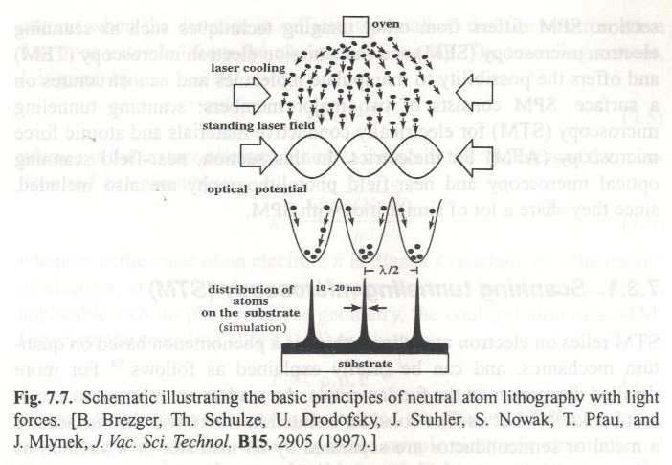
Neutral Atomic Beam Lithography

Slide 15
Interference Lithography

Slide 16
Interference Lithography

Slide 17
Interference Lithography

Slide 18
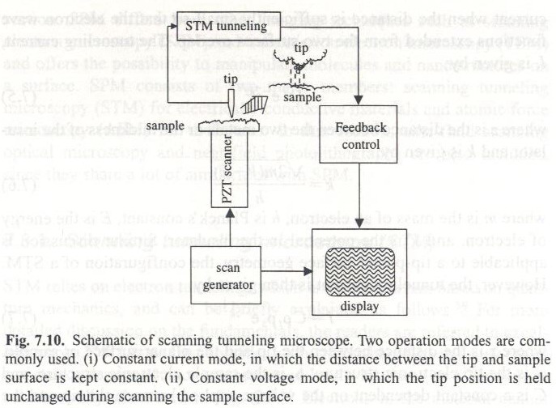
Scanning Probe Lithography
Probe
  STM, AFM
Techniques
  Voltage pulse
  CVD
  Local electrodeposition
  Dip-pen
STM
Two Different Modes of STM:
Constant current mode
Constant height mode

Slide 19
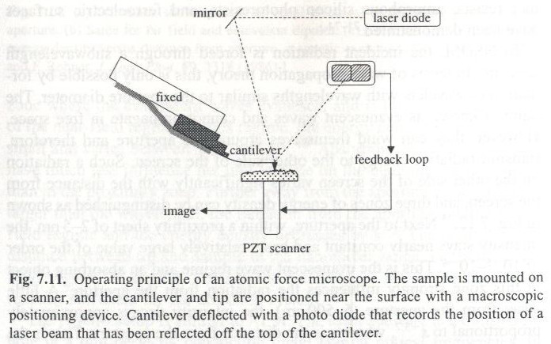
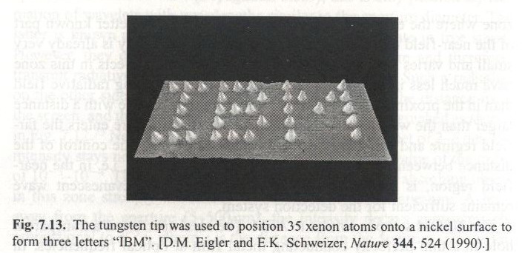
Scanning Probe Lithography
AFM:
Manipulation of Atoms

Slide 20
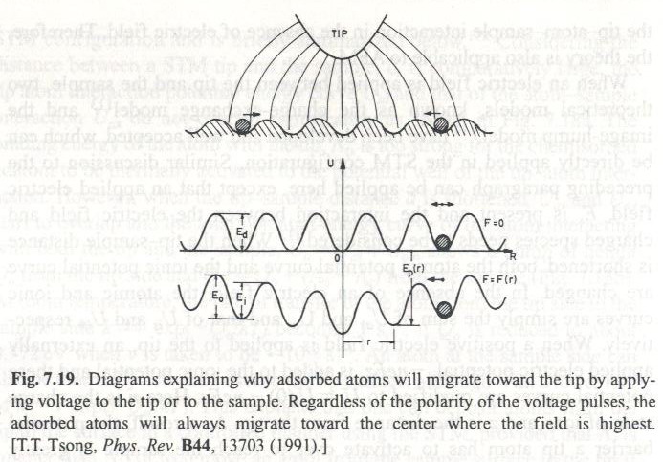
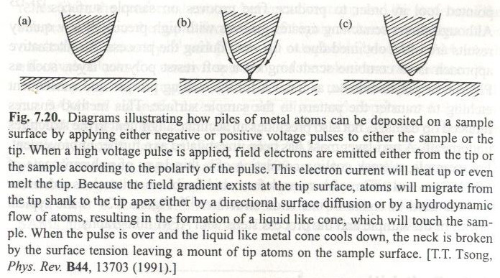
Scanning Probe Lithography
Local anodic oxidation, passivation, localized chemical vapor deposition, electrodeposition, mechanical contact of the tip with the surface, deformation of the surface by electrical pulses

Slide 21
Scanning Probe Lithography
Voltage Plus

Slide 22
Scanning Probe Lithography
STM CVD

Slide 23
Scanning Probe Lithography
Local Electrodeposition

Slide 24
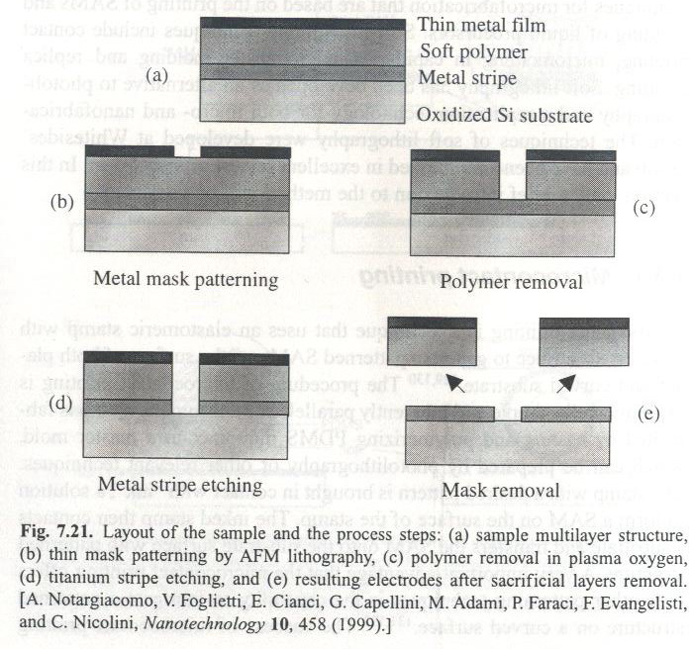
Scanning Probe Lithography
AFM
Dip Pen Lithography

Slide 25
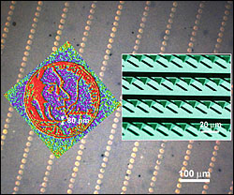
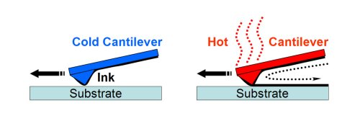
Scanning Probe Lithography
Thermal Dip Pen Lithography
Diagram illustrating thermal dip pen nanolithography. When the cantilever is cold (left) no ink is deposited. When the cantilever is heated (right), the ink melts and is deposited onto the surface. (Journal of the American Chemical Society, 128(21) pp 6774 - 6775 , 2006)
The background shows some of the 55,000 miniature images of a 2005 US nickel made with dip-pen lithography. (Each circle is only twice the diameter of a red blood cell.) Each nickel image with Thomas Jefferson's profile (in red) is made of a series of 80 nm dots. The inset (right) is an electron microscope image of a portion of the 55,000-pen array (Angewandte Chemie 45 1-4, 2006 )

Slide 26
Photolithography using Laser Lithography
Feature sizes of approximately 200 nm or greater.

Slide 27
Photolithography using Laser Lithography

Slide 28
Photolithography using Laser Lithography
Ref. 5 February 2007 / Vol. 15, No. 3 / OPTICS EXPRESS 1167 (Laser-lithography on non-planar Surfaces)

Slide 29
Photolithography using Laser Lithography

Slide 30
Photolithography using Laser Lithography

Slide 31
Laser Lithography Advantages
Photolithography (Mask) Disadvantages:
the difficulty, cost, and delay associated with designing the OPC features for a mask;
the cost and long delays in making the masks;
the uncertainties associated with future scaling of transistor dimensions.
The cost of a set of masks for producing a chip can exceed $2 million, and yet in most cases only a few wafers will be produced.
The difficulty, time, and cost associated with designing and repairing a mask leads chip designers to be conservative, which stifles innovation.
Laser Lithography Advantages:
For low volume production, i.e. when only a limited number of wafers is required, as in application-specific integrated circuits, a throughput of one to a few wafers per hour would be adequate.
Maskless optical lithography could well represent a disruptive technology that changes the complexion and direction of the semiconductor industry.

