Slide 1
Lithography Basics
Prof. Mahendra Sirsath

Slide 2
Definition of Photolithography
A process used in semiconductor device fabrication to transfer a pattern to the surface of a wafer or substrate.
The transfer of this pattern will allow for the definition of features to be etched in an underlying film or to provide a mask for ion implantation.
In a complex integrated circuit, a wafer will go through the photolithographic area on the order of 20 to 30 times.

Slide 3
Photoresists
Photoresist is a light sensitive material used in the process of photolithography to form a patterned coating on a surface.
Photoresist is dispensed in a liquid form onto the wafer as it undergoes rotation. This rotation is called “spinning.”
The speed and acceleration of this rotation are important parameters in determining the resulting thickness of the applied photoresist.

Slide 4
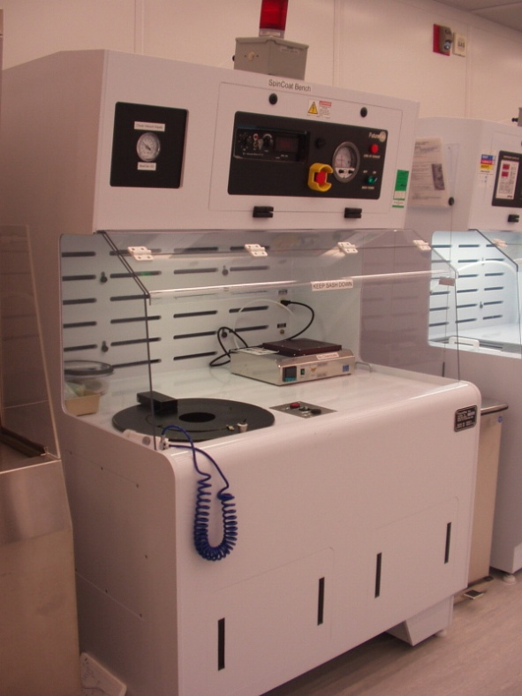
Spinning Parameters
Therefore, if any one of the parameters are changed
  the photoresist,
  the rotation speed, or
  the rotation time
You will change the photoresist thickness.

Slide 5
Examples of Spinning Parameters
All photoresists from a series have the same formula but will have different viscosities due to the amount of solvent present.
Let’s look at the 1800 series of photoresists by Rohm-Haas. WCAM supplies 3 from this series.
When spinning each formula at 4000 RPM for 30 seconds, you will have the following thicknesses after baking:
1805 0.5 um more solvent, thinner spin
1813 1.2 um
1827 2.5 um less solvent, thicker spin

Slide 6
Spinning Parameters
Here’s another example.
Rohm-Haas STR 1045 positive photoresist will spin to thicknesses between 4 – 8 um depending on the rotation speed.
In other words, change one parameter – spin speed – and you change the photoresist thickness.

Slide 7
Types of Photoresists
Photoresists are classified into two groups:
  positive resists, in which the areas exposed to the UV light become more sensitive to chemical etching and are removed in the developing process; and
  negative resists, in which the areas exposed to the UV light become resistant to chemical etching, so the unexposed areas are removed during the developing process.

Slide 8
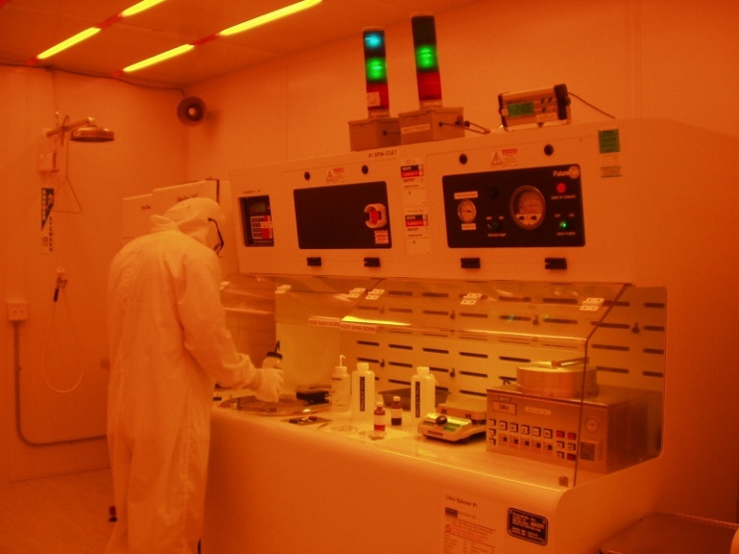
Why Different Photoresists
Selection of the correct photoresist
is dictated by your next process
  plasma (dry) or
  chemical (wet) etching; or
  ion implantation.
For example, if your next process is to etch 1um of silicon dioxide, then you need a photoresist thickness more than 1um to maintain protection during the etch process.

Slide 9
Choosing the Photoresist
Before Etching
photoresist
1um SiO2
wafer
Choosing 1805 will have a protection thickness of 0.5 um

Slide 10

Choosing the Photoresist
After Etching
photoresist
1um SiO2
wafer
1805 thickness is 0.5 um
Since the material being etched is thicker than the photoresist. The protection of the photoresist may not last for the duration of the etch.

Slide 11
Choosing the Photoresist
Before Etching
photoresist
1um SiO2
wafer
Choosing 1813 will have a protection thickness of 1.2 um

Slide 12
Choosing the Photoresist
After Etching
photoresist
1um SiO2
wafer
1813 thickness is 1.2 um
Photoresist was reduced during the etch process but the protection by the photoresist was maintained for the duration of the etch.
This photoresist would be a good choice.

Slide 13
Choosing the Photoresist
Before Etching
photoresist
1um SiO2
wafer
1827 thickness is 2.5 um

Slide 14
Choosing the Photoresist
After Etching
photoresist
1um SiO2
wafer
Choosing 1827 will have a protection thickness of 2.5 um
Photoresist was reduced during the etch process but the protection by the photoresist was maintained for the duration of the etch.
This photoresist would also be a good choice but thicker than needed. 1813 would be the better choice.

Slide 15
Soft Bake
The photoresist-coated wafer is then transferred to a hot plate or oven, where a "soft bake" is applied to drive off excess solvent before the wafer is introduced into the aligner exposure system.
  The soft bake oven is set at 90°C for 30 minutes
  The hotplate is set at 115 °C for 1 minutes
These temperatures and times vary according to the photoresist being used.

Slide 16
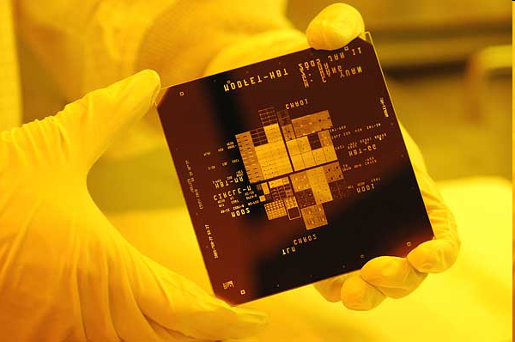
Exposure
A mask of the pattern to be transferred is made on a glass plate with chrome. The glass mask is placed directly in contact with the substrate and a UV light source is used to expose the photoresist.
The ability to project a clear pattern of a very small feature onto the wafer is limited by the wavelength of the light that is used and the ability of the reduction lens system to capture enough diffraction orders off of the illuminated mask.
Be sure to ask about design considerations for manual registration marks on masks.

Slide 17
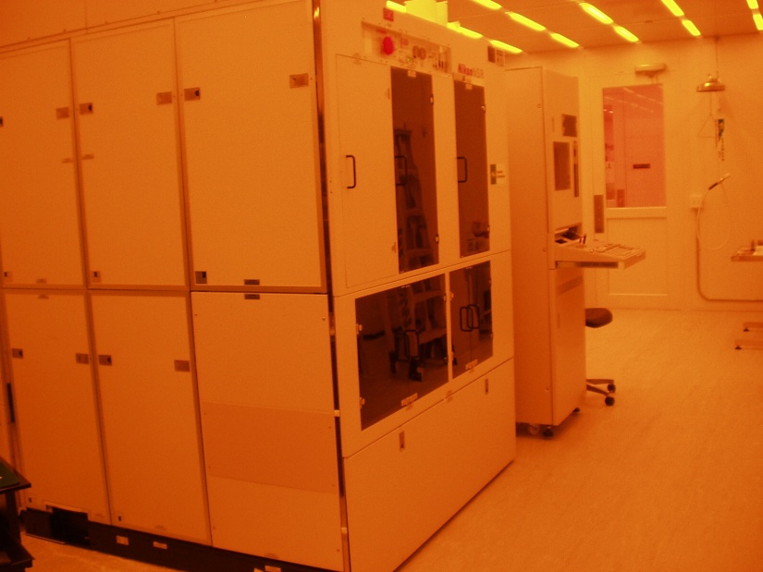
Choosing An Aligner
Selection of the aligner can depend on the size of mask you have or the type of wavelength the aligner produces.
Photoresists are developed to have not only a particular thickness for spinning but will be optimized for a particular range of wavelengths.
WCAM has 3 contact aligners and the Nikon Stepper available for lithography. A comparison of the contact aligners features follows.
For Nikon Stepper information and training, you need to contact Srdjan Milicic

Slide 18
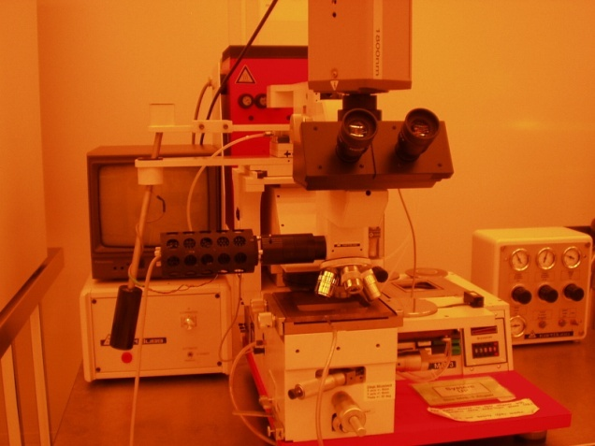
Choosing An Aligner
“New” MJB-3

Slide 19
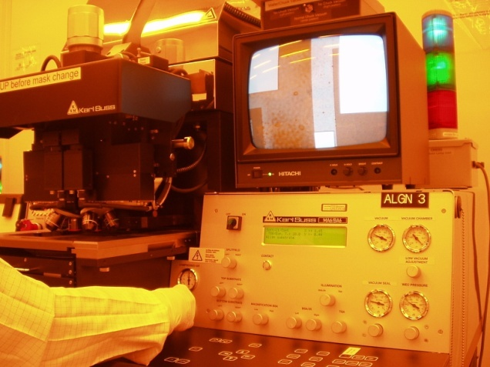
Choosing An Aligner
“New” MJB-3
MA6/BA6

Slide 20
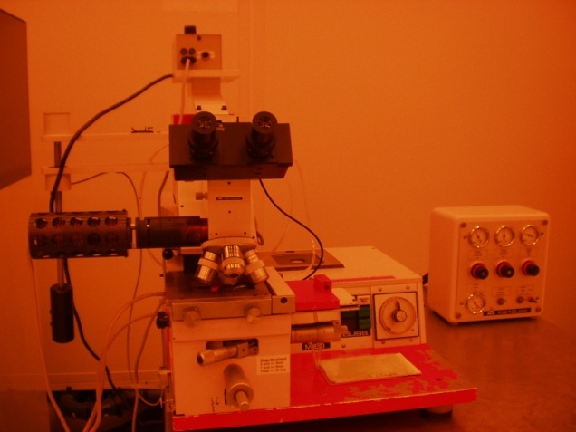
Choosing An Aligner
“New” MJB-3
MA6/BA6
“Old” MJB-3

Slide 21
Choosing An Aligner
“New” MJB-3
MA6/BA6
“Old” MJB-3
Resolution:
Mask size:
Wavelength:
Wafer pieces:
3 inch wafer:
4 inch wafer:
6 inch wafer:

Slide 22
Choosing An Aligner
“New” MJB-3
MA6/BA6
“Old” MJB-3
Resolution:
Mask size:
Wavelength:
Wafer pieces:
3 inch wafer:
4 inch wafer:
6 inch wafer:
≈ 1um
4 inch
321nm λ
Yes
Yes
Probably
No

Slide 23
Choosing An Aligner
“New” MJB-3
MA6/BA6
“Old” MJB-3
Resolution:
Mask size:
Wavelength:
Wafer pieces:
3 inch wafer:
4 inch wafer:
6 inch wafer:
≈ 1um
4 inch
321nm λ
Yes
Yes
Probably
No
≈ 1.5 um
4, 5, 7 inch
365nm λ & 405nm λ
Yes
Yes
Yes
Yes

Slide 24
Choosing An Aligner
“New” MJB-3
MA6/BA6
“Old” MJB-3
Resolution:
Mask size:
Wavelength:
Wafer pieces:
3 inch wafer:
4 inch wafer:
6 inch wafer:
≈ 1um
4 inch
321nm λ
Yes
Yes
Probably
No
≈ 1.5 um
4, 5, 7 inch
365nm λ & 405nm λ
Yes
Yes
Yes
Yes
≈ 1.5 um
4 inch
365nm λ & 405nm λ
Yes
Yes
Probably
No

Slide 25
Nikon Stepper
Resolution:
Mask size:
Wavelength:
Wafer pieces:
2 inch wafer
3 inch wafer:
4 inch wafer:
6 inch wafer:
≈ 0.5um on wafer with 20nm accuracy
6 inch
365nm λ
No
Yes
Yes
Yes
No

Slide 26
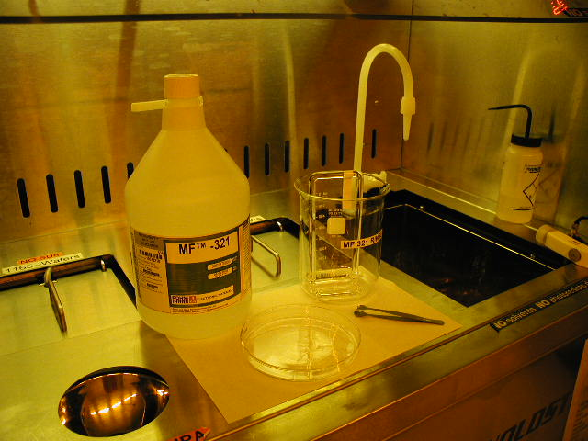
Developing
Select the chemical developer to
match the type of photoresist being
used.
Each manufacturer of photoresists
will have matching developers.
For example, use the MF-321 developer
for the Rohm-Haas 1813 photoresist.
Set up your developing station to have –
  A petri dish for the developing solution. Size the dish for the substrates. Larger dishes for full-sized wafers and smaller dishes for wafer pieces.
  Another dish for rinsing the substrate in water after the developing process has been completed.
  A nitrogen gun to dry the substrate after rinsing.

Slide 27
Inspection of Substrate
Before a wafer is “hardbaked” after development, the lithography is inspected.
If lithography is “good” and successful, the patterns are clear, with no artifacts. The substrate is able to continue to the next process of etching or ion implantation.
If lithography is “bad” and unsuccessful, the substrate should not continue to the next process of.
With positive photoresist, the substrate can be cleaned and lithography tried again.

Slide 28
What is “Good” Lithography?
Lithography patterns can be:
Top down view
Side view
Good
PR
The features are straight, corners are even. Good exposure and development time.

Slide 29
What is “Good” Lithography?
Lithography patterns can be:
Top down view
Side view
Good
Over exposed or
Over developed
PR
The features are uneven and smaller. Too long of exposure or development time.

Slide 30
What is “Good” Lithography?
Lithography patterns can be:
Top down view
Side view
Good
Over exposed or
Over developed
Under exposed or
Under developed
PR
open
The features are straight, but not all the PR has been cleared from the exposed areas. Too short of exposure or development time.

Slide 31
Hard Bake
If lift off is the next process, no hard baking is done.
After the substrate has been inspected and is ready for the next process, the substrate is “hard baked.”
Hard baking is done at high temperature in order to solidify the remaining photoresist, to better serve as a protecting layer in future ion implantation, wet chemical etching, or dry plasma etching.
  The soft bake oven is set at 125°C for 30 minutes
  The hotplate is set at 115 °C for 1 minutes
These temperatures and times vary according to the photoresist being used.

Slide 32
Lithography Troubles
Substrate has particles, “dirty”
Photoresist will collect around particles

Slide 33
Lithography Troubles
Substrate has particles, “dirty”
Photoresist will collect around particles
Substrate not round
Photoresist will not be uniform across wafer.
There will be a large edge bead.

Slide 34
Lithography Troubles
Substrate has particles, “dirty”
Photoresist will collect around particles
Substrate not round
Photoresist will not be uniform across wafer.
There will be a large edge bead.
Poor adhesion of the photoresist
Due to moisture or surface of the substrate,
the photoresist will float off or reposition
on substrate.

Slide 35
Lift off Process
Here is an informational link on the lift off process provided by researchers at Georgia Tech University.
Liftoff pdf

Slide 36
Some References on Lithography and Other Processes
Campbell, Stephen. The Science and Engineering of Microelectronic Fabrication. Oxford University Press; 2nd edition.
Runyan, WalterR. and Bean, Kenneth E. Semiconductor Integrated Circuit Processing Technology. Addition-Wesley Publishing Company, Inc.
Van Zant, Peter. Microchip Fabrication, A Practical Guide to Semiconductor Processing. McGraw-Hill, 3rd edition.

