Slide 1
Integrated circuit manufacturing technique for sensor
Prof. Mahendra Sirsath

Slide 2
Introduction
The chapter concern with the integrated circuits manufacturing techniques for sensors
Manufacturing : In simple term manufacturing can be defined as the process by which raw material are converted into finished product
In semiconductor manufacturing input material includes dopant, metals, and insulator the corresponding output include integrated circuits (ICs), IC packages, printed circuit boards, and ultimately various commercial electronic systems
The types of system arises in the IC manufacturing includes
Crystal growth, oxidation, photolithography, etching, diffusion, ion implantation, planarization and deposition process
In this chapter we are focusing on the photolithography and the etching techniques for fabrication of the sensors

Slide 3
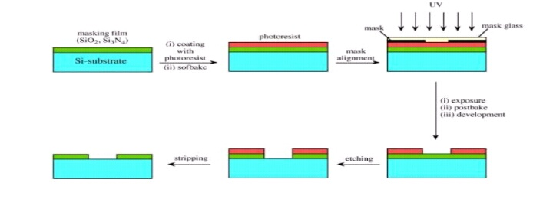
Photolithography
Lithography : it consist of patterning substrate by employing the interaction of beams of photons or particles with materials
Photolithography :
Each layer within a microsystem has a unique pattern.
Photolithography transfers this pattern from a mask to a photosensitive layer.
Another process step transfers the pattern from the photosensitive layer into an underlying layer.
After the pattern transfer, the resist is stripped (removed).

Slide 4
Steps involved in photolithography are:
Surface preparation
Spin coatingsoft baking
Exposure
Development
Mask and mask alignment
Hard bake
Stripping
Etching

Slide 5
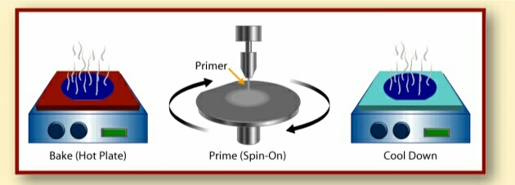
Surface preparation and coating :
Coat Step: Surface ConditioningIn most applications, surface conditioning precedes the photoresist.
Surface conditioning prepares the wafer to accept the photoresist by providing a clean surface.
It coats the wafer with a chemical that boosts adhesion of the photoresist to the wafer’s surface. (Usually Hexamethyldisalizane or HMDS)

Slide 6
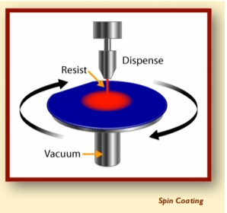
Spin Coating
Wafer is placed on a vacuum chuck
A vacuum holds the wafer on the chuck
Resist is applied
Chuck accelerates for desired resist thickness
Chuck continues to spin to dry film

Slide 7
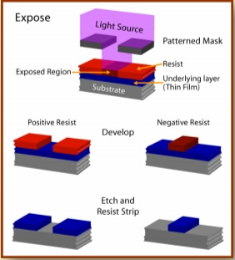
Photo resist
Photoresist is a mixture of organic compounds in a solvent solution.
Two types of resist:
Positive resist -
Exposed regions become more soluble.
A positive mask is left after develop.
Negative resist -
Exposed materials harden.
A negative mask is left after develop.

Slide 8
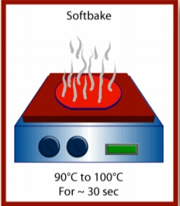
Soft bake
After the photoresist is applied to the desired thickness, a softbake is used to remove the residual solvents of the photoresist.
After the softbake, the wafer is cooled to room temperature.

Slide 9
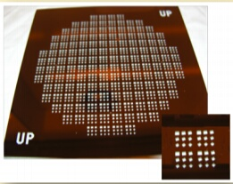
Mask and mask alignment
The patterned mask (or reticle) is a quartz or glass plate with the desired pattern (usually in chrome).
Some equipment do not use a whole mask. Instead smaller quartz plate is used with just a few die (inset). This plate is called a reticle.
"Align" is one of the most critical steps in the entire microsystems fabrication process.
A misalignment of one micron or smaller can destroy the device and all the devices on the wafer.
Each layer must be aligned properly and within specifications to the previous layers and subsequent layers.

Slide 10
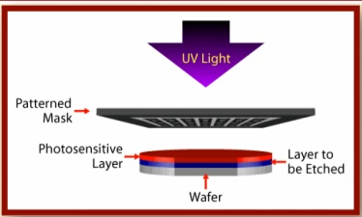
Exposure
The wafer is exposed by UV (ultraviolet) from a light source traveling through the mask to the resist.
A chemical reaction occurs between the resist and the light.
Only those areas not protected by the mask undergo a chemical reaction.

Slide 11
1.Contact printing
In contact aligners, the resist coated silicon wafer is brought in to physical contact with the photomask the wafer on the vacuum chuck, and the whole assembly rises until the wafer and mask contact each other.
The photoresist is exposed with UV light while the wafer is contact with the mask.
Because of the contact of resist and mask very high resolution is possible in contact printing.

Slide 12
2.Proximity printing
The proximity method is similar to contact printing except that a small gap 10-20µm wide, is maintained between the wafer and the mask during exposure
This gap minimizes (may not be eliminated) mask damage, but it gives the poorer image than contact aligners,
Approximately 2-4µm resolution is possible with proximity printing

Slide 13
3.Projection printing
Projection aligners avoids mask damage entirely.
An image of the pattern on the mask is projected onto the resist-coated wafer which is several centimeters away
In order to achieve the high resolution only a small portion of the mask is imaged this image scanned or stepped over the surface of the wafer.
Projection printers that steps the mask image over the wafer surface are called step-and-repeat systems.
Step-and-repeat projection printers are capable of approximately 1µm resolution.

Slide 14
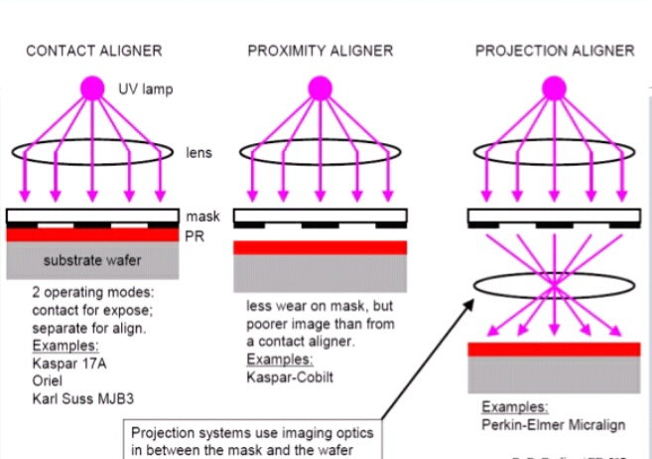

Slide 15
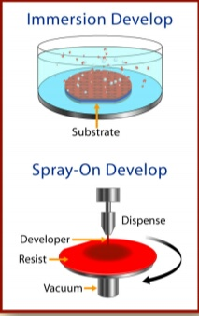
Development
Portions of the photoresistare dissolved by a chemical developer.
With positive resist, the exposed resist is dissolved while the unexposed resist remains on the wafer.
With negative resist, the unexposed resist is dissolved while the exposed resist remains.

Slide 16
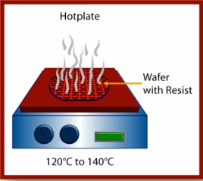
Hard bake :
Hardens the photoresist for the next process.
The temperature of the hardbake is higher than that of the softbake after coat.
After the hardbake, the wafer is cooled to room temperature.

Slide 17
Spinning resist
A resist is applied to the surface using a spin coating machine this device holds the wafer of semiconductor using a vacuum, and spin it at high-speed (3000-6000 rpm) for a period of 15-30sec
A small quantity resist is dispensed in the center of the wafer rotation causes the resist be speared across the surface of the wafer with excess being thrown spun off
Close to the center of the wafer the variation in the thickness of resist is around 30nm
Preparation of the resist is concluded by the soft baking, where the wafer is gently heated in a convection oven and then a hotplate to evaporate the resist solvent and a partially to solidify the resist

Slide 18
Etching
The etch process follows photolithography or deposition during which a protected masking layer is applied to the wafer surface
The protective masking layer is used to identify the material to be etched and to protect that is remain
The figure labeled “pattern transfer” illustrate a mask pattern transferred into photoresistive layer shown in red on the wafer surface during etching process (right) that pattern is transferred into the surface layer removing surface areas of the surface layer and leaving in the underlying layer open to a subsequent process step.

Slide 19
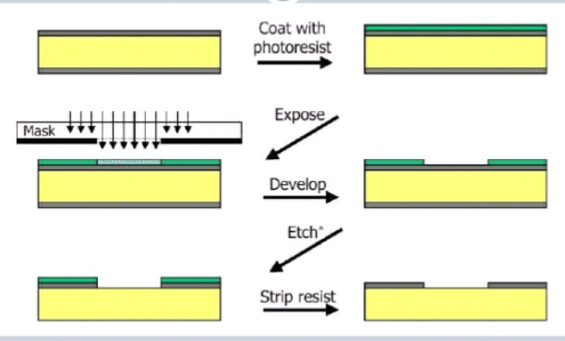

Slide 20
1.Dry etching
Dry etching is performed by placing the wafer in a chamber and pumping in chemical vapors or using plasma.
Dry etching can be chemical, physical, or both in its etch.
Wet Etch is performed by immersing entire wafers in liquid etchant solutions.
Reaction is between surface layer exposed and etchant
Purely a chemical process.

Slide 21
2.Wet etching
Wet etching is a material removal process that uses liquid chemicals or etchants to remove materials from a wafer.
The specific patters are defined by masks on the wafer. Materials that are not protected by the masks are etched away by liquid chemicals.
These masks are deposited and patterned on the wafers in a prior fabrication step using lithography
-A wet etching process involves multiple chemical reactions that consume the original reactants and produce new reactants.

