Slide 1

Chapter 4
Synthesis Methods
Dr. M. D. Shirsat,
Professor,
Department of Physics,
Dr. Babasaheb Ambedkar Marathwada University, Aurangabad (MS)

Slide 2
Introduction :
Thin Films

Slide 3
Thin Films
Thin film is a layer of material ranging from fractions of a nanometer to several micrometers in thickness.
This microscopically thin layer is deposited onto any substrate such as metal, semiconductor, ceramic or plastic base.

Slide 4
Classification of Thin Films
Thin Film
Epitaxial
Polycrystalline
Amorphous
Classification of thin films based on crystallinity

Slide 5
Classification of Thin Films
Epitaxial (single‐crystalline, formed layer-by-layer, lattice match to substrate): no grain boundaries, requires high temperatures and slow growth rate. High quality thin films such as III‐V semiconductor films (e.g. GaAs) and complex oxides.
Polycrystalline (island or mixed growth): lots of grain boundaries, e.g. most elemental metals grown near room temperatures.
Amorphous (island or mixed growth): no‐crystalline structures (yet with some short range atomic ordering), no crystalline defects, e.g. common insulators such as amorphous SiO₂.

Slide 6
Thin Films (Contd…)
Properties of thin films:
High surface to volume ratio
Geometrical control (dictated by substrate)
Compact
Single crystal like properties
Typical steps in making thin films:
Emission of particles from source (heat, high voltage . . .)
Transport of particles to substrate
Condensation of particles on substrate

Slide 7
Uses of Thin Films
Microelectronic Devices
Telecommunication Devices
Wear Resistant Coatings
Decorative Coatings
Optical Coatings (Windows, Solar Cells, etc.)
Sensors
Catalysts

Slide 8
Different Thin Film Synthesis Techniques
Solid
Particle Deposition
Liquid
Sol-Gel
CBD
SILAR
Langmuir – Blodgett
Electrochemical
Gas
CVD
APCVD
LPCVD
PECVD
MOCVD
ALD
PVD
Evaporation
Sputtering
MBE

Slide 9
Sol-Gel Method

Slide 10
Introduction to Sol-gel technique
The sol-gel process is very long known since the late 1800s. The versatility of the technique has been rediscovered in the early 1970s when glasses were produced without high temperature melting processes.
This made possible by the organic modification of silicon compounds (ORMOSIL), which cannot withstand in high temperatures.
Sol-gel is a chemical solution process used to make ceramic and glass materials in the form of thin films, fibers , or powders .
A sol is a colloidal (the dispersed phase is so small that gravitational forces do not exist; only Van der Waals forces and surface charges are present) or molecular suspension of solid particles of ions in a solvent.
A gel is a semi-rigid mass that forms when the solvent from the sol begins to evaporate and the particles or ions left behind begin to join together in a continuous network.

Slide 11
Introduction to Sol-gel Technique
Sol-gel processing
  It is widely used in the synthesis of inorganic and organic-inorganic hybrid materials
  Sol-gel films are made by coating sols onto substrates.
  Commonly used methods for sol-gel film deposition
    - spin-coating
    - dip-coatings
    - spray
    - ultrasonically pulverized spray

Slide 12
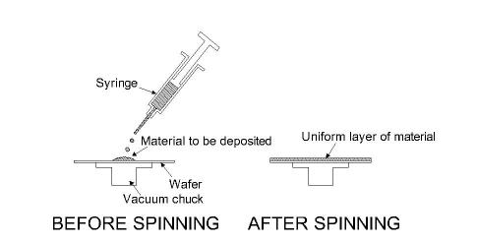
Spin Coating
  Deposit a small puddle of a viscous fluid onto the center of a substrate
  Spin the substrate at high speed (~ 3000 rpm).
  Liquid spreads to, and eventually off, the edge of the substrate.
  Thin film of fluid left behind on the surface.
  Final film thickness depends on the liquid (viscosity, drying rate, % solids, surface tension, etc.) the spin parameters (rpm, diameter, substrate).

Slide 13
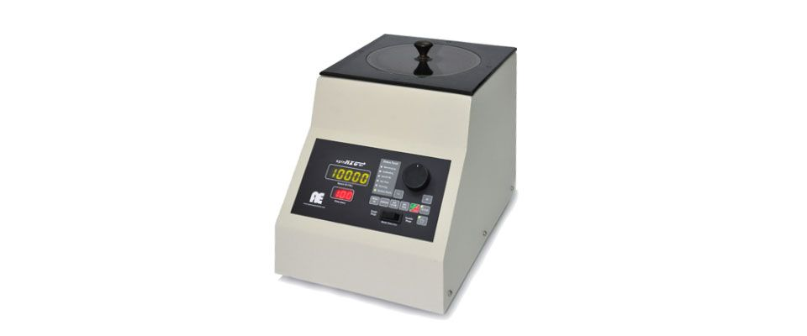
Apex NXG Spin Coating System

Slide 14
Dip Coating
The dip coating process can be separated into five stages
  Immersion: The substrate is immersed in the solution of the coating material at a constant speed (preferably jitter-free).
  Start-up: The substrate has remained inside the solution for a while and is starting to be pulled up.
  Deposition: The thin layer deposits itself on the substrate while it is pulled up. The withdrawing is carried out at a constant speed to avoid any jitters. The speed determines the thickness of the coating (faster withdrawal gives thicker coating material).
  Drainage: Excess liquid will drain from the surface.
  Evaporation: The solvent evaporates from the liquid, forming the thin layer. For volatile solvents, such as alcohols, evaporation starts during the deposition & drainage steps.

Slide 15
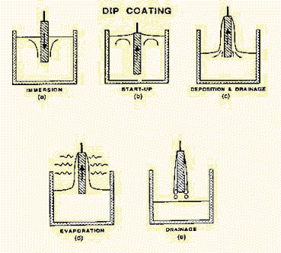
Dip Coating

Slide 16
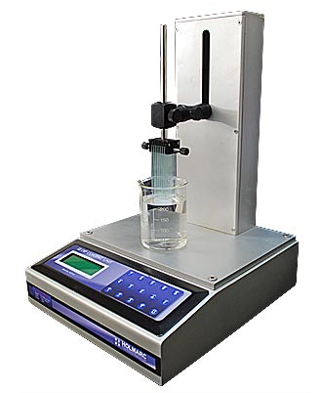
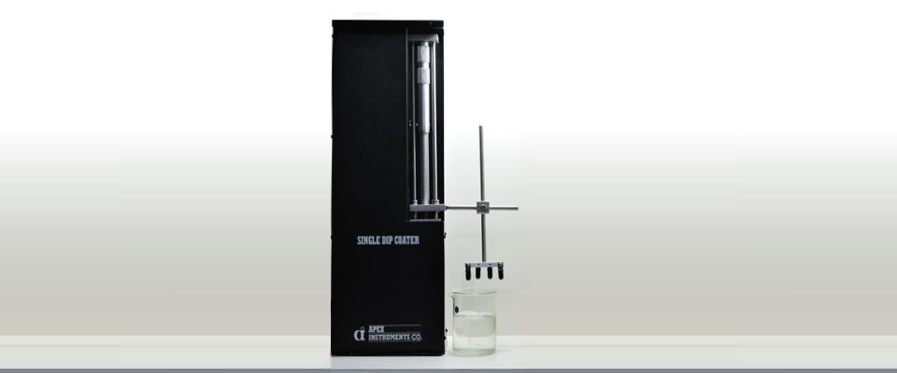
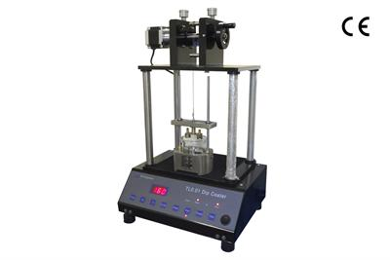
Dip Coating
Photographs of Commercial available Dip Coater
  (courtesy : HOLMARC OPTO-MECHATRONICS PVT. LTD)
  (courtesy: APEX INSTRUMENTS CO.)
  (courtesy: MTI CORPORATION)

Slide 17
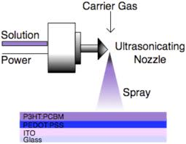
Ultrasonically Pulverized Spray
This type of spray nozzle utilizes high frequency (20–50 kHz) vibration to produce narrow drop-size distribution and low velocity spray from a liquid. The vibration of a piezoelectric crystal causes capillary waves on the nozzle surface liquid film.

Slide 18
Spray Pyrolysis
Spray pyrolysis is a processing technique being considered in research to prepare thin and thick ﬁlms, ceramic coatings, and powders.
spray pyrolysis represents a very simple and relatively cost-effective processing method (especially with regard to equipment costs).
Typical spray pyrolysis equipment consists of an atomizer, precursor solution, substrate heater, and temperature controller.
Spray pyrolysis technique involves spraying of a solution containing soluble salts of the desired compound on to preheated substrates, where the constituents react to form a chemical compound.

Slide 19
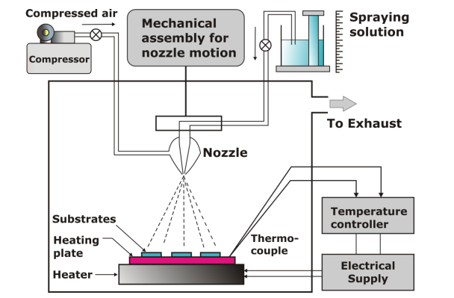
Spray Pyrolysis System
The chemical reactants used for making solution are selected such that the products other than the desired compound are volatile at the temperature of deposition.
The basic principle involved in spray pyrolysis technique is pyrolytic decomposition of salts of a desired compound to be de deposited.
Schematic diagram of spray pyrolysis method

Slide 20
Description of Spray Pyrolysis System
a) Spray nozzle:
It is made up of glass and consists of the solution tube surrounded by the glass bulb. With the application of pressure to the carrier gas, the vacuum is created at the tip of the nozzle, and the solution is automatically sucked in the solution tube and the spray starts.
b) Rotor for spray nozzle
Stepper motor-based microprocessor controller is used to control the linear simple harmonic motion of the spray nozzle over the required length of the hot plate.
Hence, the to-n-fro motion and the speed of the spray nozzle is monitored in a
controlled manner.
c) Liquid level monitor
The spray rate at a fixed air pressure depends upon the height of the solution measured with respect to the tip of the nozzle. The arrangement for the change in height of the solution forms the liquid level monitor.

Slide 21
Description of Spray Pyrolysis System
d) Hot plate
The iron disc (with diameter 16 cm and thickness 0.7 cm to which 2000 W heating coil is fixed) served as a hot plate. Maximum temperature of 600 ± 5ºC can be achieved with this arrangement.
e) Gas regulator value
The gas regulator value is used to control the pressure of the carrier gas flowing through the gas tube of the spray nozzle. A glass tube of length 25 cm and of diameter 1.5 cm is converted into gas flow meter.
f) Air tight fiber chamber
Since the number of toxic gases is evolved during the thermal decomposition of sprayed solution, it is necessary to fix the spraying system inside with airtight fiber chamber.
An airtight fiber chamber of the size (60 cm x 60 cm x 60 cm) could be fabricated. The fiber avoids the corrosion of the chamber. The outlet of chamber is fitted to exhaust fan to remove the gases evolved during thermal decomposition.

Slide 22
Factors affecting bonding and subsequent build up of the coating by spray method
  Cleanliness
  Surface area
  Surface topography or profile
  Temperature ( thermal energy )
  Time ( reaction rates, cooling rates etc.)
  Velocity ( kinetic energy )
  Physical & chemical properties
  Physical & chemical reactions

Slide 23
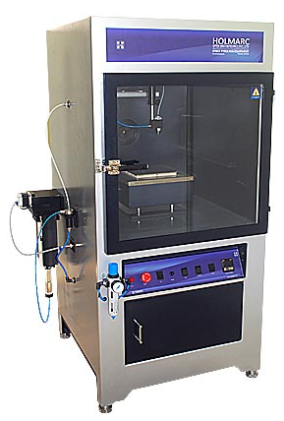
Spray Pyrolysis Equipment
HOLMARK PVT. LTD
Model No: HO-TH-04

Slide 24
Sol-gel (Contd…)
In essence, the sol-gel process usually consists of 4 steps:
  The desired colloidal particles once dispersed in a liquid to form a sol.
  The deposition of sol solution produces the coatings on the substrates by spraying, dipping or spinning.
  The particles in sol are polymerized through the removal of the stabilizing components and produce a gel in a state of a continuous network.
  The final heat treatments pyrolyze the remaining organic or inorganic components and form an amorphous or crystalline coating.

Slide 25
Introduction to Sol-gel Technique
Sol-Gel process
Hydrolysis
Condensation
Gelation
Ageing
Drying
Densification
Powders: microcrystalline, nanocrystalline, amorphous, Monoliths Coatings, Films, Fibers, Aerogels Glasses, Ceramics, Hybrid materials

Slide 26
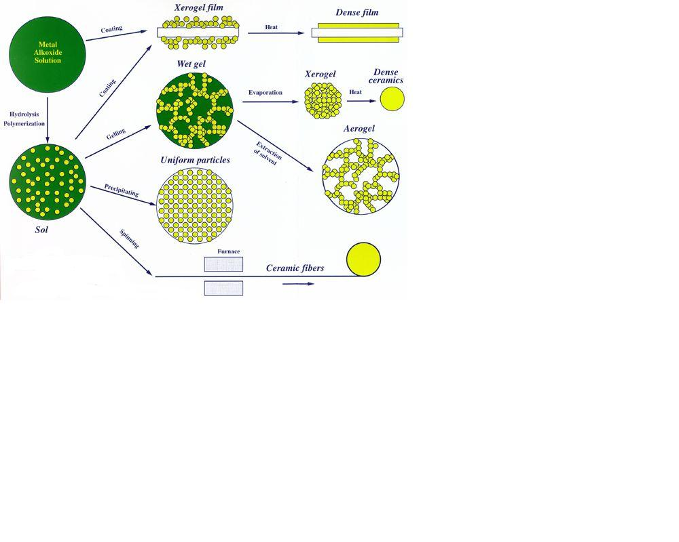
Sol gel process

Slide 27
Sol-gel (Contd…)
Sol = a stable suspension of colloidal solid particles or polymers in a liquid
Gel = porous, three-dimensional, continuous solid network surrounding a continuous liquid phase
Colloidal (particulate) gels = agglomeration of dense colloidal particles
Polymeric gels = agglomeration of polymeric particles made from sub colloidal units
Agglomeration = covalent bonds, van der Walls, hydrogen bonds, polymeric chain entanglement

Slide 28
Sol-gel (Contd…)
Sol Gel methods
Colloid Route
Metal-organic Route

Slide 29
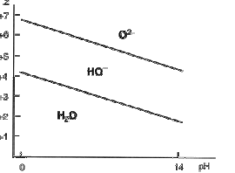
Colloid Route
metal salts in aqueous solution, pH and temperature control
Hydrolysis
M(H₂O)b Z⁺ [M(H₂O)b-1OH](Z-1)⁺ + H⁺
Condensation-polymerization
M(H₂O)b Z⁺ [(H₂O)b⁻¹M(OH)2M(H₂O)b-1](2Z-2)⁺ + 2H⁺

Slide 30
Metal-organic Route
Metal-organic Route
Acid catalyzed hydrolysis
Base catalyzed hydrolysis

Slide 31
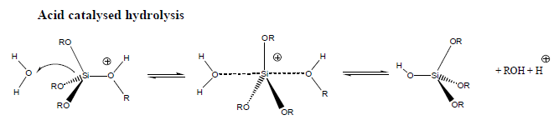
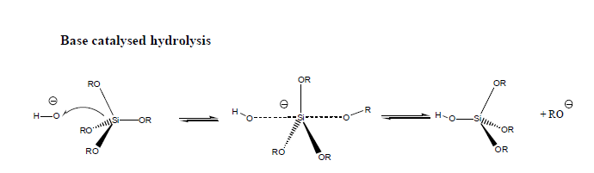

Slide 32
Advantages of Sol-Gel Technique
Can produce thin bond-coating to provide excellent adhesion between the metallic substrate and the top coat.
Can produce thick coating to provide corrosion protection performance.
Can easily shape materials into complex geometries in a gel state.
Can produce high purity products because the organo-metallic precursor of the desired ceramic oxides can be mixed, dissolved in a specified solvent and hydrolyzed into a sol, and subsequently a gel, the composition can be highly controllable.
Can have low temperature sintering capability, usually 200-600°C.
Can provide a simple, economic and effective method to produce high quality coatings.

Slide 33
Applications
It can be used in ceramics manufacturing processes, as an investment casting material, or as a means of producing very thin films of metal oxides for various purposes.
Sol-gel derived materials have diverse applications in optics, electronics, energy, space, (bio)sensors, medicine (e.g. controlled drug release) and separation (e.g. chromatography) technology. One of the more important applications of sol-gel processing is to carry out zeolite synthesis.
Other elements (metals, metal oxides) can be easily incorporated into the final product and the silicalite sol formed by this method is very stable.

Slide 34
Applications
Other products fabricated with this process include various ceramic membranes for microfiltration, ultra filtration, nanofiltration, pervaporation and reverse osmosis.

Slide 35
Chemical bath deposition

Slide 36
Chemical Bath Deposition
The Chemical bath deposition (CBD) method is one of the cheapest methods to deposit thin films and nanomaterials.
as it does not depend on expensive equipment and is a scalable technique that can be employed for large area batch processing or continuous deposition.
In 1933 Bruckman deposited Lead(II) sulfide (PbS) thin film by chemical bath deposition (CBD) or solution grown method.

Slide 37
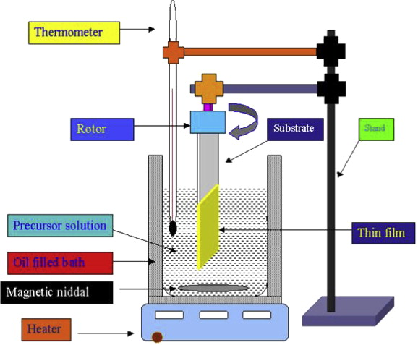
Chemical Bath Deposition

Slide 38
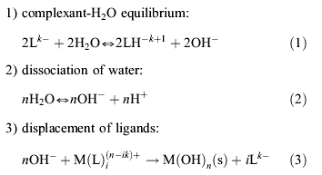

Chemical Bath Deposition

Slide 39
Some Principles Involved
While the water itself provides oxygen, initially in the form of OH⁻ ions.
Hydrolysis can occur even in acidic solutions when the metal cation is easily hydrolysable,
as with Fe³⁺ , Ti⁴⁺ , Zr⁴⁺ , and Al³⁺
CBD requires supersaturated solutions, i.e. the concentrations must exceed the solubility product
In a closed system, growth cannot continue once the reactants have been depleted below this point, which determines the thickness of the film

Slide 40
.
Reaction Mechanism
The chemical bath deposition involves two steps, nucleation and particle growth, and is based on the formation of a solid phase from a solution.
In the chemical bath deposition procedure, the substrate is immersed in an aqueous solution containing the precursors.

Slide 41
Factors Governing Chemical Bath Deposition
Bath composition
The growth rate and quality of the deposited films is greatly influences by the concentration of the reacting species.
The films deposited by using low concentration are thin and non uniform.
This observation can be relates to the insufficient supply of ionic species at such concentration levels.
On the other hand when concentration of the species increases, the quality and uniformity of the films goes on increasing and the films will be thick.
This is true up to a certain level of concentration and then saturation in the growth process could be observed.

Slide 42
Factors Governing Chemical Bath Deposition
The pH:
It is the most important factor in the Chemical bath deposition.
Thus the desired films are to be obtained on the substrate surface by optimizing the pH value of its bath solution which avoids the deleterious effects
Deposition time:
Growth of the thin film by chemical bath deposition is time dependent.
The deposition time of the film affects film thickness.
Deposition temperature:
The temperature dependence of growth rate show that the rate of deposition increases with bath temperature resulting into formation of fine grained structure.

Slide 43
Advantages
The major advantage of CBD is that it requires only solution containers and substrate mounting devices.
Among various deposition techniques, chemical bath deposition yields stable, adherent, uniform and hard films with good reproducibility by a relatively simple process.
The chemical bath deposition method is one of the suitable methods for preparing highly efficient thin films in a simple manner.
The growth of thin films strongly depends on growth conditions, such as duration of deposition, composition and temperature of the solution, and topographical and chemical nature of the substrate.
Disadvantages:
The one drawback of this method is the wastage of solution after every deposition

Slide 44
successive ionic layer adsorption and reaction
(SILAR)

Slide 45
SILAR
The critical operations for the deposition of thin films by Successive Ionic Layer Adsorption and Reaction (SILAR) method, are adsorption of the cations, rinsing with deionized water, reaction of pre-adsorbed cations with newly adsorbed anions and again rinsing with deionized water.
Generally, manual, electro pneumatic and computer based system have been used to perform these operations in SILAR method

Slide 46
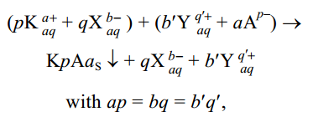
Basics of SILAR
The SILAR is based on sequential reaction at the substrate surface. Rinsing follows each reaction, which enables heterogeneous reaction between the solid phase and the solvated ions in the solution.
The SILAR process is intended to grow thin films of water insoluble ionic or ion covalent compounds of the type KpAa by heterogeneous chemical reaction at the solid solution interface between adsorbed cations, pKa+ and anion, aAp– , following the reaction

Slide 47
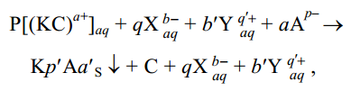
where,
K represents cation (Cd2+, Zn2+, Fe3+, Cu+ , etc), p represents the number of cations,
a represents the numerical value of charge on cation,
X is a ion in cationic precursors having negative charge (X = SO4 2– , Cl– , NO3– etc),
q represents the number of X in cationic precursors and b the numerical value of charges on X, b¢ the number of Y in the anionic solutions,
q¢ the numerical value of charge on Y, Y the ion which is attached to chalcogen ion,
A represents the anion (O, S, Se and Te), a¢ the number of anions.
A is the chalcogen ion. In the presence of complexing agent, above reaction can be written as
C is complexing agent.

Slide 48
Steps in SILAR Technique
Adsorption
Rinsing
Reaction
Rinsing

Slide 49
Adsorption
In this first step of SILAR process, the cations present in the precursor solution are adsorbed on the surface of the substrate and form the Helmholtz electric double layer.
This layer is composed of two layers: the inner (positively charged) and outer (negatively charged) layers.
The positive layer consists of the cations and the negative form the counter ions of the cations.

Slide 50
Rinsing
In this step, excess adsorbed ions, pKa⁺ and Aa p– , are rinsed away from the diffusion layer. This results into saturated electrical double layer.

Slide 51
Reaction
In this reaction step, the anions from anionic precursor solution are introduced to the system.
Due to the low stability of the material, KpAa, a solid substance is formed on the interface.
This process involves the reaction of pK a+ surface species with the anionic precursor, aA p–

Slide 52
Rinsing
In last step of a SILAR cycle, the excess and unreacted species aA p– , X, Y, and the reaction byproduct from the diffusion layer are removed.

Slide 53
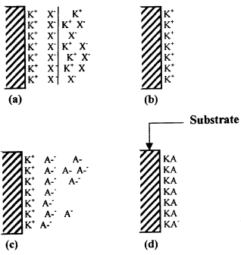
SILAR Growth
Schematic diagram of SILAR growth: (a) Adsorption of K+X– and the formation of electrical double layer, (b) rinsing (I) removes excess, unabsorbed K+ and X– , (c) reaction of A– with pre-adsorbed K+ ions to form KA and (d) rinsing (II) to remove excess and unreacted species and form the solid solution KA on surface of the substrate

Slide 54
SILAR Deposition Systems
Manually operated
Microprocessor based
Computer based

Slide 55
Manually Operated
This system does not require any power supply for operations, hence it is economical.
In this system, four or more glass beakers of typically 50 ml capacity containing precursor solutions and deionized water are placed separately in the tray.
The beakers containing precursor solutions and deionized water are alternately placed. The beaker containing deionized water is placed in between the beakers containing cationic and anionic precursor solutions.
The immersion and rinsing of substrates are done manually.
The SILAR deposition of sufficiently thick film requires many hours and therefore manual deposition of certain materials is not possible for a single person

Slide 56
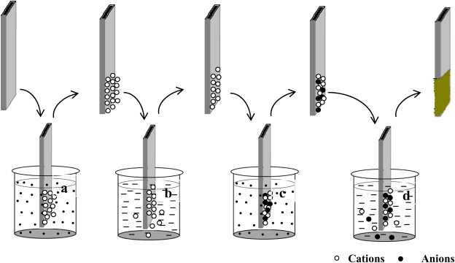
Manually Operated

Slide 57
Computer Controlled
The schematic diagram of computer-based operating system (Nicolau 1985; Jim’enez-Gonz’ailez and Nair 1995)
The equipment consists of two beakers of 50 ml each containing the precursor solution and two rinsing vessels, lying in a circle on the circular tray.
Each rinsing vessel being placed in between beakers containing cationic and anionic precursor solutions.
The substrates are attached vertically by means of four arms.
The arms are set out in line or a right angle and supported on the spindle.
The spindle can turn and slide tightly in a bearing.
Two steeping motors drive it. The computer program governs the vertical and translation movement of the spindle.

Slide 58
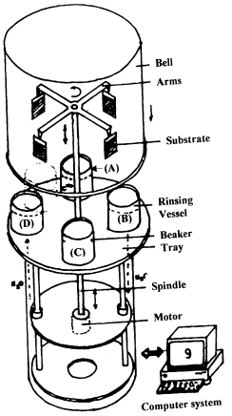
Computer Controlled
Computer based SILAR deposition system: (a) cationic precursor, (b) ® ion exchange water, (c) ® anionic precursor and (d) ® ion exchange water.

Slide 59
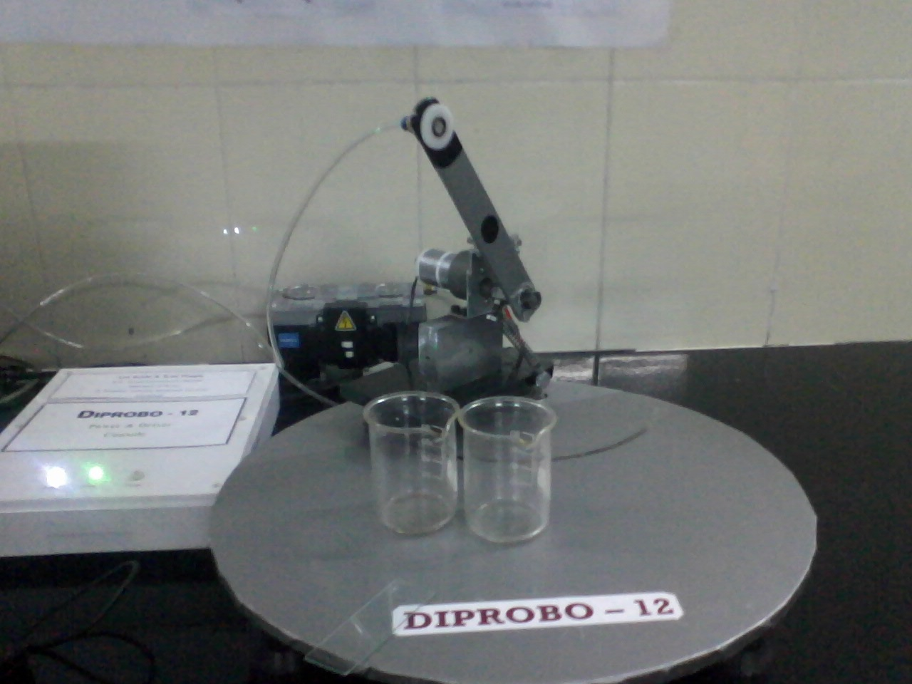
Computer Controlled System Designed by Our Group

Slide 60
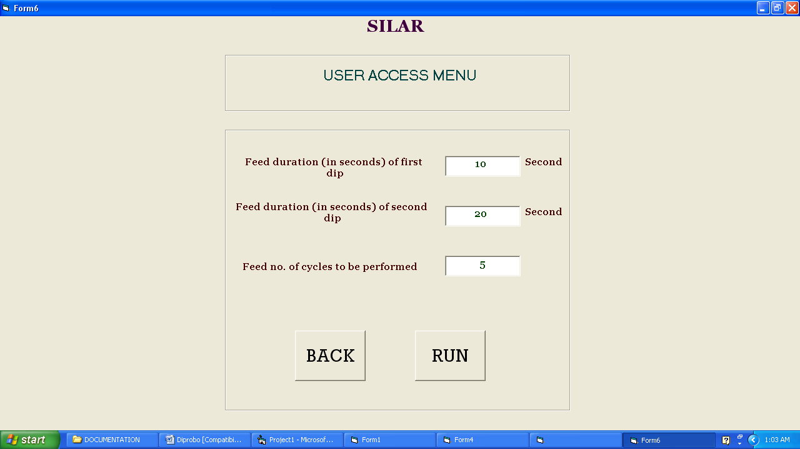
User Access Menu for DIPROBO-12 In Windows

Slide 61
Microprocessor Based
The schematic diagram of microprocessor-based operating system as shown.
The equipment is feasible for elemental, binary, ternary, composite etc. materials Each rinsing vessel being placed in between beakers containing cationic and anionic precursor solutions.
The substrates are attached vertically by means of robotic arms.
The microprocessor governs the vertical and translational movement of the robotic arms.

Slide 62
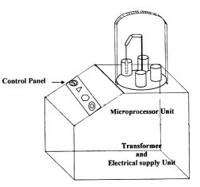
Microprocessor Based
Microprocessor based SILAR deposition system

Slide 63
Advantages of SILAR method
SILAR method can be used to prepare metal chalcogenide thin films.
SILAR is a cheap method, making the process feasible for commercial application.
wastage of material is avoided as no precipitate is formed during this process.
the materials are stoichiometric and doping of semiconductors, desired type for device formation etc. can be achieved.

Slide 64
Applications of SILAR method
The optimization of various preparative parameters could be tabulated along with film properties.
The film properties are well comparable with the properties obtained by other chemical methods.
This shows the wide applicability of SILAR method for deposition of various metal chalcogenides.
These chalcogenides are technologically important in device formation based on solar selective coatings, solar cells, photoconductive cells etc where large area is desirable.
At the same time, SILAR opens a window for the preparation of nanocrystalline films, which are important for finding new applications.

Slide 65
Langmuir – Blodgett Technique

Slide 66
Introduction
Langmuir – Blodgett films are monofilms or multifilms on solid substrate.
Molecules form a monolayer at the interface air-liquid
They are nanomaterials
The films are layers at scale 0.1 – 0.001 nm
~ 1 nm

Slide 67

Monolayer Phases
When the molecules are first spread on the water surface, they are loosely packed and form a so-called gas phase.
Increasing the surface pressure translates as a transition to a liquid phase.
Further increases in pressure bring about a last compressibility change that is associated to a liquid-solid phase transition.
Solid phase
Surface pressure (mN/m)
Liquid phase
Gas phase
Molecular area (nm²/molecule)

Slide 68
A barrier on the water surface pushes and compacts the molecules.
Spreading amphiphile molecules on a water surface yields monolayers or films where the hydrophobic segments stem at the water/air interface.
Films with tailored stability, orientation of molecules or phase transition can thereby be transferred to the substrate.

Slide 69

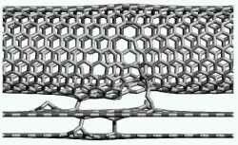
Characteristics of Substrate
Hydrophilic:
  Glass
  Aluminium, chromium,
  Wafer
Hydrophobic:
  trimethylchlorsilane

Slide 70
Film transfer
Water subphase
Water
Vertical
  This technique is actual for highly hydrophobic molecules.
Horizontal
  This technique is suitable for transfer of very stif films.

Slide 71
Langmuir – Blodgett Films
Vertically prepared films
3 types:
  repeated submergence – type X
  repeated emergence – type Z
  switching both types – type Y
X
Z
Y

Slide 72
Electrochemical Synthesis

Slide 73
Electrochemical Deposition
        Electrochemical deposition is a well-established method for thin film deposition.
It is a special kind of electrolysis resulting in the deposition of solid material on an electrode.
The electrochemical deposition process involves oriented deposition of charged growth species (e.g., cations) through a solution when an external electric field is applied, and reduction of the charged growth species at the deposition surface which also serves as an electrode.
        Generally this method is applicable to the electrically conductive materials such as metals, alloys, semiconductors and conductive polymers.
        The electrochemical deposition method is widely used for making metallic coatings, which is known as electroplating. A somewhat similar method is electrophoretic deposition.

Slide 74
Electrochemical Deposition
        It has been explored for the deposition of ceramic and organoceramic materials from colloidal dispersions. The material in this case need not be electrically conductive. The colloid particles are stabilized by electrostatic double layer or steric forces.

Slide 75
Electroplating
        An electrochemical process where metal ions are transferred from a solution and are deposited as thin film layer onto surface of a cathode.
        The set up is composed DC circuit with an anode and a cathode sitting in a bath solution that has the metal ions necessary for coating or plating.
        Electroplating can enhance:
        Chemical properties – increase corrosion resistance
        Physical properties – increase thickness
        Mechanical properties – increase tensile strength and hardness

Slide 76
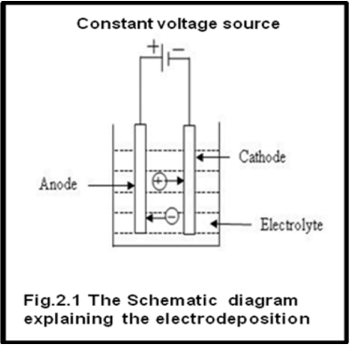

Mechanism of Electrodeposition
Electrodeposition is process of depositing atoms from solution on a conducting substrate by passing direct current through solution.
The schematic diagram explaining the electrodeposition is shown in figure.
The typical electrodeposition set up consists of following,
1. Electrolyte
2. Cathode and anode
3. Source of electricity

Slide 77
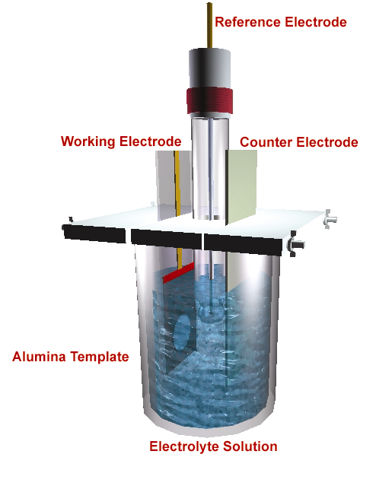
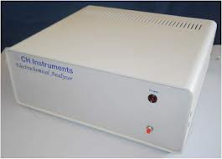
CHI Instrument along with Electrochemical Cell
1
2
Typical electrochemical set up used in electrochemical deposition which consists of
1. electrochemical cell consisting of electrolyte solution in which three electrodes viz. working electrode, reference electrode and counter electrode immersed in it
2. CHI 660 electrochemical workstation

Slide 78
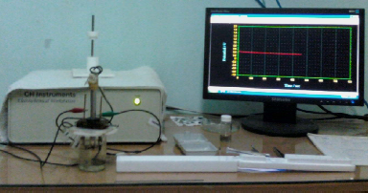

Slide 79
Electrochemical Synthesis ( Basic Route) -
CE RE WE
Current /voltage meter
I/V
Constant Current & voltage Source
3-electrode electrochemical cell

Slide 80
700
600
500
400
300
Chrono-Potentiogram
Potential mV (vs SCE)
-50 200 450 700 950 1200
Time (sec)
Reference
Electrode
(S C E)
Counter
Electrode
4 cm
Electrolyte solution
Working
Electrode

Slide 81
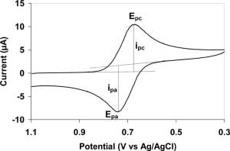
Electrochemical Deposition
Electrochemical synthesis technique is the one in which synthesis is carried out along with some electrochemical characterizations such as:
1. Cyclic Voltammerty: Cyclic voltammetry or CV is a type of potentiodynamic electrochemical measurement. In a cyclic voltammetry experiment the working electrode potential is ramped linearly versus time. When cyclic voltammetry reaches a set potential, the working electrode's potential ramp is inverted.
Typical cyclic voltammogram where i_{pc} and i_{pa} show the peak cathodic and
anodic current respectively for a reversible reaction.

Slide 82
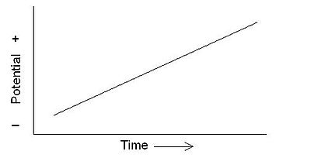
Electrochemical Deposition (Contd…)
2. Linear Sweep Voltammerty: Linear sweep voltammetry is a voltammetric method where the current at a working electrode is measured while the potential between the working electrode and a reference electrode is swept linearly in time. Oxidation or reduction of species is registered as a peak or trough in the current signal at the potential at which the species begins to be oxidized or reduced.
Linear sweep voltammetry graph

Slide 83
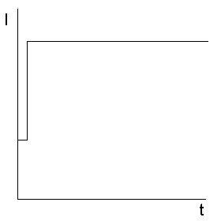
Electrochemical Deposition (Contd…)
3. Chronopotentiometry: It is an electrochemical technique in which a controlled current, usually a constant current, is caused to flow between two electrodes; the potential of one electrode is monitored as a function of time with respect to a suitable reference electrode.
Current excitation signal for a chronopotentiometry experiment.

Slide 84
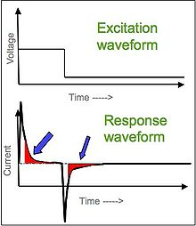
Electrochemical Deposition (Contd…)
4. Chronoamperometry: Chronoamperometry is an electrochemical technique in which the potential of the working electrode is stepped and the resulting current from faradic processes occurring at the electrode (caused by the potential step) is monitored as a function of time.
Double-pulsed chronoamperometry waveform showing integrated region for charge determination.

Slide 85
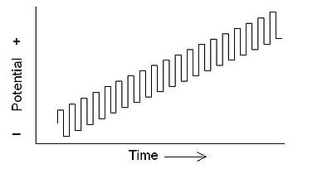
Electrochemical Deposition (Contd…)
5. Squarewave Voltammerty: In squarewave voltammetry, a squarewave is superimposed on the potential staircase sweep. Oxidation or reduction of species is registered as a peak or trough in the current signal at the potential at which the species begins to be oxidized or reduced.
Squarewave potential sweep

Slide 86
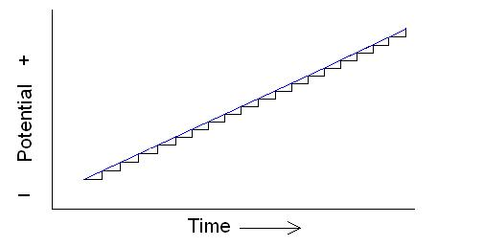
Electrochemical Deposition (Contd…)
6. Staircase voltammetry: In staircase voltammetry the potential sweep is a series of stair steps. The current is measured at the end of each potential change, right before the next, so that the contribution to the current signal from the capacitive charging current is reduced.
Staircase potential sweep set against a linear potential sweep

Slide 87
  Electrochemical Synthesis
  Electrochemical polymerization of conducting polymers generally carried out by:
    Constant current or galvanostatic method,
    Constant potential or potentiostatic method and
    Potential scanning/cycling or sweeping method.
  Potentiostatic deposition method
    A predetermined optimum voltage is applied during synthesis with no control over the resulting current in the system
    No control over the polymerization
  Galvanostatic deposition method
    A fixed oxidation current is supplied with no control over the resulting potential of the system.
    Galvanostatic method is more widely used because it provides more control over film thickness, and it is reproducible too.
    The galvanostatic method enables a more uniform polymer matrix.

Slide 88
Anodic Peak Potential
Plateau Peak Potential / Polymerization potential
The behavior of the galvanostatic synthesis during the first few seconds probably indicates the formation of dimers and oligomers.
After this, the potential becomes almost constant indicating that building up of the film proceeds according to the same reaction along the full thickness of the polymer.

Slide 89
Factors Governing Electrodeposition
Substrate:
It should have good conductivity because it is one of the electrodes in electrodeposition. A good conductivity is beneficial in improving carrier collection efficiency.
The thermal expansion coefficient should match with that of electrodeposition. A mismatch may cause cracking or peeling of the film.
It should have good mechanical strength.
It should be stable in electrolyte bath.
It should be smooth. Uneven, porous, voids and other irregularities influence the local current distribution.
Some other factors governing the electrodeposition are
Bath temperature, Current density and pH of the solution

Slide 90
Advantages of Electrodeposition
Structurally and compositionally modulated alloys and compounds can be deposited which are not possible with other deposition techniques.
In most of the cases the deposition can be carried out at room temperature enabling to form the semiconductor junctions without interdiffusion.
Deposition on complex shapes is possible.
Toxic gaseous precursors need not to be used (unlike gas phase methods).
The deposition process can be controlled more accurately and easily.

Slide 91
Chemical Vapour Deposition
(CVD)

Slide 92
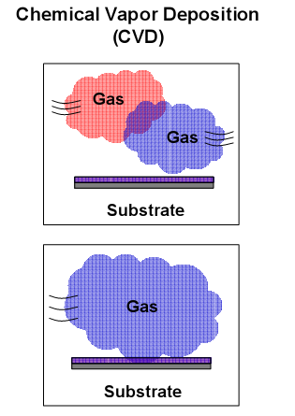
Chemical Vapour Deposition
It is the process where the epitaxial layer will be grown by chemical reaction between gaseous compounds .
It can be performed at atmospheric pressure (APCVD) or at low pressure (LPCVD)
Usually wafers are placed on susceptor which referred as crucibles in crystal growing furnaces

Slide 93
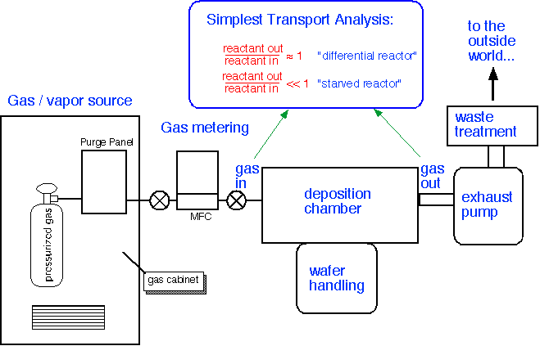
Chemical Vapour Deposition

Slide 94
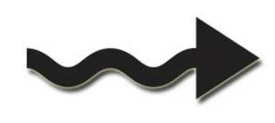
CVD Mechanism
Reactant
1
5
Stagnant
gas layer
Surface
diffusion
2
4
3
Substrate
1 = Diffusion of reactant to surface
2 = Absorption of reactant to surface
3 = Chemical reaction
4 = Desorption of gas by-products
5 = Outdiffusion of by-product gas

Slide 95
CVD sources and substrates
Types of sources
    Gasses (easiest)
    Volatile liquids
    Sublimable solids
    Combination
Source materials should be
    Stable at room temperature
    Sufficiently volatile
    High enough partial pressure to get good growth rates
    Reaction temperature < melting point of substrate
    Produce desired element on substrate with easily removable by-products
    Low toxicity

Slide 96
CVD sources and substrates
Substrates :
  Need to consider adsorption and surface reactions
  For example, WF₆ deposits on Si but not on SiO₂
Growth of films depends on :
  transport of gas to surface
  adsorption of gas on substrate
  reaction rates on substrate
  transport of products away from substrate

Slide 97
Types of CVD
CVD
APCVD
LPCVD
MOCVD
PECVD
ALCVD

Slide 98
APCVD
APCVD (Atmospheric Pressure CVD):
APCVD is a CVD method at normal pressure (atmospheric pressure) which is used for deposition of doped and undoped oxides.
The deposited oxide has a low density and the coverage is moderate due to a relatively low temperature. Because of improved tools, the APCVD undergoes a renaissance. The high wafer throughput is a big advantage of this process.
As process gases silane SiH₄ (highly diluted with nitrogen N₂) and oxygen O₂ are used. The gases are decomposed thermally at about 400 ⁰C and react with each other to form the desired film.
SiH₄ + O₂→SiO₂ + 2H₂ (T = 430 °C, p = 10⁵ °Pa)

Slide 99
APCVD
Added ozone O₃ can cause a better conformity because it improves the movability of the accumulated particles.
The oxide is porous and electrically instable and can be densified by a high temperature process.
To avoid edges which can result in difficulties at the deposition of additional layers, phosphorus silicate glass (PSG) is used for interlayers.
Therefore phosphine is added to SiH₄ and O₂, so that the deposited oxide contains 4 to 8 % phosphorus.
A high amount of phosphorus leads to a high increase of the flow properties, however, phosphoric acid can be formed which corrodes aluminum (conductor paths).
Because annealing affects earlier processes (e.g. doping) only short tempering is done with powerful argon lamps (several hundrets kW, less than 10s, T = 1100 °C) instead of annealing in longsome furnace processes.

Slide 100
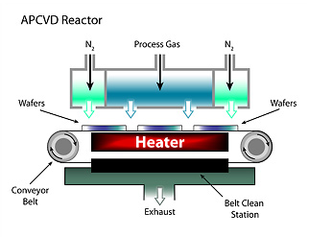
APCVD
Analog to PSG boron can be added simultaneously (boron phosphorus silicate glass, BPSG, 4 % B and 4 % P).
APCVD Reactor

Slide 101
LPCVD
LPCVD (Low Pressure CVD)
  LPCVD reactors use: P = 0.25 – 2.0 Torr, T = 500 – 900°C.
  Transport of reactants from gas phase to surface through boundary layer is still not rate limiting (despite the high T), so wafers can be stacked vertically for high throughput (100-200 wafers per run).
  Because LPCVD operates in reaction limited regime, it is VERY sensitive to temperature and so temperature needs to be controlled closely (within +/- 1 ⁰Cs ), so use of hot walled reactor for this precise control is advisable.

Slide 102
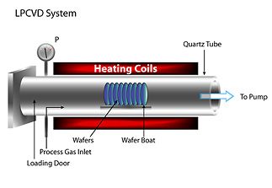
LPCVD
  Again, a 5-25^{O}C temperature gradient is often created to offset source gas depletion effects (or one can use distributed feeding).
  Requires no carrier gas, and low gas pressure reduces gas-phase reaction which causes particle cluster that contaminates the wafer and system.
  Less auto-doping (at lower P), as out-diffused dopant gas pumped away quickly.

Slide 103
LPCVD
Possible disadvantages:
  For too low temperature, deposition rates may be too low, film quality decreases.
  Shadowing (less gas-phase collisions) due to directional diffusion to the surface, so deterioration of the step coverage and filling

Slide 104
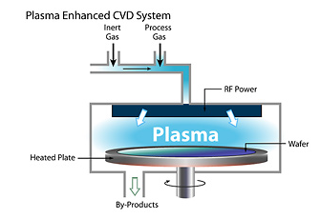
PECVD
PECVD (Plasma Enhanced CVD)
  Plasma helps to break up gas molecules: high reactivity, able to process at lower temperature and lower pressure (good for electronics on plastics).
  Pressure higher than in sputter deposition: more collision in gas phase, less ion bombardment on substrate
  Can run in RF plasma mode: avoid charge buildup for insulators
  Process temperature around 100 - 400°C.

Slide 105
MOCVD
  MOCVD (Metal-organic CVD, also called OMVPE - organo metallic VPE),
  Unlike conventional CVD, MOCVD is distinguished by the chemical nature of precursor.
  MOCVD has been extensively applied in the hetroepitaxial growth of III-V and II-VI compounds.
  TO grow GaAs, we can use metal organic compounds such as trimethylgallium [Ga(CH₃)₃] for the gallium component and arsine (AsH₃) component.
  Both the chemical can be transported in vapor form into the reactor.
  The overall reaction is
  AsH₃ + Ga (CH₃)₃ GaAs + 3CH₄

Slide 106
MOCVD
  For Al containing compounds such as AlAs, trimethylaluminium is used.
  During epitaxy, the GaAs is doped by introducing dopants in vapor form.
  Diethylzinc [Zn (C₂H₅)₂] and diethylcadmium [Cd (C₂H₅)₂] are typical p-type dopants and silane is an n-type dopant for III-V compounds.
  Since all these compounds are highly poisonous and often spontaneously inflammable in air, rigorous safety precautions are necessary in the MOCVD process.
  Typically metalorganic compound is transported to the quartz reactor by hydrogen carrier gas where it is mixed with AsH₃ in case of GaAs growth.

Slide 107
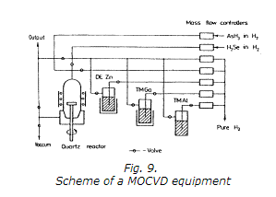
MOCVD

Slide 108
MOCVD
  The chemical reaction is induced by heating gases to 600ºC to 800ºC above a substrate placed on a graphite susceptor using RF heating.
  A pyrolytic reaction forms the GaAs layer.
  Advantages over CVD
  It is operated on low temperature.
  There are no troublesome for liquid Ga or In sources in the reator.

Slide 109
ALD
Atomic layer deposition (ALD) is a unique method for depositing thin films. It is also known as atomic layer epitaxy, atomic layer growth or atomic layer CVD.
Its most distinctive feature is that it has a self-limiting growth: each time only one molecular layer can grow. Therefore, ALD offers a very good method for depositing films having thickness in the nanometer range.
In a typical ALD process, the surface is first activated by chemical reaction. When the precursor is introduced in the deposition chamber, the molecules of the precursor react with the surface species and forms bonds with the substrate.
Since the precursor molecules do not react with each other, a film of only a single molecular thickness can be deposited.

Slide 110
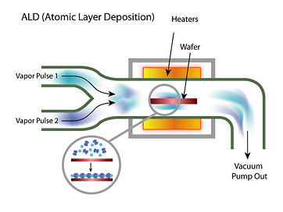
ALD
In the next step, the monolayer is activated again by surface reaction and a layer of the same or a different precursor is deposited on top of the layer of the previous precursor molecules. A few layers of the same or different precursors can be deposited by this procedure.

Slide 111
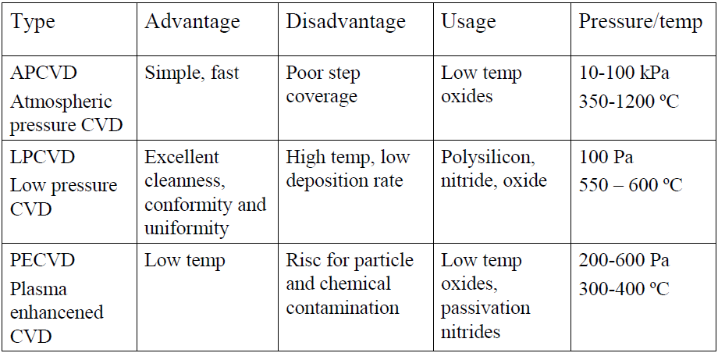
Comparison of CVD Types

Slide 112
CVD Advantages and Disadvantages
Advantages:
High growth rates possible, good reproducibility.
Can deposit materials which are hard to evaporate.
Can grow epitaxial films.
Generally better film quality, more conformal step coverage.
Uniform distribution over large areas.
Disadvantages:
High process temperatures.
Complex processes, toxic and corrosive gasses.
Film may not be pure (hydrogen incorporation).

Slide 113
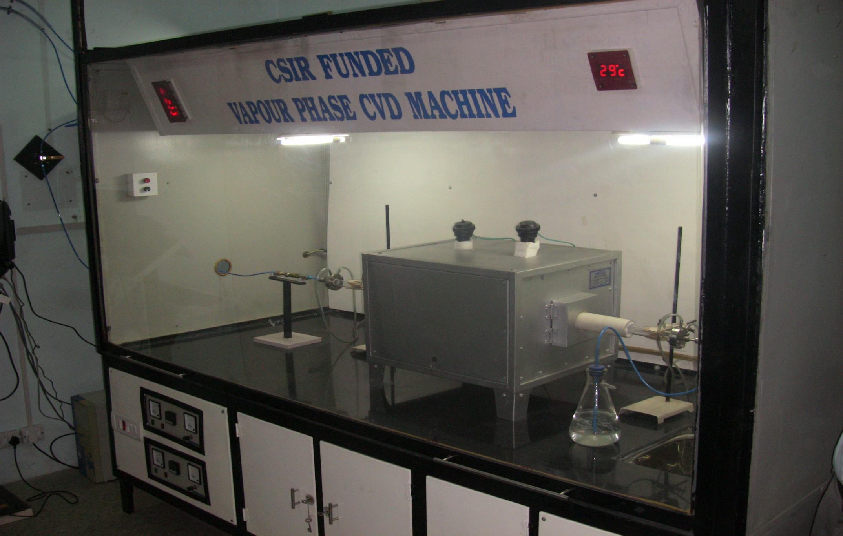
APCVD System Designed by our Group

Slide 114




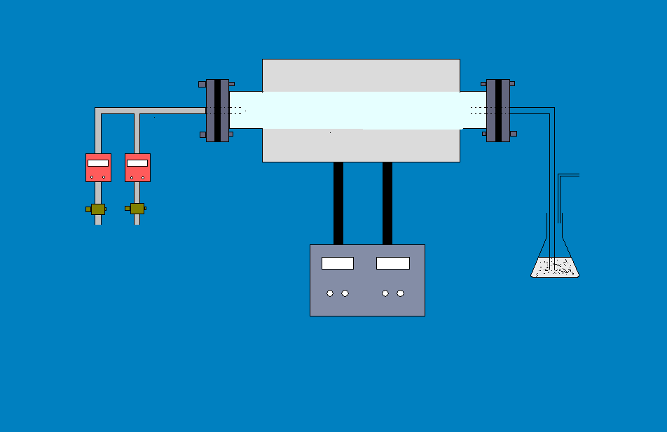
Temperature F1
Temperature F2
Furnace Enclave
Quartz Tube
MFC
Quartz Boat
Quartz Substrate
Ar
H₂
FURNACE 1
FURNACE 2
Paraffin Bubbler
Temperature Controller
Schematic of Vapor Phase CVD Machine for the synthesis of carbon nanotubes (CNTs)

Slide 115
Physical Vapour Deposition
(pVD)

Slide 116
Physical Vapour Deposition
The physical vapor deposition technique is based on the formation of vapor of the material to be deposited as a thin film.
The material in solid form is either heated until evaporation (thermal evaporation) or sputtered by ions (sputtering).
In the last case, ions are generated by a plasma discharge usually within an inert gas (argon). It is also possible to bombard the sample with an ion beam from an external ion source. This allows to vary the energy and intensity of ions reaching the target surface.

Slide 117
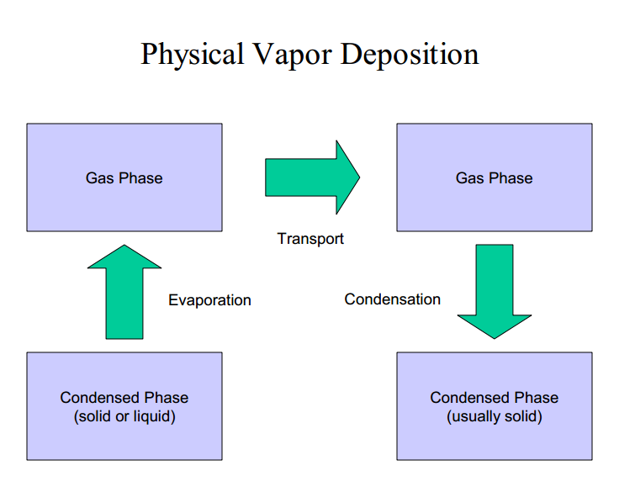
Physical Vapour Deposition

Slide 118
Working of PVD
PVD processes are carried out under vacuum conditions. The process involved four steps as shown in figure:
Evaporation
During this stage, a target, consisting of the material to be deposited is bombarded by a high energy source such as a beam of electrons or ions. This dislodges atoms from the surface of the target, ‘vaporising’ them
Transportation
This process simply consists of the movement of ‘vaporised’ atoms from the target to the substrate to be coated and will generally be a straight line affair.
Reaction
In some cases coatings will consist of metal oxides, nitrides, carbides and other such materials. In these cases, the target will consist of the metal. The atoms of metal will then react with the appropriate gas during the transport stage. For the above examples, the reactive gases may be oxygen, nitrogen and methane.
Deposition
This is the process of coating build up on the substrate surface.
Depending on the actual process, some reactions between target materials and the reactive gases may also take place at the substrate surface simultaneously with the deposition process

Slide 119
Advantages of PVD
PVD coatings are sometimes harder and more corrosion resistant than coatings applied by the electroplating process. Most coatings have high temperature and good impact strength, excellent abrasion resistance.
Ability to utilize virtually any type of inorganic and some organic coating materials on an equally diverse group of substrates and surfaces using a wide variety of finishes.
More environmentally friendly than traditional coating processes such as electroplating and painting.
More than one technique can be used to deposit a given film.

Slide 120
Disadvantages of PVD
Specific technologies can impose constraints; for example, line-of-sight transfer makes coating annular shapes practically impossible.
Some PVD technologies typically operate at very high temperatures and vacuums, requiring special attention by operating personnel.
Requires a cooling water system to dissipate large heat loads.

Slide 121
Evaporation

Slide 122
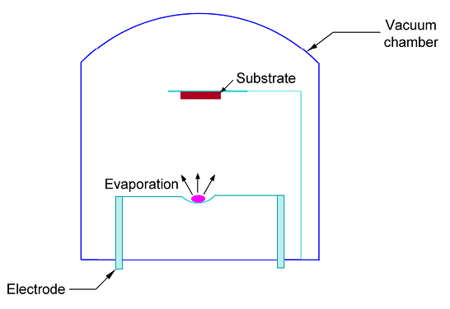
Evaporation
Evaporation is the simplest physical deposition method for preparation of thin films. The evaporation system consists of an evaporation source that vaporizes the desired material and the substrate. Both the source and the substrate are placed in the vacuum chamber. The substrate faces the evaporation source. The set-up is schematically in fig.
A typical evaporation system depicting the source, substrate and
the vacuum chamber

Slide 123

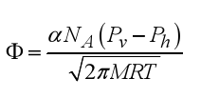
Evaporation
The substrate can be placed and heated as desired. The necessary vapor pressure of the source material can be generated by simply heating the source as per the requirements of the concentration of the growth species in the gas phase. The vapour pressure of an element can be estimated from the equilibrium vapor pressure (Pv) Clausius–Clapeyron equation.
where ∆H is the molar heat of evaporation, R is the gas constant, T is temperature and C is a constant. The rate of evaporation is given by,

Slide 124
Evaporation
where α is the coefficient of evaporation, N _{A} is Avogadro’s number, P_{h} is the hydrostatic pressure acting on the source,
P_{v} is vapor pressure, M is the molecular weight, R is gas constant and T is temperature.
        Precautions need to be taken for pyrolysis, decomposition and dissociation of the compound being heated.
        Deposition of thin films by evaporation is carried out at very low pressures (1 X10⁻⁸ – 0.1 Pa).
        The molecules in the vapor phase do not collide with each other prior to the arrival at the growth surface because the mean free path is very large as compared to the distance between the source and the substrate.

Slide 125
Evaporation
        The transport of molecules from the source to the growth substrate is straight-forward along the line of sight. Therefore, the conformal coverage is relatively poor and it is difficult to obtain a uniform film over a large area. films.
        To overcome this difficulty, multiple sources are used and the substrate is rotated.
        Laser beams have been used to evaporate the material. Pulsed laser beams are used where high power density is required. This process is known as laser ablation.
        The composition of the vapor can be controlled precisely using this technique. Laser ablation has been used for depositing metal oxides in superconductor films.

Slide 126
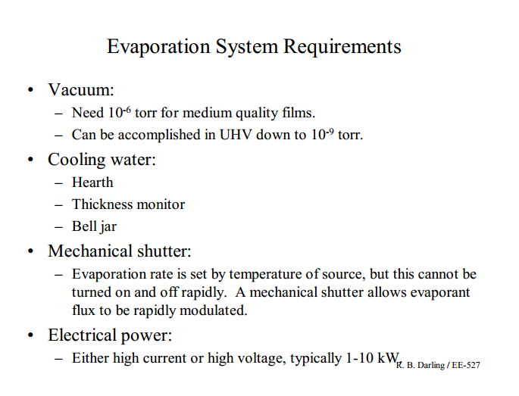

Evaporation

Slide 127
Evaporation
Evaporation
Thermal
E-beam

Slide 128
Thermal Evaporation
Simple, robust, and in widespread use.
Can only achieve temperatures of about 1800°C.
Use W ( Tnungsten) , Ta ( Tantalum), or Mo ( Molybdenum) filaments to heat evaporation source.
Typical filament currents are 200-300 Amperes.
Exposes substrates to visible and IR radiation.
Typical deposition rates are 1-20 Angstroms/second.
Common evaporant materials:
  Au, Ag, Al, Sn, Cr, Sb, Ge, In, Mg, Ga
  CdS, PbS, CdSe, NaCl, KCl, AgCl, MgF₂, CaF₂, PbCl₂

Slide 129
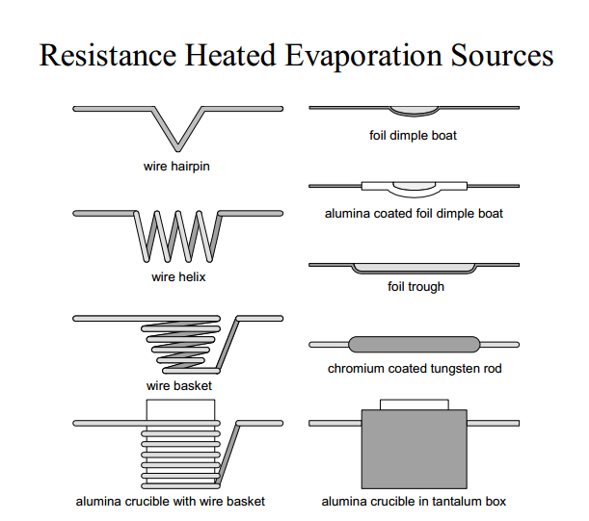
Thermal Evaporation

Slide 130
E-beam Evaporation
More complex, but extremely versatile.
Can achieve temperatures in excess of 3000°C.
Use evaporation cones or crucibles in a copper hearth.
Typical emission voltage is 8-10 kV.
Exposes substrates to secondary electron radiation.
  X-rays can also be generated by high voltage electron beam.
Typical deposition rates are 10-100 Angstroms/second.
Common evaporant materials:
  Everything a resistance heated evaporator will accommodate, plus:
  Ni, Pt, Ir, Rh, Ti, V, Zr, W, Ta, Mo
  Al₂O₃, SiO, SiO₂, SnO2, TiO₂, ZrO₂

Slide 131

E-beam Evaporation

Slide 132
E-beam Evaporation
270° bent beam electron gun is most preferred:
  Filament is out of direct exposure from evaporant flux.
  Magnetic field can be used for beam focusing.
  Magnetic field can be used for beam positioning.
  Additional lateral magnetic field can be used produce X-Y sweep.
Sweeping or rastering of the evaporant source is useful to:
  Allow a larger evaporant surface area for higher deposition rates.
  Allow initial charge to be “soaked” or preheated.
  Allow evaporant source to be more fully utilized.

Slide 133
E-beam Evaporation
Multiple pocket rotary hearth is also preferred:
  Allows sequential deposition of layers with a single pump-down.
  Allows larger evaporation sources to be used.

Slide 134

HHV Make BC-300 Thermal & E-beam Evaporation System procured by our research group

Slide 135
Sputtering

Slide 136
Sputtering
When a solid surface is bombarded with energetic particles the surface is eroded and surface atoms are removed due to collisions between surface atoms and energetic particles. This phenomenon is named as ‘sputtering’.
Sputtering was first discovered more than 130 years ago by Grove.
Now days, sputtering is being widely used to thin film deposition as well as to surface cleaning and etching.

Slide 137
The Mechanisms of Sputtering
Interactions of ions with surfaces
When the surface of solid i.e. target is bombarded with ions, several interactions of ions with the surface are expected:
The incident ions are reflected
The impact of the ion causes the target to eject an secondary electron.
The ions are buried in the target (this phenomenon is called as ion implantation)
The ion impact causes some rearrangements in target materials
The ion impact sets up a series of collision between atoms of the target possibly leading to the ejection of one of these atoms. This is the phenomenon of sputtering.

Slide 138


The Mechanisms of Sputtering

Slide 139
The Mechanisms of Sputtering
Sputtering refers to a process in which atoms are dislodged from the surface of a solid due to momentum exchange associated with collisions involving high energy ions.
This process is widely being used for the deposition of variety of thin films, that finds applications in semiconductor technology.

Slide 140
Sputtering Deposition Process
In fig A a source and substrate contained in a partially evacuated chamber (pressure = a few 100 m torr) containing argon atoms.
If the source is at negative potential with respect to the substrate, a plasma consisting of positively charged argon ions and electrons may be created between the source and substrate (Fig B).
The positively charged argon ions will move toward the source, as a results source surface will dislodge atoms.
The atoms will carry to the substrate because of transferred momentum, as a result thin film is form on the substrate (Fig C)

Slide 141
Sputtering Deposition Process
Substrate
(Anode)
Substrate
+
Argon atoms
Argon atoms
Electrons
Argon ions
+
+
Source
Source
(Cathode)
A
B
Substrate
+
+
+
+
Source Atom
+
Source
C
Motion of the source atoms dislodged by sputtering is control
so that it can reach to the substrates

Slide 142
Sputter Yield
  Sputtering process is characterized by sputter yield (S)
S values are typically in the range of 0.01 and 4 and increase with the mass of metals and energy of the sputtering gas.

Slide 143

Sputter Yield (Contd…)
The sputter yield depends on:
the energy of the incident ions;
(b) the masses of the ions and target atoms;
(c) the binding energy of atoms in the solid and
(d) the incident angle of ions.

Slide 144

Sputtering Alloy Targets
composition of alloy in film is approximately the same as alloy in target (unlike evaporation)
slow diffusion mixing in solids (sputtering)
target reaches steady state
surface composition balances sputter yield

Slide 145
Advantages of Sputter Deposition
Elements, alloys and compounds can be sputtered and deposited.
The sputtering target provides a stable, long-lived vaporization source.
In some configurations, reactive deposition can be easily accomplished using reactive gaseous species that are activated in plasma.
The source and substrate can be spaced close together.
The sputter deposition chamber can have a small volume.

Slide 146
Disadvantages of Sputter Deposition
Sputtering rates are low compared to those that can be attained in thermal evaporation.
Sputtering targets are often expensive and material use may be poor.
Most of the energy incident on the target becomes heat, which must be removed.
In reactive sputter deposition, the gas composition must be carefully controlled to prevent poisoning the sputtering target.

Slide 147
Basic Techniques
Sputtering
DC (diode) sputtering
RF (radio frequency) sputtering
Magnetron sputtering
Reactive sputtering

Slide 148

DC Sputtering

Slide 149

DC Sputtering

Slide 150

DC Sputtering

Slide 151
Parameters for DC Sputtering
Sputter voltage
  typically -2 to -5 kV
Substrate Bias Voltage
  substrate is being bombarded by electrons and ions from target and plasma
  sputtering film while you deposit
  neutral atoms deposit independently
  put negative bias on the substrate to control this
  can significantly change film properties
Deposition rate
  changes with Ar pressure
  increases with sputter yield
  usually increases with high voltage

Slide 152

RF Sputtering

Slide 153

RF Sputtering

Slide 154
Advantages of RF Sputtering
It works well with insulating targets
High efficiency
  easier to keep plasma going → can operate at lower Ar pressures (1-15 mTorr) → fewer gas collisions → more line of sight deposition

Slide 155
Magnetron Sputter Deposition
Use with DC or RF
High sputtering efficiency
  increase ionization of Ar
  Why? Higher sputter rates at lower Ar pressure (down to 0.5 mTorr)
  fewer gas collisions - more line of sight
  How ? increase probability of electrons striking Ar
      increase electron path length
      use electric and magnetic fields

Slide 156

Magnetron Sputtering Principle
This technology uses powerful magnets to confine the “glow discharge” plasma to the region closest to the target plate. That vastly improves the deposition rate by maintaining a higher density of ions, which makes the electron/gas molecule collision process much more efficient.

Slide 157
Advantages of Magnetron Sputtering
High deposition rate
Reducing electron bombardment of substrate
Extending the operating vacuum range
  ability to operate at lower pressures
The most widely commercially practiced sputtering method

Slide 158
Parameters for Magnetron Sputtering
Deposition pressure : 10⁻³ to 0.1 Pa ( 10⁻⁵ to 10⁻³ torr)
Deposition rate : 0.2 ~ 2-6 micro meter /min (10 times higher than conventional sputtering)
Deposition temperature : 100 to 150ºC

Slide 159

Disadvantages of Magnetron Sputtering
An erosion track in the target
  This leads to poor efficiency of sputtering yield versus target volume compared to non-magnetron sputtering
Non uniform removal of particles from target result in non uniform films on substrate

Slide 160
Reactive Sputtering
Sputtering metallic target in the presence of a reactive gas mixed with inert gas (Ar)
• A mixture of inert +reactive gases used for sputtering
oxides – Al₂O₃, SiO₂, Ta₂O₅ (O₂)
nitrides – TaN, TiN, Si₃N₄ (N₂, NH₃)
carbides – TiC, WC, SiC (CH₄, C₂H₄, C₃H₈)

Slide 161

HHV 18MSPT Sputter Coater

Slide 162

Comparison

Slide 163

Deposition Technology Comparison of Typical Thin Film

Slide 164
Molecular Beam epitaxy
(MBE)

Slide 165
MBE ( Molecular Beam Epitaxy)
MBE is an epitaxial process involving the reaction of one or more thermal beams of atoms or molecules with a crystalline surface under ultra-high vacuum conditions.
Features of MBE:
  A low growth rate (between 0.1 and 0.3 mm/sec for GaAs)
  Low growth temp (< 630ºC for GaAs)
  The provision of abrupt cessation or initiation of growth that enables us to grow heterostructure.
  Ability to smooth growth surfaces.
  The potential for in situ monitoring of the growth and chemical analysis.

Slide 166
MBE
MBE can achieve precise control of both chemical composition and doping profile.
Simple crystal, multilayer structure with dimensions of the order of atomic layer can be grown using MBE.
Thus MBE method enables the precise fabrication of semiconductor heterostructures with a thin layer.
MBE growth rate is very small (1 μm/hr for GaAs)

Slide 167

Schematic of Typical MBE System

Slide 168
MBE
MBE system shown here is for deposition of GaAs and related III-V compounds such as AlGaAs.
This system is identified for film deposition control, cleanliness and in situ chemical characterization capability.
Separate effusion oven made up of pyrolytic boron nitride are used for Ga, As and dopant.
All effusion ovens are housed in ultrahigh vacuum chamber.
Temperature of the ovens is adjusted to give desired evaporation rate.
Substrate holder is rotated continuously to achieve uniform epitaxial layer.
To grow GaAs, over pressure of As has to be maintained.
One or more effusion ovens are used for the dopants.

Slide 169
MBE
Effusions ovens behave like small area sources and exhibit a cosθ is the angle between the direction of the source and the normal to the substrate surface.
MBE uses an evaporation method in vacuum system.
An important parameter for vacuum technology is the molecular impingement rate.
That is how many molecules impinge on a unit area of the substrate per unit time.
The impingement rate (φ) is a function of the molecular weight, temperature and pressure

Slide 170

SVTA Linear MBE Configuration

Slide 171
= p (2πmkT)^{-1/2}
Where p is the pressure, m is the mass of the molecule, k is the Boltzmann's constant , T is the temperature
Or
φ = 2.64 X 10²⁰ (p/ √mT) molecules/cm² /S
Where m is the molecular weight

Slide 172
Crystal Growth Techniques
Liquid Growth
Solution Growth
High Temperature solution Growth
Low Temperature solution Growth
Melt growth
Vapour Growth
Solid Growth

Slide 173
Solid Growth

Slide 174
The single crystals are grown by solid to solid phase transition.
The solid state growth requires atomic diffusion in the given material.
This method of crystal growth is limited only for those materials which are stable at the high temperature where appreciable diffusion can occur.
The metal crystals are particularly grown by this method.

Slide 175
Melt Technique
1.Bridgman Technique
  2.Czochralski-Kyropoulos Technique
  4.Zone melting Technique
  5.Verneuil Technique

Slide 176


Bridgman Technique
temperature
T_{melt}
characteristics:
charge and seed are placed into the crucible
no material is added or removed (conservative process)
axial temperature gradient along the crucible
Notes:
Slide 12/28:

Slide 177
BRIDGMAN AND STOCKBARGER METHODS
Controlled Crystallization of a Stoichiometric Melt
T
Temperature gradient
STOCKBARGER fixed temperature gradient - moving crystal
T_{m}
Crystallization of melt on seed as crucible gradually displaced through temperature gradient from hotter to cooler end
melt
crystal
Distance
T
BRIDGEMAN changing temperature gradient - static crystal
T1
T_{m}
T2
T3
Furnace gradually cooled and crystallization begins on seed at cooler end of crucible
Distance

Slide 178
BRIDGMAN AND STOCKBARGER METHODS
These methods based on the solidification of a stoichiometric melt but crystallization is controlled by passing the melt through temperature gradient such that crystallization occurs at the cooler end.
Stockbarger method is based on the relative displacement of melt and a temperature gradient.
In the Bridgman method, melt is inside the temperature gradient furnace and the furnace is gradually cooled so that solidification begins at the cooler end.
In both methods, it is again advantageous to use a seed crystal and atmospheric control may be necessary.

Slide 179
Advantages
The shape of the crystal is defined by the container.
No radial temperature gradients are needed to control the crystal shape.
Low thermal stresses result in low level of stress-induced dislocations.
Crystals may be grown in sealed ampules (easy control of stoichiometry).
Relatively low level of natural convection.
Easy control and maintenance .

Slide 180


Verneuil Flame Fusion Method
1902, Auguste Verneuil
vibration
growth
characteristics:
no crucible contamination
highly pure starting material (>99.9995%)
strict control of flame temperature
precise positioning of melted region
Notes:
Slide 11/28:

Slide 181
VERNEUIL FUSION FLAME METHOD
O₂ + powdered precursor(s)
O₂ + H₂
Fusion flame
Liquid drops of molten precursor(s)
Growing crystal
Support for growing crystal

Slide 182
VERNEUIL FUSION FLAME METHOD
1904 first recorded use of the method, useful for growing crystals of extremely high melting and refractory metal oxides.
Starting material fine powder form, passed through O₂/H₂ flame or plasma torch
Melting of the powder occurs in the flame, molten microdroplets fall onto the surface of a seed or growing crystal, leads to controlled crystal growth

Slide 183
Czochralski-Kyropoulos Technique
Czochralski
seed
1918
grown crystal
Characteristics
Charge and seed are separated at start. No material is added or removed (conservative process)
Charge is held at temperature slightly above melting point
molten raw material
heating elements
Kyropoulos
seed
1926
grown crystal
molten raw material
Notes:
Slide 15/28:

Slide 184
Crystal seed
Pulling direction of seed on rod
Inert atmosphere under pressure prevents material loss and unwanted reactions
Layer of molten oxide like B₂O₃ prevents preferential volatilization of one component - precise stoichiometry control
Growing crystal
Heater
Melt just above mp
High viscosity low vapor pressure
CZOCHRALSKI
Counterclockwise rotation of melt and crystal being pulled from melt, helps maintain uniform T, composition and homogeneity of crystal growth
Crucible

Slide 185
Interesting crystal pulling technique.
Single crystal growth from the melt precursor(s)
Crystal seed of material to be grown placed in contact with surface of melt
Temperature of melt held just above melting point, highest viscosity, lowest vapor pressure favors crystal growth
Seed gradually pulled out of the melt (not with your hands of course, special crystal pulling equipment is used)

Slide 186
Advantages
Growth from free surface (stress free).
Crystal can be observed during the growth
process.
Forced convection easy to impose.
Large crystals can be obtained.
High crystalline perfection can be achieved.
Good radial homogeneity

Slide 187


Zone Melting
ultra-pure silicon
characteristics:
Only a small part of the charge is molten.
Material is added to molten region (nonconservative process).
Molten zone is advanced by moving the charge or the gradient.
Axial temperature gradient is imposed along the crucible.
Notes:
Slide 17/28:

Slide 188
ZONE MELTING CRYSTAL GROWTH AND PURIFICATION OF SOLIDS
T
Temperature profile furnce
T_{m}
Pulling direction
Distance
Crystal or powder
Crystal growing from seed
Localized melt region - impurities concentrated in melt – energetic benefit

Slide 189
ZONE MELTING CRYSTAL GROWTH AND PURIFICATION OF SOLIDS
Method related to the Stockbarger technique - thermal profile furnace employed - material contained in a boat
Only a small region of the charge is melted at any one time - initially part of the melt is in contact with the seed
Boat containing sample pulled at a controlled velocity through the thermal profile furnace
Zone of material melted, hence the name of the method - oriented solidification of crystal occurs on the seed - simultaneously more of the charge melts

Slide 190
Advantages
Charge is purified by repeated passage of the zone (zone refining).
Crystals may be grown in sealed ampules or without containers (floating zone).
Steady-state growth possible.
Zone leveling is possible; can lead to superior axial
homogeneity.
Process requires little attention (maintenance).
Simple: no need to control the shape of the crystal.
Radial temperature gradients are high.

Slide 191

HYDROTHERMAL AUTOCLAVE
Growth region
Crystal seeds
Separating baffle
Dissolving region
Source nutrient

Slide 192
HYDROTHERMAL SYNTHESIS AND GROWTH OF SINGLE CRYSTALS
Basic methodology, water medium and high temperature growth, above normal boiling point.
Water functions as solublizing phase, pressure transmitting agent, often mineralizing agent added to enhance dissolution, transport of reactants and crystal growth, speeds up chemical reactions between solids.
Useful technique for the synthesis and crystal growth of phases that are unstable in a high temperature preparation in the absence of water.

Slide 193
HYDROTHERMAL SYNTHESIS AND GROWTH OF SINGLE CRYSTALS
Temperature gradient reactor - dissolution of reactants at one end - with help of mineralizer transport to seed at the other end - crystallization at seeded end
Because some materials have negative solubility coefficients, nutrients dissolve at cooler end and crystals grow at the hotter end in a temperature gradient hydrothermal reactor.
Good example is a-AlPO₄ known as Berlinite, isoelectronic and isostructural with Quartz, important for its high piezoelectric coefficient - application of pressure to a crystal of Quartz or Berlinite creates a distortion of structure, electrical polarization of the lattice and associated voltage.

Slide 194
Growth From Solution
The mechanism of crystallizations from solution is governed mainly by the interaction of the ions or molecules of the solute and solvents.
There are two methods in solution growth depending upon the solvents and solubility of solute
1) High Temperature Solution Growth
a) Flux thermal Growth
b) Hydro thermal Growth
2) Low Temperature Solution Growth
Low temperature solution growth is a well-established technique due to its versatility and simplicity. It is possible to grow the large crystal of high perfection as the growth occurs close to equilibrium condition

Slide 195
Solubility
The homogeneous medium of solute and solvent is called as Solution.
The total size of the grown crystal depends on the solubility of the material in the given solvent.
The solubility coefficient dictates the growth procedure.
For solvent selection following properties are taken into consideration
High solubility for given solute
Low viscosity
Low volatility
Less corrosion and non-toxicity
Low cost
The size of grown crystal depends on the solubility of material in given solvent

Slide 196
Steps in the Crystal Growth
The crystal is grown in three different steps
Achievement of super saturation or super cooling
Nucleation
Growth of crystal
All above steps may occur simultaneously at different regions of the crystallization unit.

Slide 197
Schematic diagram of Solution growth apparatus

Slide 198


Slide 199
Low Temperature Advantages
This technique is inexpensive.
Low temperature ensures minimum thermal stress on the grown crystal.
It is suitable for the growth of substances that undergo decomposition before melting.

Slide 200

Vapour Diffusion
dissolve solute in solvent (purple)
precipitating solvent (blue)
blue should be more volatile than purple
Don't let sides of small vessel touch vertical surface of outer vessel (prevent capillary action)

Slide 201


Crystals grown by our group
Glycine doped BTCC
L-Alanine doped ZTC

Slide 202


Glycine doped ZTC
Glycine doped KDP

Slide 203
Glycine doped ADP

Slide 204


Bis Glycine Hydrogen Bromide
ZTS Crystal

Slide 205
Laser Ablation Technique
In 1995, Smalley at Rice University reported the synthesis of carbon nanotubes by lasers group vaporisation.
The laser vaporisation apparatus used by Smalley's group is shown next slide.
A pulsed, or continuous laser is used to vaporise a graphite target in an oven at 1200 °C.
The main difference between continuous and pulsed laser, is that the pulsed laser demands a much higher light intensity (100 kW/cm² compared with 12 kW/cm²).
The oven is filled with helium or argon gas in order to keep the pressure at 500 Torr.
A very hot vapour cloud forms, then expands and cools rapidly.
As the vaporised species cool, small carbon molecules and atoms quickly condense to form larger clusters, possibly including fullerenes.
The catalysts also begin to condense, but more slowly at first, and attach to carbon clusters and prevent their closing into cage structures.

Slide 206
Catalysts may even open cage structures when they attach to them.
From these initial clusters, tubular molecules grow into single-wall carbon nanotubes until the catalyst particles become too large, or until conditions have cooled sufficiently that carbon no longer can diffuse through or over the surface of the catalyst particles.
It is also possible that the particles become that much coated with a carbon layer that they cannot absorb more and the nanotube stops growing.
The SWNTs formed in this case are bundled together by van der Waals forces.

Slide 207


Slide 208
SWNT versus MWNT
The condensates obtained by laser ablation are contaminated with carbon nanotubes and carbon nanoparticles.
In the case of pure graphite electrodes, MWNTs would be synthesised, but uniform SWNTs could be synthesised if a mixture of graphite with Co, Ni, Fe or Y was used instead of pure graphite.
SWNTs synthesised ( shown on next slide)
Laser vaporisation results ropes' in a higher yield for SWNT synthesis and the nanotubes have better properties and a narrower size distribution than SWNTs produced by arc-discharge.
Nanotubes produced by laser ablation are purer (up to about 90 % purity) than those produced in the arc discharge process. The Ni/Y mixture catalyst (Ni/Y is 4.2/1) gave the best yield.

Slide 209

The size of the SWNTs ranges from 1-2 nm, for example the Ni/Co catalyst with a pulsed laser at 1470 °C gives SWNTs with a diameter of 1.3-1.4 nm.
In case of a continuous laser at 1200 °C and Ni catalyst , SWNTs with an average diameter of 1.4 nm were formed with 20­ to 30 % yield

Slide 210
SCREEN PRINTING

Slide 211
Introduction
Screen-printing is a form of stencil printing using a design cut out of a special screen film, attached to a sheet of special fabric that has been tightly stretched across a frame.
Ink is then forced through the open meshes of the fabric by means of a rubber blade called a squeegee.
The printing of stationary, T-shirts, and bumper stickers are a few of the opportunities for students to use the process of screen-printing.

Slide 212

What is Screen Printing?
Screen printing is essentially forcing ink to flow through openings of a block-out material and depositing the ink on the printing surface according to the cut design as shown below:

Slide 213
History
The screen-printing process is a recognized and accepted method of printing, and can be easily and quickly mastered.
This principle of printing dates back to ancient times when the Chinese, Egyptians and Japanese pounded colored pigments through stencils woven from human hair onto a variety of objects.

Slide 214
Tools and Materials
Frame - Made from wood or metal. Has grooves
Screen - Fabric made up of fine, evenly spaced strands
Adhering Solution - Solution used to “stick” film to the screen
Squeegee - Instrument used to “push” ink through screen
Alignment tab - Keeps paper in the same place

Slide 215
Tools and Materials
Film - Two parts: emulsion with plastic backing
Block out - Commonly newsprint held on w/ masking tape
Cutting Board - Poster board on which you cut film
Screen Printing Base - Plywood with 2 thumb-screw clamps
Build-up - Pad of used newspaper

Slide 216
Preparing the Film
Print a copy of the artwork you are going to use.
Cut the film to cover the artwork completely. Make sure you leave at least 1” margin on each side of the artwork.
Tape the artwork to a cutting board.
Position the film (emulsion side up) centered on top of the artwork and tape it down on the cutting board.
Cut and remove the emulsion from the areas to be printed using an “Exacto” knife. Be certain not to cut through or into the plastic backing.

Slide 217
Adhering the Film to the Screen
Place the cut film (emulsion side up) onto a build-up of newsprint, which is smaller than the inside area of the frame.
Place the screen over the build up and dab adhering solution over the film until it changes color. Weight the frame and let sit for 15 minutes. Remove weight and set frame to dry.
Cut a piece of newsprint to fit inside of the screen frame.
Holding the frame to the light, mark the position of the film with a pencil.
Cut a window from the newsprint a little larger than the film with scissors.
Adhere the newsprint to the screen by overlapping the edges of the window with masking tape.

Slide 218
Printing
Attach the screen frame to the base unit using the thumbscrew hinges.
Place the printing medium under the screen. Position it according to the image on the screen. You can even make minor alignment adjustment by shifting the frame in the thumbscrew hinges.
Carefully raise the screen, leaving the printing medium in the correct location on the base.
Place three alignment tabs on the opposite edges of your art work and fasten them to the baseboard with masking tape. (If you are printing on paper, place two guides on the long side of the sheet, and one guide on the short side of the sheet).
Place a sheet to be printed against the guides, and lower the screen frame.

Slide 219
Printing
Pour a bead of ink the width of the image on one side of the screen.
With firm pressure on the squeegee, pull the ink across the image, holding the squeegee at a 60-degree angle. Make only one pull per print.
Lift the squeegee and replace the excess of ink on the other side of the screen. Lift the screen and remove the print.
Repeat steps 5, 7, and 8 for additional copies, adding ink as necessary.
Place the prints on a piece of large poster board and overlap the print to conserve space.

Slide 220
Cleaning Ink from the Screen
Remove the excess of ink from the screen and squeegee, and replace it in the can.
Remove the sheet of block out (newsprint) covering the screen and fold it onto itself. Place into the trash can.
Remove the frame from the printing base by loosening the thumbscrews.
Wash the screen off with hot water and a brush to remove all traces of ink.
Wash the squeegee with hot water and a brush to remove all traces of ink.
Store the frame until the water has dried and return squeegee to storage.\
Clean up the work area.

Slide 221
Removing Film From the Screen
Wet the film on both sides with a brush soaked in lacquer thinner
Cover the film with newsprint on both sides and wet the newsprint with a brush soaked in lacquer thinner. Let this soak for five minutes.
Remove the newsprint and discard. Scrub the film area with a brush soaked in lacquer thinner until all traces of the film are no longer visible.
Wash the screen with Ullano one step cleaner. Rinse the screen thoroughly and set to dry.
Clean up the work area.

Slide 222

Samples

Slide 223


Samples

Slide 224


Samples

Slide 225

Any Questions / Queries ?

Slide 226

For Your Kind Attention !

