Slide 1
Chapter 6: Program Control Instructions
Chapter 3
Program Control Instructions
Dr. Mahendra D. Shirsat
Professor,
Department of Physics,
Dr. Babasaheb Ambedkar Marathwada University,
Aurangabad (MS)

Slide 2
Introduction
This chapter explains the program control instructions, including the jumps, calls, returns, interrupts, and machine control instructions.
This chapter also presents the relational assembly language statements (.IF, .ELSE, .ELSEIF, .ENDIF, .WHILE, .ENDW, .REPEAT, and .UNTIL) that are available in version 6.xx and above of MASM or TASM, with version 5.xx set for MASM compatibility.

Slide 3
Chapter Objectives
Upon completion of this chapter, you will be able to:
Use both conditional and unconditional jump instructions to control the flow of a program.
Use the relational assembly language statements .IF, .REPEAT, .WHILE, and so forth in programs.
Use the call and return instructions to include procedures in the program structure.

Slide 4
Chapter Objectives
(cont.)
Upon completion of this chapter, you will be able to:
Explain the operation of the interrupts and interrupt control instructions.
Use machine control instructions to modify the flag bits.
Use ENTER and LEAVE to enter and leave programming structures.

Slide 5
6–1 THE JUMP GROUP
Allows programmer to skip program sections and branch to any part of memory for the next instruction.
A conditional jump instruction allows decisions based upon numerical tests.
results are held in the flag bits, then tested by conditional jump instructions
LOOP and conditional LOOP are also forms of the jump instruction.

Slide 6
Unconditional Jump (JMP)
Three types: short jump, near jump, far jump.
Short jump is a 2-byte instruction that allows jumps or branches to memory locations within +127 and –128 bytes.
from the address following the jump
3-byte near jump allows a branch or jump within ±32K bytes from the instruction in the current code segment.

Slide 7
5-byte far jump allows a jump to any memory location within the real memory system.
The short and near jumps are often called intrasegment jumps.
Far jumps are called intersegment jumps.

Slide 8
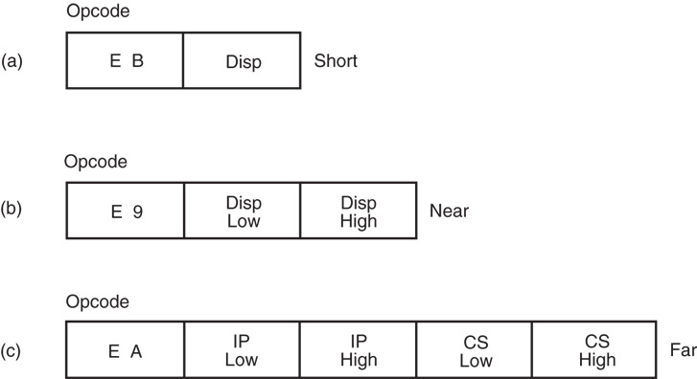
Figure 6–1 The three main forms of the JMP instruction. Note that Disp is either an 8- or 16-bit signed displacement or distance.

Slide 9
Short Jump
Called relative jumps because they can be moved, with related software, to any location in the current code segment without a change.
jump address is not stored with the opcode
a distance, or displacement, follows the opcode
The short jump displacement is a distance represented by a 1-byte signed number whose value ranges between +127 and –128.
Short jump instruction appears in Figure 6–2.

Slide 10
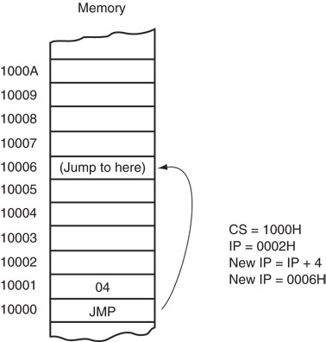
Figure 6–2 A short jump to four memory locations beyond the address of the next instruction.
when the microprocessor executes a short jump, the displacement is sign-extended and added to the instruction pointer (IP/EIP) to generate the jump address within the current code segment
The instruction branches to this new address for the next instruction in the program

Slide 11
When a jump references an address, a label normally identifies the address.
The JMP NEXT instruction is an example.
it jumps to label NEXT for the next instruction
very rare to use an actual hexadecimal address with any jump instruction
The label NEXT must be followed by a colon (NEXT:) to allow an instruction to reference it
if a colon does not follow, you cannot jump to it
The only time a colon is used is when the label is used with a jump or call instruction.

Slide 12
Near Jump
A near jump passes control to an instruction in the current code segment located within ±32K bytes from the near jump instruction.
distance is ±2G in 80386 and above when operated in protected mode
Near jump is a 3-byte instruction with opcode followed by a signed 16-bit displacement.
80386 - Pentium 4 displacement is 32 bits and the near jump is 5 bytes long

Slide 13
Signed displacement adds to the instruction pointer (IP) to generate the jump address.
because signed displacement is ±32K, a near jump can jump to any memory location within the current real mode code segment
The protected mode code segment in the 80386 and above can be 4G bytes long.
32-bit displacement allows a near jump to any location within ±2G bytes
Figure 6–3 illustrates the operation of the real mode near jump instruction.

Slide 14
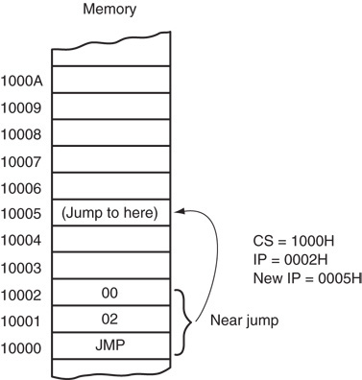
Figure 6–3 A near jump that adds the displacement (0002H) to the contents of IP.

Slide 15
The near jump is also relocatable because it is also a relative jump.
This feature, along with the relocatable data segments, Intel microprocessors ideal for use in a general-purpose computer system.
Software can be written and loaded anywhere in the memory and function without modification because of the relative jumps and relocatable data segments.

Slide 16
Far Jump
Obtains a new segment and offset address to accomplish the jump:
bytes 2 and 3 of this 5-byte instruction contain the new offset address
bytes 4 and 5 contain the new segment address
in protected mode, the segment address accesses a descriptor with the base address of the far jump segment
offset address, either 16 or 32 bits, contains the offset address within the new code segment

Slide 17
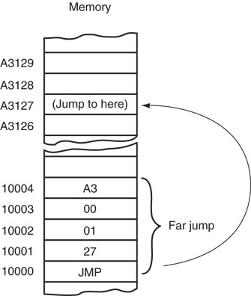
Figure 6–4 A far jump instruction replaces the contents of both CS and IP with 4 bytes following the opcode.

Slide 18
The far jump instruction sometimes appears with the FAR PTR directive.
another way to obtain a far jump is to define a label as a far label
a label is far only if it is external to the current code segment or procedure
The JMP UP instruction references a far label.
label UP is defined as a far label by the EXTRN UP:FAR directive
External labels appear in programs that contain more than one program file.

Slide 19
Another way of defining a label as global is to use a double colon (LABEL::)
required inside procedure blocks defined as near if the label is accessed from outside the procedure block
When the program files are joined, the linker inserts the address for the UP label into the JMP UP instruction.
Also inserts segment address in JMP START instruction.

Slide 20
Jumps with Register Operands
Jump can also use a 16- or 32-bit register as an operand.
automatically sets up as an indirect jump
address of the jump is in the register specified by the jump instruction
Unlike displacement associated with the near jump, register contents are transferred directly into the instruction pointer.
An indirect jump does not add to the instruction pointer.

Slide 21
JMP AX, for example, copies the contents of the AX register into the IP.
allows a jump to any location within the current code segment
In 80386 and above, JMP EAX also jumps to any location within the current code segment;
in protected mode the code segment can be 4G bytes long, so a 32-bit offset address is needed

Slide 22
Indirect Jumps Using an Index
Jump instruction may also use the [ ] form of addressing to directly access the jump table.
The jump table can contain offset addresses for near indirect jumps, or segment and offset addresses for far indirect jumps.
also known as a double-indirect jump if the register jump is called an indirect jump
The assembler assumes that the jump is near unless the FAR PTR directive indicates a far jump instruction.

Slide 23
Mechanism used to access the jump table is identical with a normal memory reference.
JMP TABLE [SI] instruction points to a jump address stored at the code segment offset location addressed by SI
Both the register and indirect indexed jump instructions usually address a 16-bit offset.
both types of jumps are near jumps
If JMP FAR PTR [SI] or JMP TABLE [SI], with TABLE data defined with the DD directive:
microprocessor assumes the jump table contains doubleword, 32-bit addresses (IP and CS)

Slide 24
Conditional Jumps and Conditional Sets
Always short jumps in 8086 - 80286.
limits range to within +127 and –128 bytes from the location following the conditional jump
In 80386 and above, conditional jumps are either short or near jumps (±32K).
in 64-bit mode of the Pentium 4, the near jump distance is ±2G for the conditional jumps
Allows a conditional jump to any location within the current code segment.

Slide 25
Conditional jump instructions test flag bits:
sign (S), zero (Z), carry (C)
parity (P), overflow (0)
If the condition under test is true, a branch to the label associated with the jump instruction occurs.
if false, next sequential step in program executes
for example, a JC will jump if the carry bit is set
Most conditional jump instructions are straightforward as they often test one flag bit.
although some test more than one

Slide 26
Because both signed and unsigned numbers are used in programming.
Because the order of these numbers is different, there are two sets of conditional jump instructions for magnitude comparisons.
16- and 32-bit numbers follow the same order as 8-bit numbers, except that they are larger.
Figure 6–5 shows the order of both signed and unsigned 8-bit numbers.

Slide 27
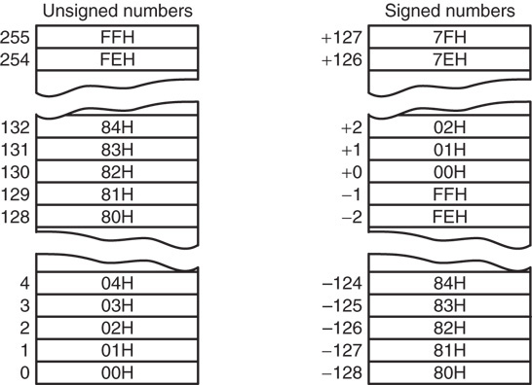
Figure 6–5 Signed and unsigned numbers follow different orders.

Slide 28
When signed numbers are compared, use the JG, JL, JGE, JLE, JE, and JNE instructions.
terms greater than and less than refer to signed numbers
When unsigned numbers are compared, use the JA, JB, JAB, JBE, JE, and JNE instructions.
terms above and below refer to unsigned numbers
Remaining conditional jumps test individual flag bits, such as overflow and parity.

Slide 29
Remaining conditional jumps test individual flag bits, such as overflow and parity.
notice that JE has an alternative opcode JZ
All instructions have alternates, but many aren’t used in programming because they don’t usually fit the condition under test.

Slide 30
The Conditional Set Instructions
80386 - Core2 processors also contain conditional set instructions.
conditions tested by conditional jumps put to work with the conditional set instructions
conditional set instructions set a byte to either 01H or clear a byte to 00H, depending on the outcome of the condition under test
Useful where a condition must be tested at a point much later in the program.

Slide 31
LOOP
A combination of a decrement CX and the JNZ conditional jump.
In 8086 - 80286 LOOP decrements CX.
if CX != 0, it jumps to the address indicated by the label
If CX becomes 0, the next sequential instruction executes
In 80386 and above, LOOP decrements either CX or ECX, depending upon instruction mode.

Slide 32
In 16-bit instruction mode, LOOP uses CX; in the 32-bit mode, LOOP uses ECX.
default is changed by the LOOPW (using CX) and LOOPD (using ECX) instructions 80386 - Core2
In 64-bit mode, the loop counter is in RCX.
and is 64 bits wide
There is no direct move from segment register to segment register instruction.

Slide 33
Conditional LOOPs
LOOP instruction also has conditional forms: LOOPE and LOOPNE
LOOPE (loop while equal) instruction jumps if CX = 0 while an equal condition exists.
will exit loop if the condition is not equal or the CX register not equal to zero
LOOPNE (loop while not equal) jumps if CX ≠ 0 while a not-equal condition exists.
will exit loop if the condition is equal or the CX register decrements to 0

Slide 34
In 80386 - Core2 processors, conditional LOOP can use CX or ECX as the counter.
LOOPEW/LOOPED or LOOPNEW/LOOPNED override the instruction mode if needed
Under 64-bit operation, the loop counter uses RCX and is 64 bits in width
Alternates exist for LOOPE and LOOPNE.
LOOPE same as LOOPZ
LOOPNE instruction is the same as LOOPNZ
In most programs, only the LOOPE and LOOPNE apply.

Slide 35
6–2 CONTROLLING THE FLOW OF THE PROGRAM
Easier to use assembly language statements .IF, .ELSE, .ELSEIF, and .ENDIF to control the flow of the program than to use the correct conditional jump statement.
these statements always indicate a special assembly language command to MASM
Control flow assembly language statements beginning with a period available to MASM version 6.xx, and not to earlier versions.

Slide 36
Other statements developed include .REPEAT–.UNTIL and .WHILE–.ENDW.
the dot commands do not function using the Visual C++ inline assembler
Never use uppercase for assembly language commands with the inline assembler.
some of them are reserved by C++ and will cause problems

Slide 37
WHILE Loops
Used with a condition to begin the loop.
the .ENDW statement ends the loop
The .BREAK and .CONTINUE statements are available for use with the while loop.
.BREAK is often followed by .IF to select the break condition as in .BREAK .IF AL == 0DH
.CONTINUE can be used to allow a DO–.WHILE loop to continue if a certain condition is met
The .BREAK and .CONTINUE commands function the same manner in C++.

Slide 38
REPEAT-UNTIL Loops
A series of instructions is repeated until some condition occurs.
The .REPEAT statement defines the start of the loop.
end is defined with the .UNTIL statement, which contains a condition
An .UNTILCXZ instruction uses the LOOP instruction to check CX for a repeat loop.
.UNTILCXZ uses the CX register as a counter to repeat a loop a fixed number of times

Slide 39
6–3 PROCEDURES
A procedure is a group of instructions that usually performs one task.
subroutine, method, or function is an important part of any system’s architecture
A procedure is a reusable section of the software stored in memory once, used as often as necessary.
saves memory space and makes it easier to develop software

Slide 40
Disadvantage of procedure is time it takes the computer to link to, and return from it.
CALL links to the procedure; the RET (return) instruction returns from the procedure
CALL pushes the address of the instruction following the CALL (return address) on the stack.
the stack stores the return address when a procedure is called during a program
RET instruction removes an address from the stack so the program returns to the instruction following the CALL.

Slide 41
A procedure begins with the PROC directive and ends with the ENDP directive.
each directive appears with the procedure name
PROC is followed by the type of procedure:
NEAR or FAR
In MASM version 6.x, the NEAR or FAR type can be followed by the USES statement.
USES allows any number of registers to be automatically pushed to the stack and popped from the stack within the procedure

Slide 42
Procedures that are to be used by all software (global) should be written as far procedures.
Procedures that are used by a given task (local) are normally defined as near procedures.
Most procedures are near procedures.

Slide 43
CALL
Transfers the flow of the program to the procedure.
CALL instruction differs from the jump instruction because a CALL saves a return address on the stack.
The return address returns control to the instruction that immediately follows the CALL in a program when a RET instruction executes.

Slide 44
Near CALL
3 bytes long.
the first byte contains the opcode; the second and third bytes contain the displacement
When the near CALL executes, it first pushes the offset address of the next instruction onto the stack.
offset address of the next instruction appears in the instruction pointer (IP or EIP)
It then adds displacement from bytes 2 & 3 to the IP to transfer control to the procedure.

Slide 45
Why save the IP or EIP on the stack?
the instruction pointer always points to the next instruction in the program
For the CALL instruction, the contents of IP/EIP are pushed onto the stack.
program control passes to the instruction following the CALL after a procedure ends
Figure 6–6 shows the return address (IP) stored on the stack and the call to the procedure.

Slide 46
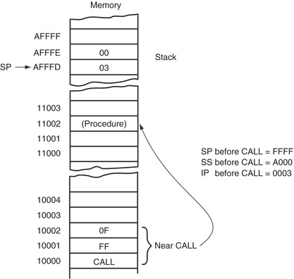
Figure 6–6 The effect of a near CALL on the stack and the instruction pointer.

Slide 47
Far CALL
5-byte instruction contains an opcode followed by the next value for the IP and CS registers.
bytes 2 and 3 contain new contents of the IP
bytes 4 and 5 contain the new contents for CS
Far CALL places the contents of both IP and CS on the stack before jumping to the address indicated by bytes 2 through 5.
This allows far CALL to call a procedure located anywhere in the memory and return from that procedure.

Slide 48
Figure 6–7 shows how far CALL calls a far procedure.
contents of IP and CS are pushed onto the stack
The program branches to the procedure.
A variant of far call exists as CALLF, but should be avoided in favor of defining the type of call instruction with the PROC statement
In 64-bit mode a far call is to any memory location and information placed onto the stack is an 8-byte number.
the far return instruction retrieves an 8-byte return address from the stack and places it into RIP

Slide 49
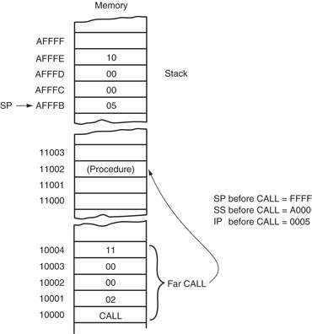
Figure 6–7 The effect of a far CALL instruction.

Slide 50
CALLs with Register Operands
An example CALL BX, which pushes the contents of IP onto the stack.
then jumps to the offset address, located in register BX, in the current code segment
Always uses a 16-bit offset address, stored in any 16-bit register except segment registers.

Slide 51
CALLs with Indirect Memory Addresses
Particularly useful when different subroutines need to be chosen in a program.
selection process is often keyed with a number that addresses a CALL address in a lookup table
Essentially the same as the indirect jump that used a lookup table for a jump address.

Slide 52
RET
Removes a 16-bit number (near return) from the stack placing it in IP, or removes a 32-bit number (far return) and places it in IP & CS.
near and far return instructions in procedure’s PROC directive
automatically selects the proper return instruction
Figure 6–8 shows how the CALL instruction links to a procedure and how RET returns in the 8086–Core2 operating in the real mode.

Slide 53
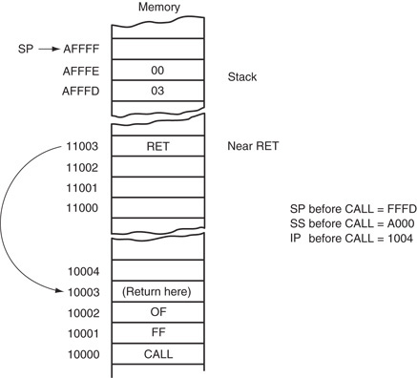
Figure 6–8 The effect of a near return instruction on the stack and instruction pointer.

Slide 54
Another form of return adds a number to the contents of the stack pointer (SP) after the return address is removed from the stack.
A return that uses an immediate operand is ideal for use in a system that uses the C/C++ or PASCAL calling conventions.
these conventions push parameters on the stack before calling a procedure
If the parameters are discarded upon return, the return instruction contains the number of bytes pushed to the stack as parameters.

Slide 55
Parameters are addressed on the stack by using the BP register, which by default addresses the stack segment.
Parameter stacking is common in procedures written for C++ or PASCAL by using the C++ or PASCAL calling conventions.
Variants of the return instruction:
RETN and RETF
Variants should also be avoided in favor of using the PROC statement to define the type of call and return.

Slide 56
6–4 INTRO TO INTERRUPTS
An interrupt is a hardware-generated CALL
externally derived from a hardware signal
Or a software-generated CALL
internally derived from the execution of an instruction or by some other internal event
at times an internal interrupt is called an exception
Either type interrupts the program by calling an interrupt service procedure (ISP) or interrupt handler.

Slide 57
Interrupt Vectors
A 4-byte number stored in the first 1024 bytes of memory (00000H–003FFH) in real mode.
in protected mode, the vector table is replaced by an interrupt descriptor table that uses 8-byte descriptors to describe each of the interrupts
256 different interrupt vectors.
each vector contains the address of an interrupt service procedure

Slide 58
Each vector contains a value for IP and CS that forms the address of the interrupt service procedure.
the first 2 bytes contain IP; the last 2 bytes CS
Intel reserves the first 32 interrupt vectors for the present and future products.
interrupt vectors (32–255) are available to users
Some reserved vectors are for errors that occur during the execution of software
such as the divide error interrupt

Slide 59
Some vectors are reserved for the coprocessor.
others occur for normal events in the system
In a personal computer, reserved vectors are used for system functions
Vectors 1–6, 7, 9, 16, and 17 function in the real mode and protected mode.
the remaining vectors function only in the protected mode

Slide 60
Interrupt Instructions
Three different interrupt instructions available:
INT, INTO, and INT 3
In real mode, each fetches a vector from the vector table, and then calls the procedure stored at the location addressed by the vector.
In protected mode, each fetches an interrupt descriptor from the interrupt descriptor table.
Similar to a far CALL instruction because it places the return address (IP/EIP and CS) on the stack.

Slide 61
INTs
256 different software interrupt instructions (INTs) available to the programmer.
each INT instruction has a numeric operand whose range is 0 to 255 (00H–FFH)
For example, INT 100 uses interrupt vector 100, which appears at memory address 190H–193H.
address of the interrupt vector is determined by multiplying the interrupt type number by 4

Slide 62
Address of the interrupt vector is determined by multiplying the interrupt type number by 4.
INT 10H instruction calls the interrupt service procedure whose address is stored beginning at memory location 40H (10H × 4) in the mode
In protected mode, the interrupt descriptor is located by multiplying the type number by 8
because each descriptor is 8 bytes long
Each INT instruction is 2 bytes long.
the first byte contains the opcode
the second byte contains the vector type number

Slide 63
When a software interrupt executes, it:
pushes the flags onto the stack
clears the T and I flag bits
pushes CS onto the stack
fetches the new value for CS from the interrupt vector
pushes IP/EIP onto the stack
fetches the new value for IP/EIP from the vector
jumps to the new location addressed by CS and IP/EIP

Slide 64
INT performs as a far CALL
not only pushes CS & IP onto the stack, also pushes the flags onto the stack
The INT instruction performs the operation of a PUSHF, followed by a far CALL instruction.
Software interrupts are most commonly used to call system procedures because the address of the function need not be known.
The interrupts often control printers, video displays, and disk drives.

Slide 65
INT replaces a far CALL that would otherwise be used to call a system function.
INT instruction is 2 bytes long, whereas the far CALL is 5 bytes long
Each time that the INT instruction replaces a far CALL, it saves 3 bytes of memory.
This can amount to a sizable saving if INT often appears in a program, as it does for system calls.

Slide 66
IRET/IRETD
Used only with software or hardware interrupt service procedures.
IRET instruction will
pop stack data back into the IP
pop stack data back into CS
pop stack data back into the flag register
Accomplishes the same tasks as the POPF followed by a far RET instruction.

Slide 67
When IRET executes, it restores the contents of I and T from the stack.
preserves the state of these flag bits
If interrupts were enabled before an interrupt service procedure, they are automatically re-enabled by the IRET instruction.
because it restores the flag register
IRET is used in real mode and IRETD in the protected mode.

Slide 68
INT 3
A special software interrupt designed to function as a breakpoint.
a 1-byte instruction, while others are 2-byte
Common to insert an INT 3 in software to interrupt or break the flow of the software.
function is called a breakpoint
breakpoints help to debug faulty software
A breakpoint occurs for any software interrupt, but because INT 3 is 1 byte long, it is easier to use for this function.

Slide 69
INTO
Interrupt on overflow (INTO) is a conditional software interrupt that tests overflow flag (O).
If O = 0, INTO performs no operation
if O = 1 and an INTO executes, an interrupt occurs via vector type number 4
The INTO instruction appears in software that adds or subtracts signed binary numbers.
eith these operations, it is possible to have an overflow
JO or INTO instructions detect the overflow.

Slide 70
An Interrupt Service Procedure
Interrupts are usually reserved for system events.
Suppose a procedure is required to add the contents of DI, SI, BP, and BX and save the sum in AX.
as a common task, it may be worthwhile to develop the task as a software interrupt
It is also important to save all registers are changed by the procedure using USES.

Slide 71
Interrupt Control
Two instructions control the INTR pin.
The set interrupt flag instruction (STI) places 1 in the I flag bit.
which enables the INTR pin
The clear interrupt flag instruction (CLI) places a 0 into the I flag bit.
which disables the INTR pin
The STI instruction enables INTR and the CLI instruction disables INTR.

Slide 72
In software interrupt service procedure, hardware interrupts are enabled as one of the first steps.
accomplished by the STI instruction
Interrupts are enabled early because just about all of the I/O devices in the personal computer are interrupt-processed.
if interrupts are disabled too long, severe system problems result

Slide 73
Interrupts in the Personal Computer
Interrupts found in the personal computer only contained Intel-specified interrupts 0–4.
Access to protected mode interrupt structure in use by Windows is accomplished through kernel functions Microsoft provides.
and cannot be directly addressed
Protected mode interrupts use an interrupt descriptor table.

Slide 74
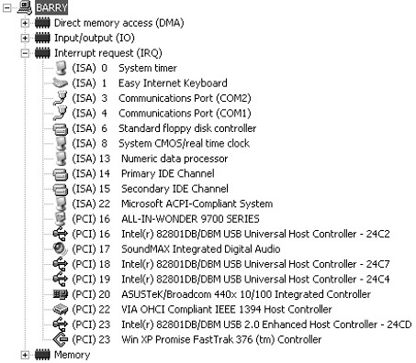
Figure 6–9 Interrupts in a typical personal computer.

Slide 75
64-Bit Mode Interrupts
The 64-bit system uses the IRETQ instruction to return from an interrupt service procedure.
IRETQ retrieves an 8-byte return from the stack
IRETQ also retrieves the 32-bit EFLAG register from the stack and places it into the RFLAG register.
It appears that Intel has no plans for using the leftmost 32 bits of the RFLAG register.
otherwise, 64-bit mode interrupts are the same as 32-bit mode interrupts

Slide 76
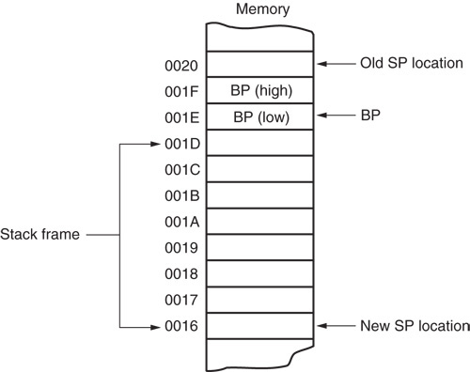
Figure 6–10 The stack frame created by the ENTER 8,0 instruction. Notice that BP is stored beginning at the top of the stack frame. This is followed by an 8-byte area called a stack frame.

Slide 77
6–5 MACHINE CONTROL AND MISCELLANEOUS INSTRUCTIONS
These instructions provide control of the carry bit, sample the BUSY/TEST pin, and perform various other functions.

Slide 78
Controlling the Carry Flag Bit
The carry flag (C) propagates the carry or borrow in multiple-word/doubleword addition and subtraction.
can indicate errors in assembly language procedures
Three instructions control the contents of the carry flag:
STC (set carry), CLC (clear carry), and CMC (complement carry)

Slide 79
WAIT
Monitors the hardware BUSY pin on 80286 and 80386, and the TEST pin on 8086/8088.
If the WAIT instruction executes while the BUSY pin = 1, nothing happens and the next instruction executes.
pin inputs a busy condition when at a logic 0 level
if BUSY pin = 0 the microprocessor waits for the pin to return to a logic 1

Slide 80
HLT
Stops the execution of software.
There are three ways to exit a halt:
by interrupt; a hardware reset, or DMA operation
Often synchronizes external hardware interrupts with the software system.
DOS and Windows both use interrupts extensively.
so HLT will not halt the computer when operated under these operating systems

Slide 81
NOP
In early years, before software development tools were available, a NOP, which performs absolutely no operation, was often used to pad software with space for future machine language instructions.
When the microprocessor encounters a NOP, it takes a short time to execute.

Slide 82
If you are developing machine language programs, which are extremely rare, it is recommended that you place 10 or so NOPS in your program at 50-byte intervals.
in case you need to add instructions at some future point
A NOP may also find application in time delays to waste time.
A NOP used for timing is not very accurate because of the cache and pipelines in modern microprocessors.

Slide 83
LOCK Prefix
Appends an instruction and causes the pin to become a logic 0.
LOCK pin often disables external bus masters or other system components
causes pin to activate for duration of instruction
If more than one sequential instruction islocked, LOCK pin remains logic 0 for duration of the sequence of instructions.
The LOCK:MOV AL,[SI] instruction is an example of a locked instruction.

Slide 84
ESC
Passes instructions to the floating-point coprocessor from the microprocessor.
When an ESC executes, the microprocessor provides the memory address, if required, but otherwise performs a NOP.
Six bits of the ESC instruction provide the opcode to the coprocessor and begin executing a coprocessor instruction.
ESC is considered obsolete as an opcode.

Slide 85
BOUND
A comparison instruction that may cause an interrupt (vector type number 5).
Compares the contents of any 16-bit or 32-bit register against the contents of two words or doublewords of memory
an upper and a lower boundary
If register value compared with memory is not within the boundary, a type 5 interrupt ensues.
If it is within the boundary, the next instruction in the program executes.

Slide 86
ENTER and LEAVE
Used with stack frames, mechanisms used to pass parameters to a procedure through the stack memory.
Stack frame also holds local memory variables for the procedure.
Stack frames provide dynamic areas of memory for procedures in multiuser environments.

Slide 87
ENTER creates a stack frame by pushing BP onto the stack and then loading BP with the uppermost address of the stack frame.
allows stack frame variables to be accessed through the BP register
ENTER contains two operands:
first operand specifies the number of bytes to reserve for variables on the stack frame
the second specifies the level of the procedure
The ENTER and LEAVE instructions were used to call C++ functions in Windows 3.1.

Slide 88
SUMMARY
(cont.)
There are three types of unconditional jump instructions: short, near, and far.
The short jump allows a branch to within +127 and -128 bytes. The near jump (using a displacement of ±32K) allows a jump to any location in the current code segment (intrasegment). The far jump allows a jump to any location in the memory system (intersegment).

Slide 89
SUMMARY
(cont.)
Whenever a label appears with a JMP instruction or conditional jump, the label, located in the label field, must be followed by a colon (LABEL:). For example, the JMP DOGGY instruction jumps to memory location DOGGY:.
The displacement that follows a short or near jump is the distance from the next instruction to the jump location.

Slide 90
SUMMARY
(cont.)
Indirect jumps are available in two forms: (1) jump to the location stored in a register and (2) jump to the location stored in a memory word (near indi-rect) or doubleword (far indirect).
Conditional jumps are all short jumps that test one or more of the flag bits: C, Z, O, P, or S. If the condition is true, a jump occurs; if the condition is false, the next sequential instruction executes.

Slide 91
SUMMARY
(cont.)
The 80386 and above allow a 16-bit signed displacement for the conditional jump instructions.
In 64-bit mode, the displacement is 32 bits allowing a range of ±2G.
A special conditional jump instruction (LOOP) decrements CX and jumps to the label when CX is not 0.

Slide 92
SUMMARY
(cont.)
The 80386 through the Core2 contain conditional set instructions that either set a byte to 01H or clear it to 00H.
If the condition under test is true, the operand byte is set to 01H; if the condition under test is false, the operand byte is cleared to 00H.

Slide 93
SUMMARY
(cont.)
The .IF and .ENDIF statements are useful in assembly language for making decisions.
The instructions cause the assembler to generate conditional jump statements that modify the flow of the program.
The .WHILE and .ENDW statements allow an assembly language program to use the WHILE construction, and the .REPEAT and .UNTIL statements allow use of the REPEAT-UNTIL construct.

Slide 94
SUMMARY
(cont.)
Procedures are groups of instructions that perform one task and are used from any point in a program.
The CALL instruction links to a procedure and the RET instruction returns from a procedure. In assembly language, the PROC directive defines the name and type of procedure.
The ENDP directive declares the end of the procedure.

Slide 95
SUMMARY
(cont.)
The CALL construction is a combination of a PUSH and a JMP instruction.
When CALL executes, it pushes the return address on the stack and then jumps to the procedure.
A near CALL places the contents of IP on the stack, and a far CALL places both IP and CS on the stack.

Slide 96
SUMMARY
(cont.)
The RET instruction returns from a procedure by removing the return address from the stack and placing it into IP (near return), or IP and CS (far return).
Interrupts are either software instructions similar to CALL or hardware signals used to call procedures. This process interrupts the current program and calls a procedure.
After the procedure, a special IRET instruction returns control to the software.

Slide 97
SUMMARY
(cont.)
Real mode interrupt vectors are 4 bytes long and contain the address (IP and CS) of the interrupt service procedure.
The microprocessor contains 256 interrupt vectors in the first 1K bytes of memory. The first 32 are defined by Intel; the remaining 224 are user interrupts.
In protected mode, the interrupt vector is 8 bytes long and the vector table may be relocated to any section of the memory.

Slide 98
SUMMARY
(cont.)
Whenever an interrupt is accepted by the microprocessor, the flags IP and CS are pushed onto the stack.
Besides pushing the flags, the T and I flag bits are cleared to disable both the trace function and the INTR pin.
The final event that occurs for the interrupt is that the interrupt vector is fetched from the vector table and a jump to the interrupt service procedure occurs.

Slide 99
SUMMARY
(cont.)
Software interrupt instructions (INT) often replace system calls. Soft-ware interrupts save 3 bytes of memory each time they replace CALL instructions.
A special return instruction (IRET) must be used to return from an in-terrupt service procedure. The IRET instruction not only removes IP and CS from the stack, it also removes the flags from the stack.

Slide 100
SUMMARY
(cont.)
Interrupt on an overflow (INTO) is a conditional interrupt that calls an interrupt service procedure if overflow flag (O) = 1.
The interrupt enable flag (I) controls the INTR pin connection.
If the STI instruction executes, it sets I to enable the INTR pin. If the CLI instruction executes, it clears I to disable the INTR pin.

Slide 101
SUMMARY
(cont.)
The carry flag bit (C) is clear, set, and complemented by the CLC, STC, and CMC instructions.
The BOUND instruction compares the contents of any 16-bit register against the contents of two words of memory: an upper and a lower boundary.
If the value in the register compared with memory is not within the upper and lower boundary, a type 5 interrupt ensues.

Slide 102
SUMMARY
The ENTER and LEAVE instructions are used with stack frames. A stack frame is a mechanism used to pass parameters to a procedure through the stack memory.
The stack frame also holds local memory variables for the procedure.
The ENTER instruction creates the stack frame, and the LEAVE instruction removes the stack frame from the stack. The BP register addresses stack frame data.

