Slide 1
Chapter 2 : Chemical Sensors
Mahendra D. Shirsat
Professor
Department of Physics
Dr. Babasaheb Ambedkar Marathwada University,
Aurangabad (MS)-431 004
Email: mdshirsat@gmail.com

Slide 2
Chemical Sensor Characteristics
Most chemical sensors can be described using criteria and characteristics general to all sensors such as stability, repeatability, linearity, hysteresis, saturation, response time, and span (see Chapter 2), but two characteristics are unique and meaningful as applied to chemical detection.
Because chemical sensors are used both for identification and quantification, they need to be both selective and sensitive to a desired target species in a mixture of chemical species.
Selectivity describes the degree to which a sensor responds to only the desired target species, with little or no interference from non target species.
Sensitivity describes the minimal concentrations and concentration changes (then referred to as resolution) that can be successfully and repeatedly sensed by a device.

Slide 3
Note that for the sensors described in the previous chapters, the term “sensitivity” is often used as a synonym of “slope” when the transfer function of a sensor is linear.
For the chemical sensors, sensitivity is the synonym of resolution.
This is a characteristic that other sensors, like pressure and temperature, are rarely concerned with.
Therefore, one of the most important functions in the evaluation of a chemical sensor’s performance is the qualification of its selectivity.
It is common practice to evaluate the response of a sensor only for increasing the values of activity (concentration) to the primary target species.
This is mainly due to the fact that it is more convenient to prepare a continuously broad range of test concentrations by adding increasing amounts of a concentrated (pure) primary species to the background sample than vice versa.
An absolutely selective sensor really does not exist and there is commonly some interference present.

Slide 4
Specific Difficulties
The difficulty of developing chemical sensors versus other sensors (such as temperature, pressure, humidity, etc.) is that chemical reactions change the sensor, often in a way that is non reversible.
For example, electrochemical cells employing liquid electrolytes (material that conducts electrical current via charged ions, not electrons) lose a small amount of electrolytes with each measurement, requiring that the electrolyte be replenished eventually or have carbonic acid forming at the gate–membrane interface and etching components in chemical field-effect transistor (FET) sensors.

Slide 5
Also, unlike pressure or temperature sensors which have comparatively few conditions under which they need to be modeled to operate, chemical sensors are often exposed to nearly unlimited numbers of chemical combinations.
This introduces interference responses, contamination from acid attack, or, for porous film devices, the sorption of species that cannot be removed (such as silicone on zirconia sensors), altering their surface area and effectively changing their calibrated behavior.

Slide 6
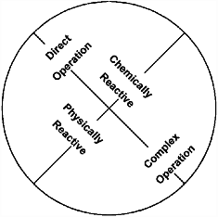
Classification of Chemical-Sensing Mechanisms
All chemical sensing can be classified by the actual indicator phenomena employed for sensing, and they also can be classified by the measurement strategy employed.
We will separate chemical sensors into two major groups, direct (simple) and indirect (complex), and will also distinguish between chemically reactive devices and physically reactive devices in each group (Fig. 17.1).
Fig. 17.1. Direct versus complex and chemically versus
physically reactive groupings.

Slide 7
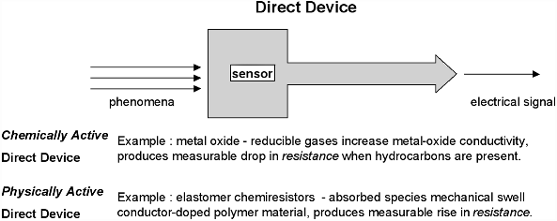
Direct chemical sensors utilize any of a variety of chemical reaction phenomena that directly affect a measurable electrical characteristic such as resistance, potential, current, or capacitance (Fig. 17.2).
Fig. 17.2. Direct devices.
These devices require some sort of electrical signal conditioning, but no transducing (converting the sensor phenomena from one form of energy to another).

Slide 8
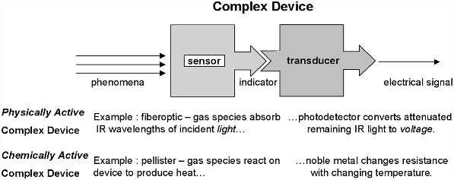
Complex devices (Fig. 17.3) employ chemistry-influenced phenomena that do not directly affect an electrical characteristic and will require some form of transducing to obtain electrical signal in order to interface with common measurement electronics.
Nondirect phenomena include physical shape change, frequency
shifts, modulation of light, temperature or produced heat change, and even mass change.
Fig. 17.3. Complex devices.

Slide 9

Sensor Modalities
Transducers | Type of Signal | Challenges
Chemiresistive | Ionic or Chemical interaction | Charged analytes only Solid state device ; Gas and Liquid phase Direct detection ; Fast response High sensitivity ; Label-free detection Easy miniaturization
ChemFET
Amperometric | Electrochemical activity | Mostly for liquid phase Electroactive species are detected
Thermistor | Thermal conductivity variation | Limited to temperature gradient
Pellistor | Thermal conductivity variation | Catalyst pellets required
Optodes | Optical detection | Label required
Piezoelectric | Mass dependant resonant frequency change | Moving parts Difficult to miniaturize
Notes:
9
For example gas causes change in resistance with/without current modulation or gas causes change in current, heat generation, optical property & resonant frequency.
Those sensors I have mentioned are classify as solid state sensors whose advantages are good sensitivity, cheap & manufacturable fabrication, & long life expectancy. However, there are some challenges such as high temperature operation for metal oxide sensor, cross selectivity in other words, there is no sensor selective to just one analyte, and complex fabrication. Currently, chemFET & chemiresistor are of our particular interest. So, let take look a little bit to see how they work start from ChemFET based gas sensor
As of focusing on chemFET & chemiresitor, let take a few minutes to take a look a little bit more in detail to see how they work. Start from chemFET,

Slide 10
Dominant Hurdles
Selectivity, altogether, has remained an unresolved yet most challenging mystery for gas sensors.
Cross Sensitivity : Most popular sensing backbones (e.g. conducting polymers, carbon nanotubes) in pristine form suffers from poor selectivity and results in poor cross sensitivity if validated under complex atmosphere.
Other Issues :
Sensitivity
Response and recovery time
Lower detection limit
Stability
Intelligent Materials
or
Intelligent use of Materials

Slide 11
Direct Sensors
Direct chemical sensors that affect the electrical characteristics of a sensing element can be separated into categories by the characteristic that they affect.
Conductometric devices affect the resistance or impedance of the sensing element, amperometric devices affect the measurable electrical or electronic current passing through the sensing element, and potentiometric devices affect the electrical potential or voltage across some pair of electrodes.
Through circuitry, these characteristics can be readily converted from one characteristic to another to simplify interfacing.
There are a wide variety of chemical-sensing phenomena that employ direct sensing.

Slide 12
Metal-Oxide Chemical Sensors
Metal-oxide gas sensors (such as tin dioxide, SnO2) have been popular since the late 1960s.
They are simple rugged devices that perform reasonably well with
relatively simple electronics support.
Bulk metal oxides have electrical properties that change in the presence of reducible gases such as methyl ethyl alcohol (C2H5OH).
When a metal-oxide crystal such as SnO₂ is heated at a certain high temperature in air, oxygen is adsorbed on the crystal surface and a surface potential is formed that inhibits electron flow.
When the surface is exposed to reducible gases ( those who donate electrons), the surface potential decreases and conductivity measurably increases.

Slide 13
The relationship between the film’s electrical resistance and a given reducible gas’ concentration is described by the following empirical equation:
Rs =A[C]^{−α}, --------------------------- (17.1)
Where Rs is the sensor electrical resistance, A is a constant specific for a given film composition, C is the gas concentration, and α is the characteristic slope of the Rs curve for that material and expected gas.

Slide 14
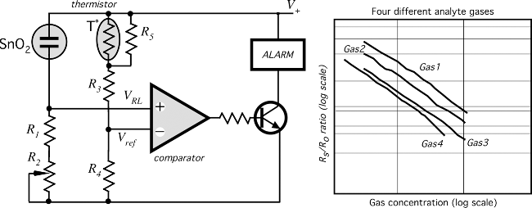
Metal-oxide devices change the resistivity as a function of the presence of reducible gases, and as such, they require an additional electronic circuit to operate.
A typical arrangement is to design the sensor as one leg in a common Wheatstone bridge circuit so that the changing resistance can be detected as an unbalancing of the potential drops observed across the bridge circuit (Fig. 17.4A).
Fig. 17.4. SnO2 Wheatstone bridge circuit (A) and its response for different gases (B).

Slide 15
Enhanced Catalytic Gas Sensors
Enhanced catalytic gas sensors are experimental devices that employ active measurement techniques coupled with fairly simple electrochemical cells.
The electrochemical cells are fabricated of ceramic–metallic films and provide the reaction environment for potentiometric and amperometric measurements.
These sensors provide broad-spectrum responses allowing identification and quantification of a wide range of gases.
The enhanced catalytic devices are divided into electro-enhanced catalytic devices (electrocatalytic) and photo-enhanced catalytic devices (photocatalytic).

Slide 16
Elastomer Chemiresistors
Elastomer chemiresistors or polymer conductive composites (also polymer conductors or simply PCs) are polymer films that adsorb chemical species and swell, increasing resistance as a physical response to the presence of a chemical species.
These can be used as chemical detectors but do not truly employ a chemical reaction.
The polymers are designed and/or treated to attract subsets of chemicals providing a degree of speciation or selectivity.
PCs have become commercially viable [15] as the sensing element inside of a more complex instrument.
The PC sensors can respond to the presence of simple hydrocarbons like isopropyl alcohol in only a couple of seconds, whereas more complex oils may take 10–15 s.

Slide 17
The PC element is not expected to be tolerant of corrosives, but barring exposure to such, it should have a life span of months in normal operation.
The PC measurement strategy uses several differently treated PC elements to produce an array, and then it samples the array to produce a signature.
The commercial instruments based on this technology can readily differentiate between compounds such as acetone and acetic acid, but they are not designed to be quantitative.
These commercial instruments are complements to metal-oxide
sensors in that they are rather insensitive to fixed gases like O2, Cl2, H2, and NO that are commonly detected using metal-oxide devices.
Unlike metal-oxide-based sensors, the PCs do not require the high controlled operating temperatures and consume
significantly less power.

Slide 18
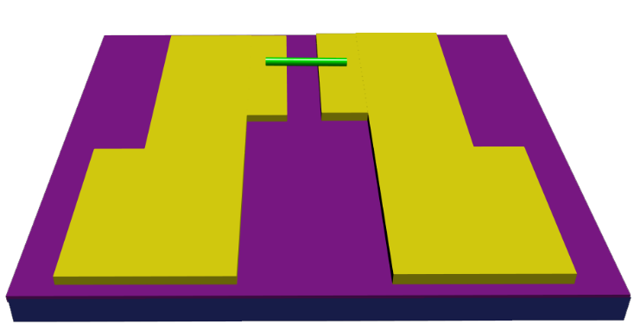
Chemiresistive Sensor Configuration
Porphyrin / OCP coated SWNT conducting Channel
Insulating Layer (SiO₂)
Drain
Source
V_{DS}
Silicon substrate

Slide 19
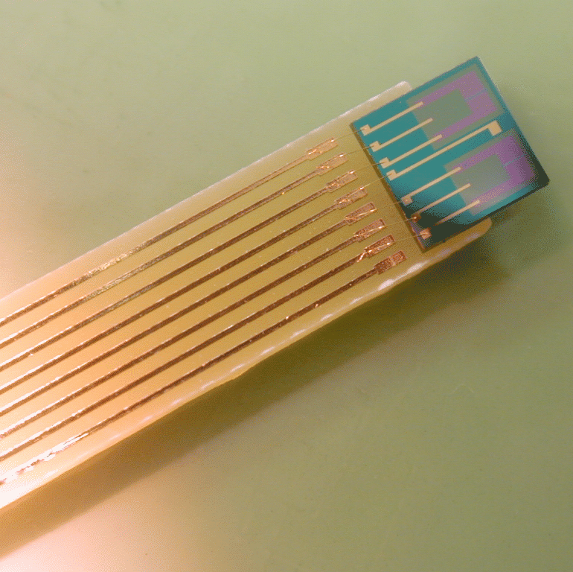
CHEMFET Sensors
Very popular where small size and low power consumption is essential. (Biological and Medical monitoring).
CHEMFETs are chemical amperrometric sensors based on the Field-Effect transistors
CHEMFETs are solid state sensors suitable for batch fabrication.
The surface field effect can provide high selectivity and sensitivity.
These are extended gate field-effect transistors with the electrochemical potential inserted over the gate surface.

Slide 20
Four types of CHEMFETs:
Ion Selective
gas selective,
enzyme-selective
immuno-selective sensors.
Ion selective are the most widely used, known as ISFETs
A lot of the art of CHEMFETs is in engineering the porous layer over the gate.

Slide 21
FET Measurements Scheme
Source
Porphyrin Functionalized SWNTs
(Active material)
Drain
Insulator
Gate
Keithley 2400
(Source Measure Unit)
Aplab PD300S
(Programmable Power Supply)

Slide 22

ChemFET Sensor Configuration
Porphyrins / OCP coated SWNT conducting Channel
Insulating Layer (SiO₂)
Drain
Source
Silicon substrate
Gate
V_{G}
V_{DS}

Slide 23
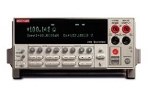
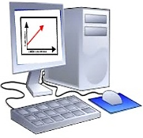

Sensor Characterization
Evaluation of sensing properties in chemiresistive and ChemFET modality using Indigenously developed gas sensing system and Keithley – 4200 SCS
  Chemiresistive Sensing:
Chemiresistive sensing experiments would be carried out by using Keithley- 4200 SCS and indigenously designed dynamic gas sensing setup.
The change in electrical resistance would be measured as a function of Concentration of the analyte.
Sensor would be evaluated by various parameters viz. Response time, Recovery time, etc. the change in electrical resistance would be measured as a function of time.
Schematic of Impedimetric sensing plan
Schematic of Chemiresistive Sensing
Analyte in dry air controlled by MFCs
Keithley-2400 Source meter
Keithley 4200 SCS
3 μm
Gas sensing setup
Gold Micro- electrode on Si/SiO₂
MOF deposited Gold Micro-electrodes
Resistance
Analyte concentration
Time
Impedimetric Sensing Graph
Chemiresistive Sensing
Dr. Babasaheb Ambedkar Marathwada University, Aurangabad-431004

Slide 24
Sensor Characterization ( Contd..)
  ChemFET Sensing:
ChemFET sensing experiments would be carried out by using Keithley-4200 SCS and indigenously designed dynamic gas sensing setup.
The change in FET transfer behavior would be recorded as a function of Concentration of the analytes.
Schematic of ChemFET Sensing
Analyte in dry air controlled by MFCs
Keithley 4200 SCS
Keithley-2400 Source meter
3 μm
Gas sensing setup
Sensitive Element
Gold Micro-electrodes or Si/SiO₂
MOF deposited on Gold Micro-electrodes
Resistance
Insulator (SiO₂)
Si substrate
Analyte concentration
Time
Impedimetric Sensing Graph
Schematic of FET
Dr. Babasaheb Ambedkar Marathwada University, Aurangabad-431004

Slide 25
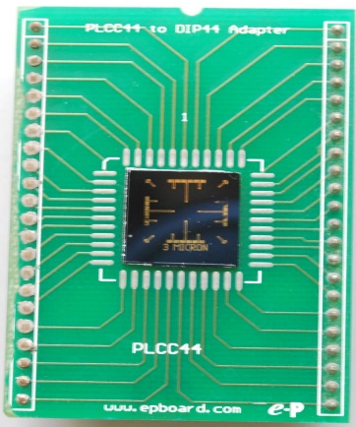
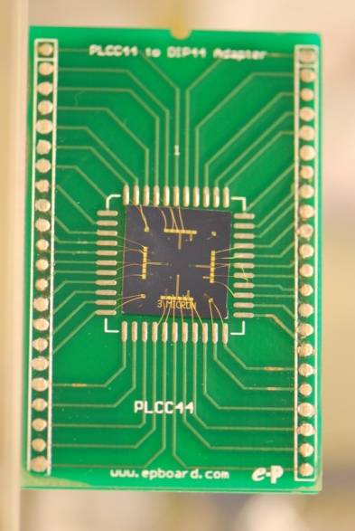
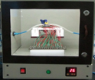

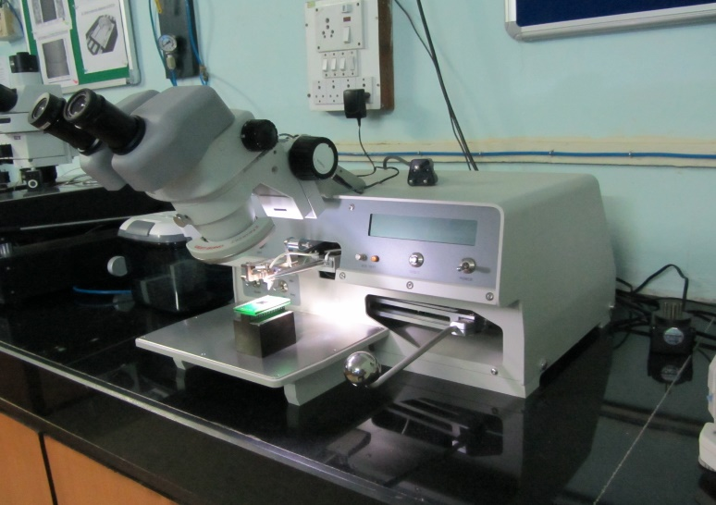

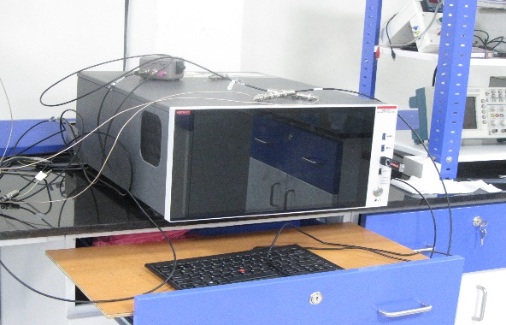
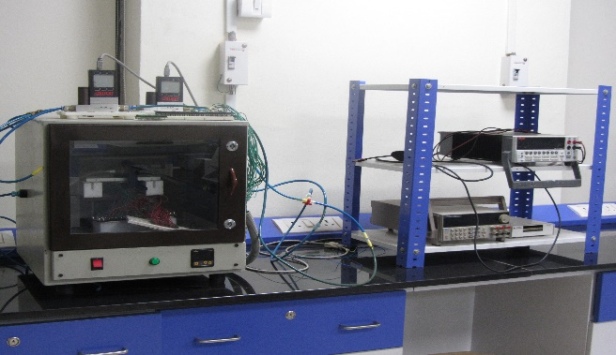
Sensor Characterization ( Contd..)
MFC 2 (MC 200; Alicat)
CARRIER
SENSING CHAMBER
Schematic Of Dynamic Gas Sensing System
ANALYTE
TO EXHAUST
Keithley 4200 SCS
Keithley – 4200 SCS
Dynamic Gas Sensing System
West Bond 7476D Wire Bonder
Dr. Babasaheb Ambedkar Marathwada University, Aurangabad-431004

Slide 26

Types of ChemFETs
V_{g}
V_{SD}
Source
Transducer
Drain
Gate
Back-gated FET sensor
V_{SD}
V_{SD}
V_{g}
Gate
V_{g}
Liquid
Gate
Source
Transducer
Drain
Source
Sensing Layer
Drain
Transducer
Liquid Ion-gated FET sensor
FET sensor with sensing layer as gate

Slide 27

Gas
Gate
Insulator
Source
Drain
n
n
p-Si
Insulated Gate Field Effect Transistor

Slide 28
Gas
Active Layer
(Conducting Polymer)
Source
Drain
Insulator
Gate
Back-gated Field Effect Transistor

Slide 29
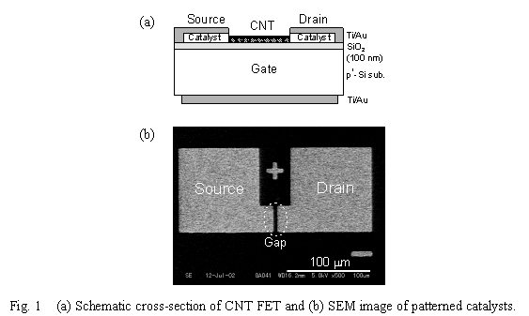
CNT FET sensor
Can also make FET sensors out of carbon nanotubes
A small current in the nanotube causes a much larger current in the FET
This particular sensor responds to light.
www.echo.nuee.nagoya-u.ac.jp/~yohno/research/cnt/qnn03_abstract_submitted.htm

Slide 30
FET Transfer curves ( Sensing of Analytes )
Before Analyte
Schottkey Barrier Modulation
I _{DS}
After Analyte
Before Analyte
V _{GS}
I _{DS}
After Analyte
Electrostatic Gating Effect
V _{GS}

Slide 31
Electrochemical Sensors
Electrochemical sensors are the most versatile and highly developed chemical sensors.
They are divided into several types:
Potentiometric (measure voltage)
Amperometric (measure current)
Conductometric (measure conductivity)
Sometimes the distinction between these types can be blurred.
In all these sensors, special electrodes are used.

Slide 33
Electrochemical Sensors
Either a chemical reaction takes place or the charge transport is modulated by the reaction
Electrochemical sensing always requires a closed circuit. Current must flow to make a measurement.
Since we need a closed loop we need at least two electrodes.
These sensors are often called an electrochemical cell.
How the cell is used depends heavily on the sensitivity, selectivity and accuracy.

Slide 34
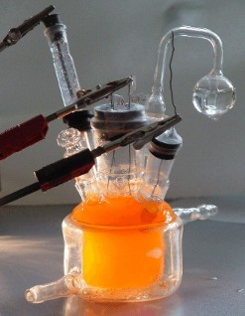
Potentiometric Sensors
Potentiometric sensors use the effect of the concentration on the equilibrium of redox reactions occurring at the electrode-electrolyte interface of an electrochemical cell
The redox reaction takes on the electrode surface:
Oxidant + Ze⁻ => Reduced product
Z is the number of electrons involved in the redox reaction
www.chemie.uni-greifswald.de/

Slide 35
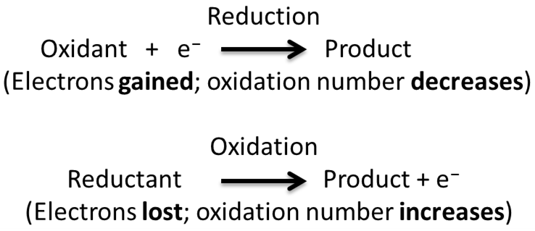
Redox (reduction-oxidation) reactions include all chemical reactions in which atoms have their oxidation state changed; in general, redox reactions involve the transfer of electrons between species.
Oxidation is the loss of electrons or an increase in oxidation state by a molecule, atom, or ion.
Reduction is the gain of electrons or a decrease in oxidation state by a molecule, atom, or ion.

Slide 36
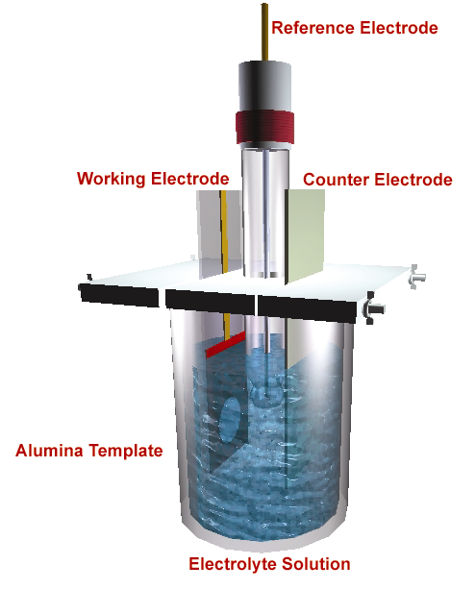
Schematic of 3-electrode electrochemical cell

Slide 37
Electrochemical Potentiometric Sensor
WE RE
Current /voltage meter
I/V
Constant Current & voltage Source
2-electrode electrochemical cell

Slide 38
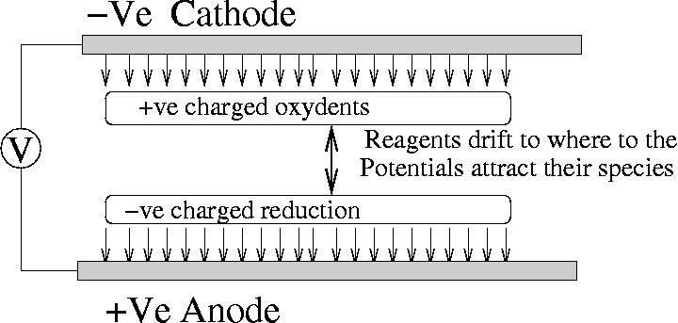
Electrochemical Cell
The reaction takes place at the cathode where electrons are “pulled” out of the electrode.

Slide 39
Nernst Equation
The Nernst equation gives the potential of each half cell.
Co is the oxidant concentration
C_{R} is the Reduced Product Concentration
n is the number of electrons transferred per redox reaction
F is the Faraday constant
T is the temperature
R is the gas Constant
E₀ is the electrode potential at a standard state.
In a potentiometric sensor, two half-cell reactions take place at each electrode. Only one of the reactions should involve sensing the species of interest. The other should be a well understood reversible and non-interfering reaction

Slide 40
Complex Sensors
Complex sensors involve chemical phenomena that change the state of an indicator as a function of some chemical reaction.
The indicator can be a temperature change, an opacity change, an oscillation frequency change, and so forth.
These indicators require another transducer to convert the changing indicator to an electrical output.

Slide 41
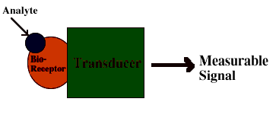
Bio-chemical Sensor / Enzyme Sensor ?
What Is a Biosensor ?
Biosensor = Bio-receptor + Transducer
The bioreceptor is a biomolecule that recognizes the target analyte. Ex enzymes, antibodies, nucleic acids.
The transducer converts the recognition event into a measurable signal.
Analyte
Measurable
Signal
Transducer

Slide 42
    Analytical device used for detection and estimation of biological compounds
Bioreceptor + Transducer Biosensors
Analyte
Electro active
Substance
Enzyme
Electrode
pH Change
Semiconductor pH Electrode
Antibody
Micro Organism
Heat
Thermister
Electric Signal
Photon Counter
Light
Cell
Piezoelectric device
Mass Change
Molecularly
Recognizing
Material
Signal
Transducer

Slide 43
Working of Glucose Biosensor
Electrode
Conducting Polymer Matrix
H₂O
O₂
Glucose Oxidase
Glucose (C₆H₁₂O₆)
2 e⁻
H₂O₂
Gluconic acid (C₆H₁₂O₇)
GOD_{x}
Glucose + O₂ + H₂O Gluconic acid + H₂O₂
H₂O₂ O₂ + 2H⁺ + 2e⁻

Slide 44
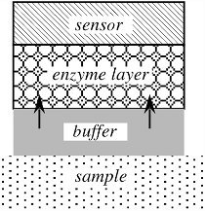
Fig. 17.15. Schematic diagram of an enzyme sensor.

Slide 45
Optical Chemical Sensors
Optical sensors are based on the interaction of electromagnetic radiation with matter, which results in altering (modulating) some properties of the radiation.
Examples of such modulations are variations in intensity, polarization, and velocity of light in the medium.
The presence of different chemicals in the analyte affects which wavelengths of light are modulated.
Optical modulation is studied by spectroscopy, which provides information on various microscopic structures from atoms to the dynamics in polymers.
In a general arrangement, the monochromatic radiation passes through a sample (which may be gas, liquid, or solid), and its properties are examined at the output.
Alternatively, the sample may respond with a secondary radiation (induced
luminescence), which is also measured.

Slide 46
Optical chemical sensors can be and are designed and built in a great variety of ways, which are limited only by the designer’s imagination.
Here, we will describe only one device just to illustrate how an optical sensor works.
Figure 17.12 shows a simplified configuration of a CO₂ sensor.
It consists of two chambers which are illuminated by a common LED.
Each chamber has metalized surfaces for better internal reflectivity.
The left chamber has slots covered with a gas-permeable membrane.
The slots allow CO₂ to diffuse into the chamber.
The bottom parts of the chambers are made of glass.
Both wafers, A and B, form optical waveguides.
The test chamber is filled with a reagent, and the reference chamber is not.

Slide 47
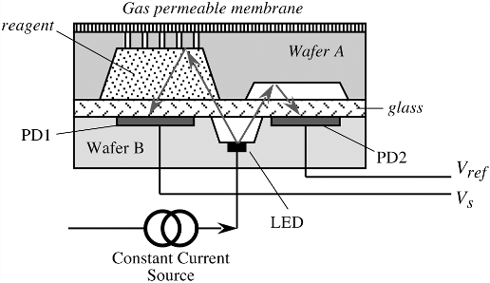
Fig. 17.12. Simplified configuration of an optical CO₂ sensor.
The sample part of the sensor monitors the optical absorbency of a pH indicator in a dilute solution, where the optical absorbency changes in accordance with the Beer–Lambert law:
I =I₀ exp [−α (λ, pH) dC] ,
where I is the transmitted intensity, I₀ is the source intensity, a is the molar absorptivity, λ is the wavelength, C is the concentration, and d is the optical path length.

Slide 48
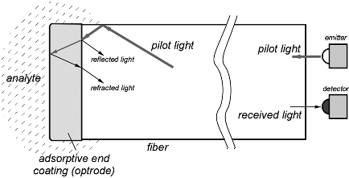
The LED common for both halves of the sensor transmits light through the pH sensitive sample to a test photodiode (PD1).
he second photodiode (PD2) is for reference purposes to negate variations in the light intensity of the LED.
For temperature stability, the sensor should operate in a thermally stable environment
Fig. 17.13. Fiber-optic gas sensor.

Slide 49
Chemical Sensors Versus Instruments
Because of the complexity of operation and numerous influences, a chemical sensor is rarely used alone, but, rather, it is a key part of a more rigorous chemical detection instrument.
An instrument often combines sensor measurement hardware with decision-making and control software (instructions).
Most instruments employ some form of feedback to adjust the operation based on actual conditions versus desired conditions.
Some instruments and micro instruments include components to perform
mechanical actions (e.g., pumping, filtration, and separation).
Instruments such as gas chromatographs, mass spectrometers, IR spectrometers, and others provide the most comprehensive chemical analysis, especially when compared to simple individual gas sensors
These instruments contain sensors calibrated to perform a specific type of measurement or analysis as well as support circuits and signal processing to control, minimize, and compensate for chemical signal drift and other operation-induced errors.

Slide 50
Liquid and gas chromatography (LC and GC, respectively) are effective and popular chemical analysis methods.
Chromatography involves injecting a liquid or gas analyte into a restrictive tube that is filled with a highly porous material presenting a highly tortuous path to the molecules in the analyte
The size of the pores in the material are chosen by prior experiments to closely match the physical size of the expected molecules in the sample.
The adsorption behavior of the material is also matched to the anticipated molecules.
An electrical (e.g., conductance) detector resides at the end of the tubing path and recognizes the presence of any molecules that exit the tube.
A timer is started when the sample is injected. As the sample passes through the porous material, the smaller molecules move easier and exit sooner than larger molecules.
This effectively separates the sample

Slide 51
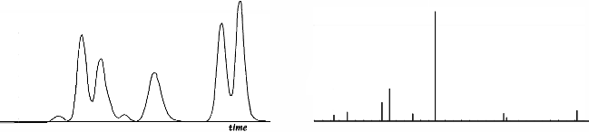
The samples are separated and eventually exit the tube, typically in groups with gaps in between.
The electrical detector records their overall concentration as a peak with a width, and an integrated area that is a function of that molecule’s concentration in the sample.
The time at which each peak is recorded is a function of the molecule size and adsorption characteristics and is used to differentiate molecules and identify them.
The resulting peak versus time data are called a “chromatogram”
(Fig. 17.16A).
B
A
Fig. 17.16. Gas-chromatography example (A) and mass-spectrometry example (B).

Slide 52
Chemometrics
Often, chemical analysis instruments produce a response signal that is complex and contains a significant amount of information.
This requires more advanced analysis than simple single-value measurements or threshold comparisons.
It is important to relate the required signal processing to the chemical sensor, as they influence each other quite significantly.
The study of chemical measurements is referred to as chemometrics and has been developed to address the particular challenges of chemical
sensors and complex chemical response analysis.
Chemometrics is responsible for a great deal of advanced data processing techniques, applying mathematical and statistical modeling to chemical systems.
In general, these techniques can be divided into data exploration and data analysis topics.

Slide 53
Part of both the exploration and analysis involves modeling the response data.
Models can be divided into parametric and nonparametric types.
Statistical techniques were once taught based on strong assumption about the data—assumptions that continuous variables followed Gaussian (Normal) distributions.
This also describes any fitting operation where a preassumed shape is assigned and the data fit against it.
The error is measured as deviation from the assumed fit. Statistical methods that make strict assumptions about the distribution for experimental data are referred to as parametric methods and produce exact solutions to approximate problems.
Approximate solutions to exact problems, the complement, make no assumptions about distributions.
These nonparametric models are usually easier and quicker to apply, with a simple theory that allows better judgment to be used in their application.
Robust statistical models are an alternative to strictly parametric or nonparametric methods.

Slide 54
Multisensor Arrays
Processing multiple measurements from individual chemical sensors and from a number of independent sensors can provide information needed to statistically reduce error and improve both the selectivity and sensitivity of a chemical sensor or chemical detection instrument.
Because measurement error is a sum of systematic error and random error, the measurement error of an individual sensor can be statistically reduced via multiple samples by using statistics to reduce or eliminate the random
error.
Multiple redundant sampling can provide enough data to reduce the measurement standard deviation by a factor of
1/ √ n,
where n is the number of redundant samples.
The redundant samples may come from the same sensor or multiple sensors of the same type to further ensure the best possible response .
This, however, is useful against random errors but is not efficient against systematic errors.

Slide 55
Responses from multiple independent sensors of different types can be combined (often referred to as sensor fusion) to provide overlapping reinforced responses that better span the sensors’ response spaces, leaving fewer gaps where analyte identification would be weak or unavailable.
Obviously, introducing any redundancy of sensors or multiplicity of measurements increases the amount of data and the complexity of signal processing.
There is a trade-off decision to be made between the additional work created and the quality of the decision that can be made with that corresponding data.
Often, the majority of improvements can be made to the measurement accuracy with only a limited number of multiple measurements.
Significant additional effort typically only gains a small amount of additional accuracy.

Slide 56
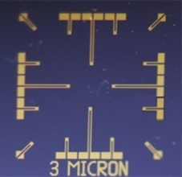
Substrate
Electrochemical bridging of 3 μm apart Au microelectrodes with P(NMP) nanowires were carried out in a template-free technique
3 μm
Au -180nm
Cr - 20nm
SiO2 - 300nm
Cross Sectional View
Si - 525μm
The Au microelectrodes were photolithographically patterned on Si/SiO2 wafers (having 3 µm gap between two electrodes) .
3 μm

Slide 57
Electronic Noses (Olfactory Sensors)

Slide 58
Electronic Nose : An Overview
The electronic nose mimics the human olfaction system
It include three major parts: a sample delivery system, a detection system, a computing system.
The sample delivery system is needed in order to introduce the odor into the nose
The detection system, generally a sensor set, is the “reactive” part of the instrument.
The computing system is needed to take care of the signal from the electronic interface transforming the signal into a digital value. Recorded data are then processed using algorithms and various models

Slide 59

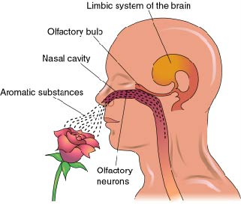


Rose
E-nose : A Conceptualization
Garbage

Slide 60
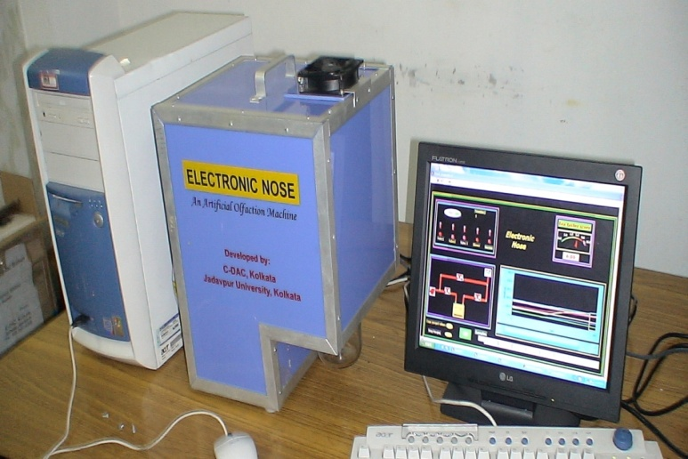
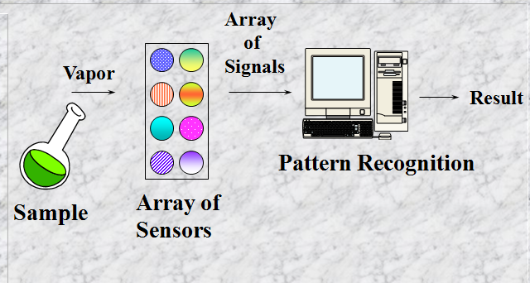
Electronic Nose : An Overview
Electronic nose is a device which
detects odour and analyze it.
MAIN COMPONENTS
Sensing system
Pattern recognition
system
SUB COMPONENTS
Sample delivery
system
Detection system
Computing system

Slide 61
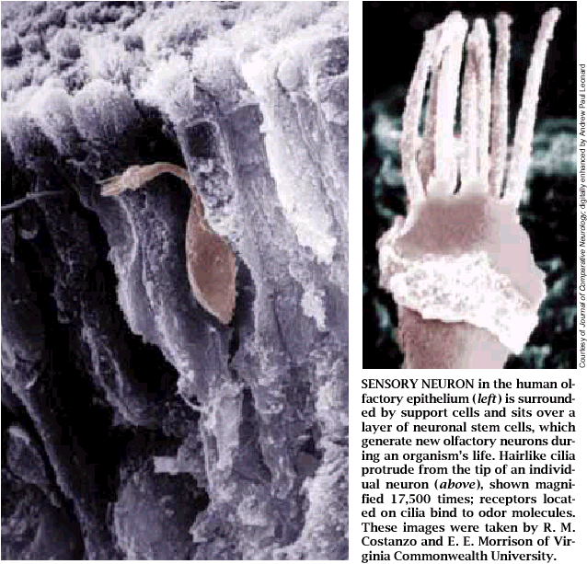
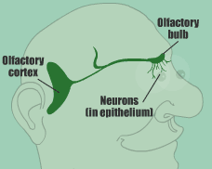
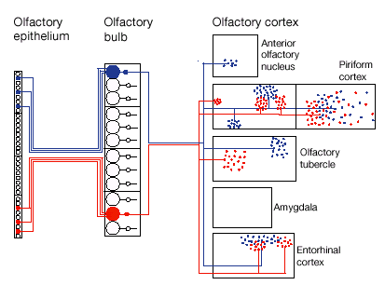
A Code in the Nose – Mammalian Olfaction
Mammalian olfactory systems have large numbers of ORNs in the epithelium (~10M humans, ~100M dog).
There are ~1000 different ORN genes. (We smell in ~1000 different “colors”).
Sensors are broadly tuned:
  Single receptor recognizes multiple odorants (ligands).
  A single odorant is recognized by multiple receptors.
A full 1% of the rat genome is encoding for ORNs – smell is important!
Each receptor expresses only one gene.
Each Glomerulus (~2000) receives signals from only one type of ORN.
Approximately 2500 receptors impinging into each Glomerulus. (This makes sense: ORNs die-you need redundancy, Improved signal to noise ratio .

Slide 62
E-nose Technology – Conceptualization
Polymer doped with conducting particles.
Sensor polymer material swells upon exposure to odor.
Results in a long path for current, hence higher resistance.
Conduction mechanism primarily electron tunneling.
On
B
Off
Resistance
∆R_{max}
A
R_{baseline}
Time
A
B

Slide 63
E- nose : Sensor Requisite
3
9
9
0
0
3
9
8
0
0
O
d
o
)
r
s
R
e
m
o
v
e
m
d
h
3
9
7
0
O
0
(
e
c
n
a
3
9
6
0
t
0
O
d
o
s
r
i
s
e
A
p
p
l
i
e
R
3
d
9
5
0
0
3
9
4
0
0
3
9
3
0
0
0
2
0
0
4
0
0
6
0
0
8
0
0
T
i
m
e
(
s
)
Fast (<100ms) – essential for robotic applications
Repeatable-essential for real world applications
Linear with concentration – essential for simple concentration invariant pattern recognition (unlike the mammalian olfactory system)
Broadly tuned – one sensor responds to many different odors to varying degrees (like the mammalian olfactory system)

Slide 64
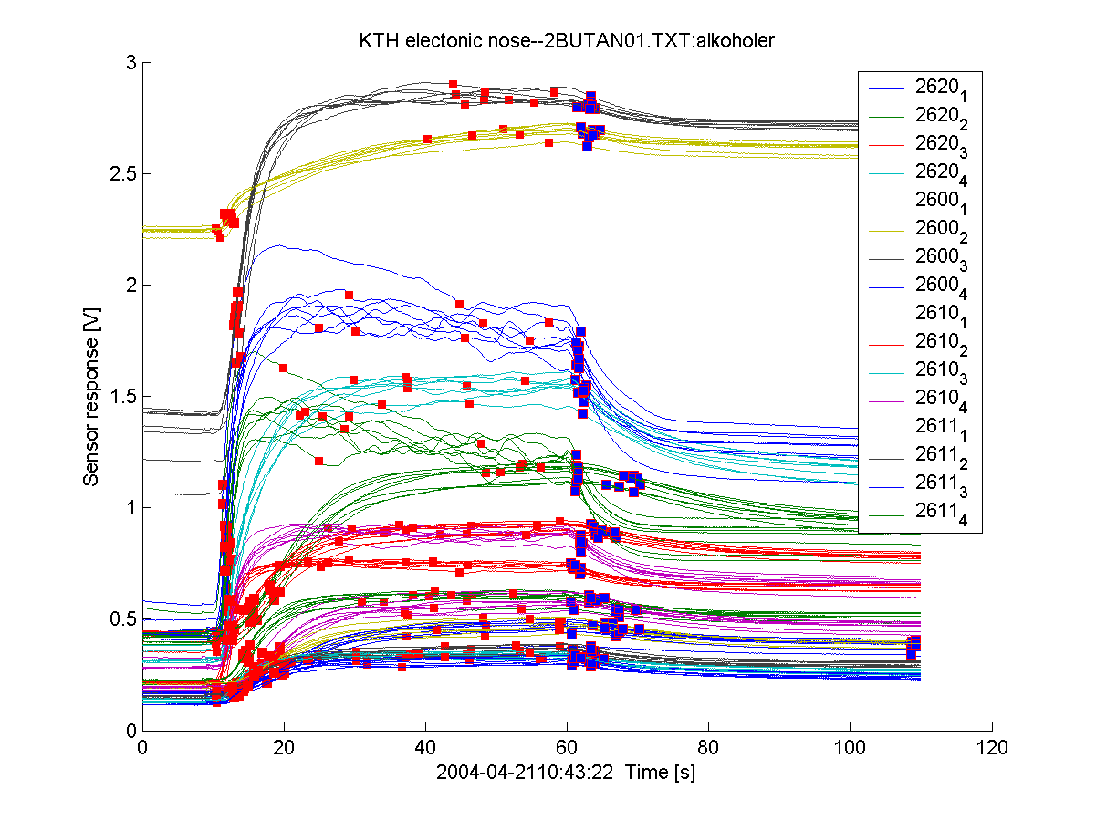
Electronic Nose : Conceptualization
When we have 16 sensors in e-nose to smell alcohol, we get 16 analog signals like this

Slide 65
Data Processing : Sensor Array ( e-nose)

Slide 66
∆R_{max} / R_{b} for each sensor normalized across the array results in a concentration independent pattern that characterizes the odor.

Slide 68
Electronic Nose : Overview
Biological taste system
Taste compounds
Electric
responses
Brain
Taste cell
Taste
reception
Nerve cell
Artificial liquid system - electronic tongue
Sensor
responses
Sensor
array
Computer
Pattern
recognition

Slide 69
The principle of measurement and data processing that is described in this subsection is an example of a bionic approach of resolving the selectivity and sensitivity.
The main idea is to use many sensors of different types and process data in a way that resembles data processing by living brains.
Although today we still know very little of how brain really works, some ideas suggested by Nature already can be put to a practical use.
Processing and analyzing the signals produced by multisensor arrays
typically involves pattern recognition.
Electronic noses, or e-noses, are less a sensor or instrument and more a measurement strategy.
Electronic noses have become popular and combine advanced sensors and sensor array strategies with chemometrics techniques to produce a broad range of intermediate instruments and analyzers.

Slide 70
Early e-noses tried to duplicate the behavior and capability of human odor sensing.
They combined different sensor types to represent the different cell tissues in the nasal cavity and they took the approach of detecting an odor as a collection of individual chemicals.
The name “odor sensor” is used instead of “gas sensor” whenever its
sensitivity approaches that of a human.
Odor and fragrance sensors find applications in forensic science, quality assurance in the cosmetic and food industry, environmental control, and so forth.
All methods of odor measurements can be divided into four groups: instrumentational analysis, semiconductor gas sensors, membrane potentialtype odor sensors, and the quartz microbalance method.

Slide 71
Porphyrin-Functionalized Single-Walled Carbon Nanotube
Chemiresistive Sensor Arrays for VOCs
Mahendra D. Shirsat,Tapan Sarkar,James Kakoullis, Jr.,Nosang V. Myung,Bharatan Konnanath, Andreas Spanias,and Ashok Mulchandani,
Department of Chemical and Environmental Engineering, University of California, Riverside, California, United States
Department of Chemistry, University of California, Riverside, California, United States
SIP Center, School of ECEE, Arizona State University, Tempe, Arizona, United States
J. Phys. Chem. C 2012, 116, 3845−3850
American Chemical Society

Slide 72
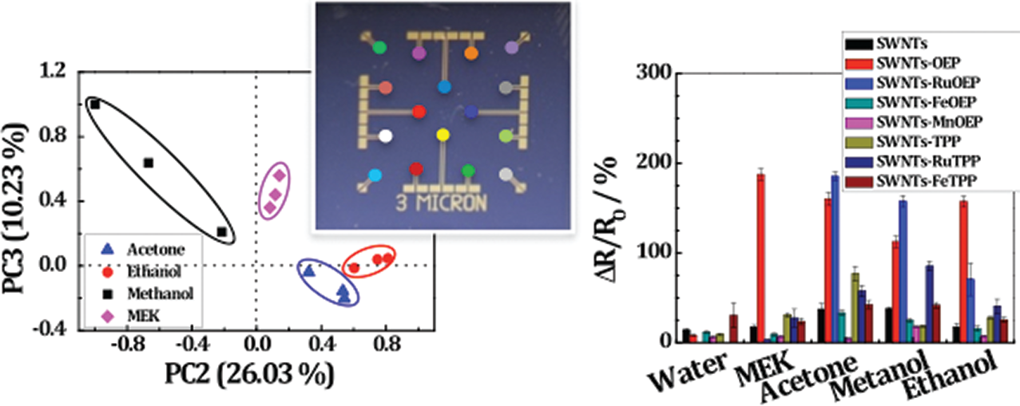

Slide 73
“Smart” Chemical Sensors
Many other chemical sensors, both commercial and experimental, employ a growing variety of phenomena and strategies.
Trends in microelectronics and programmable controllers will lead to the production of “smart” chemical sensors.
The future of chemical sensors lies in these smart devices.
A smart sensor incorporates some level of the data processing into the sensor directly, distributing some of the intelligence of the instrument and allowing functional and useful systems to be designed with lower intelligence required in the instrument.
A smart chemical sensor should include inter device communication and local drift and recalibration capabilities so that remote polling control systems would only receive measurements.
A smart chemical sensor may also perform routine unit conversion (i.e., from % to ppm) and report different units to different requests.

Slide 74
In this way, the same (smart) sensor can provide a measurement to different hosts without requiring any of them to introduce any additional scaling of their own; they work with whatever local units they chose.

Slide 75
Microcontroller
Timer Logic
A/D
Memory
I/O Port
Intelligent Display
Filter & Amplifier
Time Div. Multiplex.
Selector Logic
Sensor
External Channel Selector
Power

Slide 76

Thank
You

