Slide 1
A4 Chapter 3 and 4 : Optical and Physical Sensors
Mahendra D. Shirsat
Professor
Department of Physics
Dr. Babasaheb Ambedkar Marathwada University,
Aurangabad (MS)-431 004
Email: mdshirsat@gmail.com

Slide 2
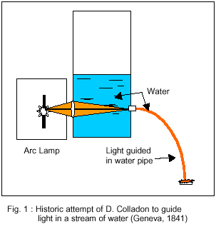
Historical Overview of optical fiber
The first attempt for guiding light on the basis of total internal reflection in a medium has been made in 1841 by Daniel Colladon. He attempted to couple light from an arc lamp into a stream of water

Slide 3
What is an Optical Fiber?
An optical fiber is a waveguide for light
consists of :
core inner part where light propagates
cladding outer part used to keep light in core
buffer protective coating
jacket outer protective shield

Slide 4
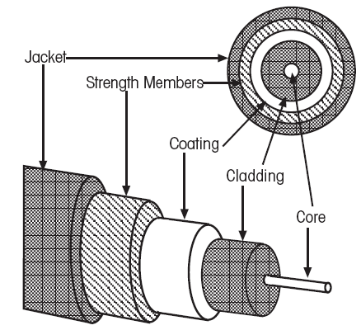
Structure of Optical Fiber
Figure : Cross section of an optical fiber

Slide 5
Optical fibers are made up of either glass or plastic
Core & Cladding : Glass
Core & Cladding : Plastic
Core : Glass and Cladding : Plastic
They make use of TIR to confine light within core of the fiber. The core has a higher refractive index than the cladding.
Although cladding does not carry light, it is nevertheless an essential part of the fiber.

Slide 6
The cladding is not just a mere covering. It keeps the value of the critical angle constant throughout the whole length of the fiber.
Optical Fibers are optical waveguides. This means that wherever the light travel through the fiber is confined to the core of the fiber.

Slide 7
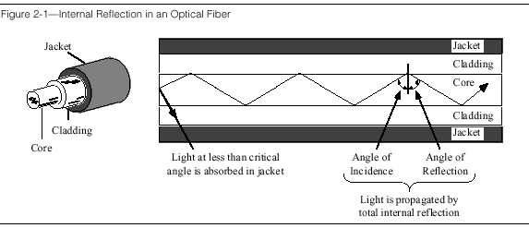
Structure of optical Fiber (contd)

Slide 8

Figure : Total Internal Reflection
The main principle behind the reflection is, total internal reflection, as the walls of the thin fiber acted like mirrors in which the incident light bounced back and forth

Slide 9
Propagation of light from one medium to another medium
Refractive Index n₁
θ₁
Medium 1
Medium 2
θ₂
Refractive Index n₂
n₁=n₂

Slide 10
Propagation of light from one medium to another medium
Refractive Index n₁
θ₁
Medium 1
Medium 2
θ₂
Refractive Index n₂
Figure n₁ < n₂

Slide 11
Propagation of light from one medium to another medium
Medium 2
Refractive Index n₂
θ₁
θ₁
Medium 1
Refractive Index n₁
n₁>n₂

Slide 12
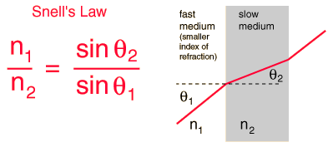
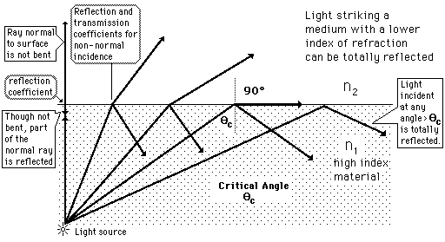
Based on Total Internal Reflection
Taken from http://hyperphysics.phy-astr.gsu.edu/hbase/phyopt/totint.html#c1

Slide 13
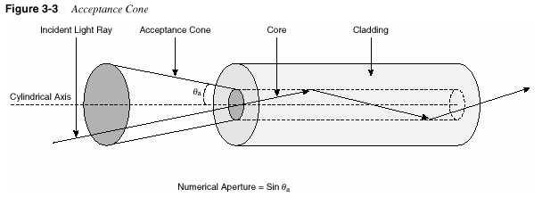
Acceptance cone

Slide 14
NA of a Fiber
The NA defines a cone of acceptance for light
that will be guided by the fiber

Slide 15
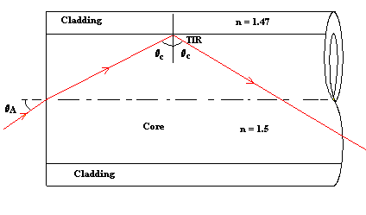
Figure : Propagation of light in Fiber
The angle θ_{A} in above is called the Acceptance Angle.
Any light entering the fiber at less than this angle will meet the cladding at an angle greater than θ_{C}.
If light meets the inner surface of the cladding (the core - cladding interface) at greater than or equal to θ_{C} then TIR occurs.

Slide 16
Types of Optical Fiber
There are two types of optical fibers
Step index (multimode, single mode).
Graded index (multimode).

Slide 17
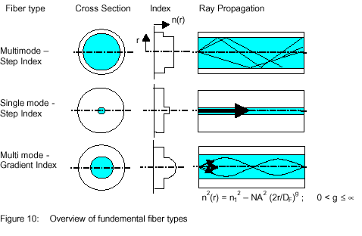

Slide 18
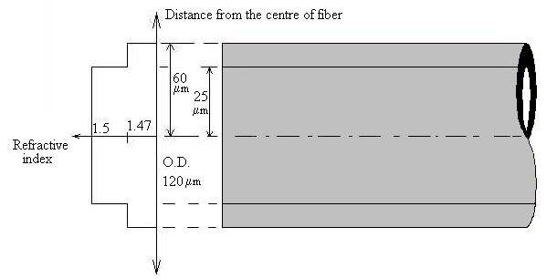
Figure : Step Index

Slide 19
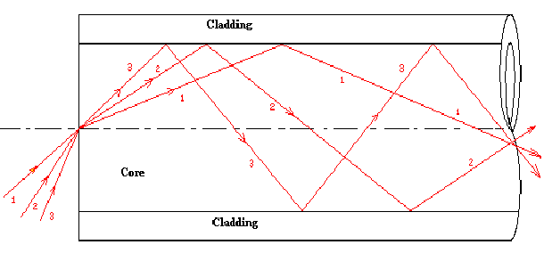
In a multimode fiber many different modes are supported by the fiber. This is shown in the diagram below.
Multimode

Slide 20
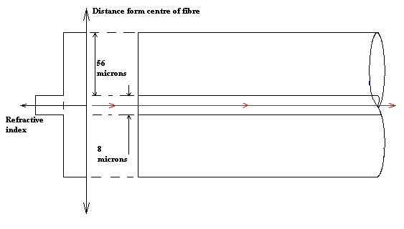
Since core of single mode fiber is narrow it can support only one mode.
This is called the "Lowest Order Mode". Single mode fiber has many advantages over multimode fiber
Single Mode

Slide 21
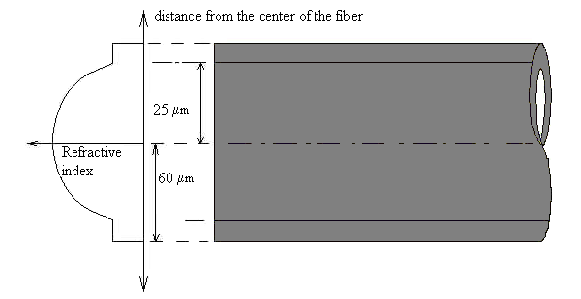
Graded Index Fiber has a different core structure from single mode and multimode fiber.
In a step-index fiber the refractive index of the core is constant throughout the core.
However, in a graded index fiber the value of the refractive index is maximum at the center and minimum at the edge of the fiber.
Graded Index Fiber

Slide 22
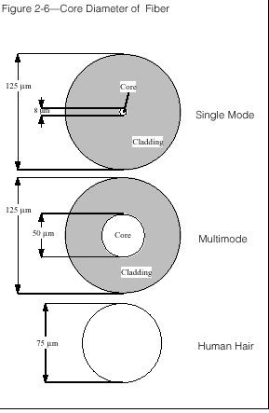
Core diameter of the Fiber

Slide 23
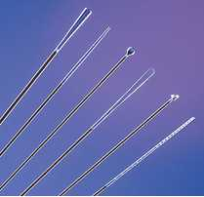
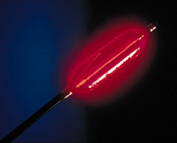

Types of fiber ends
beam patterns can be:
spherical
cylindrical
bundles
90 degree

Slide 24
Advantages
Capacity
Optical fibers carry signals with much less energy loss than copper cable and with a much higher bandwidth.
Bandwidth
Fiber optic systems are now able to transmit several gigabits per second over several hundreds of kilometers.

Slide 25
Size and Weight
Optical fiber cables are much lighter and thinner than copper cables.
Security
It is difficult to tap information with optical fiber cable.
They can be routed safely through explosive or flammable atmospheres.

Slide 26
Running Costs
A copper cable system consumes far more electrical power than fiber.
Flexibility
The glasses are of small diameters allowing it to be flexible enough to wrap around a pencil.

Slide 27
Less Loss
Fiber cables are able to give better reception as well as transmit more information.
Reliability
Fiber optics has a long life span since it is more resistant to corrosion, which is caused by environmental extreme conditions.

Slide 28
Disadvantages
Price
Optical fibers are still more expensive than copper.
Special Skills
Optical fibers cannot be joined (spliced) together as a easily as copper cable and requires additional training of personnel and expensive precision splicing and measurement equipment

Slide 29
Advantages of Optical fiber sensors
No electrical power in the sensing head
Chemically inert
Light weight and small.
Allows integration with semi conducting
material component.
Disadvantages
Dependence on several environmental parameters.

Slide 30
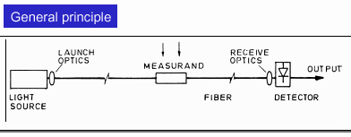
Basic Principle of Optical fiber Sensor
Basic block diagram

Slide 31
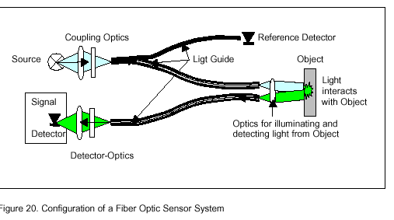

Slide 32
Fiber Optics Sensors
Intrinsic Extrinsic
In intrinsic, the physical properties of the fiber undergo a change.
Extrinsic sensing takes place in a region outside of the fiber

Slide 33
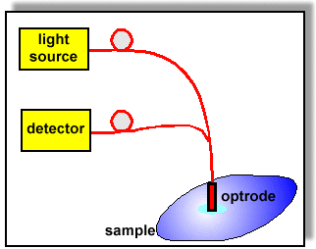
Fiber optic chemical sensors
Fig. Schematic experimental set-up of FOCS.

Slide 34
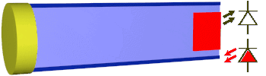
Operating Principle of pH Sensor
Operating principle of a pH sensor based on absorbance indicator
The pulse of light from a light emitting diode (LED) is coupled into optical fiber and transmitted to a pH sensitive membrane. The membrane changes its absorbance (colour) is depends on pH of the sample. If the absorbance is quite low the light is only slightly absorbed which is depicted by almost the same pulse of the light returning to the photodiode.

Slide 35
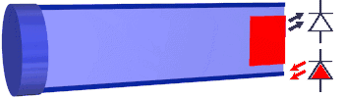
Sensor based on absorbance indicator at solution of different pH.
When the pH of the sample increases the absorbance of the membrane increases so the returning pulse of the light is smaller

Slide 36
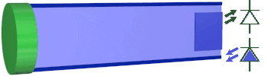
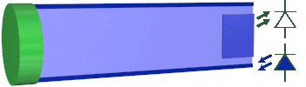

Slide 37
Signal Conversion in the Sensor
Typical conversion process of the signal in the FOCS is presented
Light
Electrical
Analyte
Chemo optical
Interface
Optoelectronic
Interface
Signal
Conversion of the signal in fiber optic chemical Sensor

Slide 38
Potentiometric Sensors
A position or displacement transducer may be built with a linear or rotary potentiometer or a pot for short. The operating principle of this sensor is based on following Eq. (3.54) of Chapter 3 for wire resistance.
R =ρ l /a
where a is the cross sectional area and l is the length of the conductor
From the formula, it follows that the resistance linearly relates to the wire length.
Thus, by making an object to control the length of the wire, as it is done in a pot, a displacement measurement can be performed.
Because a resistance measurement requires passage of an electric current through the pot wire, the potentiometric transducer is of an active type; that is, it requires an excitation signal, (e.g., dc current).
A stimulus (displacement) is coupled to the pot wiper, whose movement causes the resistance change (Fig. 7.1A).

Slide 39
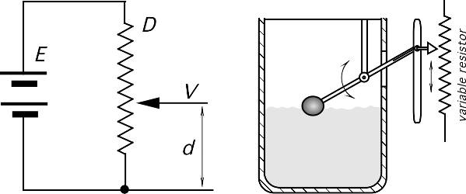
A
Fig. 7.1. (A) Potentiometer as a position sensor;

Slide 40
In most practical circuits, the resistance measurement is replaced by a measurement of voltage drop.
The voltage across the wiper of a linear pot is proportional to the displacement d:
V =E d / D , (7.1)
where D is the full-scale displacement and E is the voltage across the pot (excitation signal).
This assumes that there is no loading effect from the interface circuit. If there is an appreciable load, the linear relationship between the wiper position and the output voltage will not hold.
In addition, the output signal is proportional to the excitation voltage applied across the sensor.
This voltage, if not maintained constant, may be a source of error.

Slide 41
It should be noted that a potentiometric sensor is a ratiometric device ; hence the resistance of the pot is not a part of the equation.
This means that its stability (e.g., over a temperature range) virtually has no effect on accuracy.
For the low-power applications, high-impedance pots are desirable; however, the loading effect must be always considered.
Thus, a good voltage follower is required.
The wiper of the pot is usually electrically isolated from the sensing shaft

Slide 42
Electrochemical Sensors
Electrochemical sensors are the most versatile and highly developed chemical sensors.
They are divided into several types:
Potentiometric (measure voltage)
Amperometric (measure current)
Conductometric (measure conductivity)
Sometimes the distinction between these types can be blurred.
In all these sensors, special electrodes are used.

Slide 44
Electrochemical Sensors
Either a chemical reaction takes place or the charge transport is modulated by the reaction
Electrochemical sensing always requires a closed circuit. Current must flow to make a measurement.
Since we need a closed loop we need at least two electrodes.
These sensors are often called an electrochemical cell.
How the cell is used depends heavily on the sensitivity, selectivity and accuracy.

Slide 45
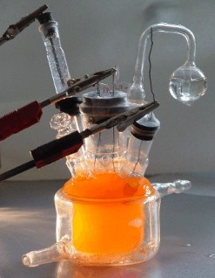
Potentiometric Sensors
Potentiometric sensors use the effect of the concentration on the equilibrium of redox reactions occurring at the electrode-electrolyte interface of an electrochemical cell
The redox reaction takes on the electrode surface:
Oxidant + Ze⁻ => Reduced product
Z is the number of electrons involved in the redox reaction
www.chemie.uni-greifswald.de/

Slide 46
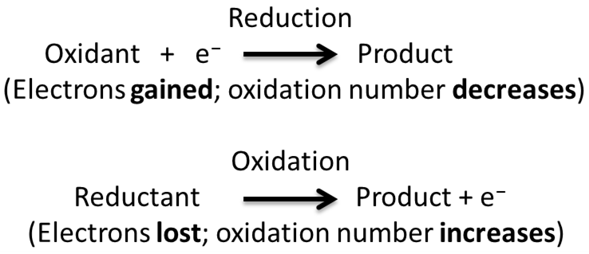
Redox (reduction-oxidation) reactions include all chemical reactions in which atoms have their oxidation state changed; in general, redox reactions involve the transfer of electrons between species.
Oxidation is the loss of electrons or an increase in oxidation state by a molecule, atom, or ion.
Reduction is the gain of electrons or a decrease in oxidation state by a molecule, atom, or ion.

Slide 47
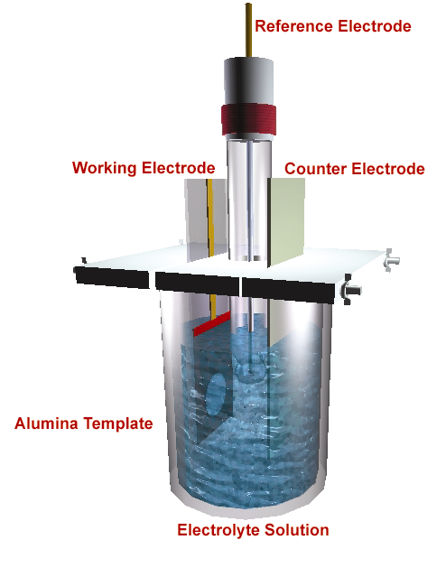
Schematic of 3-electrode electrochemical cell

Slide 48
Electrochemical Potentiometric Sensor
WE RE
Current /voltage meter
I/V
Constant Current & voltage Source
2-electrode electrochemical cell

Slide 49
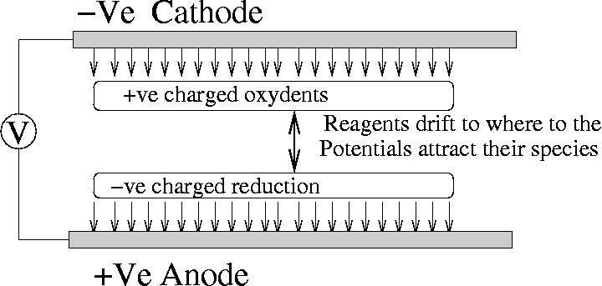
Electrochemical Cell
The reaction takes place at the cathode where electrons are “pulled” out of the electrode.

Slide 50
Nernst Equation
The Nernst equation gives the potential of each half cell.
Co is the oxidant concentration
C_{R} is the Reduced Product Concentration
n is the number of electrons transferred per redox reaction
F is the Faraday constant
T is the temperature
R is the gas Constant
E₀ is the electrode potential at a standard state.
In a potentiometric sensor, two half-cell reactions take place at each electrode. Only one of the reactions should involve sensing the species of interest. The other should be a well understood reversible and non-interfering reaction

Slide 51
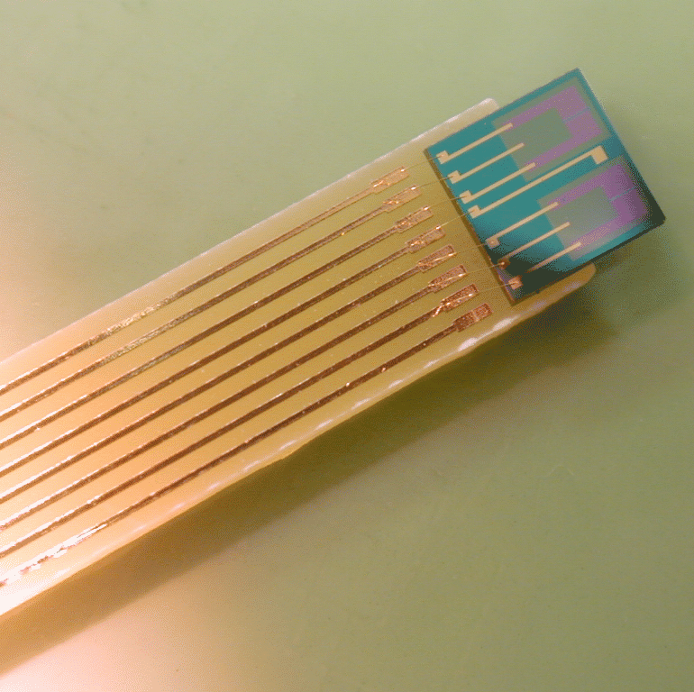
CHEMFET Sensors
Very popular where small size and low power consumption is essential. (Biological and Medical monitoring).
CHEMFETs are chemical amperrometric sensors based on the Field-Effect transistors
CHEMFETs are solid state sensors suitable for batch fabrication.
The surface field effect can provide high selectivity and sensitivity.
These are extended gate field-effect transistors with the electrochemical potential inserted over the gate surface.

Slide 52
Four types of CHEMFETs:
Ion Selective
gas selective,
enzyme-selective
immuno-selective sensors.
Ion selective are the most widely used, known as ISFETs
A lot of the art of CHEMFETs is in engineering the porous layer over the gate.

Slide 53
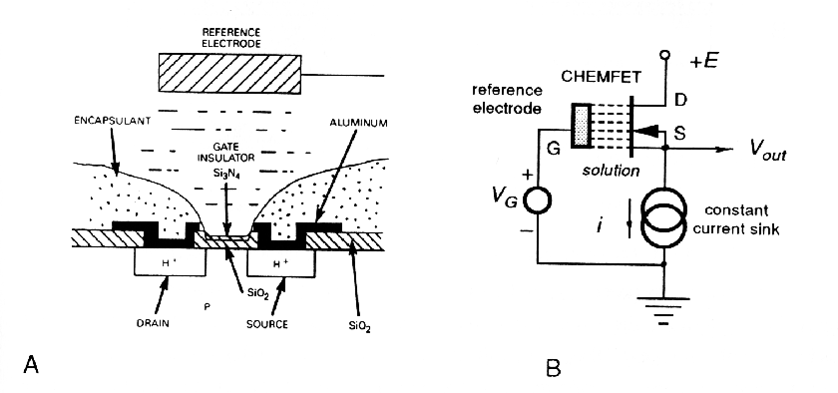
The sensor is given a pH sensitivity by exposing the bare silicon nitride gate insulator to the sample solution.
Ion selective CHEMFET with a silicon nitride gate for measuring pH (H⁺ ion concentration.)

Slide 54
Ionic selectivity is determined by the surface complexation of the gate insulator. Selectivity of the sensor can be obtained by varying the composition of the gate insulator.
As the ionic concentration varies, the surface charge density at the CHEMFET gate changes as well.

Slide 55
Also add ion-selective membranes can be deposited on the top of of the gate to provide a large selection of different chemical sensors.
A change in the surface charge density affects the CHEMFET channel conductance, which can be measured as a variation in the drain current.
Thus a bias applied to to the drain and source of the FET results in a current I, controlled by the electrochemical potential.
This in turn is proportional to the concentration of the interesting ions in solution.

Slide 56
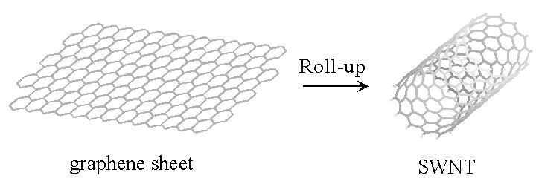
Carbon nanotubes
Sheets of carbon atoms can be ‘rolled’ up into tubes of nanometer dimensions
Layers of nanotubes have a huge surface to volume ratio

Slide 57
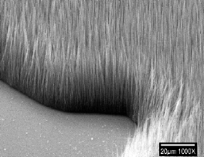
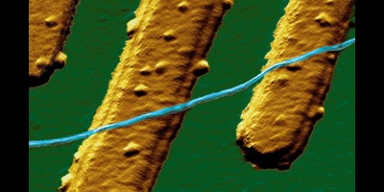
Carbon nanotubes
Carbon nanotubes can be grown in mass, or separated as individuals.
Nanotube (blue) lying across electrodes
Nanotube forest

Slide 58
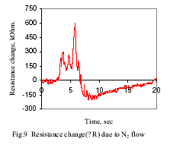
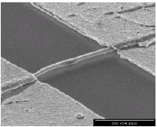
Carbon Nanotube sensors
The Scanning Electron Micrograph shows a bridge made from a single nanotube.
It is linking two ‘cliffs’ made of Au and Ti.
N₂ gas is blown up from the bottom
The resistance of the sensor increases upon exposure to N₂ gas
www.bios.el.utwente.nl/internal/Transducers03/Volume_1/2E80.P.pdf

Slide 59
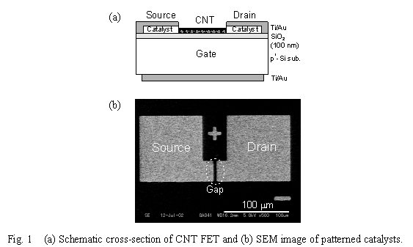
CNT FET sensor
Can also make FET sensors out of carbon nanotubes
A small current in the nanotube causes a much larger current in the FET
This particular sensor responds to light.
www.echo.nuee.nagoya-u.ac.jp/~yohno/research/cnt/qnn03_abstract_submitted.htm

Slide 60
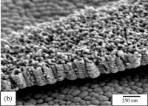
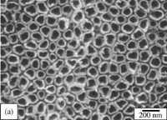
Titanium nanotube sensors
H₂ gas is ionised when it hits the walls of the titanium nanotubes
The resulting electron current is a measure of the amount of hydrogen present.
www.eurekalert.org/pub_releases/2003-07/ps-tnm072903.php

Slide 61

Gas
Gate
Insulator
Source
Drain
n
n
p-Si
Insulated Gate Field Effect Transistor

Slide 62
Gas
Active Layer
(Conducting Polymer)
Source
Drain
Insulator
Gate
Back-gated Field Effect Transistor

Slide 63
FET Transfer Sensing of Analytes
Before Analyte
Schottkey Barrier Modulation
I _{DS}
After Analyte
Before Analyte
V _{GS}
I _{DS}
Electrostatic Gating Effect
After Analyte
V _{GS}

Slide 64

Types of ChemFETs
V_{g}
V_{SD}
Source
Transducer
Drain
Gate
Back-gated FET sensor
V_{SD}
V_{SD}
V_{g}
Gate
V_{g}
Liquid
Gate
Source
Transducer
Drain
Source
Sensing Layer
Drain
Transducer
Liquid Ion-gated FET sensor
FET sensor with sensing layer as gate

Slide 65
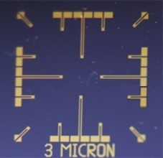
Substrate
3 μm
Au -180nm
Cr - 20nm
SiO2 - 300nm
Cross Sectional View
Si - 525μm
The Au microelectrodes were photolithographically patterned on Si/SiO2 wafers (having 3 µm gap between two electrodes)
3 μm

Slide 66

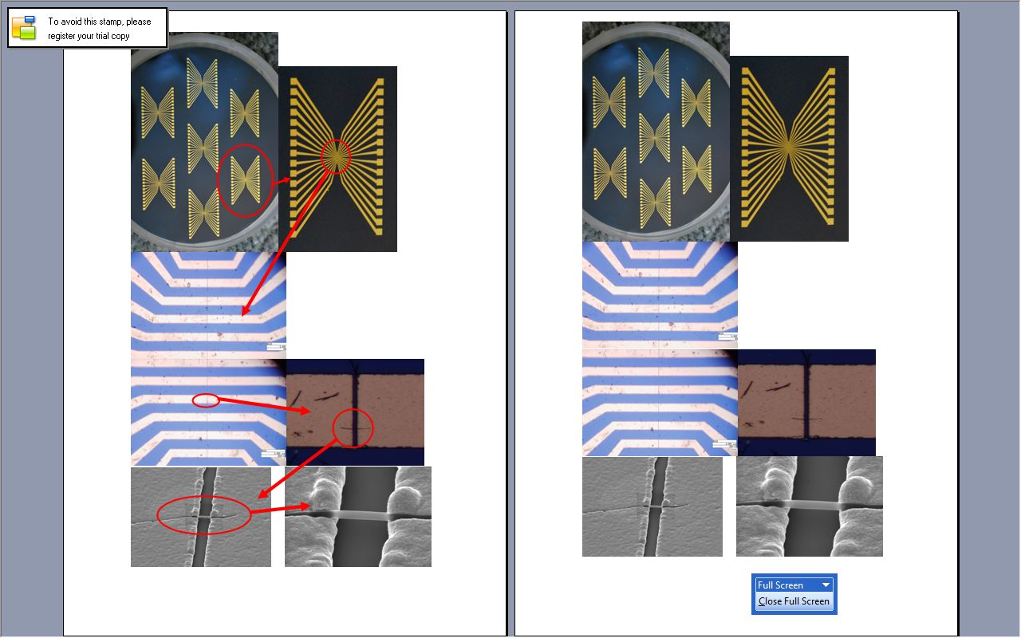
Electrode Design
Microfabricated Gold Electrodes:
Si/SiO substrate
Cr adhesion Layer ~ 20 nm
Gold Layer ~ 180 nm
Au ~180 nm
SiO₂ ~ 300 nm
Cr ~20 nm
Si ~ 525 μm

Slide 67
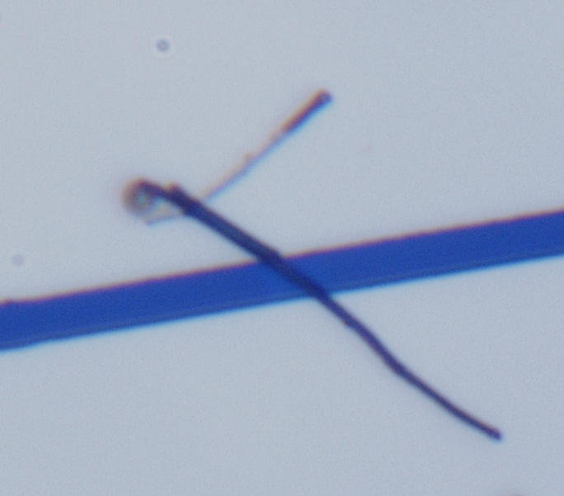
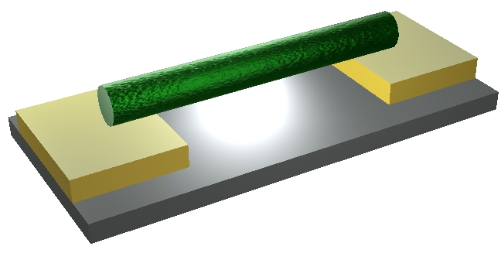
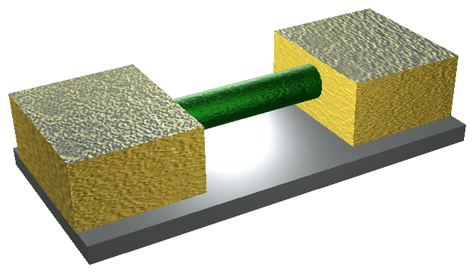
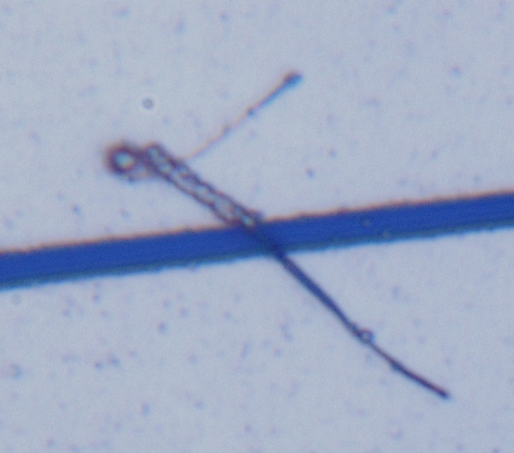
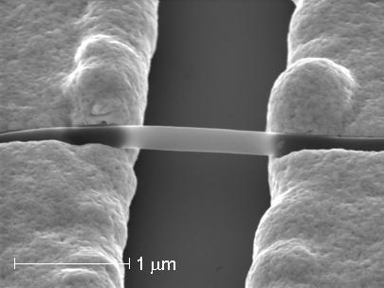
Device Fabrication
Electrodeposition of Au
10 mins
Notes:
67

Slide 68
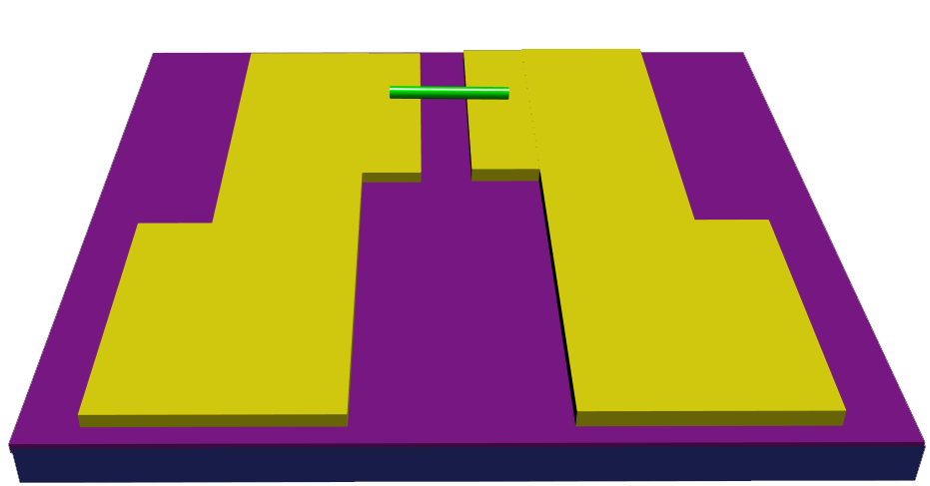
ChemFET Sensor Schematic
Conducting polymer coated SWNT conducting Channel
Insulating Layer (SiO₂)
Drain
Source
Gate
Silicon substrate
V_{G}
V_{DS}
Notes:
68
ChemFET based gas sensor. How it works is that when current is passed through the sensitive layer in contact with electrodes pairs (source & drain) and the third electrode which normally is highly doped Si is used as a back gate to modulate the current flow by applying gate bias potential., at the same time, sensors are exposed to gaseous analytes causing the electrical resistance of the sensitive layer changed as a result of charge transfer between sensitive layer surface and binded gas analyte.
chemiresistor configuration functions tha same way as ChemFET except no back gate applied. Showing here is a chemiresistor of conventional thin film sensor. Since it requires a number of adsorbed gas molecules to cause the effect on the bulk current flow in order to detect a measurable signal, it has low sensitivity. To improve the sensitivity with expanding world of nanotechnology,

Slide 69
Room Temperature FET Measurements

Slide 70
FET transfer characteristics

Slide 71
Gravitational Sensors
A well-known, popular gravitational-level transducer is used in a toilet tank.
The transducer’s main element is a float—a device whose density is lower than that of water.
In most tanks, it is directly coupled to a water valve to keep it either open or shut, depending on how much water the tank holds.
The float is a detector of the position of the water surface.
For the measurement purposes, the float can be coupled to a position transducer, such as a potentiometric, magnetic, capacitive, or any other direct sensor (Fig. 7.1B).

Slide 72
B
Fig. 7.1. (B) gravitational fluid level sensor with a float;

Slide 73
It should be noted that the gravitational sensor is susceptible to various interfering forces, resulting from friction and acceleration.
Obviously, such a sensor will not work whenever gravity is altered or absent.
A space station or a jet is not an appropriate place for such a sensor.
Inclination detectors, which measure the angle from the direction to the Earth’s center of gravity, are employed in road construction, machine tools, inertial navigation systems, and other applications requiring a gravity reference.
An old and still quite popular detector of a position is a mercury switch (Figs. 7.3A and 7.3B).

Slide 74
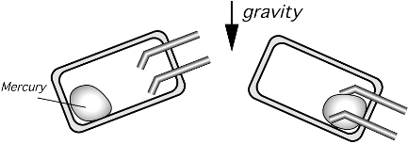
A
B
Fig. 7.3. Conductive gravitational sensors: (A) mercury switch in the open position; (B) mercury switch in the closed position;
The switch is made of a nonconductive (often glass) tube having two electrical contacts and a drop of mercury.
When the sensor is positioned with respect to the gravity force in such a
way that the mercury moves away from the contacts, the switch is open.
A change in the switch orientation causes the mercury to move to the contacts and touch both of them, thus closing the switch.

Slide 75
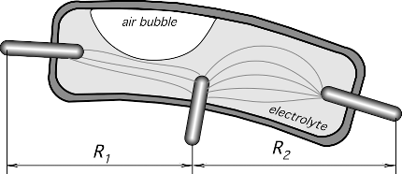
Fig. 7.3 (C) electrolytic tilt sensor.
C
To measure angular displacement with higher resolution, a more complex sensor
is required.
One elegant design is shown in Fig. 7.3C. It is called the electrolytic tilt sensor. Asmall slightly curved glass tube is filled with a partly conductive electrolyte.
Three electrodes are built into the tube: two at the ends, and the third electrode at the center of the tube.
An air bubble resides in the tube and may move along its length as the tube tilts. Electrical resistances between the center electrode and each of the end electrodes depend on the position of the bubble.
As the tube shifts away from the balance position, the resistances increase or decrease proportionally.
The electrodes are connected into a bridge circuit which is excited with an ac current to avoid damage to the electrolyte and electrodes.

Slide 76
Capacitive Sensors
The capacitive displacement sensors have very broad applications, they are employed directly to gauge displacement and position and also as building blocks in other sensors where displacements are produced by force, pressure, temperature, and so forth.
The ability of capacitive detectors to sense virtually all materials makes them an attractive choice for many applications.
Following Equation states that the capacitance of a flat capacitor is inversely proportional to the distance between the plates.
C = ε0A / d
The operating principle of a capacitive gauge, proximity, and position sensors is based on either changing the geometry (i.e., a distance between the capacitor plates) or capacitance variations in the presence of conductive or dielectric materials.

Slide 77
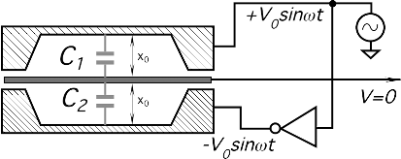
When the capacitance changes, it can be converted into a variable electrical signal.
As with many sensors, a capacitive sensor can be either monopolar (using just one capacitor) or differential (using two capacitors), or a capacitive bridge can be employed (using four capacitors).
When two or four capacitors are used, one or two capacitors may be either fixed or variable with the opposite phase.
As an introductory example consider three equally spaced plates, each of area A (Fig. 7.5A).
The plates form two capacitors C1 and C2.
The upper and lower plates are fed with the out-of-phase sine-wave signals; that is, the signal phases are shifted by 180◦.
Both capacitors nearly equal one another and thus the central plate has almost no voltage because the currents through C1 and C2 cancel each other.
A
Fig. 7.5. Operating principle of a flat plate capacitive sensor ( A) -balanced position;

Slide 78
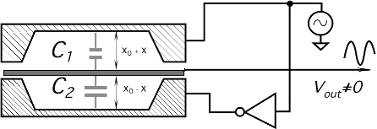
Fig. 7.5. Operating principle of a flat plate capacitive ; (B)disbalanced position
Now, let us assume that the central plate moves downward by a distance x (Fig. 7.5B).
This results in changes in the respective capacitance values:
C1 = εA / x0 +x and C2 = εA / x0 −x
and the central plate signal increases in proportion to the displacement and the phase of that signal is an indication of the central plate direction—up or down.
The amplitude of the output signals is
Vout =V0 { ( − x / (x0 +x) ) + (ΔC /C) }
As long as x< X0, the output voltage may be considered a linear function of displacement.

Slide 79
Inductive and Magnetic Sensors
One of many advantages of using magnetic field for sensing position and distance is that any nonmagnetic material can be penetrated by the field with no loss of position accuracy.
Stainless steel, aluminum, brass, copper, plastics, masonry, and woods can be penetrated, meaning that the accurate position with respect to the probe at the opposite side of a wall can be determined almost instantly.
Another advantage is the magnetic sensors can work in severe environments and corrosive situations because the probes and targets can be coated with inert materials that will not adversely affect the magnetic fields.

Slide 80
LVDT ( linear variable differential transformer) and RVDT ( rotary variable differential transformer)
Position and displacement may be sensed by methods of electromagnetic induction.
A magnetic flux coupling between two coils may be altered by the movement of an object and subsequently converted into voltage.
Variable-inductance sensors that uses a nonmagnetized ferromagnetic medium to alter the reluctance (magnetic resistance) of the flux path are known as variable-reluctance transducers.

Slide 81
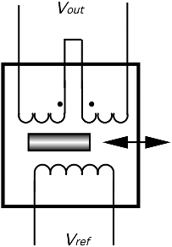
The basic arrangement of a multi-induction transducer contains two coils: primary and secondary.
The primary carries ac excitation (Vref ) that induces a steady ac voltage in the secondary coil (Fig. 7.9).
The induced amplitude depends on flux coupling between the coils.
There are two techniques for changing the coupling.
One is the movement of an object made of ferromagnetic material within the flux path.
This changes the reluctance of the path, which, in turn, alters the coupling between the coils.
This is the basis for the operation of a LVDT (linear variable differential transformer), a RVDT (rotary variable differential transformer), and the mutual inductance proximity sensors.
Fig. 7.9. Circuit diagram of the LVDT sensor.

Slide 82
The LVDT is a transformer with a mechanically actuated core.
The primary coil is driven by a sine wave (excitation signal) having a stabilized amplitude.
The sine wave eliminates error-related harmonics in the transformer.
An ac signal is induced in the secondary coils.
A core made of a ferromagnetic material is inserted coaxially into the cylindrical opening without physically touching the coils.
The two secondaries are connected in the opposed phase.
When the core is positioned in the magnetic center of the transformer, the secondary output signals cancel and there is no output voltage.

Slide 83
Moving the core away from the central position unbalances the induced magnetic flux ratio between the secondaries, developing an output.
As the core moves, the reluctance of the flux path changes.
Hence, the degree of flux coupling depends on the axial position of the core.
At a steady state, the amplitude of the induced voltage is proportional, in the linear operating region, to the core displacement.
Consequently, voltage may be used as a measure of a displacement.
The LVDT provides the direction as well as magnitude of the displacement.
The direction is determined by the phase angle between the primary (reference) voltage and the secondary voltage.
Excitation voltage is generated by a stable oscillator.

Slide 84

To exemplify how the sensor works, Fig. 7.10 shows the LVDT connected to a synchronous detector which rectifies the sine wave and presents it at the output as a dc signal.
Fig. 7.10. A simplified circuit diagram of an interface for an LVDT sensor.

Slide 85
The synchronous detector is composed of an analog multiplexer (MUX) and a zero-crossing detector which converts the sine wave into the square pulses compatible with the control input of the multiplexer.
A phase of the zero-crossing detector should be trimmed for the zero output at the central position of the core.
The output amplifier can be trimmed to a desirable gain to make the signal compatible with the next stages.
The synchronized clock to the multiplexer means that the information presented to the RC filter at the input of the amplifier is amplitude and phase sensitive.
The output voltage represents how far the core is from the center and on which side.

Slide 86
Advantages of the LVDT and RVDT are the following:
The sensor is a noncontact device with no or very little friction resistance with small resistive forces;
(2) hystereses (magnetic and mechanical) are negligible;
(3) output impedance is very low;
(4) there is low susceptibility to noise and interferences;
(5) its construction is solid and robust,

Slide 87



Eddy Current Sensors
To sense the proximity of nonmagnetic but conductive materials, the effect of eddy currents is used in a dual-coil sensor (Fig. 7.11A).
B
A
C
Fig. 7.11. (A) Electromagnetic proximity sensor; (B) sensor with the shielded front end; (C) unshielded sensor.

Slide 88
One coil is used as a reference, and the other is for the sensing of the magnetic currents induced in the conductive object.
Eddy (circular) currents produce a magnetic field which opposes that of the sensing coil, thus resulting in a disbalance with respect to the reference coil.
The closer the object to the coil, the larger the change in the magnetic impedance.
The depth of the object where eddy currents are produced is defined by
δ = 1 / √ π f μσ
where f is the frequency and σ is the target conductivity.
Naturally, for effective operation, the object thickness should be larger than the depth.
Hence, eddy detectors should not be used for detecting metallized film or foil objects.

Slide 89
Generally, the relationship between the coil impedance and distance to the object x is nonlinear and temperature dependent.
The operating frequency of the eddy current sensors range from 50 kHz to 10 MHz
Figures 7.11B and 7.11C show two configurations of the eddy sensors: with the shield and without one.
The shielded sensor has a metal guard around the ferrite core and the coil assembly.
It focuses the electromagnetic field to the front of the sensor.
This allows the sensor to be imbedded into a metal structure without influencing the detection range.
The unshielded sensor can sense at its sides as well as from the front.
As a result, the detecting range of an unshielded sensor is usually somewhat greater than that of the shielded sensor of the same diameter.
To operate properly, the unshielded sensors require nonmetallic surrounding objects.

Slide 90
Light Detectors
Detectors of electromagnetic radiation in the spectral range from ultraviolet to far infrared are called light detectors.
From the standpoint of a sensor designer, absorption of photons by a sensing material may result either in a quantum or thermal response.
Therefore, all light detectors are divided into two major groups that are called quantum and thermal.
The quantum detectors operate from the ultraviolet to mid-infrared spectral ranges, whereas thermal detectors are most useful in the mid- and far-infrared spectral range where their efficiency at room temperatures exceeds that of the quantum detectors.

Slide 91
Photodiodes
Photodiodes are semiconductive optical sensors, which, if broadly defined, may even include solar batteries.
In a simple way, the operation of a photodiode can be described as follows. If a p-n junction is forward biased (positive side of a battery is connected to the p side) and is exposed to light of proper frequency, the current increase will be very small with respect to a dark current.
In other words, the bias current is much greater than the current generated by light.
If the junction is reverse biased (Fig. 14.3), the current will increase quite noticeably

Slide 92

Fig. 14.3. Structure of a photodiode.

Slide 93
Impinging photons create electron–hole pairs on both sides of the junction.
When electrons enter the conduction band, they start flowing toward the positive side of the battery.
Correspondingly, the created holes flow to the negative terminal, meaning that the photocurrent ip flows in the network.
Under dark conditions, the leakage current i0 is independent of applied voltage and mainly is the result of thermal generation of charge carriers.
Thus, a reverse-biased photodiode electrical equivalent circuit (Fig. 14.4A) contains two current sources and an RC network.

Slide 94

A
B
Fig. 14.4. An equivalent circuit of a photodiode (A) and its volt-ampere characteristic (B).

Slide 95
The process of optical detection involves the direct conversion of optical energy (in the form of photons) into an electrical signal (in the form of electrons).
If the probability that a photon of energy hv will produce an electron in a detection is η, then the average rate of production of electrons r for an incident beam of optical power P is given by
r = ηP / hv

Slide 96
Phototransistor
A photodiode directly converts photons into charge carriers—specifically one electron and one hole (hole–electron pair) per a photon.
Phototransistors can do the same, and in addition can provide current gain, resulting in a much higher sensitivity.
The collector-base junction is a reverse-bias diode which functions as described earlier.
If the transistor is connected into a circuit containing a battery, a photo-induced current flows through the loop, which includes the base–emitter region.
This current is amplified by the transistor in the same manner as in a conventional transistor, resulting in a significant increase in the collector current.

Slide 97
The energy bands for the phototransistor are shown in Fig. 14.11.
The photon induced base current is returned to the collector through the emitter and the external circuitry.
In so doing, electrons are supplied to the base region by the emitter, where they are pulled into the collector by the electric field.
The sensitivity of a phototransistor is a function of the collector–base diode quantum efficiency and also of the dc current gain of the transistor.
Therefore, the overall sensitivity is a function of collector current.

Slide 98

Fig. 14.11. Energy bands in a phototransistor.

Slide 99
Photoresistors
As a photodiode, a photoresistor is a photoconductive device.
The most common materials for its fabrication are cadmium sulfide (CdS) and cadmium selenide (CdSe), which are semiconductors whose resistances change upon light entering the surface.
For its operation, a photoresistor requires a power source because it does not generate photocurrent; a photoeffect is manifested in the change in the material’s electrical resistance.

Slide 100
Figure 14.14A shows a schematic diagram of a photoresistive cell.
An electrode is set at each end of the photoconductor.
In darkness, the resistance of the material is high.
Hence, the applied voltage V results in a small dark current which is attributed to temperature effect. When light is incident on the surface, the current ip flows.

Slide 101

Fig. 14.14. Structure of a photoresistor (A) and a plastic-coated photoresistor having a serpentine shape (B).

Slide 102
The reason for the current increase is the following.
Directly beneath the conduction band of the crystal is a donor level and there is an acceptor level above the valence band.
In darkness, the electrons and holes in each level are almost crammed in place in the crystal, resulting in the high resistance of the semiconductor.
When light illuminates the photoconductive crystal, photons are absorbed, which results in the added-up energy in the valence band electrons.
This moves them into the conduction band, creating free holes in the valence band, increasing the conductivity of the material.

Slide 103

Electromagnetic Spectrum

Slide 104
Thermal Detectors
Thermal infrared detectors are primarily used for detecting infrared radiation in mid and far-infrared spectral ranges and noncontact temperature measurements;
A typical infrared noncontact temperature sensor consists of the following:
A sensing element, which is responsive to electromagnetic radiation in the infrared wavelength range. The main requirements of the element are fast, predictable, and strong response to thermal radiation, and a good long-term stability.
A supporting structure to hold the sensing element and to expose it to the radiation. The structure should have low thermal conductivity to minimize heat loss.
A housing, which protects the sensing element from the environment. It usually should be hermetically sealed and often filled either with dry air or inert gas, such as argon or nitrogen.
A protective window which is impermeable to environmental factors and transparent in the wavelength of detection. The window may have surface coatings to improve transparency and to filter out undesirable portions of the spectrum.

Slide 105
Golay Cells
Golay cells are the broadband detectors of infrared radiation.
They are extremely sensitive, but usually very delicate.
The operating principle of the cell is based on the detection of a thermal expansion of gas trapped inside an enclosure.
This is why these detectors sometimes are called thermopneumatic detectors.
Figure 14.19 depicts an enclosed chamber having two membranes: the upper and lower.
The upper membrane is coated with a heat absorber (gold black, e.g.) and the lower membrane has a mirror surface (coated with aluminum, e.g.).

Slide 106

Fig. 14.19. Golay cell detector for mid and far-infrared radiation.

Slide 107
The mirror is illuminated by a light source.
The incident light beam is reflected from the mirror and impinges on a position-sensitive detector (PSD).
The upper membrane is exposed to infrared radiation, which is absorbed by the coating and elevates the temperature of the membrane.
This, in turn, warms up gas which is trapped inside the sensor.
Gas expands and its pressure increases.
The increase in the internal pressure deflects the lower membrane, which bulges out.

Slide 108
A change in the mirror curvature modulates the direction of the reflected light beam.
The reflected light impinges on the PSD at various locations, depending on the degree of bulging of the membrane and, therefore, on the intensity of the absorbed radiation.
The entire sensor maybe micromachined using modern MEMStechnology (see Chapter 18).
The degree of the lower membrane deflection lternatively may be measured by different methods [e.g., by using a Fabry–Perot (FP) interferometer; see Section 7.5 of Chapter 7].

Slide 109
Thermopile Sensors
Thermopiles belong to a class of PIR detectors.
Their operating principle is the same as that of thermocouples.
In effect, a thermopile is serially connected thermocouples.
Originally, it was invented by Joule to increase the output signal of a thermoelectric sensor.
He connected several thermocouples in a series and thermally joined their hot junctions.
Currently, thermopiles have a different configuration. Their prime application is in the thermal detection of light in the mid- and far-infrared spectral ranges.

Slide 110


B
C
A
Fig. 14.20. Thermopile for detecting thermal radiation:
(A) Equivalent schematic with a reference temperature sensor attached; x and y are different materials;
(B) micromachined thermopile sensor; note the semiconductor reference temperature sensor on the silicon frame where the cold junctions are deposited and the absorptive coating on the hot junctions in the center
of the membrane;
(C) sensor in a TO-5 packaging.

Slide 111
An equivalent schematic of a thermopile sensor is shown in Fig. 14.20A.
The sensor consists of a frame having a relatively large thermal mass which is the place where the “cold” junctions are positioned.
The frame may be thermally coupled with a reference temperature sensor or attached to a thermostat having a known temperature.
The base supports a thin membrane whose thermal capacity and thermal conductivity are small.
The membrane is the surface where the “hot” junctions are positioned.
The words hot and cold are the remnants of traditional thermocouple jargon and are used here conditionally because the junctions in reality are rarely cold or hot.

Slide 112
The operating principle of a thermopile is the same as of any PIR detector.
Infrared light is absorbed by or emanated from the membrane and changes its temperature.
Because the membrane carries “hot” junctions, the temperature differential with respect to the “cold” junction generates thermoelectric voltage.
The membrane temperature increase depends on the thermal capacity, thermal conductivity, and intensity of the infrared light.

Slide 113
Pyroelectric Sensors
Pyroelectric Infrared Detectors (PIR) convert the changes in incoming infrared light to electric signals.
Pyroelectric materials are characterized by having spontaneous electric polarization, which is altered by temperature changes as infrared light illuminates the elements.
Pyroelectric sensors belong to a class of PIR (passive infrared ) detectors.
A typical construction of a solid-state pyroelectric sensor is shown in Fig. 14.21A.

Slide 114
It is housed in a metal TO-5 or TO-39 can for better shielding and is protected from the environment by a silicon or any other appropriate window.
The inner space of the can is often filled with dry air or nitrogen.
Usually, two sensing elements are oppositely, serially, or in parallel connected for better compensation of rapid thermal changes and mechanical stresses resulting from acoustical noise and vibrations.

Slide 115
Sometimes, one of the elements is coated with heat-absorbing paint or gold black and the other element is shielded from radiation and gold plated for better reflectivity.
Alternatively, the element is given nichrome electrodes.
Nichrome has high emissivity and thus serves a dual purpose: to collect electric charge and to absorb thermal radiation. For applications in PIR motion detectors, both pyroelectric elements are exposed to the window.

Slide 116


Fig. 14.21. A dual-pyroelectric sensor: (A) structure of a sensor in a metal can; (B) metal electrodes are deposited on the opposite sides of a material; (C) equivalent circuit of a dual element.

Slide 117
Active Far-Infrared Sensors
In the active far-infrared (AFIR) sensor, a process of measuring thermal radiation flux is different from the previously described passive (PIR) detectors.
Contrary to a PIR sensing element, whose temperature depends on both the ambient and object’s temperatures, the AFIR sensor’s surface is actively controlled by a special circuit to have a defined temperature Ts , which, in most applications, is maintained constant during an entire measurement process.

Slide 118
To control the sensor’s surface temperature, electric power P is provided by a control (or excitation) circuit (Fig. 14.28A).
To regulate Ts , the circuit measures the element’s surface temperature and compares it with an internal reference.
Obviously, the incoming power maintains Ts higher than ambient.
In some applications, Ts may be selected higher than the highest temperature of the object; however, in most cases, just several tenths of a degree Celsius above the ambient is sufficient.

Slide 119

Fig. 14.28. The AFIR element radiates thermal flux Φη toward its housing and absorbs flux Φb from the object (A); timing diagrams for radiative flux, surface temperature, and supplied power (B).

Slide 120
Photovoltaic Cell
The word Photovoltaic is a combination of the Greek word for Light photo and the name of the physicist Allexandro Volta.
Photo-voltaic is the direct conversion of light into electricity at the atomic level.
Some materials exhibit a property known as the photoelectric effect that causes them to absorb photons of light and release electrons.
When these free electrons are captured, an electric current results that can be used as electricity.
Thus photo voltaic cells are used to convert solar energy into electrical energy.

Slide 121
History of Photo-voltaic cells
Story of photovoltaic starts from 1839-Bequerel.
In 1905, Albert Einstein described the nature of light and the photoelectric effect on which photovoltaic technology is based, for which he won a Nobel prize in physics in 1921
The first photovoltaic module was built by Bell Laboratories in 1954.
It was billed as a solar battery and was mostly just a curiosity as it was too expensive to gain widespread use.

Slide 122
Historical review of solar energy utilization trends
Efforts to concentrate solar energy | 200 BC
Discovery of photo voltaic effect(PV cell developed in 1950) | 1839
Solar electric power generation | 1915
Photo voltaic cells for space research solar space power plant | 1950
Solar PV power plant 340 KW | 1989- Kobern-Gondorf Germany
Solar PV, diesel hybrid (10 KW solar+ 14 KW diesel) | 1991 Etisalat UAE
Solar residential heating, Solar Cooker , Solar AC , solar street lighting system, solar stand alone power supply systems | 1990;s in developed and developing countries

Slide 123

Solar / Photovoltaic Cell
Solar cell is a photovoltaic device that converts the light energy into electrical energy based on the principles of photovoltaic effect
Photovoltaic effect:
The generation of voltage across the PN junction in a semiconductor due to the absorption of light radiation is called photovoltaic effect. The Devices based on this effect is called photovoltaic device.

Slide 124
Mechanism of photovoltaic cell
The solar cell is composed of a P-type semiconductor and an N-type semiconductor. Solar light hitting the cell produces two types of electrons, negatively and positively charged electrons in the semiconductors.
Negatively charged (-) electrons gather around the N-type semiconductor while positively charged (+) electrons gather around the P-type semiconductor. When you connect loads such as a light bulb, electric current flows between the two electrodes.
Electrode
Reflect-Proof Film
Solar Energy
N-Type Semiconductor
P-Type Semiconductor
Load
+
-
Electric Current
+
-
-
Electrode
+
-
+
Photo Voltaic cell
Notes:
I will introduce the principle to begin with.
Solar cell, invented in the USA in 1954, is a kind of semiconductor to convert energy of light directly into electricity. Most semiconductor used for solar cell are silicon semiconductors and it is composed of P-type semiconductor and N-type semiconductor.
Sunlight hitting the cell produces two types of electrons, negatively charged and positively charged electrons in the semiconductors. Negatively charged electrons gather around N-type semiconductor while positively charged electrons gather around P-type semiconductor.
When youconnect loads such as a light bulb or motor, electric current occurs between two electrodes.

Slide 125
Physics of Photovoltaic Generation
n-type semiconductor
+ + + + + + + + + + + + + + +
Depletion Zone
- - - - - - - - - - - - - - - - - -
p-type semiconductor

Slide 126

How Photovoltaic Solar Cell Work
p-n junction
Light can be separated into different wavelengths
Only photon has more energy required can generate electron-hole pair

Slide 127


Slide 128
Voltage and Current of PV cell ( I-V Curve )
P
Voltage on normal operation point
0.5V (in case of Silicon PV)
Current depend on
- Intensity of insolation
- Size of cell
Short Circuit Current ( Isc)
A
(A)
N
Short Circuit
High insolation
Normal operation point
(Maximum Power point)
Current(I)
Low insolation
P
V
I x V = W
N
Open Circuit
( Not connected to Load)
(V)
Voltage(V)
about 0.5V (Silicon)
Open Circuit Voltage ( Voc)
Notes:
I will introduce the principle to begin with.
Solar cell, invented in the USA in 1954, is a kind of semiconductor to convert energy of light directly into electricity. Most semiconductor used for solar cell are silicon semiconductors and it is composed of P-type semiconductor and N-type semiconductor.
Sunlight hitting the cell produces two types of electrons, negatively charged and positively charged electrons in the semiconductors. Negatively charged electrons gather around N-type semiconductor while positively charged electrons gather around P-type semiconductor.
When youconnect loads such as a light bulb or motor, electric current occurs between two electrodes.

Slide 129
Typical I-V Curve
(A)
Depend on cell-size
5.55A
Depend on
Solar insolation
Standard insolation 1.0 kWh/m²
4.95A
Depend on
type of cell or cell-material
( Si = 0.5V )
Current(I)
(V)
Voltage(V)
0.49 V
0.62 V
Notes:
I will introduce the principle to begin with.
Solar cell, invented in the USA in 1954, is a kind of semiconductor to convert energy of light directly into electricity. Most semiconductor used for solar cell are silicon semiconductors and it is composed of P-type semiconductor and N-type semiconductor.
Sunlight hitting the cell produces two types of electrons, negatively charged and positively charged electrons in the semiconductors. Negatively charged electrons gather around N-type semiconductor while positively charged electrons gather around P-type semiconductor.
When youconnect loads such as a light bulb or motor, electric current occurs between two electrodes.

Slide 130
Solar Module
A number of solar cells electrically connected to each other and mounted in a support structure or frame is called a photovoltaic module.
Modules are designed to supply electricity at a certain voltage, such as a common 12 volts system.
The current produced is directly dependent on how much light strikes the module.

Slide 131
Multiple modules can be wired together to form an array.
In general, the larger the area of a module or array, the more electricity that will be produced.
Photovoltaic modules and arrays produce direct-current (dc) electricity.
They can be connected in both series and parallel electrical arrangements to produce any required voltage and current combination.

Slide 132

Solar Array

Slide 133
Types of PV cells
Organic
PV Cells
Inorganic
PV Cells
Hybrid
PV Cells
Bi
Layer
Single
Layer
Multi
Layer
Crystalline Silicon
Mono
Poly
Amorphous Silicon

Slide 134
Organic solar cell
An organic photovoltaic cell(OPVC) is a photovoltaic cell that uses organic electronics-for light absorption and charge transport.
Organic electronics-a branch of electronics that deals with conductive organic polymers or small organic molecules.
The Optical absorption coefficient of organic molecules is high, so a large amount of light can be absorbed with a small amount of materials.
The main disadvantages associated with organic photovoltaic cells are low efficiency, low stability and low strength compared to inorganic photovoltaic cells. (8.3% verses 41.4%)

Slide 135
Single layer organic photovoltaic cells
Single layer organic photovoltaic cells are the simplest form among various organic photovoltaic cells.
These cells are made by sandwiching a layer of organic electronic materials between two metallic conductors,
typically a layer of indium tin oxide (ITO) with high work function and a layer of low work function metal such as Al, Mg and Ca. The basic structure of such a cell is illustrated in following Fig.

Slide 136

Single layer OPVC

Slide 137
Limitations of single layer organic PV cells
In practice, single layer organic photovoltaic cells of this type do not work well.
They have low quantum efficiencies (<1%) and low power conversion efficiencies (<0.1%).
A major problem with them is the electric field resulting from the difference between the two conductive electrodes is seldom sufficient to break up the photo-generated excitons.
Often the electrons recombine with the holes rather than reach the electrode.
To deal with this problem, the multilayer organic photovoltaic cells were developed.

Slide 138
Bi-layer organic PV cell
This type of organic photovoltaic cell contains two different layers in between the conductive electrodes.
These two layers of materials have differences in electron affinity and ionization energy, therefore electrostatic forces are generated at the interface between the two layers.
The materials are chosen properly to make the differences large enough, so these local electric fields are strong, which may break up the excitons much more efficiently than the single layer photovoltaic cells do.
The layer with higher electron affinity and ionization potential is the electron acceptor, and the other layer is the electron donor. This structure is also called planar donor-acceptor hetero-junctions.

Slide 139

Bi-layer organic PV cell

Slide 140
Limitations of Bi-layer OPVC
The diffusion length of excitons in organic electronic materials is typically of the order of 10 nm.
In order for most excitons to diffuse to the interface of layers and break up into carriers, the layer thickness should also be in the same range with the diffusion length.
However, typically a polymer layer needs a thickness of at least 100 nm to absorb enough light.
At such a large thickness, only a small fraction of the excitons can reach the hetero-junction interface.
To address this problem, a new type of hetero-junction photovoltaic cells are designed, which is the dispersed hetero-junction photovoltaic cells.

Slide 141

Bulk hetero-junction photovoltaic cells

Slide 142
Hybrid solar cells
Hybrid solar cells combine advantages of both organic and inorganic semiconductors.
Hybrid photovoltaic cells have organic materials that consist of conjugated polymers that absorb light as the donor and transport holes.
Inorganic materials in hybrid cell are used as the acceptor and electron transporter in the structure.
The hybrid photovoltaic devices have a significant potential for not only low-cost by roll-to-roll processing but also scalable solar power conversion.

Slide 143
Inorganic Solar cells
Monocrystalline
  To produce a monocrystalline silicon cell, absolutely pure semiconducting material is necessary.
  Monocrystalline rods are extracted from melted silicon and then sawed into thin plates.
  This production process guarantees a relatively high level of efficiency.

Slide 144
  Polycrystalline
  The production of polycrystalline cells is more cost-efficient.
  In this process, liquid silicon is poured into blocks that are subsequently sawed into plates.
  During solidification of the material, crystal structures of varying sizes are formed, at whose borders defects emerge.
  As a result of this crystal defect, the solar cell is less efficient.

Slide 145
Materials used for constructing solar cells.
Inorganic-
  Silicon - The Most Popular Material for Solar Cells.
  Polycrystalline Thin Films - Reducing Material Required in Solar Cells
  Copper Indium Diselenide
  Gallium Arsenide.
Organic -
  Polythiophene.
  Polyacetylene.
  Polyphenylene Vinylene derivatives.
  Polyaniline. And etc

Slide 146

Working principle of an Organic Photovoltaic Cell

Slide 147


Slide 148
Working principle of an Organic PV cell
Illumination of donor (in red) through a transparent electrode (ITO) results in the photo excited state of the donor.
In this state an electron is promoted from the highest occupied molecular orbital (HOMO) to the lowest unoccupied molecular orbital (LUMO) of the donor.
Subsequently, the excited electron is transferred to the LUMO of the acceptor (in blue), resulting in an extra electron on the acceptor (A•-) and leaving a hole at the donor (D•+).
The photo generated charges are then transported and collected at opposite electrodes.

Slide 149
For an efficient collection of photons,
  the absorption spectrum of the photoactive organic layer should match the solar emission spectrum and
  the layer should be sufficiently thick to absorb all incident light.
A better overlap with the solar emission spectrum is obtained by lowering the band gap of the organic material, but this will ultimately have some bearing on the open-circuit voltage.
Increasing the layer thickness is advantageous for light absorption, but burdens the charge transport.

Slide 150
Piezoelectric Sensors

Slide 166

Resistive Transducer
The transducer whose resistance varies because of the environmental effects such type of transducer is known as the resistive transducer. The change in resistance is measured by the ac or dc measuring devices. The resistive transducer is used for measuring the physical quantities like temperature, displacement, vibration etc.
The sliding contacts are placed on the resistive element. The slider moves horizontally. The movement of the slider changes the value of the resistive element of the transducer which is measured by the voltage source E.
The displacement of the slider is converted into an electrical signal.

Slide 167

Advantages of Resistive Transducer ( Potentiometer)
The following are the advantages of the resistive transducer.
Both the AC and DC, current or voltage is appropriate for the measurement of variable resistance.
The resistive transducer gives the fast response.
It is available in various sizes and having a high range of resistance.
Working Principle of Resistive Transducer
The resistive transducer element works on the principle that the resistance of the element is directly proportional to the length of the conductor and inversely proportional to the area of the conductor.
Where R – resistance in ohms.
A – cross-section area of the conductor in meter square.
L – Length of the conductor in meter square.
ρ – the resistivity of the conductor in materials in ohm meter.
The resistive transducer is designed by considering the variation of the length, area and resistivity of the metal.

Slide 168
Applications of Resistive Transducer
The following are the applications of the resistive transducer.
Potentiometer – The translation and rotatory potentiometer are the examples of the resistive transducers. The resistance of their conductor varies with the variation in their lengths which is used for the measurement of displacement.
Strain gauges – The resistance of their semiconductor material changes when the strain occurs on it. This property is used for the measurement of the pressure, force-displacement etc.
Resistance Thermometer – The resistance of the metals changes because of changes in temperature. This property of conductor is used for measuring the temperature.
Thermistor – It works on the principle that the temperature coefficient of the thermistor material varies with the temperature. The thermistor has the negative temperature coefficient. The Negative temperature coefficient means the temperature is inversely proportional to resistance.

Slide 183


Slide 196

Thank
You

