Slide 1
Integrating circuits manufacturing techniques for sensors

Slide 2
Introduction
The chapter concern with the integrated circuits manufacturing techniques for sensors
Manufacturing : In simple term manufacturing can be defined as the process by which raw material are converted into finished product
In semiconductor manufacturing input material includes dopant, metals, and insulator the corresponding output include integrated circuits (ICs), IC packages, printed circuit boards, and ultimately various commercial electronic systems
The types of system arises in the IC manufacturing includes
Crystal growth, oxidation, photolithography, etching, diffusion, ion implantation, planarization and deposition process
In this chapter we are focusing on the photolithography and the etching techniques for fabrication of the sensors

Slide 3
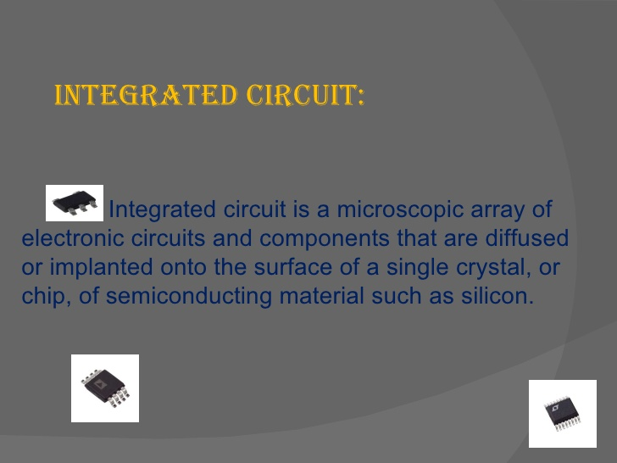

Slide 4
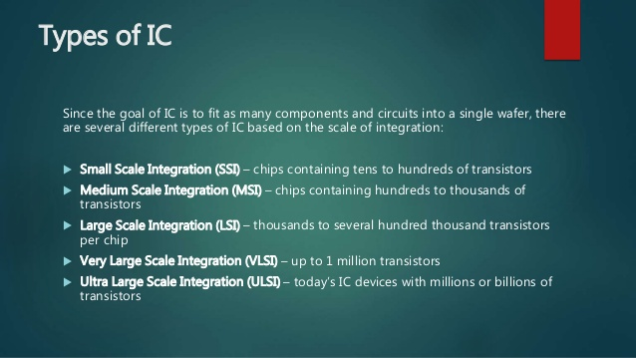

Slide 5
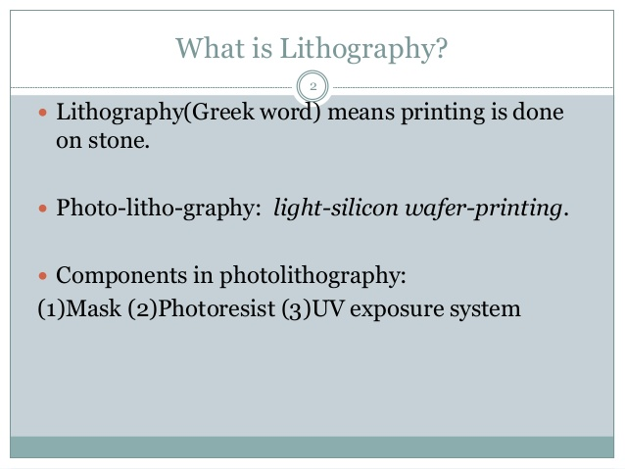

Slide 6
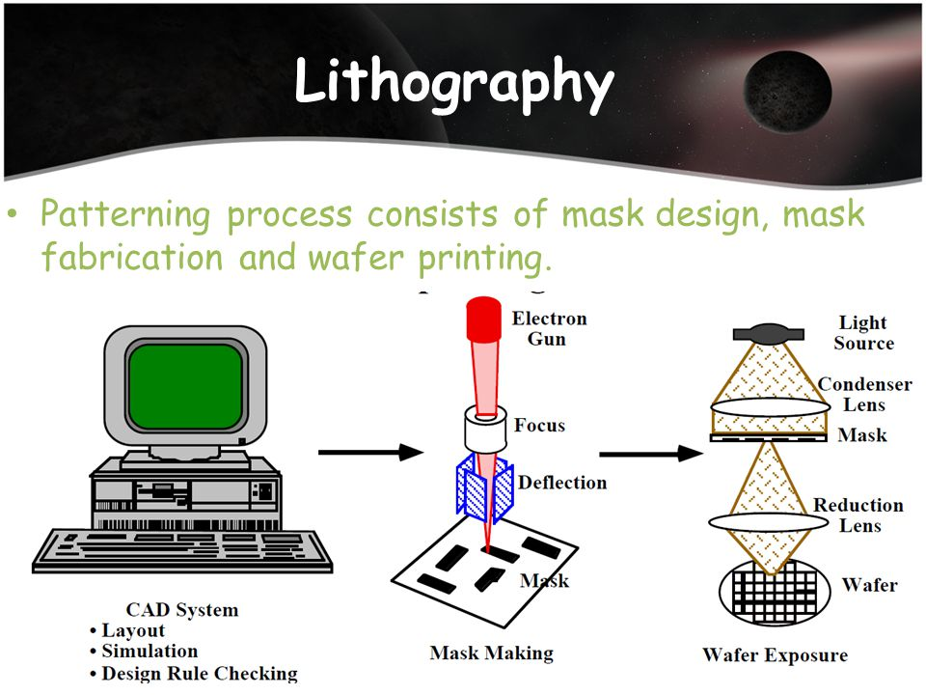

Slide 7
Photolithography
Lithography : it consist of patterning substrate by employing the interaction of beams of photons or particles with materials
Photolithography: in photolithography pattern of the required structure ( for example sensor ) is initially machined into a mask ultraviolet light (or other appropriate radiation source ) can penetrate through mask in the desired section
Subsequently pattern of the mask is transferred onto a photosensitive material by using an appropriate exposure source above the mask
A photosensitive material is a material that experiences a change in its physical properties when it is exposed to a radiation

Slide 8
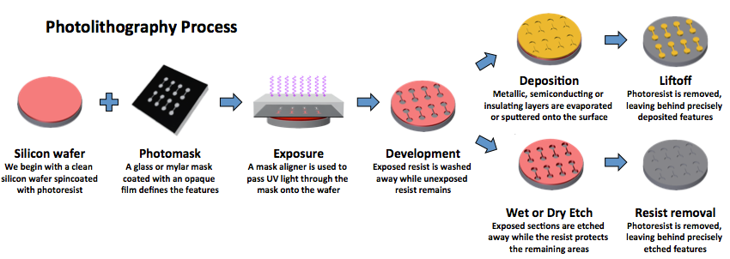

Slide 9
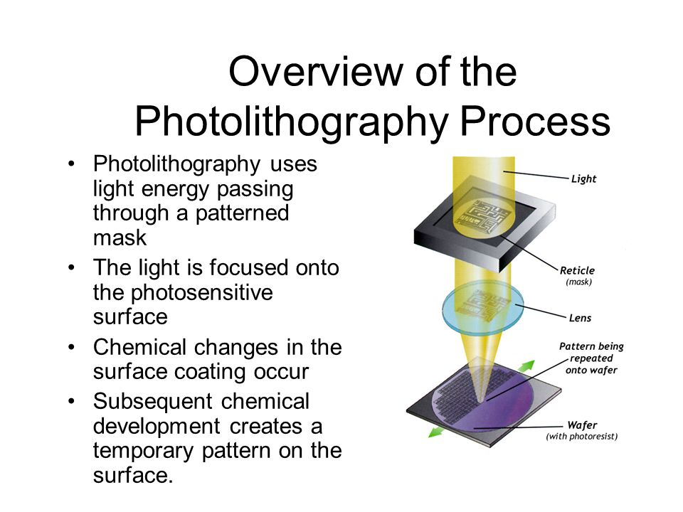
Photolithography

Slide 11
Layout
Layout: the layout will be the file in the computer, the information will be used to generate mask or this is the process where the patterns that will be transferred to the mask are defined and such will define the geometry of the device
the layout is typically performed in a graphical editing tool such as C-Edit ,cadence , Auto (AD or any CAD program)
The important thing is that it supports CIF (Caltech intermediate file format) or CDSII file format because this is the format that is needed when the mask is ordered from a manufacturer

Slide 12
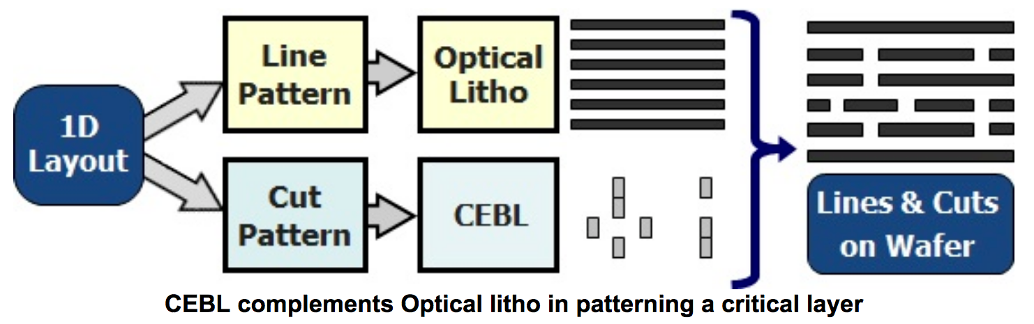
Layout

Slide 13
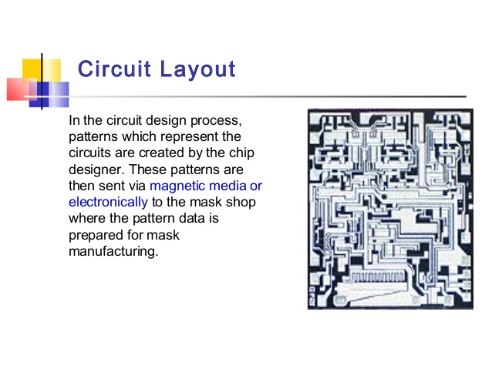

Slide 14
Mask
Mask is a stencil, where a flat plate is taken and holes of desired shapes or letters are cut in it
If we place the stencil on top of a paper and paint it, the shapes or letters are come nicely and this can be done over number of papers to get identical results
Here instead of cutting holes the mask has transparent areas which allows the light and blocks the light
The mask can be created for each layer

Slide 15
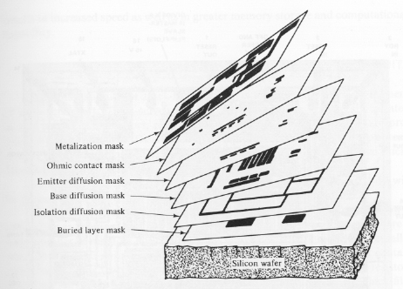
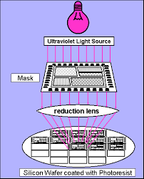

Slide 16
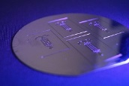
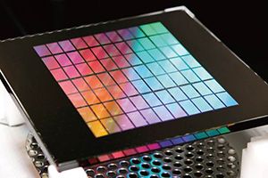
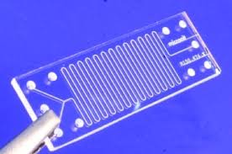
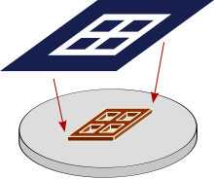
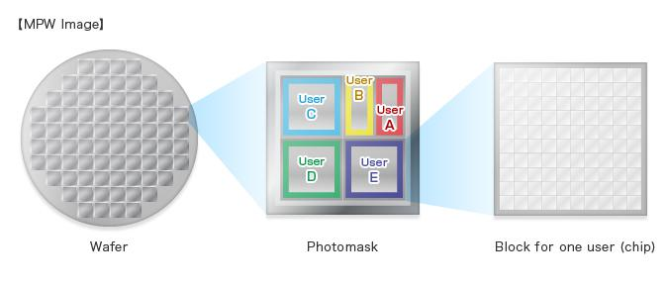
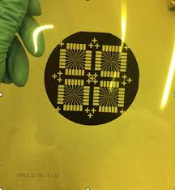

Slide 17
Mask alignment
One of the most important step in the photolithography is mask alignment
In this step the mask is aligned with the wafer so that the pattern can be transferred onto the wafer surface
Once the mask has been accurately aligned with the pattern on the wafer surface the photoresist is exposed through the mask pattern
The mask contain hard copy of the pattern that has to transferred to the different wafers during lithography
For the given integrated circuits there are multiple masks, which have to be aligned for proper device fabrication
Mask have alignment markers included with the pattern which can be used for this purpose

Slide 18
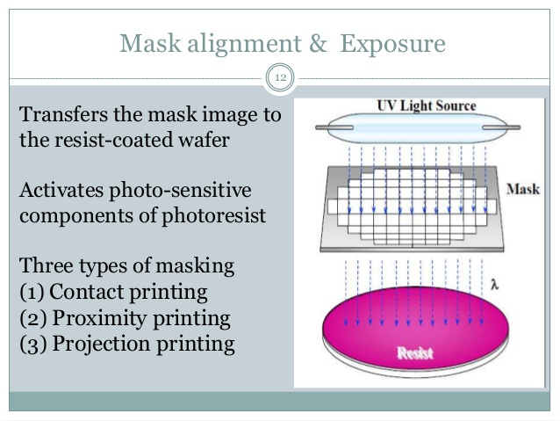

Slide 19
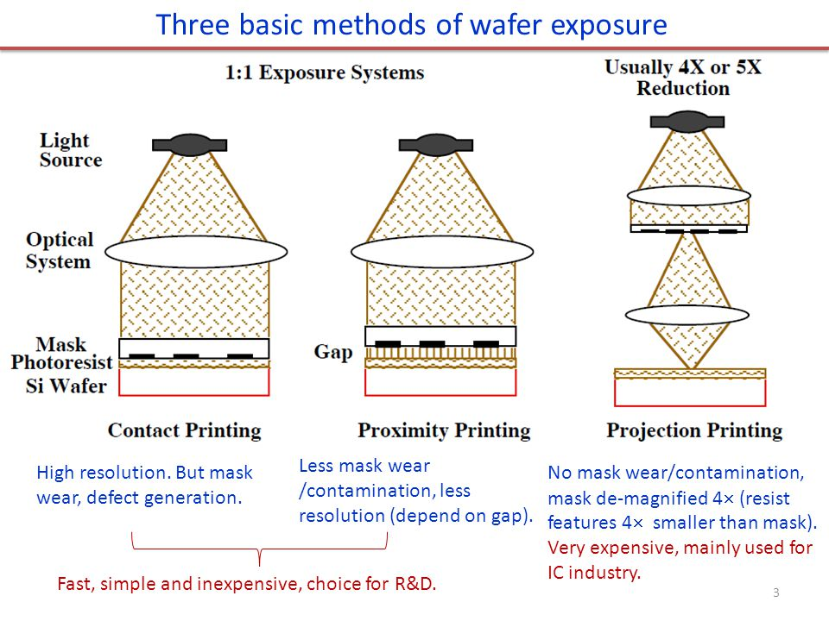

Slide 20
Contact printing
There are two operating modes are mask aligner: contact for modes and separate for alignment
In contact aligners, the resist coated silicon wafer is brought in to physical contact with the photomask the wafer on the vacuum chuck, and the whole assembly rises until the wafer and mask contact each other the photoresist is exposed with UV light while the wafer is contact with the mask because of the contact of resist and mask very high resolution is possible in contact printing (e.g. 1µm features in 0.5µm of positive resist)

Slide 21
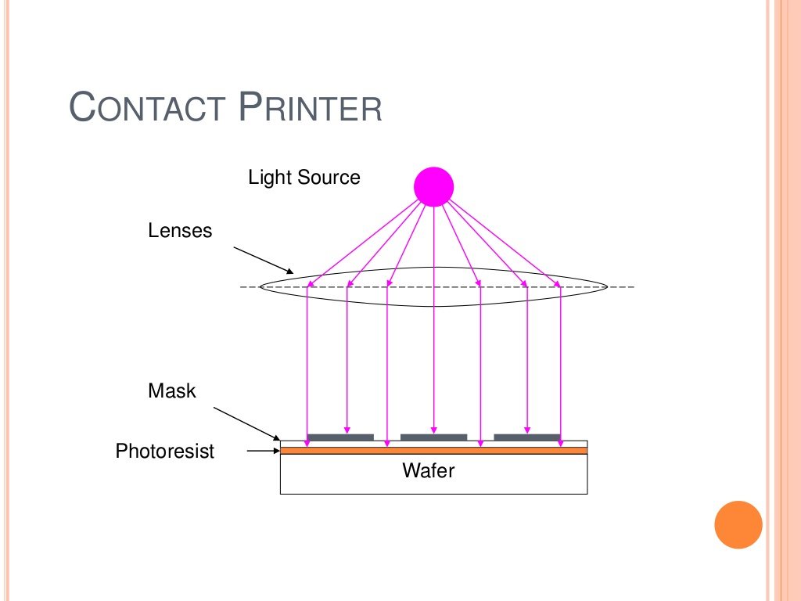

Slide 22
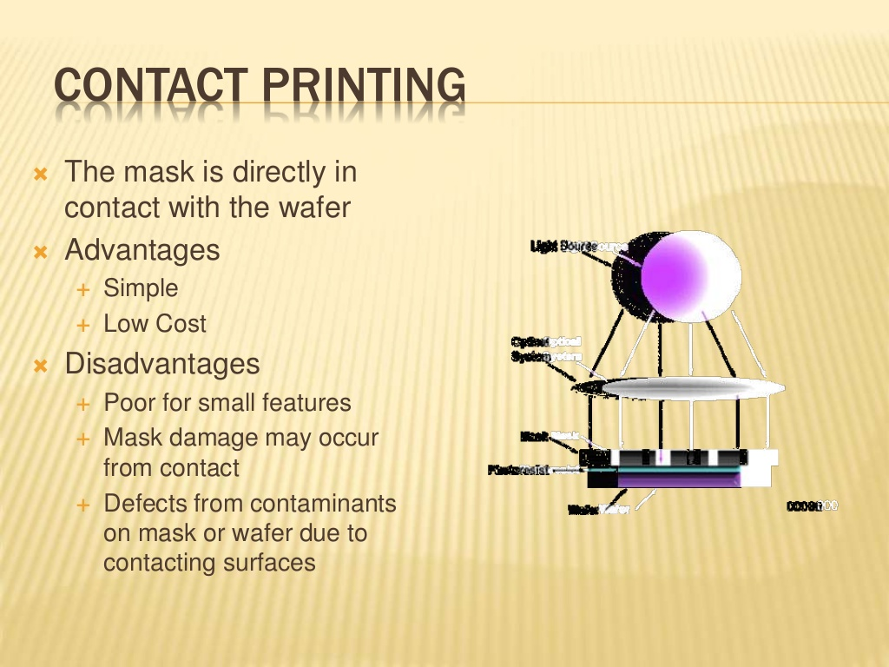

Slide 23
Proximity printing
The proximity method is similar to contact printing except that a small gap 10-20µm wide, is maintained between the wafer and the mask during exposure
This gap minimizes (may not be eliminated) mask damage, but it gives the poorer image than contact aligners,
Approximately 2-4µm resolution is possible with proximity printing

Slide 24
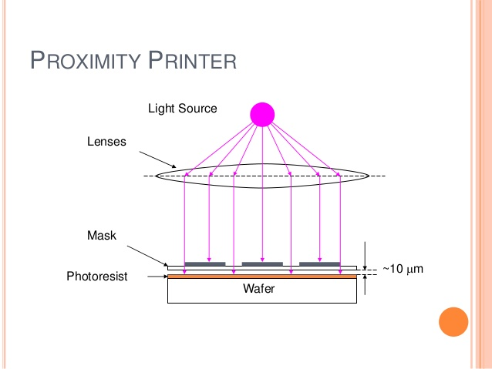

Slide 25
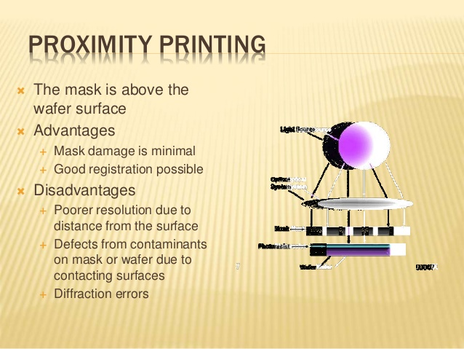

Slide 26
Projection printing
Projection aligners avoids mask damage entirely
An image of the pattern on the mask is projected onto the resist-coated wafer which is several centimeters away
In order to achieve the high resolution only a small portion of the mask is imaged this image scanned or stepped over the surface of the wafer
Projection printers that steps the mask image over the wafer surface are called step-and-repeat systems
Step-and-repeat projection printers are capable of approximately 1µm resolution

Slide 27
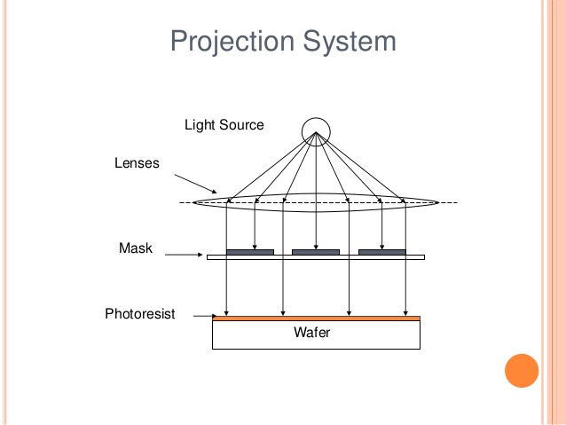

Slide 28
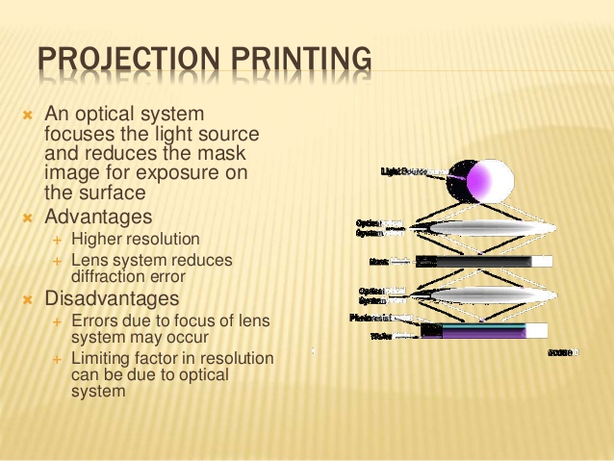

Slide 29
resist : resist is an viscous liquid which has a solid form when solvent are driven out
There are some important parameters for resist
Polymer (base resin) : changes structure when exposed to radiation
Sensitizer : controls photochemical reactions
Casting solvent : allows spin application or this layer on the wafer
Adhesive : it must be adhesive (able stick on substrate)
Photoresist : photoresist is the radiation sensitive (organic material) material changes its chemical structure when the UV light exposed on it
It contains a light-sensitive substance whose properties allows image to transfer onto the printed circuit board

Slide 30
Spinning resist (or spin coating)
A resist is applied to the surface using a spin coating machine this device holds the wafer of semiconductor using a vacuum, and spin it at high-speed (3000-6000 rpm) for a period of 15-30sec
A small quantity resist is dispensed in the center of the wafer rotation causes the resist be speared across the surface of the wafer with excess being thrown spun off
Close to the center of the wafer the variation in the thickness of resist is around 30nm
Preparation of the resist is concluded by the soft baking, where the wafer is gently heated in a convection oven and then a hotplate to evaporate the resist solvent and a partially to solidify the resist

Slide 32
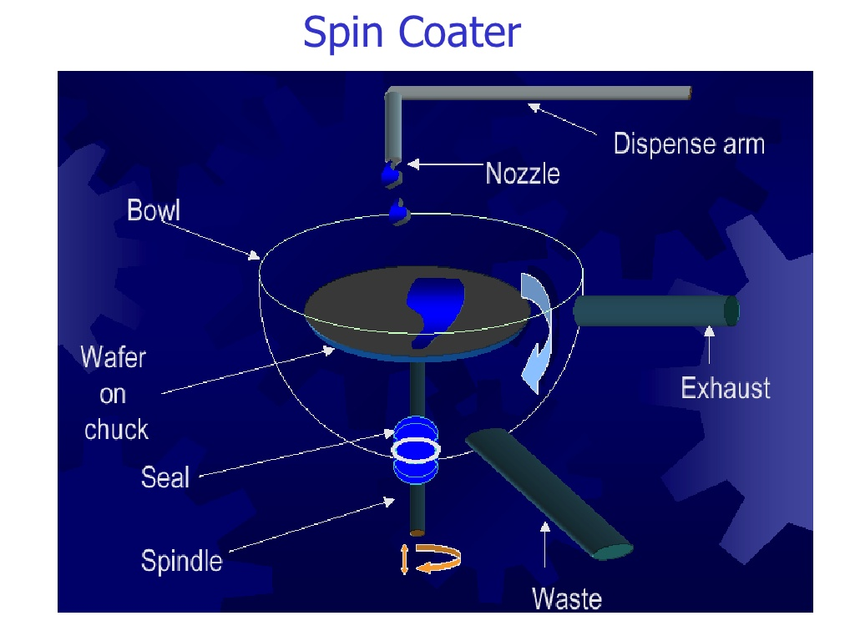

Slide 33
Exposure and development
Exposure : after the precise alignment mask to the wafer it exposed to the UV light(incident UV radiation)
The expose of resist using a specific wavelength of ultraviolet light causes a chemical reaction the photoresist to become soluble in base solution
Transparent areas on the photomask correspond to the areas of the PR (photoresist) being removed for positive photoresist and apposite for negative resist
The light exposure time is the function of the resist material and the power of density of the mask aligner UV light source
This spectral sensitivity is matched to the emission spectrum of the Hg lamp in mask aligner

Slide 34
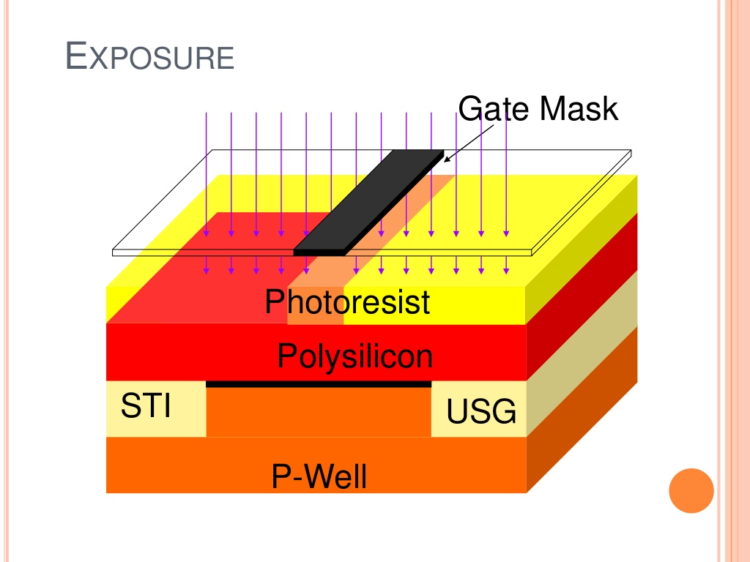

Slide 35
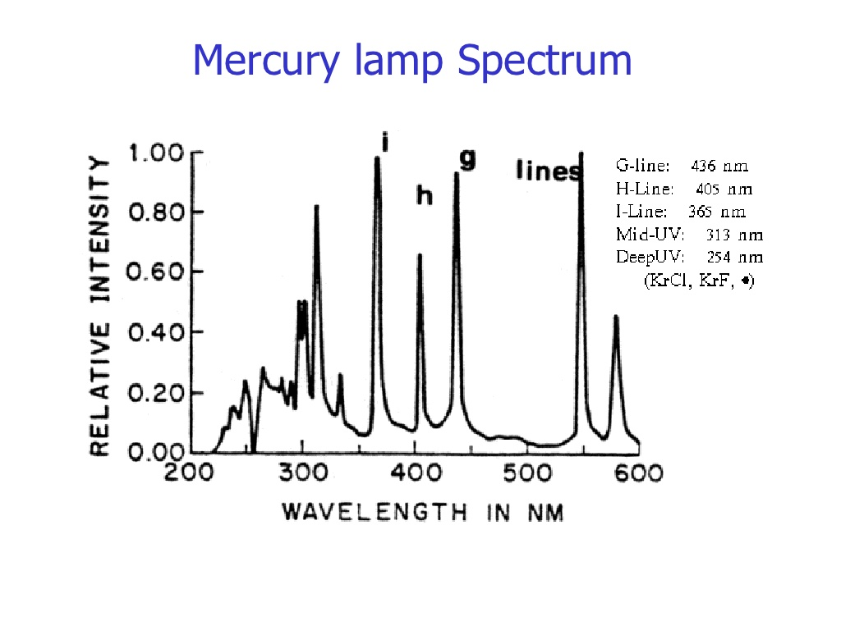

Slide 36
Development : wafer development is the removal of unpolymarized resist
Wafers are placed in the alkaline solution in the base/solvent hood which removes the resist that are not exposed to the UV light only the desired features remains
In the photolithography bay Tetraethyl ammonium hydroxide is developer
For S1800 series photoresist, where a typical development time is 60second at room temperature

Slide 37
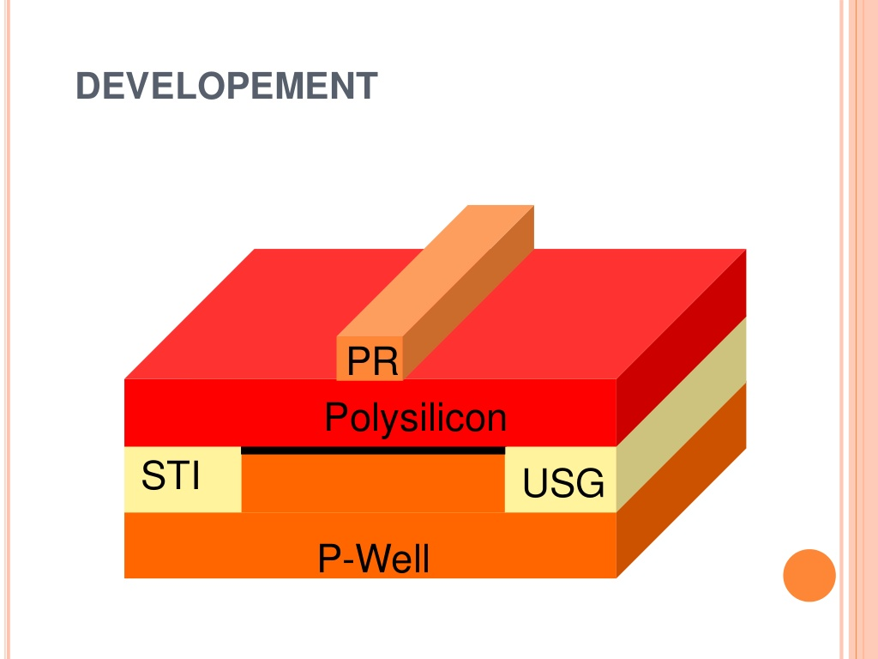

Slide 38
Resist tone
There is two resist tone, first positive tone resist and negative tone resist
Positive tone resist : the resist is exposed with UV light where the underlying material is to be removed “in these resist, exposure to the UV light changes the chemical structure of the resist so that it becomes more soluble in the developer
The exposed resist is then washed away by the developer solution, leaving windows of the underlying materials the mask therefore, contains an exact copy of the pattern which is to remain on the wafer, as stencil for the subsequent processing
Negative tone resist : negative tone resist behaves in the opposite manner. When exposed to the UV light negative resist becomes crosslinked/polymerized, and more difficult to dissolve in the developer

Slide 39
Resist tone
Therefore, the negative resist remains on the surface of the substrate where it is exposed, and the developer solution removes only the unexposed areas, mask used for negative photoresist therefore, contains the inverse or photographic ‘negative’ of the pattern to be transferred

Slide 40
Critical dimension (CD)
The critical dimension (CD) of wafer in photolithography is the important parameter that determines the final performance of the device
In photolithography, the pattern printed on a wafer is not an exact replica of the mask pattern in practice “critical dimension” or CD is defined as the linewidth of the photoresist printed on a wafer and reflects whether the exposure and development are proper to produce geometries of the correct size
CD controls is the critical for maintaining a high level of yield in wafer fabrication

Slide 41
Resolution
DOF (depth of focus): the range of focus which keeps the resist profile of a given feature within all specification specifications (linewidth, sidewall angle and, resist loss) over a specified exposure range
Resolution : the simple definition of the resolution could be
“resolution emerges the smallest feature of a given type which can be printed with specified depth of focus”

Slide 42
Resist striping (removal of photoresist)
After the imaged wafer has been transferred, the remaining photoresist must be get removed from the wafer in this process
There is two classes of resist stripping
1) wet stripping : wet stripping using organic or inorganic solutions to get removed the remaining photoresist from the surface of the wafer
2) dry stripping : in dry stripping the remaining photoresist is removed by using reactive plasma striping with oxygen, gaseous chemical reactant ozone radiations (UV)

Slide 43
Subtractive techniques(Etching)
Overview : for microfabrication etch is a process that removes selected material from
The wafers surface
Below the wafers surface or
From within the wafer surface
The etch process follows photolithography or deposition during which a protected masking layer is applied to the wafer surface
The protective masking layer is used to identify the material to be etched and to protect that is remain
The figure labeled “pattern transfer” illustrate a mask pattern transferred into photoresistive layer shown in red on the wafer surface during etching process (right) that pattern is transferred into the surface layer removing surface areas of the surface layer and leaving in the underlying layer open to a subsequent process step

Slide 44
Isotropic and Anisotropic etching
When a material is attacked by a liquid or vapor etchant, it is removed isotopically (uniformly in all directions) or anisotropic etching (uniformity in vertical direction). The difference between isotropic etching and anisotropic etching is shown in Figure. Material removal rate for wet-etching is usually faster than the rates for many dry etching processes and can easily be changed by varying temperature or the concentration of active species.
(a) Completely anisotropic
(b) Partially anisotropic and
(c) Isotropic etching of silicon

Slide 46
In microfabrication the etching process is also used to remove the material from underneath a layer or from the backside of the wafer
The graphic below illustrate both of these etch process the top graphic (bulk-back-etch) the silicon substrate has been selectively removed from the wafers backside
In bottom graphic (bulk-front-etch) silicon substrate has been removed from underneath a film on the wafers surface
A combination of these etch process allow for the construction of electronics and mechanical devices on the same microchip

Slide 48
Etch Process Properties
Any etch process is characterized by certain properties
  Etch Rate
    The amount of material removed from the wafer over a defined period of time
  Uniformity
    The evenness of the removal over the entire surface of the wafer
Notes:
In any etch process, we must look at certain key areas to characterize its performance. The etch rate, often given in angstroms/minute, indicates how quickly the process proceeds. In determining throughput, this is a key indicator. The uniformity of the etch at different sites on the wafer is checked to ensure that all devices on a wafer will be processed in the same way. A non-uniform etch could overetch certain areas of the wafer, removing protective masking or more of a layer than necessary, while leaving other areas correctly processed. In test wafers, measurements are typically made at different points to identify the uniformity.

Slide 49
Etch Process Properties
Any etch process is characterized by certain properties
  Profile
    Isotropic – Etching proceeds at equal rates in both horizontal and vertical direction
    Anisotropic – Etching proceeds faster in one plane than in another
  Selectivity
    The ability of the etch process to distinguish between the layer to be etched and the material not to be etched
Notes:
The profile of the etch process defines what features may be created by a given process. Isotropic etching proceeds in all directions. This is sometimes undesirable if tall, narrow features, such as gratings or combs are desired. Anisotropic etch processes remove more material in one direction, generally in the vertical direction, than in the other. So-called vertical sidewalls characterize a commonly defined anisotropic etch process.

Slide 50
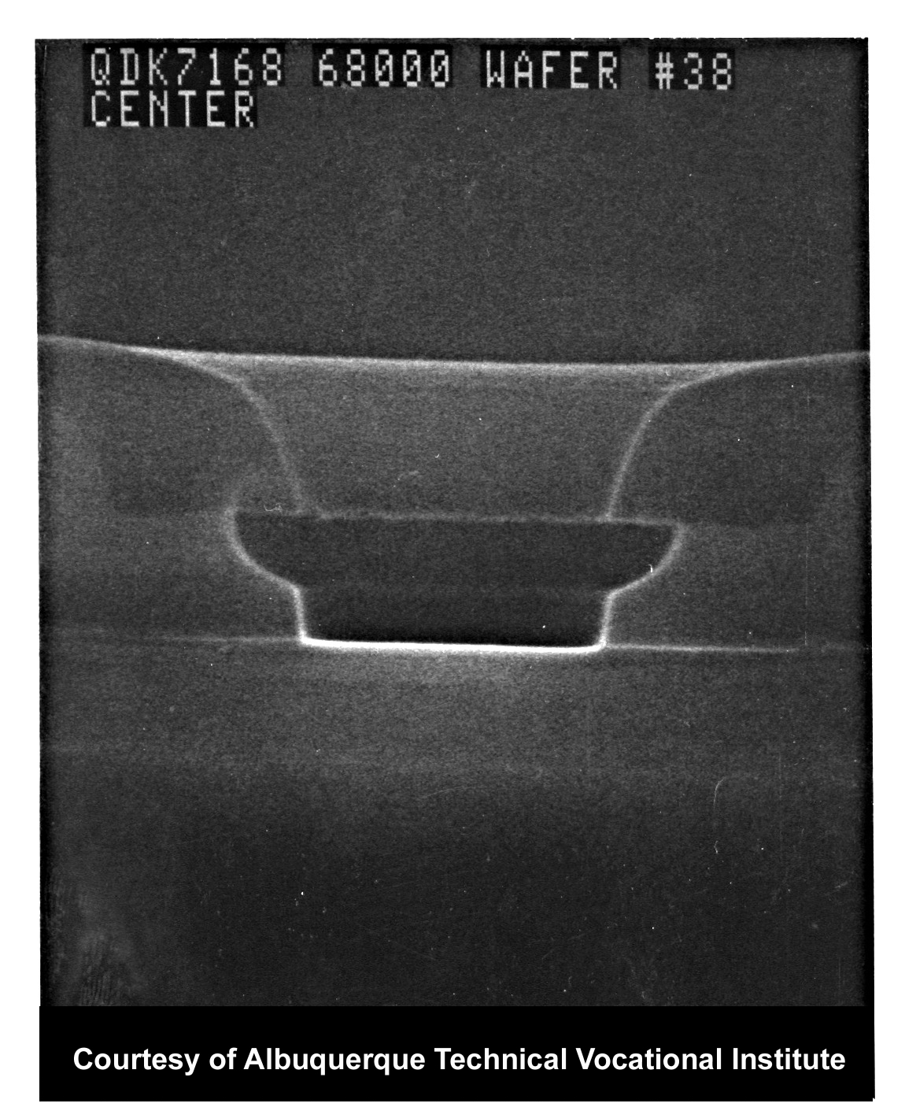
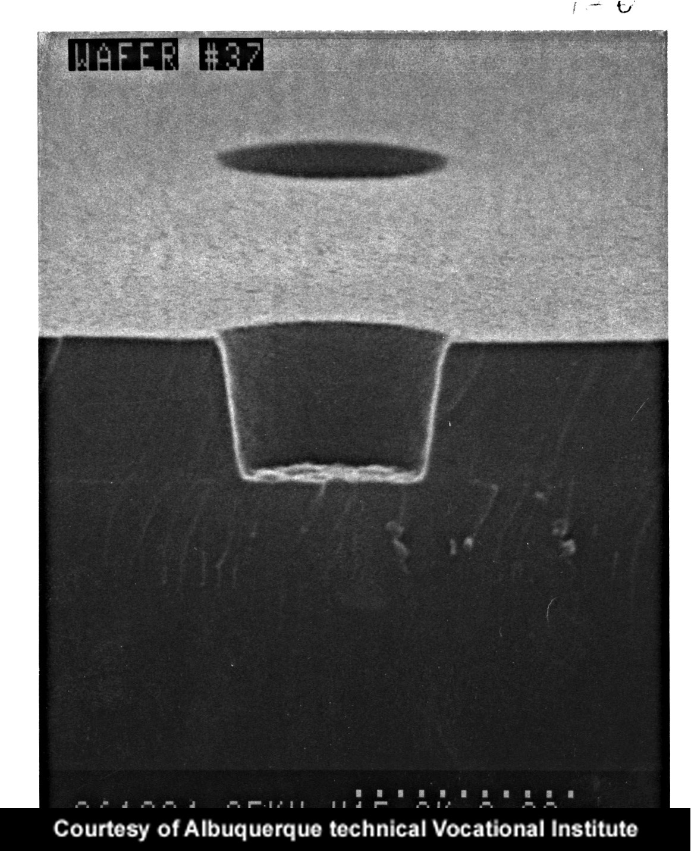
Etch Profiles
Isotropic Etch Profile
Anisotropic Etch Profile
Notes:
The isotropic etch profile on the left shows that etching of the sidewalls has occurred at a similar rate to the vertical etch. The round undercut shown is commonly found in wet etching. This can actually be used to advantage in creating some features, such as aluminum contacts. The anisotropic etch profile on the right shows that the sidewalls of the feature are nearly vertical or perpendicular to the plane.

Slide 51
Etching –Dry and Wet
Dry etching is performed by placing the wafer in a chamber and pumping in chemical vapors or using plasma
Dry etching can be chemical, physical, or both in its etch.
Wet Etch is performed by immersing entire wafers in liquid etchant solutions.
  Reaction is between surface layer exposed and etchant
  Purely a chemical process
Notes:
Wet etching is the oldest method of material removal still in use. The entire wafer, or often a boatload of wafers, is immersed in a liquid etchant solution, rinsed to remove traces of the etch solution, and dried to remove water.

Slide 52
Dry physical etching
(sputtering or ion etching)
Figure 3. The plasma hits the silicon wafer with high energy to knock-off the Si atoms on the surface. (a) The plasma atoms hitting the surface. (b) The silicon atoms being evaporated off from the surface

Slide 53
Etching profile
The shape of etching sidewalls usually depends orientation of the etched materials and etching condition figure below shows the three types of etching sidewall shapes
Rectangular- shaped, positive sloping and negative sloping for example
Gradually positive slopes are more desirable, which allows continuous interconnection beam deposited over the positive slope means rectangular-shaped sidewall can be lead to reduced conformal thickness and causes a discontinuous film
On film with negative slopping sidewalls, one is also unable to deposit continuous interconnection metallization

Slide 54
Etching profile
figure. Etching sidewall shapes: (a) rectangular-shaped, (b) positive sloping, and (c) negative sloping

Slide 55
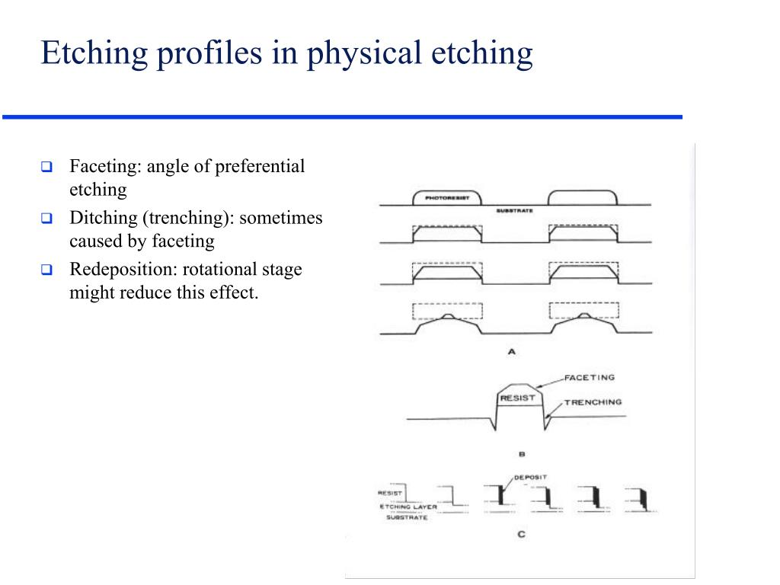

Slide 56
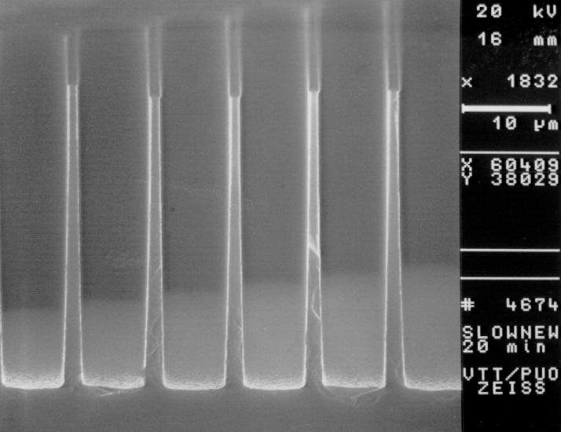
Plasma etched profiles

Slide 57
Dry chemical etching
Dry chemical etching (also called as vapor phase etching) does not use liquid chemicals or etchants.
This process involves the chemical reaction between etchant gas to attack the silicon surface
The chemical dry etching process is usually isotropic and exhibits high selectivity
Anisotropic dry etching ability to etch with finer resolution and higher aspects ratio than isotropic etching due to the directional nature of the dry etching undercutting can be avoided

Slide 58
Dry chemical etching
Figure shows the condition of the reaction that takes place in the chemical dry etching some of the ions that are used in chemical dry etching is of
Tetraflouromethane (CH₄), sulfur hexafluoride (SF₆),Nitrogen trifluoride(NF₃), chlorine gas (CL₂), or fluorine (F₂)

Slide 59
Physical-chemical dry etching(reactive ion etching)
Reactive ion etching uses both physical and chemical mechanism to achieve high level of resolution
The process is one of the most diverse and most widely used in the industry and research
Since the process combines both the physical and chemical interactions the process is much faster
The high energy collisions from the ionization helps to dissociate the etchant molecule into more reactive species

Slide 60
Physical-chemical dry etching(reactive ion etching)
In the physical-chemical etching process, cations are produced from the reactive gases which are accelerated with high energy to the substrate and chemically reacts with the silicon the typical reactive ion gases for Si are (F4), SF6, and BCl+Cl2, as seen in figure both physical and chemical reactions are takes place

Slide 61
The figure above shows the some micro and nano structures with high aspect ratio etched using RIE (reactive ion etching)

Slide 62
Wet etching
-Wet etching is a material removal process that uses liquid chemicals or etchants to remove materials from a wafer. The specific patters are defined by masks on the wafer. Materials that are not protected by the masks are etched away by liquid chemicals. These masks are deposited and patterned on the wafers in a prior fabrication step using lithography
-A wet etching process involves multiple chemical reactions that consume the original reactants and produce new reactants. The wet etch process can be described by three basic steps. (1) Diffusion of the liquid etchant to the structure that is to be removed. (2) The reaction between the liquid etchant and the material being etched away. A reduction-oxidation (redox) reaction usually occurs. This reaction entails the oxidation of the material then dissolving the oxidized material. (3) Diffusion of the byproducts in the reaction from the reacted surface

Slide 63
Anisotropic wet etching
Liquid etchants etch crystalline materials at different rates depending upon which crystal face is exposed to the etchant. There is a large difference in the etch rate depending on the silicon crystalline plane.
In materials such as silicon, this effect can allow for very high anisotropy. Some of the anisotropic wet etching agents for silicon are potassium hydroxide (KOH), ethylenediamine pyrocatechol (EDP), or tetramethylammonium hydroxide (TMAH)
Etching a (100) silicon wafer would result in a pyramid shaped etch pit as shown in Figure 2a. The etched wall will be flat and angled. The angle to the surface of the wafer is 54.7º. Figure c-d depicts scanning electron micrographs of (110)-oriented two-dimensional silicon walls with micro and nanoscale dimensions generated based on KOH based wet etching

Slide 64
Anisotropic wet etching
Figure . Schematics of an etch profile in (a) an anisotropic and (b) an isotropic etch of a (100) oriented silicon surface. (c-d) KOH based wet etching of (110)-oriented Si surfaces with micro and nanoscale two-dimensional walls.

Slide 65
Isotropic wet etching
For isotropic wet etching, a mixture of hydrofluoric acid, nitric acid, and acetic acid (HNA) is the most common etchant solvent for silicon.
The concentrations of each etchant determines the etch rate.
Silicon dioxide or silicon nitride is usually used as a masking material against HNA. As the reaction takes place, the material is removed laterally at a rate similar to the speed of etching downward.
This lateral and downward etching process takes places even with isotropic dry etching which is described in the dry etch section
Wet chemical etching is generally isotropic even though a mask is present since the liquid etchant can penetrate underneath the mask (Figure b).
If directionality is very important for high-resolution pattern transfer, wet chemical etching is normally not used

Slide 66
Etch stop techniques
In microfabrication, it is often the case that a precise control over the etching process is desired.
This means control over the direction and depth of the etch is critical.
The most important characteristic of an etch stop is its selectivity.
Etch stop would not be possible if there was no difference in etch rates.
Selectivity is defined as the etch rate of the fast etching material divided by the etch rate of the etch stop.
Also, the roughness of the respected layers are correlated to their etch rates.
Various etch stop techniques used to achieve this end are timing, boron or p+, and electrochemical etch stop techniques.

Slide 67
Timing etch stop technique
The simplest type of etch stop is the timing technique. With this technique, the etch rate must approximated as a function of certain variables, such as temperature and concentration of etchant.
The etch stop ‘mechanism’ is that the etching process is interrupted by rinsing away the etchant after an amount of time determined by the etch rate
There are a couple key disadvantages of this technique.
One is accuracy. For some processes the etch rate may vary considerably with a small change in temperature, so it may be very difficult to produce structures when the sizes are very small.
Another disadvantage is reliability and reproducibility. The variables that affect the etch rate are very difficult to keep constant, so the result may be different each time.

Slide 68
Timing etch-stop technique
Advantages
Simplest of all etch-stops
Cheap
Disadvantages
Low Accuracy
Not very reliable

Slide 69
Boron etch-stop technique
This is one of the most widely used techniques due to its relative simplicity. The technique relies on the fact that anisotropic etchants, such as KOH and EDP, do not etch heavily boron-doped silicon very quickly
In fact, a silicon substrate with a dopant concentration of 10^20 boron atoms/cm³ only has the etch rate of 1% of that of intrinsic silicon
Another etch stop method is called ‘buried etch stop’.
This method, like before, relies on heavy boron doping, but instead of doping the surface of the substrate, boron ions are bombarded with high energy.
Since penetration depends on the kinetic energy of the ions, controlling the energy of the ions can control the depth of the doped layer. Which then results in an etch stop layer buried in undoped, etchable silicon.

Slide 70
Boron etch-stop technique
Advantages
Relatively simple process
High selectivity and reliability
Disadvantages
Microstructures subjected to high tensile stress
Not compatible with CMOS process

Slide 71
Electrochemical etch-stop technique
The electrochemical etch-stop technique is essentially how it sounds, an etch stop achieved by a voltage potential (electro) and the use of different chemicals (chemical).
Two of the electrochemical etch-stop techniques, used today, involve electrodes and one doesn’t.
An electrode is the contact to either the silicon wafer or the doped wells, where electrons are either released or accepted.
In addition to the contact electrodes a reference electrode is often used as seen in figure below

Slide 72
Electrochemical Etch-Stop
(P-N junction etch stop)
Reverse biased
Anisotropic etch
High selectivity
passivation potential
(The passivation potential is the potential at which the n-type material becomes an etch stop)
TMAH/KOH
Three electrode vs. four
electrode system

Slide 73
Electrochemical Etch-Stop
(P-N junction etch stop)
A p-n junction etch-stop is created by reverse biasing the junction and applying a positive voltage to the n-type, which is greater than the passivation potential. The passivation potential is the potential at which the n-type material becomes an etch stop.
The p-type material is held at the open circuit potential (OCP), where there is very little current, and completely etched away.
A figure shows three electrode system , a four-electrode is the same configuration with an additional electrode on the p-type, with a negative voltage, to create a larger potential difference between the junction.
The three-electrode system has a higher current density at the corners due to the increase of the electric field, which may create a passivation of the p-type material.

Slide 74
Electrochemical Etch-Stop
(P-N junction etch stop)
A voltage potential is applied between the silicon wafer and the etch solution, the etch rate is proportional to the voltage potential.
As the voltage is increased more holes are placed near the silicon surface, the passivation potential is eventually reached and silicon dioxide is formed, which creates a temporary etch stop but if KOH or TMAH is used the silicon dioxide can be etched off.
Porous silicon can be created if a highly concentrated HF solution is used with the absence of OH- and an anodic bias. In figure electrochemical TMAH etch modulation was used

Slide 75
Electrochemical Etch-Stop
(P-N junction etch stop)
As a result, the four-electrode system can be used to obtain greater precision because the negative potential applied to the p-type decreases the current effect and allows for thinner bulk silicon lines
Electrochemical etch rate modulation is possible for either p- or n-type doping.

Slide 76
Electrochemical etch-stop
(Electrodeless)
Electrodeless electrochemical etch stops are more desirable because batch fabrication is easier and there is less stress on the wafer.
A Au/Cr/n Si/TMAH cell is deposited on the wafer using evaporation of a gold/chrome layer on the silicon.
The cell creates a passivation voltage internally, which creates an anodic oxide on the surface of the silicon wafer.
The process needs to take place below a critical value for the oxide to implemented as a etch stop.
An example of the electrodeless electrochemical etch stop can be seen in figure

Slide 77
Electrochemical Etch-Stop
(P-N junction etch stop)
Advantages
Doesn’t require as high doping level as boron
Better thickness control
Less stress on wafer
Batch fabrication *(Electrodeless)
Disadvantages
Requires cumbersome fixtures to insulate electrical wiring from etchant

Slide 78
Comparison of dry and wet-etch techniques
Dry etching
Wet etching
Dry etching is the process of etching done at plasma phase
Uses gaseous phase chemicals
Much safer than wet etching because the chemicals used are in gases form
More precise
Uses few chemicals
Expensive because specialize equipment is required
Wet etching is the process of etching done at liquid phase
Uses liquid phase chemicals
Not safe since disposing of hazardous chemicals causes wafer contamination
Less precise
Uses many chemicals
Not very expensive because it needs only a chemical bath

Slide 79



