Slide 1
Advanced internet technology 4.SERVLETS
Lecturer – Yashwant Waykar Course - MCA

Slide 2
SERVLETS VS CGI
Efficient –
- With traditional CGI a new process is started for each HTTP request. With servlets each request is handled by a lightweight java thread, not a heavyweight operating
system process.
If there are N simultaneous request to the CGI program, then the code for the CGI program is loaded into memory N times.
With servlets there are N threads but only a single copy of the servlet class.
Convenient –
- use of familiar language like java rather than Perl.
Servlet have an extensive infrastructure for automatically parsing & decoding HTML form data, reading and setting HTTP headers, handling cookies, tracking sessions etc.
Powerful -
Servlet can talk directly to the web server.(regular CGI program can’t)
This simplifies operations that need to look up images & other data stored in standard places.
Notes:
Relative vocabulary list.

Slide 3
SERVLETS VS CGI
Portable –
Servlets are written in java and follow a well-standardized API.
Servlets are supported directly or via a plugin on almost every major web server.
Inexpensive -
- There are number of free or very inexpensive web servers available that are good for personal use.
Notes:
Relative vocabulary list.

Slide 4
Servlet Structure
Java Servlet Objects on Server Side
Managed by Servlet Container
Loads/unloads servlets
Directs requests to servlets
Request → doGet()
Each request is run as its own thread

Slide 5
Web App with Servlets
GET …
Servlet
doGet()
…
…
HEADERS
BODY
Servlet Container

Slide 6
Simple Steps for Java Servlets
1. Subclass off HttpServlet
2. Override doGet(....) method
3. HttpServletRequest
getParameter("paramName")
4. HttpServletResponse
set Content Type
get PrintWriter
send text to client via PrintWriter

Slide 7
SERVLET API OVERVIEW
Servlets use classes and interfaces from
two packages:
javax.servlet : Contains classes to support generic, protocol-independent servlets.
javax.servlet.http: Contains classes to support HTTP-specific functionality.
Every servlet must implement the javax.servlet.Servlet interface.
The servlet packages define two abstract classes that implement the interface Servlet – class GenericServlet (from the package javax.servlet) and class HttpServlet (from the package javax.servlet.http). A protocol independent servlet should subclass GenericServlet, while an HTTP servlet should subclass HttpServlet, which itself a subclass of GenericServlet and added HTTP-specific
functionality.
Notes:
Relative vocabulary list.

Slide 8
SERVLET API OVERVIEW
An HTTP servlet usually overrides doGet() to handle GET requests and doPost() to handle POST request. The service() method of HttpServlet handles the setup and dispatching to all the doXXX() methods, which is why it usually should not be overridden.
Notes:
Relative vocabulary list.

Slide 9
Servlet Life Cycle
Servicing requests by
calling the
service method
Calling the
init method
Destroying the servlet
by calling the
destroy method
ServletConfig
Initialization
and Loading
Garbage
Collection
Servlet Class

Slide 10
Servlet Lifecycle
(Creation) –
Single instance created
init() method called
You can override init() in your subclass of HttpServlet to do some initial code....
init() is NOT called again on further requests

Slide 11
Servlet Lifecycle
(Service Method) -
On each request, the server spawns a new thread and calls service()
service() checks HTTP request type and calls appropriate doXXXX (Get, Post, Put...)
don't override service (unless you really know what you're doing)

Slide 12
Servlet Lifecycle
(doGet(), doPost()) -
doPost() can call doGet(), or viceversa

Slide 13
Servlet Lifecycle
(destroy()) -
For some reason (servlet idle, etc) the server may want to remove the servlet from memory
destroy() allows you to close DB connections, wrap up, etc...
Don't count on destroy to write persistent state (server may crash before you ever get here!)

Slide 14
Hello World Example
HTTP Servlet
import java.io.*;
import javax.servlet.*;
import javax.servlet.http.*;
public class HelloWorld extends HttpServlet
{
public void doGet(HttpServletRequest req, HttpServletResponse res) throws ServletException, IOException
{
res.setContentType("text/html");
PrintWriter out = res.getWriter();
out.println("<HTML><HEAD><TITLE>Hello World</TITLE></HEAD>");
out.println(“<BODY><BIG>Hello World </BIG></BODY></HTML>");
out.close();
}
}

Slide 15
Handling GET & POST Methods
<HTML>
…
<form method=“GET”
action=“http://pita.cs.huji.ac.il:8090/servlet/update”>
…
<INPUT name=“x” type=“text”>
<INPUT name=“y” type=“text”>
<INPUT type=“submit”> <INPUT type=“reset”>
</form>
…
</HTML>
http://pita.cs.huji.ac.il:8090/servlet/update?x=19&y=104

Slide 16
Getting the Parameters Values
request.getParameter(“x”);
request.getParameter(“y”);

Slide 17
<HTML>
<HEAD>
<TITLE>Sending Parameters</TITLE>
</HEAD>
<BODY BGCOLOR="#CC90E0">
<H1 ALIGN="LEFT">Please enter the parameters</H1>
<FORM ACTION=“dbi/servlet/SetColors” METHOD=“GET”>
<TABLE>
<TR><TD>Background color:</TD>
<TD><INPUT TYPE="TEXT" NAME="bgcolor"></TD></TR>
<TR><TD>Font color:</TD>
<TD><INPUT TYPE="TEXT" NAME="fgcolor"></TD></TR>
<TR><TD>Font size:</TD>
<TD><INPUT TYPE="TEXT" NAME="size"></TD></TR>
</TABLE>
<BR>
<INPUT TYPE="SUBMIT" VALUE="Show Page">
</FORM>
</BODY>
</HTML>
tomcat_home/webapps/ROOT/colors.html

Slide 18
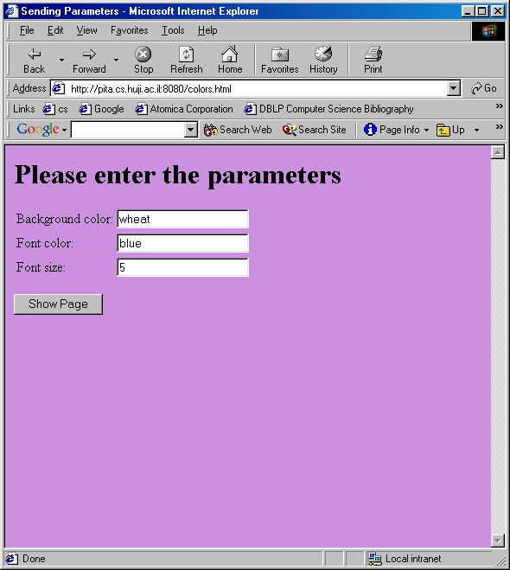
http://pita.cs.huji.ac.il:8080/colors.html

Slide 19
import java.io.*;
import javax.servlet.*;
import javax.servlet.http.*;
public class SetColors extends HttpServlet {
public void doGet(HttpServletRequest request,HttpServletResponse response)
throws ServletException, IOException
{
String title = "Set Colors Example";
response.setContentType("text/html");
PrintWriter out = response.getWriter();
String bg = request.getParameter("bgcolor");
String fg = request.getParameter("fgcolor");
String size = request.getParameter("size");
out.println("<HTML><HEAD><TITLE>" + title + "</TITLE></HEAD>");
out.println("<BODY text='" + fg + "' bgcolor='" + bg + "'>");
out.println("<H1>" + title + "</H1>");
out.println("<FONT size='" + size + "'>");
out.println("You requested a background color " + bg + "<P>");
out.println("You requested a font color " + fg + "<P>");
out.println("You requested a font size " + size + "<P>");
out.println("</FONT></BODY></HTML>");
}
}

Slide 20
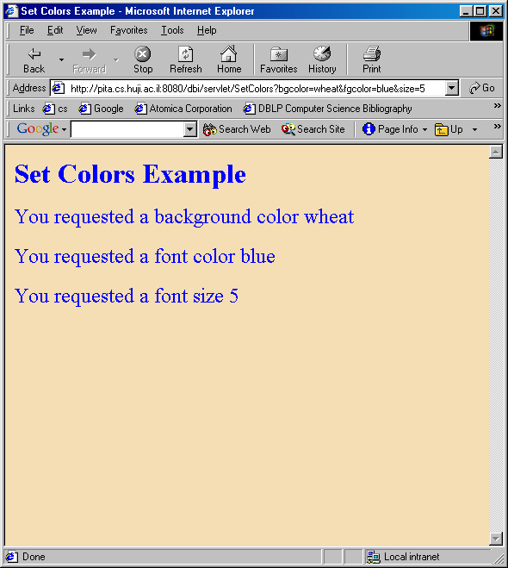
http://pita.cs.huji.ac.il:8080/dbi/servlet/
SetColors?bgcolor=wheat&fgcolor=blue&size=5

Slide 21
Handling Post
<FORM ACTION=“dbi/servlet/SetColors” METHOD=“POST”>
public void doPost(HttpServletRequest request,
HttpServletResponse response)
throws ServletException, IOException {
//
}

Slide 22
DATABASE

Slide 23
import java.io.*; import java.util.Enumeration; import javax.servlet.*; import javax.servlet.http.*; import java.sql.*; import java.net.*; public class emaildb extends HttpServlet{ Connection theConnection; private ServletConfig config;
public void init(ServletConfig config) throws ServletException{ this.config=config; }
public void service (HttpServletRequest req, HttpServletResponse res) throws ServletException, IOException {
res.setContentType("text/html");
PrintWriter out = res.getWriter();
out.println("<HTML><HEAD><TITLE>Emai List.</TITLE>");
out.println("</HEAD>");
out.println("<BODY bgColor=blanchedalmond text=#008000 topMargin=0>");
out.println("<P align=center><FONT face=Helvetica><FONT color=fuchsia style=\"BACKGROUND-COLOR: white\"><BIG><BIG>List of E-mail addresses.</BIG></BIG></FONT></P>");
out.println("<P align=center>");

Slide 24
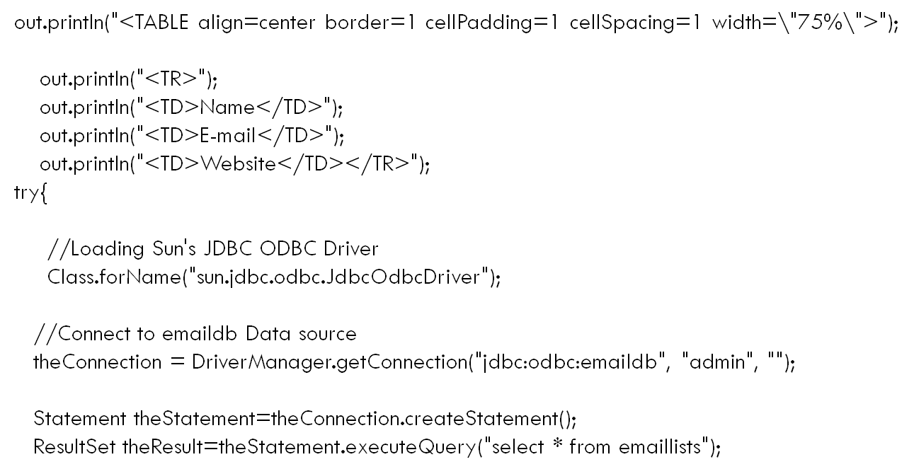

Slide 25
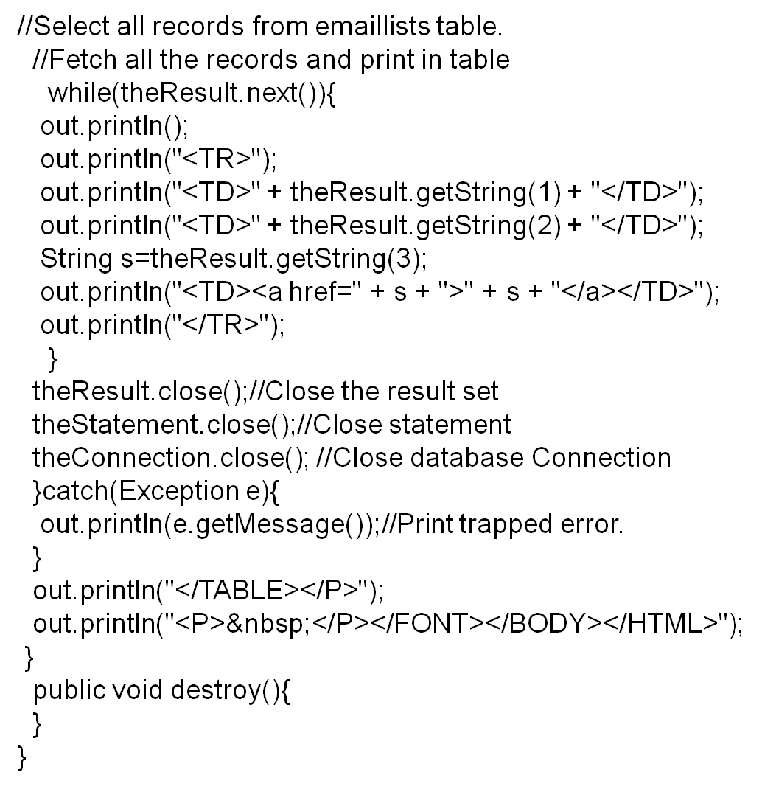

Slide 26
