Slide 1
Testing

Slide 2
TESTING REVIEW
Software testing is a critical element of software quality assurance and represents the ultimate review of specification, design, and code generation.
Testing presents an interesting anomaly for the software engineer. During earlier software engineering activities, the engineer attempts to build software from an abstract concept to a tangible product.
The engineer creates a series of test cases that are intended to "demolish" the software that has been built.
In fact, testing is the one step in the software process that could be viewed (psychologically, at least) as destructive rather than constructive.
Software engineers are by their nature constructive people.
Testing requires that the developer discard preconceived notions of the "correctness" of software just developed and overcome a conflict of interest that occurs when errors are uncovered.

Slide 3
Conti….
Testing Objectives
1. Testing is a process of executing a program with the intent of finding an error.
2. A good test case is one that has a high probability of finding an as-yet-undiscovered error.
3. A successful test is one that uncovers an as-yet-undiscovered error.
Testing Principles
All tests should be traceable to customer requirements..
Tests should be planned long before testing begins.
The Pareto principle applies to software testing.
Testing should begin “in the small” and progress toward testing “in the large.”
Exhaustive testing is not possible.
To be most effective, testing should be conducted by an independent third party.

Slide 4
Conti…
Testability
In ideal circumstances, a software engineer designs a computer program, a system, or a product with “testability” in mind.
This enables the individuals charged with testing to design effective test cases more easily.
Software testability is simply how easily [a computer program] can be tested.
Testability is used to mean how adequately a particular set of tests will cover the product.
It's also used by the military to mean how easily a tool can be checked and repaired in the field. The checklist that follows provides a set of characteristics that lead to testable software.
Operability.
Observability.
Controllability.
Decomposability.
Simplicity.
Stability.
Understandability.

Slide 5
Verification and Validation
Software testing is one element of a broader topic that is often referred to as verification and validation (V&V).
Verification refers to the set of activities that ensure that software correctly implements a specific function.
Validation refers to a different set of activities that ensure that the software that has been built is traceable to customer requirements.
Another way to define V&V.
Verification: "Are we building the product right?"
Validation: "Are we building the right product?“
The definition of V&V encompasses many of the activities that we have referred to as software quality assurance (SQA).
Verification and validation encompasses a wide array of SQA activities that include formal technical reviews, quality and configuration audits,

Slide 6
Conti…
Performance monitoring simulation, feasibility study, documentation review, database review, algorithm analysis, development testing, qualification testing, and installation testing .
Although testing plays an extremely important role in V&V, many other activities are also necessary.

Slide 7
TEST CASE DESIGN
The design of tests for software and other engineered products can be as challenging as the initial design of the product itself.
Rich variety of test case design methods have evolved for software. These methods provide the developer with a systematic approach to testing.
More important, methods provide a mechanism that can help to ensure the completeness of tests and provide the highest likelihood for uncovering errors in software.
Any engineered product (and most other things) can be tested in one of two ways:
(1) Knowing the specified function that a product has been designed to perform, tests can be conducted that demonstrate each function is fully operational while at the same time searching for errors in each function;
(2) Knowing the internal workings of a product, tests can be conducted to ensure that "all gears mesh," that is, internal operations are performed according to specifications and all internal components have been adequately exercised.

Slide 8
Black- Box testing
Black-box testing, also called behavioral testing, focuses on the functional requirements of the software.
That is, black-box testing enables the software engineer to derive sets of input conditions that will fully exercise all functional requirements for a program.
Black-box testing is not an alternative to white-box techniques. Rather, it is a complementary approach that is likely to uncover a different class of errors than white-box methods.
Black-box testing attempts to find errors in the following categories:
(1) Incorrect or missing functions,
(2) Interface errors,
(3) Errors in data structures or external data base access,
(4) Behavior or performance errors, and
(5) Initialization and termination errors.

Slide 9
Conti…
By applying black-box techniques, we derive a set of test cases that satisfy the following criteria :
(1) Test cases that reduce, by a count that is greater than one, the number of additional test cases that must be designed to achieve reasonable testing and
(2) Test cases that tell us something about the presence or absence of classes of errors, rather than an error associated only with the specific test at hand.

Slide 10
Graph-Based Testing Methods
The first step in black-box testing is to understand the objects that are modeled in software and the relationships that connect these objects. Once this has been accomplished, the next step is to define a series of tests that verify “all objects have the expected relationship to one another.”
To accomplish these steps, the software engineer begins by creating a graph—a collection of nodes that represent objects; links that represent the relationships between objects; node weights that describe the properties of a node (e.g., a specific data value or state behavior); and link weights that describe some characteristic of a link.
The symbolic representation of a graph is shown in Figure 01A. Nodes are represented as circles connected by links that take a number of different forms.
A directed link (represented by an arrow) indicates that a relationship moves in only one direction.
A bidirectional link, also called a symmetric link, implies that the relationship applies in both directions. Parallel links are used when a number of different relationships are established between graph nodes.

Slide 11
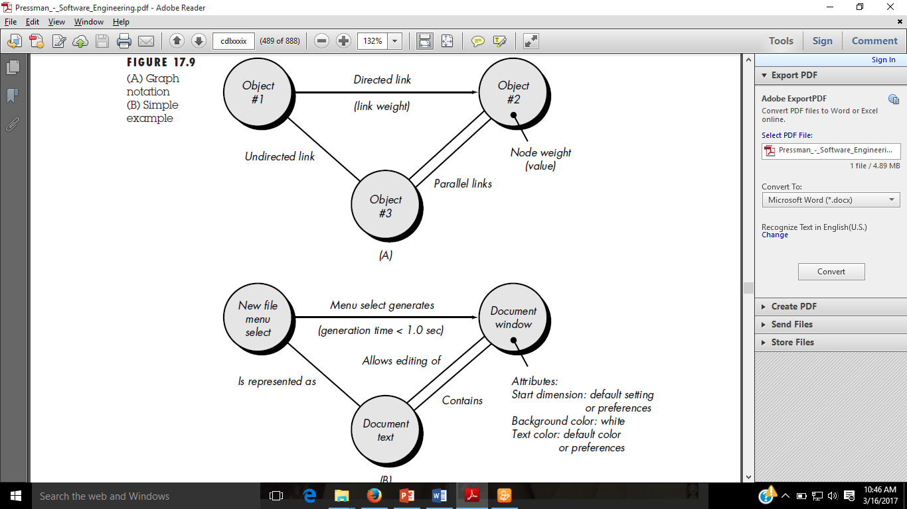
Conti…
FIGURE 01: (A) Graph notation (B) Simple example

Slide 12
Conti…
Symmetric relationship between the new file menu select and document text, and parallel links indicate relationships between document window and document text.
Beizer describes a number of behavioral testing methods that can make use of graphs:
Transaction flow modeling.
Finite state modeling.
Data flow modeling.
Timing modeling.

Slide 13
Equivalence Partitioning
Equivalence partitioning is a black-box testing method that divides the input domain of a program into classes of data from which test cases can be derived.
An ideal test case single-handedly uncovers a class of errors (e.g., incorrect processing of all character data) that might otherwise require many cases to be executed before the general error is observed.
Equivalence partitioning strives to define a test case that uncovers classes of errors, thereby reducing the total number of test cases that must be developed.
Test case design for equivalence partitioning is based on an evaluation of equivalence classes for an input condition.
An equivalence class represents a set of valid or invalid states for input conditions.
Typically, an input condition is either a specific numeric value, a range of values, a set of related values, or a Boolean condition.
Equivalence classes may be defined according to the following guidelines:

Slide 14
Conti…
1.If an input condition specifies a range, one valid and two invalid equivalence classes are defined.
2. If an input condition requires a specific value, one valid and two invalid equivalence classes are defined.
3. If an input condition specifies a member of a set, one valid and one invalid equivalence class are defined.
4. If an input condition is Boolean, one valid and one invalid class are defined.
As an example, consider data maintained as part of an automated banking application. The user can access the bank using a personal computer, provide a six-digit password, and follow with a series of typed commands that trigger various banking functions.
During the log-on sequence, the software supplied for the banking application accepts data in the form area code—blank or three-digit number.

Slide 15
Conti…
prefix—three-digit number not beginning with 0 or 1.
suffix—four-digit number.
password—six digit alphanumeric string
commands—check, deposit, bill pay, and the like.
The input conditions associated with each data element for the banking application can be specified as
area code: Input condition, Boolean—the area code may or may not be present.
Input condition, range—values defined between 200 and 999, with specific exceptions.
prefix: Input condition, range—specified value >200
Input condition, value—four-digit length
password: Input condition, Boolean—a password may or may not be present.
Input condition, value—six-character string.
command: Input condition, set—containing commands noted previously.

Slide 16
Boundary Value Analysis
For reasons that are not completely clear, a greater number of errors tends to occur at the boundaries of the input domain rather than in the "center."
It is for this reason that boundary value analysis (BVA) has been developed as a testing technique.
Boundary value analysis leads to a selection of test cases that exercise bounding values.
Boundary value analysis is a test case design technique that complements equivalence partitioning.
Rather than selecting any element of an equivalence class, BVA leads to the selection of test cases at the "edges" of the class.
Rather than focusing solely on input conditions, BVA derives test cases from the output domain as well.
Guidelines for BVA are similar in many respects to those provided for equivalence partitioning:

Slide 17
Conti…
1. If an input condition specifies a range bounded by values a and b, test cases should be designed with values a and b and just above and just below a and b.
2. If an input condition specifies a number of values, test cases should be developed that exercise the minimum and maximum numbers. Values just above and below minimum and maximum are also tested.
3. Apply guidelines 1 and 2 to output conditions. For example, assume that a temperature vs. pressure table is required as output from an engineering analysis program. Test cases should be designed to create an output report that produces the maximum (and minimum) allowable number of table entries.
4. If internal program data structures have prescribed boundaries (e.g., an array has a defined limit of 100 entries), be certain to design a test case to exercise the data structure at its boundary.

Slide 18
White- Box Testing
White-box testing, sometimes called glass-box testing, is a test case design method that uses the control structure of the procedural design to derive test cases.
Using white-box testing methods, the software engineer can derive test cases that
(1) Guarantee that all independent paths within a module have been exercised at least once,
(2) Exercise all logical decisions on their true and false sides,
(3) Execute all loops at their boundaries and within their operational bounds, and
(4) Exercise internal data structures to ensure their validity.
Logic errors and incorrect assumptions are inversely proportional to the probability that a program path will be executed.
We often believe that a logical path is not likely to be executed when, in fact, it may be executed on a regular basis.
Typographical errors are random.

Slide 19
BASIS PATH TESTING
Flow Graph Notation
Figure 02:Flow Graph Notation

Slide 20
Cyclomatic Complexity
Cyclomatic complexity is a software metric that provides a quantitative measure of the logical complexity of a program.
When used in the context of the basis path testing method, the value computed for cyclomatic complexity defines the number of independent paths in the basis set of a program and provides us with an upper bound for the number of tests that must be conducted to ensure that all statements have been executed at least once.
An independent path is any path through the program that introduces at least one new set of processing statements or a new condition.

Slide 21
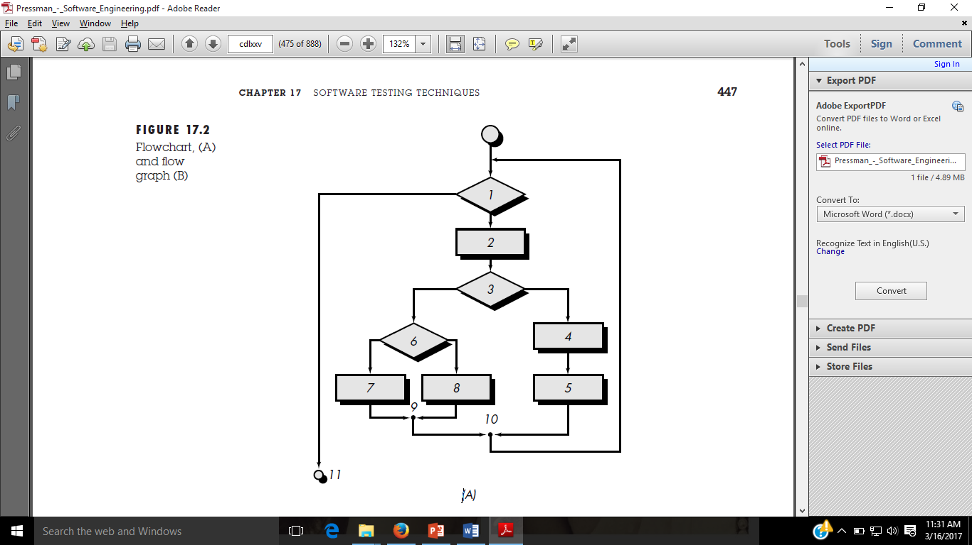
Conti…
FIGURE 03:Flowchart, (A)

Slide 22
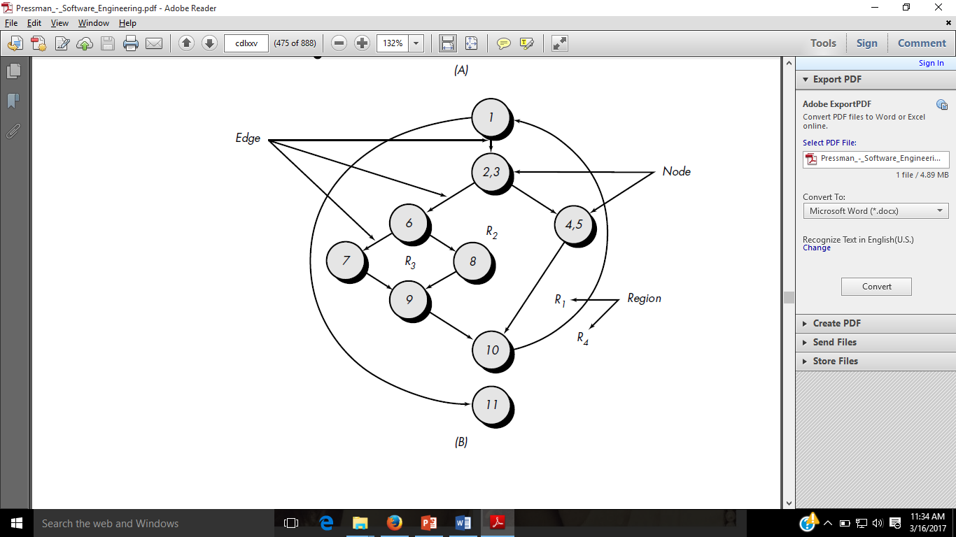
Conti…
FIGURE 03: flow graph (B)

Slide 23
Conti…

Slide 24
Conti…
Cyclomatic complexity has a foundation in graph theory and provides us with an extremely useful software metric.
Complexity is computed in one of three ways:
1. The number of regions of the flow graph correspond to the cyclomatic complexity.
2. Cyclomatic complexity, V(G), for a flow graph, G, is defined as
V(G) = E - N + 2
where E is the number of flow graph edges, N is the number of flow graph nodes.

Slide 25
Conti…
3. Cyclomatic complexity, V(G), for a flow graph, G, is also defined as V(G) = P + 1
The cyclomatic complexity can be computed using each of the algorithms just noted:
1. The flow graph has four regions.
2. V(G) = 11 edges 9 nodes + 2 = 4.
3. V(G) = 3 predicate nodes + 1 = 4.

Slide 26
Graph Matrices
A graph matrix is a square matrix whose size (i.e., number of rows and columns) is equal to the number of nodes on the flow graph.
Each row and column corresponds to an identified node, and matrix entries correspond to connections (an edge) between nodes.

Slide 27
Conti…
Figure 04:Flow graph and Graph Matrix

Slide 28
Connection Matrix

Slide 29
CONTROL STRUCTURE TESTING
Condition Testing
Data Flow Testing
Loop Testing

Slide 30
Data Flow Testing
The data flow testing method selects test paths of a program according to the locations of definitions and uses of variables in the program. A number of data flow testing strategies have been studied and compared.
Data flow testing strategies are useful for selecting test paths of a program containing nested if and loop statements.
To illustrate the data flow testing approach, assume that each statement in a program is assigned a unique statement number and that each function does not modify its parameters or global variables. For a statement with S as its statement number,
DEF(S) = {X | statement S contains a definition of X}
USE(S) = {X | statement S contains a use of X}
If statement S is an if or loop statement, its DEF set is empty and its USE set is based on the condition of statement S. The definition of variable X at statement S is said to be live at statement S' if there exists a path from statement S to statement S' that contains no other definition of X.

Slide 31
Conti…
A definition-use (DU) chain of variable X is of the form [X, S, S'], where S and S' are statement numbers, X is in DEF(S) and USE(S'), and the definition of X in statement S is live at statement S'.

Slide 32
UNIT TESTING
Unit testing focuses verification effort on the smallest unit of software design—the software component or module.
Using the component-level design description as a guide, important control paths are tested to uncover errors within the boundary of the module.
The relative complexity of tests and uncovered errors is limited by the constrained scope established for unit testing. The unit test is white-box oriented, and the step can be conducted in parallel for multiple components.
Among the more common errors in computation are
(1) misunderstood or incorrect arithmetic precedence.
(2) mixed mode operations.
(3) incorrect initialization.
(4) precision inaccuracy.
(5) incorrect symbolic representation of an expression.

Slide 33
Conti…
Comparison and control flow are closely coupled to one another (i.e., change of flow frequently occurs after a comparison). Test cases should uncover errors such as
Comparison of different data types.
(2) Incorrect logical operators or precedence.
Expectation of equality when precision error makes equality unlikely.
Incorrect comparison of variables.
Improper or nonexistent loop termination.
Failure to exit when divergent iteration is encountered, and
Improperly modified loop variables.

Slide 34
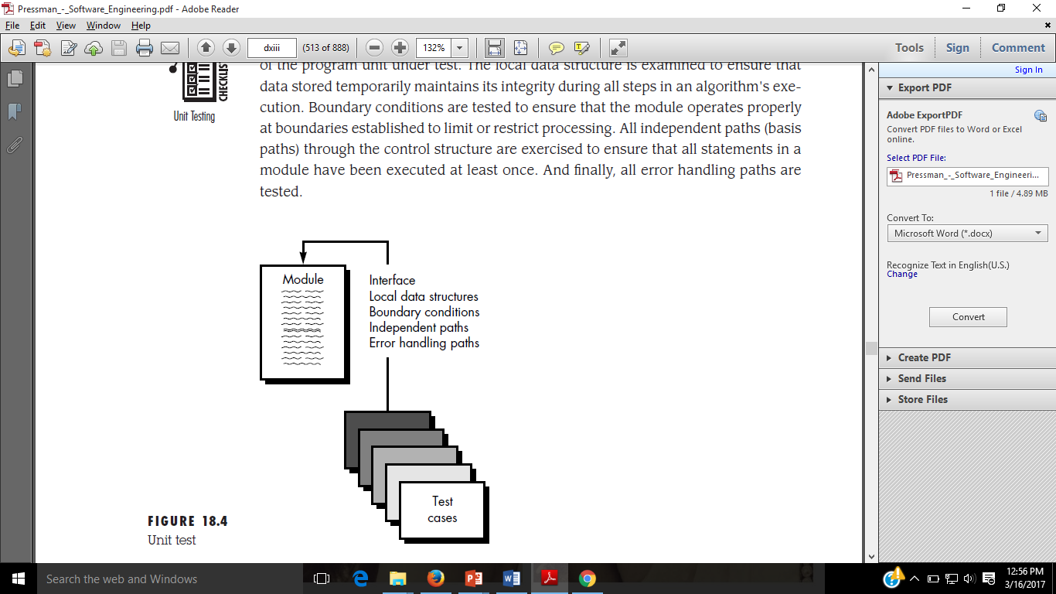
Conti…
FIGURE 05:Unit testing

Slide 35
INTEGRATION TESTING
Integration testing is a systematic technique for constructing the program structure while at the same time conducting tests to uncover errors associated with interfacing.
The objective is to take unit tested components and build a program structure that has been dictated by design.
There is often a tendency to attempt non incremental integration; that is, to construct the program using a "big bang" approach.
All components are combined in advance. The entire program is tested as a whole.
Incremental integration is the antithesis of the big bang approach.
The program is constructed and tested in small increments, where errors are easier to isolate and correct; interfaces are more likely to be tested completely; and a systematic test approach may be applied.

Slide 36
Top-down Integration
Top-down integration testing is an incremental approach to construction of program structure.
Modules are integrated by moving downward through the control hierarchy, beginning with the main control module (main program).
Modules subordinate (and ultimately subordinate) to the main control module are incorporated into the structure in either a depth-first or breadth-first manner.
The integration process is performed in a series of five steps:
1. The main control module is used as a test driver and stubs are substituted for all components directly subordinate to the main control module.
2. Depending on the integration approach selected (i.e., depth or breadth first), subordinate stubs are replaced one at a time with actual components.
3. Tests are conducted as each component is integrated.
4. On completion of each set of tests, another stub is replaced with the real component.
5. Regression testing may be conducted to ensure that new errors have not been introduced.

Slide 37
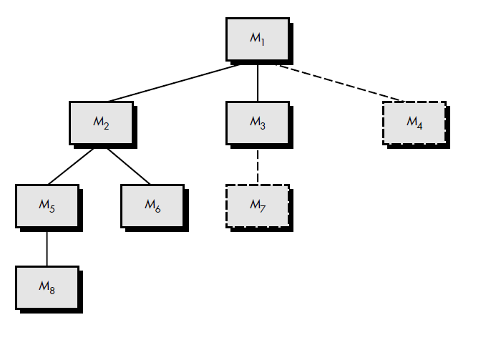
Conti…
FIGURE 06: Top-down integration

Slide 38
Bottom-up Integration
Bottom-up integration testing, as its name implies, begins construction and testing with atomic modules (i.e., components at the lowest levels in the program structure).
Because components are integrated from the bottom up, processing required for components subordinate to a given level is always available and the need for stubs is eliminated.
A bottom-up integration strategy may be implemented with the following steps:
1. Low-level components are combined into clusters (sometimes called builds) that perform a specific software sub function.
2. A driver (a control program for testing) is written to coordinate test case input and output.
3. The cluster is tested.
4. Drivers are removed and clusters are combined moving upward in the program structure.

Slide 39
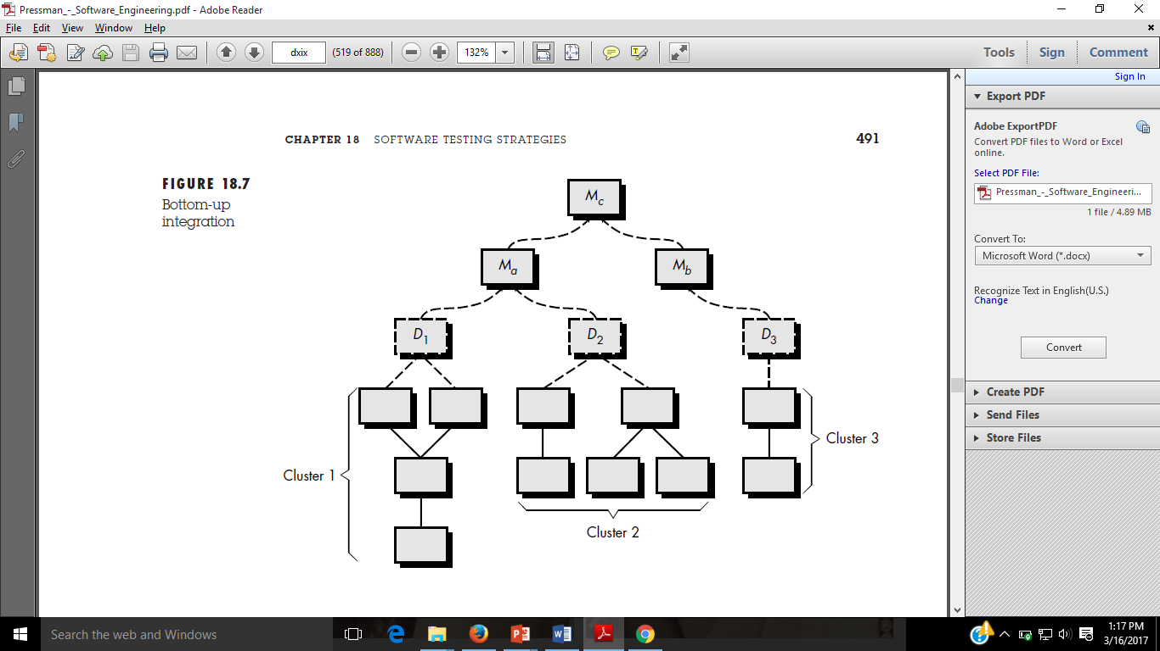
Conti…
FIGURE 07: Bottom-up integration

Slide 40
Regression Testing
Each time a new module is added as part of integration testing, the software changes.
New data flow paths are established, new I/O may occur, and new control logic is invoked.
These changes may cause problems with functions that previously worked flawlessly.
In the context of an integration test strategy, regression testing is the re-execution of some subset of tests that have already been conducted to ensure that changes have not propagated unintended side effects.
The regression test suite (the subset of tests to be executed) contains three different classes of test cases:
A representative sample of tests that will exercise all software functions.
Additional tests that focus on software functions that are likely to be affected by the change.
Tests that focus on the software components that have been changed.

Slide 41
SYSTEM TESTING
A classic system testing problem is "finger-pointing." This occurs when an error is uncovered, and each system element developer blames the other for the problem.
Rather than indulging in such nonsense, the software engineer should anticipate potential interfacing problems and
(1) Design error-handling paths that test all information coming from other elements of the system.
(2) Conduct a series of tests that simulate bad data or other potential errors at the software interface.
(3) Record the results of tests to use as "evidence" if finger-pointing does occur. and
(4) Participate in planning and design of system tests to ensure that software is adequately tested. System testing is actually a series of different tests whose primary purpose is to fully exercise the computer-based system. Although each test has a different purpose , all work to verify that system elements have been properly integrated and perform allocated functions.

Slide 42
Stress testing
Stress tests are designed to confront programs with abnormal situations. In essence, the tester who performs stress testing asks: "How high can we crank this up before it fails?“.
Stress testing executes a system in a manner that demands resources in abnormal quantity, frequency, or volume.
For example,(1) Special tests may be designed that generate ten interrupts per second, when one or two is the average rate.
(2) Input data rates may be increased by an order of magnitude to determine how input functions will respond.
(3) test cases that require maximum memory or other resources are executed.
(4) test cases that may cause thrashing in a virtual operating system are designed.
(5) test cases that may cause excessive hunting for disk-resident data are created. Essentially, the tester attempts to break the program. A variation of stress testing is a technique called sensitivity testing.

Slide 43
Recovery Testing
Many computer based systems must recover from faults and resume processing within a prespecified time. In some cases, a system must be fault tolerant; that is, processing faults must not cause overall system function to cease.
In other cases, a system failure must be corrected within a specified period of time or severe economic damage will occur.
Recovery testing is a system test that forces the software to fail in a variety of ways and verifies that recovery is properly performed.
If recovery is automatic (performed by the system itself),re-initialization, check pointing mechanisms, data recovery, and restart are evaluated for correctness. If recovery requires human intervention, the mean-time-to-repair (MTTR) is evaluated to determine whether it is within acceptable limits.

Slide 44
Security Testing
Any computer-based system that manages sensitive information or causes actions that can improperly harm (or benefit) individuals is a target for improper or illegal penetration.
Penetration spans a broad range of activities: hackers who attempt to penetrate systems for sport; disgruntled employees who attempt to penetrate for revenge; dishonest individuals who attempt to penetrate for illicit personal gain.
Security testing attempts to verify that protection mechanisms built into a system will, in fact, protect it from improper penetration.
"The system's security must, of course, be tested for invulnerability from frontal attack—but must also be tested for invulnerability from flank or rear attack.“
During security testing, the tester plays the role(s) of the individual who desires to penetrate the system.

Slide 45
Debugging Approaches
Regardless of the approach that is taken, debugging has one overriding objective: to find and correct the cause of a software error. The objective is realized by a combination of systematic evaluation, intuition, and luck.
In general, three categories for debugging approaches may be proposed
Brute force.
Backtracking, and
Cause elimination.

Slide 46
Conti…
The brute force category of debugging is probably the most common and least efficient method for isolating the cause of a software error. We apply brute force debugging methods when all else fails.
Backtracking is a fairly common debugging approach that can be used successfully in small programs.
Beginning at the site where a symptom has been uncovered, the source code is traced backward (manually) until the site of the cause is found. Unfortunately, as the number of source lines increases, the number of potential backward paths may become unmanageably large.
The third approach to debugging—cause elimination—is manifested by induction or deduction and introduces the concept of binary partitioning. Data related to the error occurrence are organized to isolate potential causes
A "cause hypothesis" is devised and the aforementioned data are used to prove or disprove the hypothesis.

