Slide 1
Processing and Analysis of Data

Slide 2
Processing and Analysis of Data
The data, after collection, has to be processed and analyzed in accordance with the outline laid down for the purpose at the time of developing the research plan.
This is essential for a scientific study and for ensuring that we have all relevant data for making contemplated comparisons and analysis.
Technically speaking, processing implies editing, coding, classification and tabulation of collected data so that they are amenable to analysis.
The term analysis refers to the computation of certain measures along with searching for patterns of relationship that exist among data-groups.

Slide 3
Processing Operations
With this brief introduction concerning the concepts of processing and analysis, we can now proceed with the explanation of all the processing operations.
Editing: Editing of data is a process of examining the collected raw data (specially in surveys) to detect errors and omissions and to correct these when possible.
As a matter of fact, editing involves a careful scrutiny of the completed questionnaires and/or schedules.
Editing is done to assure that the data are accurate, consistent with other facts gathered, uniformly entered, as completed as possible and have been well arranged to facilitate coding and tabulation.

Slide 4
Conti…
Field editing consists in the review of the reporting forms by the investigator for completing (translating or rewriting) what the latter has written in abbreviated and/or in illegible form at the time of recording the respondents’ responses.
This type of editing is necessary in view of the fact that individual writing styles often can be difficult for others to decipher.
Central editing should take place when all forms or schedules have been completed and returned to the office.
This type of editing implies that all forms should get a thorough editing by a single editor in a small study and by a team of editors in case of a large inquiry.

Slide 5
Conti…
Editors must keep in view several points while performing their work :
(a) They should be familiar with instructions given to the interviewers and coders as well as with the editing instructions supplied to them for the purpose.
(b) While crossing out an original entry for one reason or another, they should just draw a single line on it so that the same may remain legible.
(c) They must make entries (if any) on the form in some distinctive color and that too in a standardized form.
(d) They should initial all answers which they change or supply.
(e) Editor’s initials and the date of editing should be placed on each completed form or schedule.

Slide 6
Conti…
Coding: Coding refers to the process of assigning numerals or other symbols to answers so that responses can be put into a limited number of categories or classes.
Such classes should be appropriate to the research problem under consideration.
Coding is necessary for efficient analysis and through it the several replies may be reduced to a small number of classes which contain the critical information required for analysis.
Coding decisions should usually be taken at the designing stage of the questionnaire.

Slide 7
Conti…
Classification: Most research studies result in a large volume of raw data which must be reduced into homogeneous groups if we are to get meaningful relationships.
This fact necessitates classification of data which happens to be the process of arranging data in groups or classes on the basis of common characteristics.
Data having a common characteristic are placed in one class and in this way the entire data get divided into a number of groups or classes.
Classification can be one of the following two types, depending upon the nature of the phenomenon involved:

Slide 8
Conti…
Classification according to attributes: As stated above, data are classified on the basis of common characteristics which can either be descriptive (such as literacy, sex, honesty, etc.) or numerical (such as weight, height, income, etc.).
Data obtained this way on the basis of certain attributes are known as statistics of attributes and their classification is said to be classification according to attributes.
In manifold classification we consider two or more attributes simultaneously, and divide that data into a number of classes (total number of classes of final order is given by 2n, where n = number of attributes considered).*

Slide 9
Conti…
Classification according to class-intervals: Unlike descriptive characteristics, the numerical characteristics refer to quantitative phenomenon which can be measured through Some statistical units.
Data relating to income, production, age, weight, etc. come under this category.
Such data are known as statistics of variables and are classified on the basis of class intervals. For instance, persons whose incomes, say, are within Rs 201 to Rs 400 can form one group, those whose incomes are within Rs 401 to Rs 600 can form another group and so on.

Slide 10
Conti…
Classification according to class intervals usually involves the following three main problems:
(i) How may classes should be there? What should be their magnitudes?
There can be no specific answer with regard to the number of classes.
The decision about this calls for skill and experience of the researcher. However, the objective should be to display the data in such a way as to make it meaningful for the analyst.

Slide 11
Conti
Some statisticians adopt the following formula, suggested by H.A. Sturges, determining the size of class interval:
i = R/(1 + 3.3 log N)
where
i = size of class interval;
R = Range (i.e., difference between the values of the largest item and smallest item among the given items);
N = Number of items to be grouped.

Slide 12
Conti…
It should also be kept in mind that in case one or two or very few items have very high or very low values, one may use what are known as open-ended intervals in the overall frequency distribution.
It should also be kept in mind that in case one or two or very few items have very high or very low values, one may use what are known as open-ended intervals in the overall frequency distribution.
Consistent with this, the class limits should be located at multiples of 2, 5, 10, 20, 100 and such other figures. Class limits may generally be stated in any of the following forms:

Slide 13
Conti…
Exclusive type class intervals: They are usually stated as follows:
10–20
20–30
30–40
40–50

Slide 14
Conti…
The above intervals should be read as under:
10 and under 20
20 and under 30
30 and under 40
40 and under 50
Thus, under the exclusive type class intervals, the items whose values are equal to the upper limit of a class are grouped in the next higher class. For example, an item whose value is exactly 30 would be put in 30–40 class interval and not in 20–30 class interval.

Slide 15
Conti…
Inclusive type class intervals: They are usually stated as follows:
11–20
21–30
31–40
41–50
In inclusive type class intervals the upper limit of a class interval is also included in the concerning class interval. Thus, an item whose value is 20 will be put in 11–20 class interval.

Slide 16
Conti…
The stated upper limit of the class interval 11–20 is 20 but the real limit is 20.99999 and as such 11–20 class interval really means 11 and under 21.
(iii) How to determine the frequency of each class?
This can be done either by tally sheets or by mechanical aids. Under the technique of tally sheet, the class-groups are written on a sheet of paper (commonly known as the tally sheet) and for each item a stroke (usually a small vertical line) is marked against the class group in which it falls.
All this facilitates the counting of items in each one of the class groups. An illustrative tally sheet can be shown as under:

Slide 17
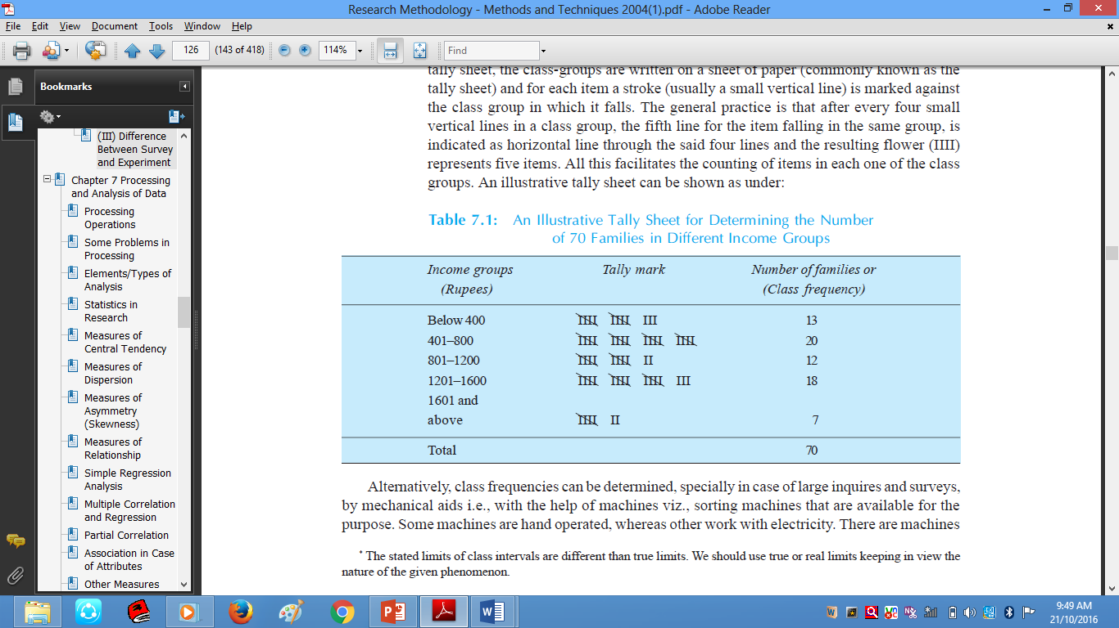
Conti…
Table01:An Illustrative Tally Sheet for Determining the Number
of 70 Families in Different Income Groups

Slide 18
Conti…
Alternatively, class frequencies can be determined, specially in case of large inquires and surveys, by mechanical aids i.e., with the help of machines viz., sorting machines that are available for the purpose.
Some machines are hand operated, whereas other work with electricity. There are machines which can sort out cards at a speed of something like 25000 cards per hour. This method is fast but expensive.

Slide 19
Conti…
Tabulation: When a mass of data has been assembled, it becomes necessary for the researcher to arrange the same in some kind of concise and logical order. This procedure is referred to as tabulation.
Thus, tabulation is the process of summarising raw data and displaying the same in compact form (i.e., in the form of statistical tables) for further analysis.
In a broader sense, tabulation is an orderly arrangement of data in columns and rows.

Slide 20
Conti…
Tabulation is essential because of the following reasons.
1. It conserves space and reduces explanatory and descriptive statement to a minimum.
2. It facilitates the process of comparison.
3. It facilitates the summation of items and the detection of errors and omissions.
4. It provides a basis for various statistical computations.

Slide 21
Conti…
Generally accepted principles of tabulation : Such principles of tabulation, particularly of constructing statistical tables, can be briefly states as follows:
Every table should be given a distinct number to facilitate easy reference.
The column headings (captions) and the row headings (stubs) of the table should be clear and brief.
The units of measurement under each heading or sub-heading must always be indicated.
The columns may be numbered to facilitate reference

Slide 22
STATISTICS IN RESEARCH
The role of statistics in research is to function as a tool in designing research, analyzing its data and drawing conclusions there from.
Most research studies result in a large volume of raw data which must be suitably reduced so that the same can be read easily and can be used for further analysis.
Clearly the science of statistics cannot be ignored by any research worker, even though he may not have occasion to use statistical methods in all their details and ramifications.

Slide 23
Conti…
Classification and tabulation, as stated earlier, achieve this objective to some extent, but we have to go a step further and develop certain indices or measures to summarize the collected/classified data.
Only after this we can adopt the process of generalization from small groups (i.e., samples) to population.
If fact, there are two major areas of statistics viz., descriptive statistics and inferential statistics.

Slide 24
Conti…
Descriptive statistics concern the development of certain indices from the raw data, whereas inferential statistics concern with the process of generalisation.
Inferential statistics are also known as sampling statistics and are mainly concerned with two major type of problems:
(i) The estimation of population parameters, and
(ii) The testing of statistical hypotheses.
The important statistical measures that are used to summarize the survey/research data are:

Slide 25
Conti…
(1) Measures of central tendency or statistical averages.
(2) Measures of dispersion.
(3) Measures of asymmetry (skewness).
(4) Measures of relationship.

Slide 26
Conti…
MEASURES OF CENTRAL TENDENCY
Measures of central tendency (or statistical averages) tell us the point about which items have a tendency to cluster. Such a measure is considered as the most representative figure for the entire mass of data.
Measure of central tendency is also known as statistical average. Mean, median and mode are the most popular averages.
Mean, also known as arithmetic average, is the most common measure of central tendency and may be defined as the value which we get by dividing the total of the values of various given items in a series by the total number of items.

Slide 27
Conti…
Median is the value of the middle item of series when it is arranged in ascending or descending order of magnitude.
Mode is the most commonly or frequently occurring value in a series. The mode in a distribution is that item around which there is maximum concentration.
Geometric mean is also useful under certain conditions. It is defined as the nth root of the product of the values of n times in a given series.
Harmonic mean is defined as the reciprocal of the average of reciprocals of the values of items of a series.

Slide 28
Conti…
MEASURES OF DISPERSION
An averages can represent a series only as best as a single figure can, but it certainly cannot reveal the entire story of any phenomenon under study.
Specially it fails to give any idea about the scatter of the values of items of a variable in the series around the true value of average.
In order to measure this scatter, statistical devices called measures of dispersion are calculated. Important measures of dispersion are (a) range, (b) mean deviation, and (c) standard deviation.

Slide 29
Conti…
Range is the simplest possible measure of dispersion and is defined as the difference between the values of the extreme items of a series.
Mean deviation is the average of difference of the values of items from some average of the series.
Standard deviation is most widely used measure of dispersion of a series and is commonly denoted by the symbol ‘ s ’ (pronounced as sigma).

Slide 30
Conti…
MEASURES OF ASYMMETRY (SKEWNESS)
When the distribution of item in a series happens to be perfectly symmetrical.
Such a curve is technically described as a normal curve and the relating distribution as normal distribution.
Such a curve is perfectly bell shaped curve in which case the value of X or M or Z is just the same and skewness is altogether absent. But if the curve is distorted (whether on the right side or on the left side), we have asymmetrical distribution which indicates that there is skewness. If the curve is distorted on the right side, we have positive skewness but when the curve is distorted towards left, we have negative skewness .

Slide 31
Conti…
Kurtosis is the measure of flat-top pedness of a curve.
A bell shaped curve or the normal curve is Mesokurtic because it is kurtic in the centre; but if the curve is relatively more peaked than the normal curve, it is called Leptokurtic whereas a curve is more flat than the normal curve, it is called Platykurtic.

Slide 32
Conti…
MEASURES OF RELATIONSHIP
So far we have dealt with those statistical measures that we use in context of univariate population i.e., the population consisting of measurement of only one variable.
But if we have the data on two variables, we are said to have a bivariate population and if the data happen to be on more than two variables, the population is known as multivariate population. If for every measurement of a variable, X, we have corresponding value of a second variable, Y, the resulting pairs of values are called a bivariate population.

Slide 33
Conti…
In case of bivariate population: Correlation can be studied through (a) cross tabulation.(b) Charles Spearman’s coefficient of correlation. (c) Karl Pearson’s coefficient of correlation, whereas cause and effect relationship can be studied through simple regression equations.
In case of multivariate population: Correlation can be studied through (a) coefficient of multiple correlation. (b) coefficient of partial correlation.
whereas cause and effect relationship can be studied through multiple regression equations.

Slide 34
Conti…
SIMPLE REGRESSION ANALYSIS
Regression is the determination of a statistical relationship between two or more variables. In simple regression, we have only two variables, one variable (defined as independent) is the cause of the behavior of another one (defined as dependent variable).
Regression can only interpret what exists physically i.e., there must be a physical way in which independent variable X can affect dependent variable Y.

