Slide 1
Design

Slide 2
Design
The designer's goal is to produce a model or representation of an entity that will later be built. The process by which the design model is developed is described by Belady [BEL81]:
There are two major phases to any design process: diversification and convergence.
Diversification is the acquisition of a repertoire of alternatives, the raw material of design: components, component solutions, and knowledge, all contained in catalogs, textbooks, and the mind.
During convergence, the designer chooses and combines appropriate elements from this repertoire to meet the design objectives, as stated in the requirements document and as agreed to by the customer.
The second phase is the gradual elimination of all but one particular configuration of components, and thus the creation of the final product.

Slide 3
SOFTWARE DESIGN AND SOFTWARE ENGINEERING
Software design sits at the technical kernel of software engineering and is applied regardless of the software process model that is used.
Beginning once software requirements have been analyzed and specified, software design is the first of three technical activities—design, code generation, and test—that are required to build and verify the software.
Each activity transforms information in a manner that ultimately results in validated computer software.

Slide 4
Conti…
The design task produces a
Data design.
An architectural design.
An interface design, and
A component design.

Slide 5
Conti…
Data design
The data design transforms the information domain model created during analysis into the data structures that will be required to implement the software.
The data objects and relationships defined in the entity relationship diagram and the detailed data content depicted in the data dictionary provide the basis for the data design activity.
Part of data design may occur in conjunction with the design of software architecture.
More detailed data design occurs as each software component is designed.

Slide 6
Conti…
Architectural design
The architectural design defines the relationship between major structural elements of the software, the “design patterns” that can be used to achieve the requirements that have been defined for the system, and the constraints that affect the way in which architectural design patterns can be applied [SHA96].
The architectural design representation— the framework of a computer-based system—can be derived from the system specification, the analysis model, and the interaction of subsystems defined within the analysis model.

Slide 7
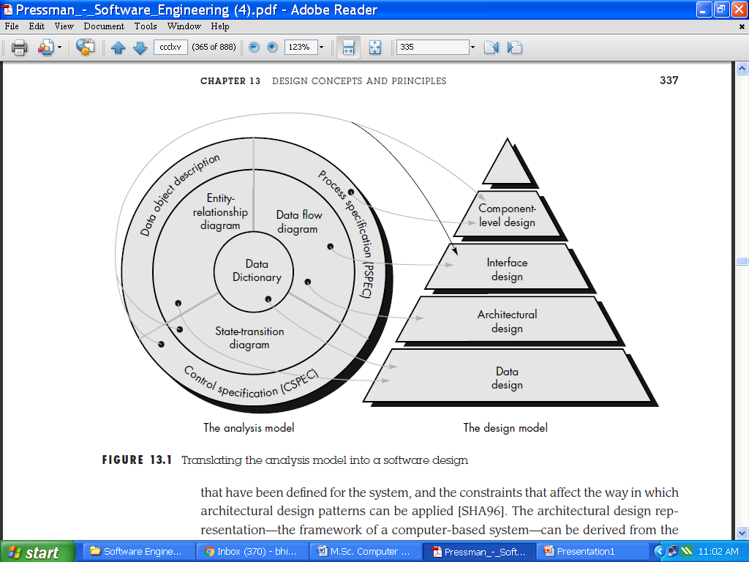
Conti…
Fig1:Translating the analysis model into a software design

Slide 8
Conti…
Interface design
The interface design describes how the software communicates within itself, with systems that interoperate with it, and with humans who use it.
An interface implies a flow of information (e.g., data and/or control) and a specific type of behavior.
Therefore, data and control flow diagrams provide much of the information required for interface design.

Slide 9
Conti…
Component design
The component-level design transforms structural elements of the software architecture into a procedural description of software components.
Information obtained from the PSPEC, CSPEC, and STD serve as the basis for component design.
During design we make decisions that will ultimately affect the success of software construction and, as important, the ease with which software can be maintained.
But why is design so important?
The importance of software design can be stated with a single word—quality. Design is the place where quality is fostered in software engineering. Design provides us with representations of software that can be assessed for quality.

Slide 10
THE DESIGN PROCESS
Software design is an iterative process through which requirements are translated into a “blueprint” for constructing the software.
Initially, the blueprint depicts a holistic view of software.
That is, the design is represented at a high level of abstraction— a level that can be directly traced to the specific system objective and more detailed data, functional, and behavioral requirements.
As design iterations occur, subsequent refinement leads to design representations at much lower levels of abstraction.
These can still be traced to requirements, but the connection is more subtle.

Slide 11
Conti…
Design and Software Quality
McGlaughlin [MCG91] suggests three characteristics that serve as a guide for the evaluation of a good design:
The design must implement all of the explicit requirements contained in the analysis model, and it must accommodate all of the implicit requirements desired by the customer.
The design must be a readable, understandable guide for those who generate code and for those who test and subsequently support the software.
The design should provide a complete picture of the software, addressing the data, functional, and behavioral domains from an implementation perspective.

Slide 12
Conti…
The Evolution of Software Design
The evolution of software design is a continuing process that has spanned the past four decades. Early design work concentrated on criteria for the development of modular programs and methods for refining software structures in a top-down manner.
Procedural aspects of design definition evolved into a philosophy called structured programming .Later work proposed methods for the translation of data flow [STE74] or data structure, into a design definition.
Newer design approaches (e.g., proposed an object-oriented approach to design derivation. Today, the emphasis in software design has been on software architecture and the design patterns that can be used to implement software architectures.

Slide 13
Conti…
Each software design method introduces unique heuristics and notation, as well as a somewhat parochial view of what characterizes design quality. Yet, all of these methods have a number of common characteristics:
(1) A mechanism for the translation of analysis model into a design representation.
(2) A notation for representing functional components and their interfaces.
(3) Heuristics for refinement and partitioning, and
(4) Guidelines for quality assessment.

Slide 14
DESIGN PRINCIPLES
Software design is both a process and a model. The design process is a sequence of steps that enable the designer to describe all aspects of the software to be built.
It is important to note, however, that the design process is not simply a cookbook.
Creative skill, past experience, a sense of what makes “good” software, and an overall commitment to quality are critical success factors for a competent design.
Basic design principles enable the software engineer to navigate the design process.
Davis suggests a set of principles for software design, which have been adapted and extended in the following list.

Slide 15
Conti…
The design process should not suffer from “tunnel vision.”
The design should be traceable to the analysis model.
The design should not reinvent the wheel.
The design should “minimize the intellectual distance” [DAV95] between the software and the problem as it exists in the real world.
The design should exhibit uniformity and integration.
The design should be structured to accommodate change.
The design should be structured to degrade gently, even when aberrant data, events, or operating conditions are encountered.
Design is not coding, coding is not design.
The design should be assessed for quality as it is being created, not after the fact. The design should be reviewed to minimize conceptual (semantic)errors.

Slide 16
DESIGN CONCEPTS
A set of fundamental software design concepts has evolved over the past four decades.
Each provides the software designer with a foundation from which more sophisticated design methods can be applied. Each helps the software engineer to answer the following questions:
What criteria can be used to partition software into individual components?
How is function or data structure detail separated from a conceptual representation of the software?
What uniform criteria define the technical quality of a software design?

Slide 17
Conti…
Abstraction
When we consider a modular solution to any problem, many levels of abstraction can be posed. At the highest level of abstraction, a solution is stated in broad terms using the language of the problem environment.
At lower levels of abstraction, a more procedural orientation is taken.
Problem-oriented terminology is coupled with implementation- oriented terminology in an effort to state a solution.
Finally, at the lowest level of abstraction, the solution is stated in a manner that can be directly implemented.
As we move through different levels of abstraction, we work to create procedural and data abstractions. A procedural abstraction is a named sequence of instructions that has a specific and limited function.
A data abstraction is a named collection of data that describes a data object . In the context of the procedural abstraction open, we can define a data abstraction called door.

Slide 18
Conti…
Refinement
Stepwise refinement is a top-down design strategy originally proposed by Niklaus Wirth[WIR71].
A program is developed by successively refining levels of procedural detail.
A hierarchy is developed by decomposing a macroscopic statement of function (procedural abstraction) in a stepwise fashion until programming language statements are reached. An overview of the concept is provided by Wirth.
The process of program refinement proposed by Wirth is analogous to the process of refinement and partitioning that is used during requirements analysis.
Refinement is actually a process of elaboration.

Slide 19
Conti…
Modularity
The concept of modularity in computer software has been espoused for almost five decades.
Software architecture embodies modularity; that is, software is divided into separately named and addressable components, often called modules, that are integrated to satisfy problem requirements.
It has been stated that "modularity is the single attribute of software that allows a program to be intellectually manageable”.
Another important question arises when modularity is considered.
How do we define an appropriate module of a given size? The answer lies in the method(s) used to define modules within a system.
Meyer [MEY88] defines five criteria that enable us to evaluate a design method with respect to its ability to define an effective modular system:

Slide 20
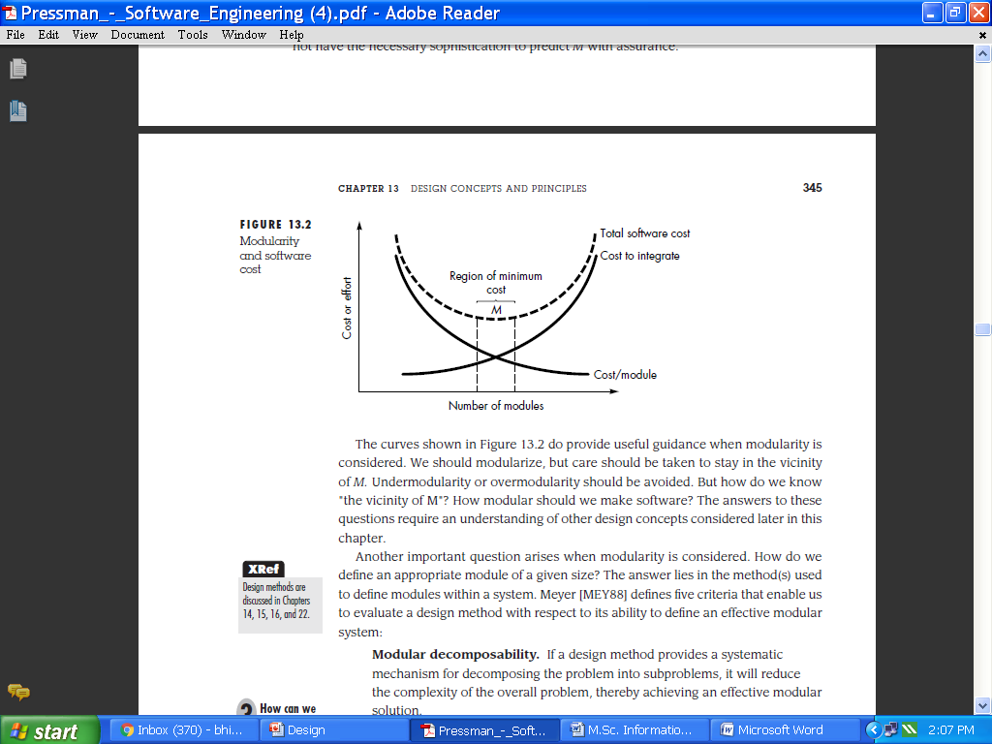
Conti…
Fig2:Modularity and software cost

Slide 21
Conti…
Modular decomposability. If a design method provides a systematic mechanism for decomposing the problem into sub problems.
Modular composability. If a design method enables existing (reusable) design components to be assembled into a new system, it will yield a modular solution that does not reinvent the wheel.
Modular understandability. If a module can be understood as a standalone unit (without reference to other modules), it will be easier to build and easier to change.
Modular continuity. If small changes to the system requirements result in changes to individual modules, rather than system wide changes, the impact of change-induced side effects will be minimized.
Modular protection. If an aberrant condition occurs within a module and its effects are constrained within that module, the impact of error-induced side effects will be minimized.

Slide 22
Software Architecture
Software architecture alludes to “the overall structure of the software and the ways in which that structure provides conceptual integrity for a system” .
In its simplest form, architecture is the hierarchical structure of program components (modules), the manner in which these components interact and the structure of data that are used by the components.
Shaw and Garlan describe a set of properties that should be specified as part of an architectural design:
Structural properties. This aspect of the architectural design representation defines the components of a system (e.g., modules, objects, filters) and the manner in which those components are packaged and interact with one another.

Slide 23
Conti…
Extra-functional properties. The architectural design description should address how the design architecture achieves requirements for performance, capacity, reliability, security, adaptability, and other system characteristics.
Families of related systems. The architectural design should draw upon repeatable patterns that are commonly encountered in the design of families of similar systems.
Given the specification of these properties, the architectural design can be represented using one or more of a number of different models.
Structural models represent architecture as an organized collection of program components.
Framework models increase the level of design abstraction by attempting to identify repeatable architectural design frameworks (patterns) that are encountered in similar types of applications.

Slide 24
Conti…
Dynamic models address the behavioral aspects of the program architecture, indicating how the structure or system configuration may change as a function of external events.
Process models focus on the design of the business or technical process that the system must accommodate.
Finally, functional models can be used to represent the functional hierarchy of a system.
A number of different architectural description languages (ADLs) have been developed to represent these models .
Although many different ADLs have been proposed, the majority provide mechanisms for describing system components and the manner in which they are connected to one another.

Slide 25
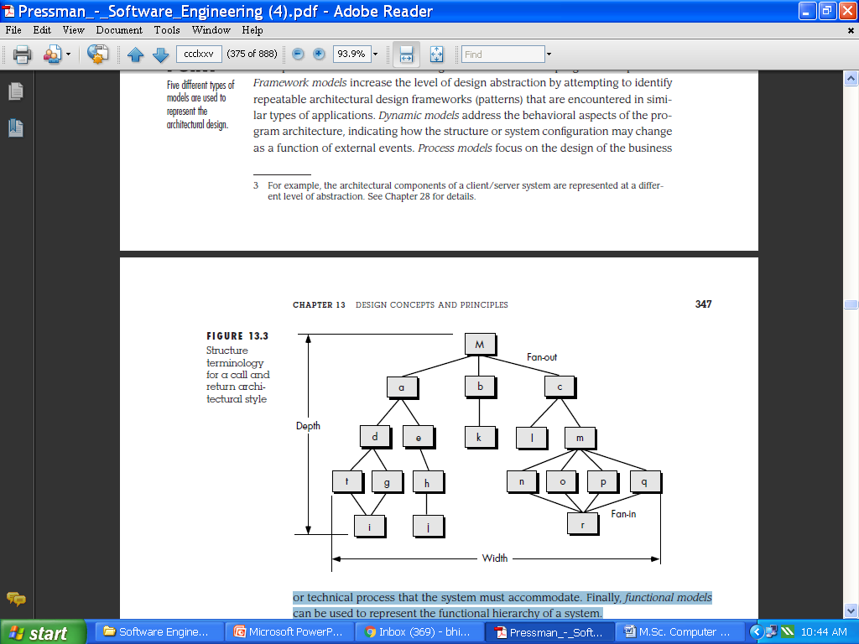
Conti…
Fig3:Structure terminology for a call and return architectural style

Slide 26
Conti…
Control Hierarchy
Control hierarchy, also called program structure, represents the organization of program components (modules) and implies a hierarchy of control.
It does not represent procedural aspects of software such as sequence of processes, occurrence or order of decisions, or repetition of operations; nor is it necessarily applicable to all architectural styles.
The control relationship among modules is expressed in the following way: A module that controls another module is said to be super ordinate to it, and conversely, a module controlled by another is said to be subordinate to the controller.
The control hierarchy also represents two subtly different characteristics of the software architecture: visibility and connectivity.

Slide 27
Conti…
Structural Partitioning
If the architectural style of a system is hierarchical, the program structure can be partitioned both horizontally and vertically.
Referring to Figure 4, horizontal partitioning defines separate branches of the modular hierarchy for each major program function.
Control modules, represented in a darker shade are used to coordinate communication between and execution of the functions. The simplest approach to horizontal partitioning defines three partitions—input, data transformation (often called processing) and output.
Partitioning the architecture horizontally provides a number of distinct benefits:
Software that is easier to test
Software that is easier to maintain
Propagation of fewer side effects
Software that is easier to extend

Slide 28
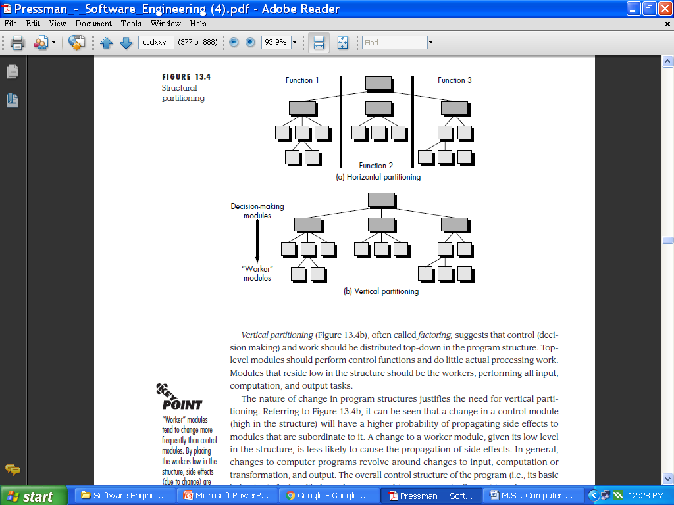
Conti…
Fig4(a,b) :Structural partitioning

Slide 29
Conti…
Vertical partitioning (Figure 4b), often called factoring, suggests that control (decision making) and work should be distributed top-down in the program structure.
Top-level modules should perform control functions and do little actual processing work.
Modules that reside low in the structure should be the workers, performing all input, computation, and output tasks.
Data Structure
Software Procedure
Information Hiding

Slide 30
EFFECTIVE MODULAR DESIGN
All the fundamental design concepts described in the preceding section serve to precipitate modular designs. In fact, modularity has become an accepted approach in all engineering disciplines.
A modular design reduces complexity ,facilitates change (a critical aspect of software maintainability), and results in easier implementation by encouraging parallel development of different parts of a system.
Functional Independence
The concept of functional independence is a direct outgrowth of modularity and the concepts of abstraction and information hiding.
Functional independence is achieved by developing modules with "single-minded“ function and an "aversion" to excessive interaction with other modules.

Slide 31
Conti…
Stated another way, we want to design software so that each module addresses a specific subfunction of requirements and has a simple interface when viewed from other parts of the program structure.
It is fair to ask why independence is important.
To summarize, functional independence is a key to good design, and design is the key to software quality.
Independence is measured using two qualitative criteria: cohesion and coupling.
Cohesion is a measure of the relative functional strength of a module.
Coupling is a measure of the relative interdependence among modules

Slide 32
Conti…
Cohesion
A cohesive module performs a single task within a software procedure, requiring little interaction with procedures being performed in other parts of a program.
Stated simply, a cohesive module should (ideally) do just one thing.
Cohesion may be represented as a "spectrum." We always strive for high cohesion, although the mid-range of the spectrum is often acceptable.
The scale for cohesion is nonlinear.
At the low (undesirable) end of the spectrum, we encounter a module that performs a set of tasks that relate to each other loosely, if at all.

Slide 33
Conti…
When processing elements of a module are related and must be executed in a specific order, procedural cohesion exists.
When all processing elements concentrate on one area of a data structure, communicational cohesion is present.
High cohesion is characterized by a module that performs one distinct procedural task.
Such modules are termed coincidentally cohesive. A module that performs tasks that are related logically (e.g., a module that produces all output regardless of type) is logically cohesive.

Slide 34
Conti…
Coupling
Coupling is a measure of interconnection among modules in a software structure.
Coupling depends on the interface complexity between modules, the point at which entry or reference is made to a module, and what data pass across the interface.
As long as a simple argument list is present (i.e., simple data are passed; a one-to-one correspondence of items exists), low coupling (called data coupling) is exhibited in this portion of structure.
A variation of data coupling, called stamp coupling, is found when a portion of a data structure (rather than simple arguments) is passed via a module interface.

Slide 35
Conti…
At moderate levels, coupling is characterized by passage of control between modules.
Control coupling is very common in most software designs and is shown in Figure 5.
where a “control flag” (a variable that controls decisions in a subordinate or super ordinate module) is passed between modules d and e.
External coupling is essential, but should be limited to a small number of modules with a structure.
High coupling also occurs when a number of modules reference a global data area. Common coupling, as this mode is called, is shown in 5.
The highest degree of coupling, content coupling, occurs when one module makes use of data or control information maintained within the boundary of another module.

Slide 36
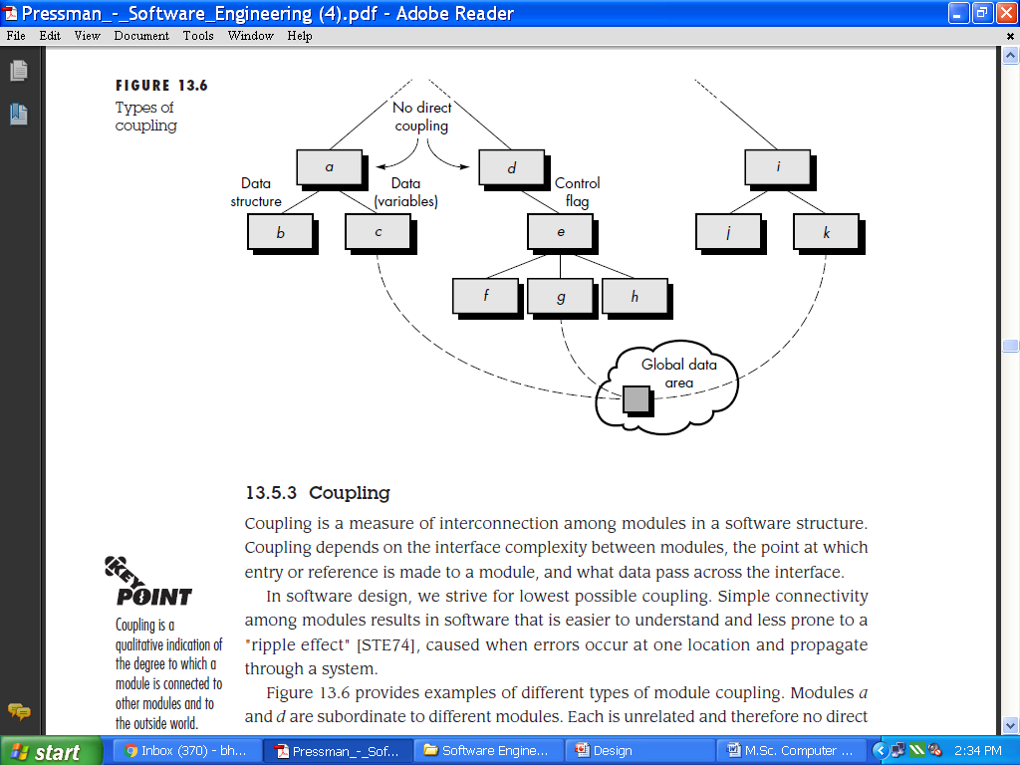
Conti…
Fg5:Types of coupling

Slide 37
Data Design at the Component Level
Data design at the component level focuses on the representation of data structures that are directly accessed by one or more software components.
The systematic analysis principles applied to function and behavior should also be applied to data.
All data structures and the operations to be performed on each should be identified.
A data dictionary should be established and used to define both data and program design.

Slide 38
Conti…
Low-level data design decisions should be deferred until late in the design process
The representation of data structure should be known only to those modules that must make direct use of the data contained within the structure.
A library of useful data structures and the operations that may be applied to them should be developed.
A software design and programming language should support the specification and realization of abstract data types.

Slide 39
ARCHITECTURAL STYLES
When a builder uses the phrase “center hall colonial” to describe a house, most people familiar with houses in the United States will be able to conjure a general image of what the house will look like and what the floor plan is likely to be.
The builder has used an architectural style as a descriptive mechanism to differentiate the house from other styles (e.g., A-frame, raised ranch, Cape Cod).
The software that is built for computer-based systems also exhibits one of many architectural styles. Each style describes a system category that encompasses
(1) a set of components (e.g., a database, computational modules) that perform a function required by a system;

Slide 40
Conti…
(2)A set of connectors that enable “communication, coordination and cooperation” among components;
(3)Constraints that define how components can be integrated to form the system; and
(4)Semantic models that enable a designer to understand the overall properties of a system by analyzing the known properties of its constituent parts.
A Brief Taxonomy of Styles and Patterns

Slide 41
Conti…
Data-centered architectures.
A data store (e.g., a file or database) resides at the center of this architecture and is accessed frequently by other components that update, add, delete, or otherwise modify data within the store.
Figure 6 illustrates a typical data-centered style. Client software accesses a central repository.
In some cases the data repository is passive.
A variation on this approach transforms the repository into a “blackboard” that sends
notifications to client software when data of interest to the client change.

Slide 42
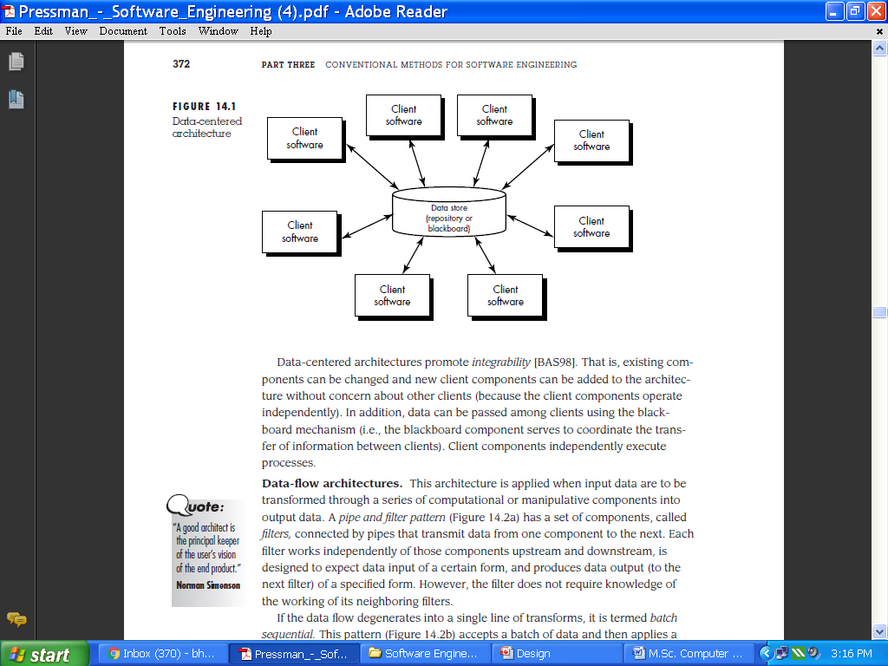
Conti…
Fig6:Data-centered architecture

Slide 43
Conti…
Data-flow architectures.
This architecture is applied when input data are to be transformed through a series of computational or manipulative components into output data.
If the data flow degenerates into a single line of transforms, it is termed batch sequential.
A pipe and filter pattern (Figure 7 a) has a set of components, called filters, connected by pipes that transmit data from one component to the next.
This pattern (Figure 7 b) accepts a batch of data and then applies a series of sequential components (filters) to transform it.

Slide 44
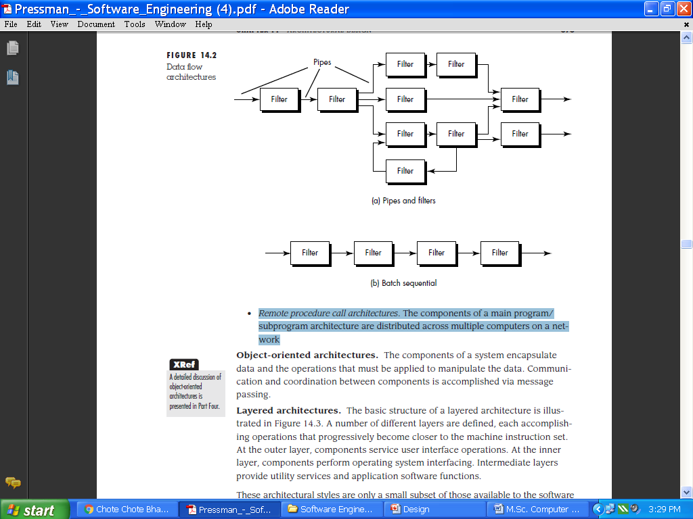
Conti…
Fig7 a,b:Data flow architectures

Slide 45
Conti…
Call and return architectures.
This architectural style enables a software designer (system architect) to achieve a program structure that is relatively easy to modify and scale.
Main program/subprogram architectures.
This classic program structure decomposes function into a control hierarchy where a “main” program invokes a number of program components, which in turn may invoke still other components.
Figure 3 illustrates an architecture of this type.
Remote procedure call architectures. The components of a main program/ subprogram architecture are distributed across multiple computers on a network.

Slide 46
Conti…
Object-oriented architectures.
The components of a system encapsulate data and the operations that must be applied to manipulate the data.
Communication and coordination between components is accomplished via message passing.

Slide 47
Conti…
Layered architectures.
The basic structure of a layered architecture is illustrated in Figure 8.
A number of different layers are defined, each accomplishing operations that progressively become closer to the machine instruction set.
At the outer layer, components service user interface operations. At the inner layer, components perform operating system interfacing.
Intermediate layers provide utility services and application software functions.
In many cases, more than one pattern might be appropriate and alternative architectural styles might be designed and evaluated.

Slide 48
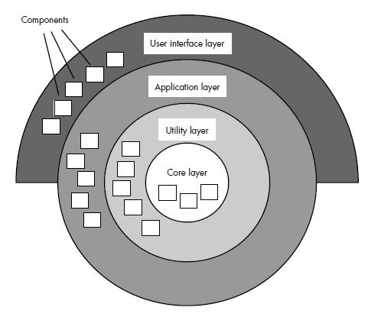
Conti…
Fig8:Layered architecture

Slide 49
ANALYZING ALTERNATIVE ARCHITECTURAL DESIGNS
The questions posed in the preceding section provide a preliminary assessment of the architectural style chosen for a given system.
However, a more complete method for evaluating the quality of an architecture is essential if design is to be accomplished effectively.
we consider two different approaches for the analysis of alternative architectural designs.
The first method uses an iterative method to assess design trade-offs.
The second approach applies a pseudo-quantitative technique for assessing design quality.

Slide 50
Conti…
An Architecture Trade-off Analysis Method
The Software Engineering Institute (SEI) has developed an architecture trade-off analysis method that establishes an iterative evaluation process for software architectures.
The design analysis activities that follow are performed iteratively:
Collect scenarios.
Elicit requirements, constraints, and environment description.
Describe the architectural styles/patterns that have been chosen to address the scenarios and requirements.
Evaluate quality attributes by considering each attribute in isolation.
Identify the sensitivity of quality attributes to various architectural attributes for a specific architectural style.
Critique candidate architectures (developed in step 3) using the sensitivity analysis conducted in step 5.

Slide 51
Conti…
One of the many problems faced by software engineers during the design process is a general lack of quantitative methods for assessing the quality of proposed designs.
Asada proposes a number of simple models that assist a designer in determining the degree to which a particular architecture meets predefined “goodness” criteria.
These criteria, sometimes called design dimensions, often encompass the quality attributes defined in the last section: reliability, performance, security, maintainability, flexibility, testability, portability, reusability, and interoperability, among others.
The QDS (Quantified Design Space ) is relatively easy to implement as a spreadsheet model and can be used to isolate why one set of design choices gets a lower score than another.

Slide 52
Conti…
Architectural Complexity
A useful technique for assessing the overall complexity of a proposed architecture is to consider dependencies between components within the architecture.
These dependencies are driven by information/control flow within the system.
Zhao suggests three types of dependencies:
Sharing dependencies.
Flow dependencies.
Constrained dependencies

Slide 53
User Interface Design
Interface design focuses on three areas of concern:
(1) The design of interfaces between software components,
(2) The design of interfaces between the software and other nonhuman producers and consumers of information (i.e., other external entities), and
(3) The design of the interface between a human (i.e., the user) and the computer.
THE GOLDEN RULES
1. Place the user in control.
2. Reduce the user’s memory load.
3. Make the interface consistent.
These golden rules actually form the basis for a set of user interface design principles that guide this important software design activity.

Slide 54
Conti…
Place the User in Control
During a requirements-gathering session for a major new information system, a key user was asked about the attributes of the window-oriented graphical interface.
Mandel [MAN97] defines a number of design principles that allow the user to maintain control.
Define interaction modes in a way that does not force a user into unnecessary or undesired actions.
Provide for flexible interaction.
Allow user interaction to be interruptible and undoable.
Streamline interaction as skill levels advance and allow the interaction to be customized.
Hide technical internals from the casual user.
Design for direct interaction with objects that appear on the screen.

Slide 55
Conti…
Reduce the User’s Memory Load
The more a user has to remember, the more error-prone will be the interaction with the system. It is for this reason that a well-designed user interface does not tax the user’s memory .Mandel defines design principles that enable an interface to reduce the user’s memory load:
Reduce demand on short-term memory.
Establish meaningful defaults.
Define shortcuts that are intuitive.
The visual layout of the interface should be based on a real world metaphor.
Disclose information in a progressive fashion

Slide 56
Conti…
Make the Interface Consistent
The interface should present and acquire information in a consistent fashion.
This implies that (1) All visual information is organized according to a design standard that is maintained throughout all screen displays, (2) Input mechanisms are constrained to a limited set that are used consistently throughout the application, and (3) mechanisms for navigating from task to task are consistently defined and implemented.
Mandel [MAN97] defines a set of design principles that help make the interface consistent:
Allow the user to put the current task into a meaningful context.
Maintain consistency across a family of applications.
If past interactive models have created user expectations, do not make changes unless there is a compelling reason to do so.

Slide 57
USER INTERFACE DESIGN
The overall process for designing a user interface begins with the creation of different models of system function (as perceived from the outside).
Interface Design Models
Four different models come into play when a user interface is to be designed.
The software engineer creates a design model, a human engineer (or the software engineer)establishes a user model, the end-user develops a mental image that is often called the user's model or the system perception, and the implementers of the system create a system image.

Slide 58
Conti…
The User Interface Design Process
The design process for user interfaces is iterative and can be represented using a spiral model .
The user interface design process encompasses four distinct framework activities.
1. User, task, and environment analysis and modeling
2. Interface design
3. Interface construction
4. Interface validation

Slide 59
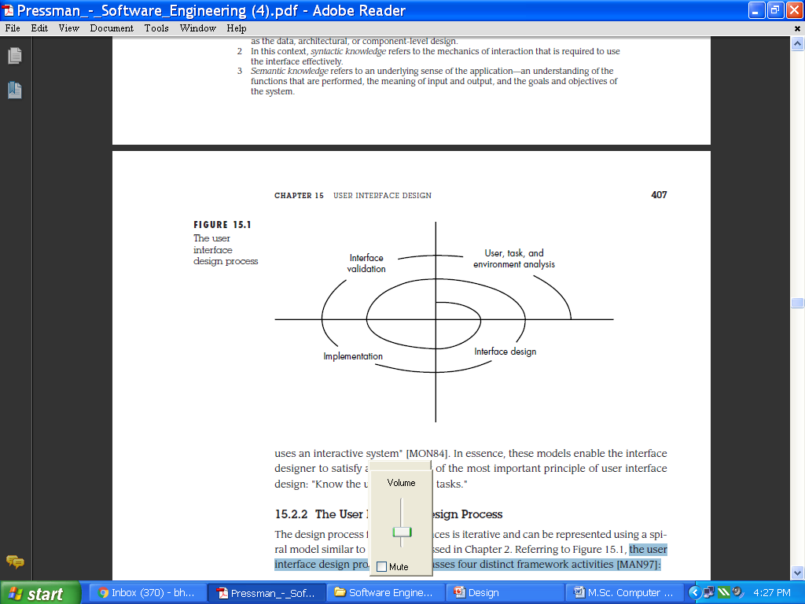
Conti…
Fig9:The user interface design process

Slide 60
INTERFACE DESIGN ACTIVITIES
Once task analysis has been completed, all tasks (or objects and actions) required by the end-user have been identified in detail and the interface design activity commences.
The first interface design steps can be accomplished using the following approach:
1. Establish the goals5 and intentions for each task.
2. Map each goal and intention to a sequence of specific actions.
3. Specify the action sequence of tasks and subtasks, also called a user scenario , as it will be executed at the interface level.
4.Indicate the state of the system; that is, what does the interface look like at the time that a user scenario is performed?
5. Define control mechanisms; that is, the objects and actions available to the user to alter the system state.

Slide 61
Conti…
6. Show how control mechanisms affect the state of the system.
7. Indicate how the user interprets the state of the system from information provided through the interface

Slide 62
DESIGN EVALUATION
Once an operational user interface prototype has been created, it must be evaluated to determine whether it meets the needs of the user.
Evaluation can span a formality spectrum that ranges from an informal "test drive," in which a user provides impromptu feedback to a formally designed study that uses statistical methods for the evaluation of questionnaires completed by a population of end-users.

Slide 63
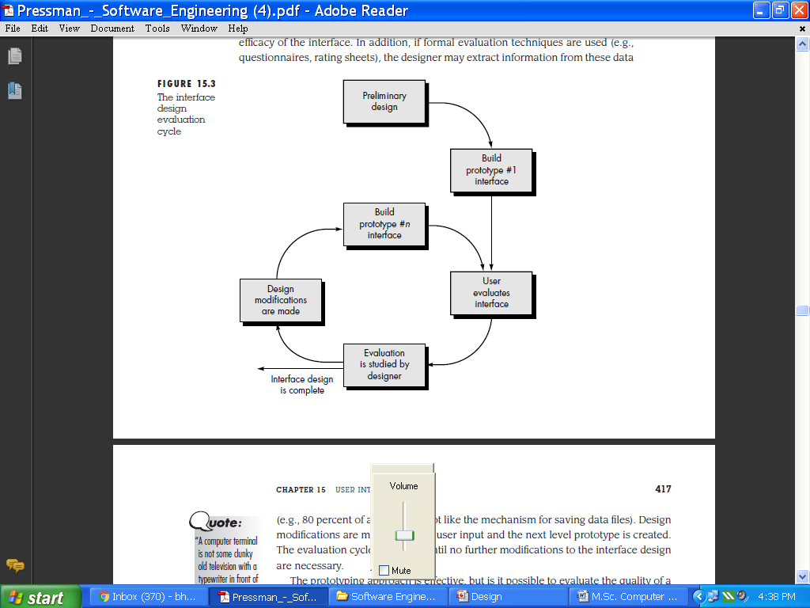
Conti…
Fig10:The interface design evaluation cycle

