Slide 1
Information Security
Dr. S. S. Yambal

Slide 2
Information Security
Information security: a “well-informed sense of assurance that the information risks and controls are in balance.” —Jim Anderson, Inovant (2002)

Slide 3
What is information security?
Information security protects information (and the facilities and systems that store, use and transmit it) from a wide range of threats, in order to preserve its value to an organisation.
This definition of information security is adapted from that of the American National Security Telecommunications and Information Systems Security Committee (NSTISSC).

Slide 4
The protection of information and its critical elements, including systems and hardware that use, store, and transmit that information
Necessary tools: policy, awareness, training, education, technology
C.I.A. triangle was standard based on confidentiality, integrity, and availability
C.I.A. triangle now expanded into list of critical characteristics of information

Slide 5
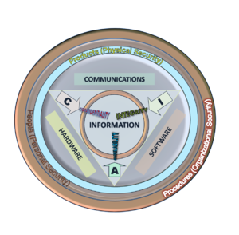

Slide 6
Characteristics of Information Security
There are two important characteristics of information that determine its value to an organisation:
the scarcity of the information outside the organisation;
the shareability of the information within the organisation, or some part of it.

Slide 7
Critical Characteristics of Information
The value of information comes from the characteristics it possesses:
Availability
Accuracy
Authenticity
Confidentiality
Integrity
Utility
Possession

Slide 8
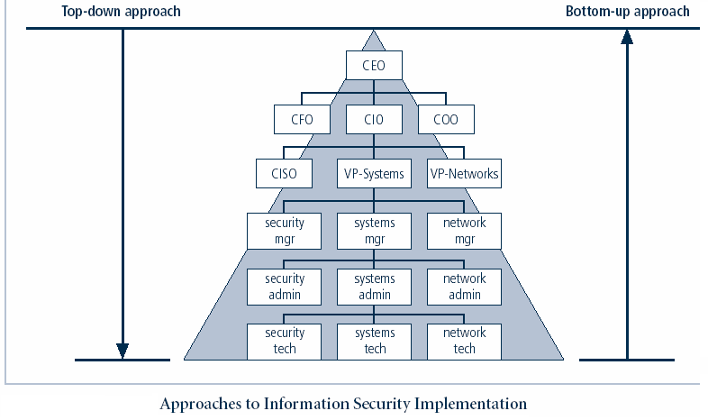

Slide 9
Computer crimes and viruses
A computer virus is a computer program that can infect other computer programs by modifying them in such a way as to include a (possibly evolved) copy of it. Note that a program does not have to perform outright damage (such as deleting or corrupting files) in order to be called a "virus".

Slide 10
Example 1: Softbank – theft of consumer data for extortion
Softbank of Japan offers broadband internet services across Japan through two subsidiaries – Yahoo! BB and Softbank BB. In February 2004, the bank announced that the security of 4.5 million customer records had been compromised: data from both subsidiaries had been illegally copied and disseminated. The leaked details included customer names, home phone numbers, addresses and email IDs, but did not include passwords, access logs or credit card details.
Softbank became aware of the problem only when they were approached by two groups of extortionists. The criminals produced apparently genuine customer data and threatened that all of the data would be posted to the internet if they were not paid a large sum of money.

Slide 11
Japanese police made three arrests but suspected that there may have been connections to organised crime and the political far-right. Amazingly, the police concluded that there had in fact been two simultaneous, yet independent, extortion attempts against Softbank, both of them masterminded by employees of the company. All of the people accused of extortion had been authorised to access the customer data; but it appeared that Softbank had inadequate procedures to protect against its unwarranted copying and dissemination.
The bank immediately announced a tightening of security, further restricting access to their systems and enforcing tighter security on all of their subsidiaries. Profuse apologies were offered to the affected customers and ¥4 billion (£20 million) were paid in compensation. Furthermore, Softbank BB's president, Masayoshi Son, announced that he and other senior executives would take a 50 per cent pay cut for the next six months.
In this example, the threat was to reduce the value of an organisation by revealing information that should have been a well-kept secret – scarce-within as well as scarce-without. It cost the company £20 million in compensation and affected its reputation.

Slide 12
Need of IS
There are many reasons why you should protect the information you use on your computer, including:
Ensuring that your information remains confidential and only those who should access that information, can Knowing that no one has been able to change your information, so you can depend on its accuracy (information integrity)
Making sure that your information is available when you need it (by making back-up copies and, if appropriate, storing the back-up copies off-site)

Slide 13
Security Controls
When management chooses to mitigate a risk, they will do so by implementing one or more of three different types of controls:
Logical Control
Physical Control

Slide 14
Logical Control
Logical controls (also called technical controls) use software and data to monitor and control access to information and computing systems. For example: passwords, network and host based firewalls, network intrusion detection systems, access control lists, and data encryption are logical controls.

Slide 15
Physical Control
Physical controls monitor and control the environment of the work place and computing facilities. They also monitor and control access to and from such facilities. For example: doors, locks, heating and air conditioning, smoke and fire alarms, fire suppression systems, cameras, barricades, fencing, security guards, cable locks, etc. Separating the network and workplace into functional areas are also physical controls.

Slide 16
Access Control
Authorization
Authentication
Identification
Non-discretionary approach consolidates all access control under a centralized administration.
Discretionary approach – under individual

Slide 17
Cryptography
Information security uses cryptography to transform usable information into a form that renders it unusable by anyone other than an authorized user; this process is called encryption. Information that has been encrypted (rendered unusable) can be transformed back into its original usable form by an authorized user, who possesses the cryptographic key, through the process of decryption. Cryptography is used in information security to protect information from unauthorized or accidental disclosure while the information is in transit (either electronically or physically) and while information is in storage.

Slide 18
Assignment
Define Information Security. Discuss its need and available tools to maintain it.
What are the controls to maintain Information Security. Discuss
What is an SRS? List its characteristics
What is requirement analysis? Discuss its types.
Define feasibility study. List and elaborate about its factors.
List the Input design objectives and input validation.
List the constraints to be followed while form designing

Slide 19
Write short note on:
Economic feasibility
JAD
Object oriented methodology
SDD
UML
Software acquisition
What is a system proposal. List its contents.
Discuss the need of software evaluation
What is an Information system? List its types.
What is SDLC? Elaborate with diagram.
Discuss system analysis activity in detail.
SN: Role of system analyst.
Discuss waterfall model with its strengths and weaknesses
What is a spiral model? Explain with diagram.

