Slide 1
OODBMS (Object –Oriented Database Management System)
Dr. S. S. Yambal

Slide 2
Features of OODBMS
Polymorphism
Inheritance
Strong Encapsulation
ObjectID
Reusability
Sharing
Objects
Methods

Slide 3
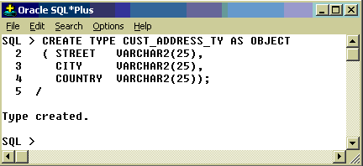
Abstract Datatype

Slide 4
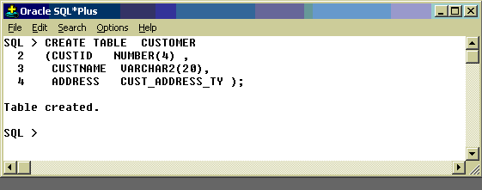
Abstract Datatype contd…

Slide 5
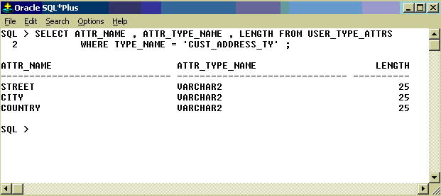
Abstract Datatype contd…

Slide 6
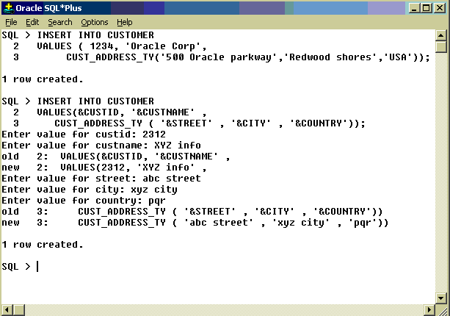
Abstract Datatype contd…

Slide 7
Methods (FUNCTION, PROCEDURES)
CREATE OR REPLACE Function FindCourse ( name_in IN varchar2 ) RETURN number IS cnumber number;
cursor c1 is select course_number from courses_tbl where course_name = name_in;

Slide 8
BEGIN
open c1; fetch c1 into cnumber; if c1%notfound then cnumber := 9999; end if; close c1;
RETURN cnumber;
EXCEPTION WHEN OTHERS THEN raise_application_error(-20001,'An error was encountered - '||SQLCODE||' -ERROR- '||SQLERRM); END;

Slide 9
Calling function
select course_name, FindCourse(course_name) as course_id from courses where subject = 'Mathematics';

Slide 10
OBJECT ID (As in RDBMS)
create or replace type empType as object 2 (cid NUMBER, 3 Name VARCHAR2(25), 4 Street VARCHAR2(50), 5 City VARCHAR2(25), 6 State CHAR(2), 7 Zip NUMBER); 8 / SQL> SQL> create view empView of empType 2 with object OID (cid) as 3 select cid, Name, Street, City, State, Zip 4 from emp; SQL>

Slide 11
Object ID(As in OODBMS)
OID is the identity maintained for each object.
The OID is assigned by the system when the object is created and cannot be changed.
This is unlike the RDBMS, for example, where a data value stored within the object is used to identify the object.

Slide 12
Benefits of Object Orientation
Programming Language
Reduces no. of lines of code
Decreases development time
Enhance code reusability
Makes code maintenance easier
Enhance programmer productivity

Slide 13
2) GUI (Graphical User Interface)
Enhance ability to create easy-to –use interfaces.
Improves System user-friendliness
Makes it easier to define standards
3) Databases
Support ADTs
Support complex Objects
Support multimedia databases

Slide 14
4) Operating System
Enhances system portability
Improved system interoperability
5) Design
Represents real world better.

Slide 15
Limitations of OODBMS
Lack of accepted standards
Lack of development tools – e.g. CASE & 4GLs
Performance
Data management facilities are not adequate – e.g. concurrency control, back up and recovery
Lack of proper query language.

Slide 16
Reference types
The type constructor can be used to define the data structures for an OO database schema.
Attributes that refer to other objects – such as address of customer are basically references to other objects and serve to represent relationships among the object types.
Here the reference means the reference between the type and its implementation in the table.

Slide 17
Assignment
Define OODBMS
Need of OODBMS
History of OODBMS
Advantages of OODBMS
Difference between RDBMS and OODBMS

