Slide 1
Data warehousing
Dr. S. S. Yambal

Slide 2
Data warehouse
In computing, a data warehouse (DW) is a database used for reporting and analysis. The data stored in the warehouse is uploaded from the operational systems. The data may pass through an operational data store for additional operations before it is used in the DW for reporting.
“A data warehouse is a subject-oriented, integrated, timevariant, and nonvolatile collection of data in support of management’s decision-making process.”—W. H. Inmon

Slide 3
A data warehouse maintains its functions in three layers: staging, integration, and access.
Staging is used to store raw data for use by developers.
The integration layer is used to integrate data and to have a level of abstraction from users.
The access layer is for getting data out for users.

Slide 4
This definition of the data warehouse focuses on data storage. The main source of the data is cleaned, transformed, catalogued and made available for use by managers and other business professionals for data mining, online analytical processing, market research and decision support (Marakas & O'Brien 2009).

Slide 5
Benefits of a data warehouse
A data warehouse maintains a copy of information from the source transaction systems. This architectural complexity provides the opportunity to:
Maintain data history, even if the source transaction systems do not.
Integrate data from multiple source systems, enabling a central view across the enterprise. This benefit is always valuable, but particularly so when the organization has grown by merger.
Improve data, by providing consistent codes and descriptions, flagging or even fixing bad data.
Present the organization's information consistently.
Provide a single common data model for all data of interest regardless of the data's source.
Restructure the data so that it makes sense to the business users.
Restructure the data so that it delivers excellent query performance, even for complex analytic queries, without impacting the operational systems.
Add value to operational business applications, notably customer relationship management (CRM) systems.

Slide 6
Normalized versus dimensional approach for storage of data
There are two leading approaches to storing data in a data warehouse — the dimensional approach and the normalized approach.
The dimensional approach, whose supporters are referred to as “Kimballites”, believe in Ralph Kimball’s approach in which it is stated that the data warehouse should be modeled using a Dimensional Model/star schema.

Slide 7
The normalized approach, also called the 3NF model, whose supporters are referred to as “Inmonites”, believe in Bill Inmon's approach in which it is stated that the data warehouse should be modeled using an E-R model/normalized model.

Slide 8
Evolution in organization use
Offline operational data warehouse :
Data warehouses in this stage of evolution are updated on a regular time cycle (usually daily, weekly or monthly) from the operational systems and the data is stored in an integrated reporting-oriented data
Offline data warehouse :
Data warehouses at this stage are updated from data in the operational systems on a regular basis and the data warehouse data are stored in a data structure designed to facilitate reporting.

Slide 9
On time data warehouse:
Online Integrated Data Warehousing represent the real time Data warehouses stage data in the warehouse is updated for every transaction performed on the source data
Integrated data warehouse:
These data warehouses assemble data from different areas of business, so users can look up the information they need across other systems.

Slide 10
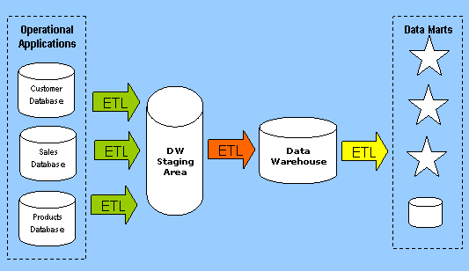
Architecture

Slide 11
Data is moved from databases used in operational systems into a data warehouse staging area, then into a data warehouse and finally into a set of conformed data marts. Data is copied from one database to another using a technology called ETL (Extract, Transform, Load).
The ETL software extracts data, transforms values of inconsistent data, cleanses "bad" data, filters data and loads data into a target database. The scheduling of ETL jobs is critical. Should there be a failure in one ETL job, the remaining ETL jobs must respond appropriately.

Slide 12
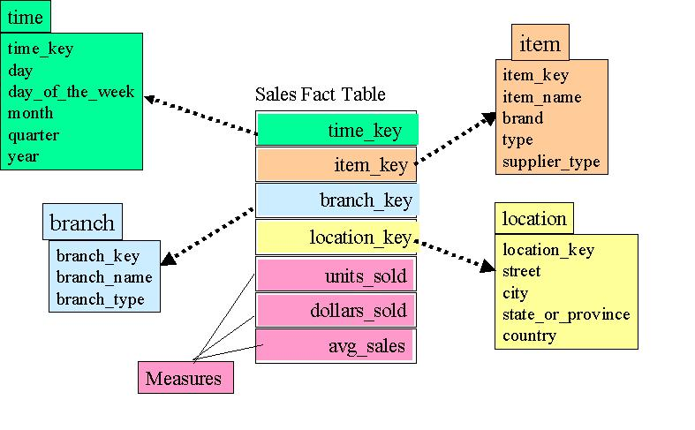
Dimensional Model Star Schema using Star Query

Slide 13
The star schema is perhaps the simplest data warehouse schema. It is called a star schema because the entity-relationship diagram of this schema resembles a star, with points radiating from a central table. The center of the star consists of a large fact table and the points of the star are the dimension tables.
A star schema is characterized by one OR more very large fact tables that contain the primary information in the data warehouse, and a number of much smaller dimension tables (OR lookup tables), each of which contains information about the entries for a particular attribute in the fact table.

Slide 14
A star query is a join between a fact table and a number of dimension tables. Each dimension table is joined to the fact table using a primary key to foreign key join, but the dimension tables are not joined to each other. The cost-based optimizer recognizes star queries and generates efficient execution plans for them.
A typical fact table contains keys and measures. For example, in the sample schema, the fact table, sales, contain the measures quantity_sold, amount, and average, and the keys time_key, item-key, branch_key, and location_key. The dimension tables are time, branch, item and location.
A star join is a primary key to foreign key join of the dimension tables to a fact table.

Slide 15
The main advantages of star schemas are that they:
Provide a direct and intuitive mapping between the business entities being analyzed by end users and the schema design.
Provide highly optimized performance for typical star queries.
Are widely supported by a large number of business intelligence tools, which may anticipate OR even require that the data-warehouse schema contains dimension tables

Slide 16
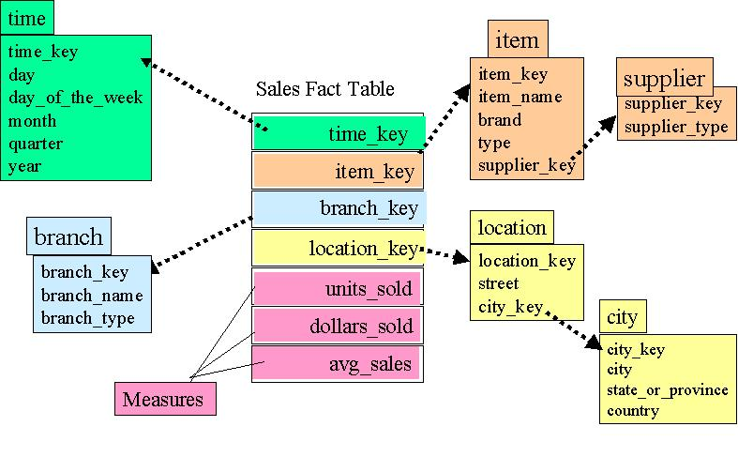
Snow-Flake Schema in Dimensional Modeling

Slide 17
The snowflake schema is a more complex data warehouse model than a star schema, and is a type of star schema. It is called a snowflake schema because the diagram of the schema resembles a snowflake.
Snowflake schemas normalize dimensions to eliminate redundancy. That is, the dimension data has been grouped into multiple tables instead of one large table. For example, a location dimension table in a star schema might be normalized into a location table and city table in a snowflake schema. While this saves space, it increases the number of dimension tables and requires more foreign key joins. The result is more complex queries and reduced query performance. Figure above presents a graphical representation of a snowflake schema.

Slide 18
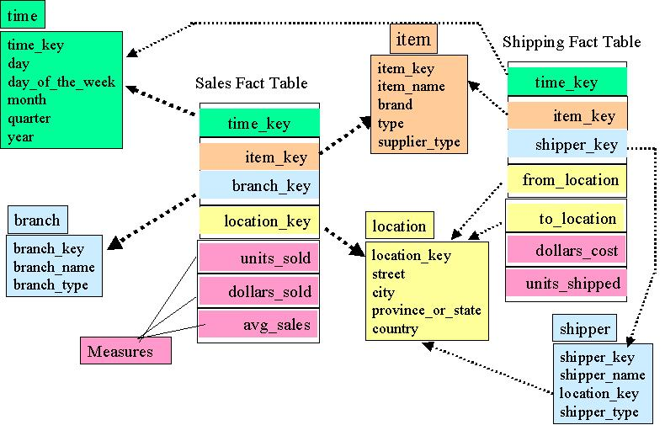
Fact Constellation Schema

Slide 19
This Schema is used mainly for the aggregate fact tables, OR where we want to split a fact table for better comprehension. The split of fact table is done only when we want to focus on aggregation over few facts & dimensions.

Slide 20
Terms related to Datawarehouse
Data extraction
» get data from multiple, heterogeneous, and external
sources
􀂃 Data cleaning
» detect errors in the data and rectify them when possible
􀂃 Data transformation
» convert data from legacy or host format to warehouse
format
􀂃 Load
» sort, summarize, consolidate, compute views, check
integrity, and build indicies and partitions
􀂃 Refresh
» propagate the updates from the data sources to the
warehouse

Slide 21
Kinds of data warehouse applications
» Information processing
• supports querying, basic statistical analysis, and reporting
using crosstabs, tables, charts and graphs
» Analytical processing
• multidimensional analysis of data warehouse data
• supports basic OLAP operations, slice-dice, drilling, pivoting
» Data mining
• knowledge discovery from hidden patterns
• supports associations, constructing analytical models,
performing classification and prediction, and presenting the
mining results using visualization tools

Slide 22
OLAP
OLAP tools enable users to interactively analyze multidimensional data from multiple perspectives. OLAP consists of three basic analytical operations: consolidation, drill-down, and slicing and dicing. Consolidation involves the aggregation of data that can be accumulated and computed in one or more dimensions.
In computing, online analytical processing, or OLAP ,is an approach to swiftly answer multi-dimensional analytical (MDA) queries.

Slide 23
OLAP Cube
The core of any OLAP system is an OLAP cube (also called a 'multidimensional cube' or a hypercube). It consists of numeric facts called measures which are categorized by dimensions. The cube metadata is typically created from a star schema or snowflake schema of tables in a relational database. Measures are derived from the records in the fact table and dimensions are derived from the dimension tables.

Slide 24
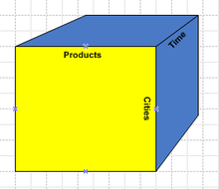

Slide 25
An OLAP cube (for online analytical processing) is a data structure that allows fast analysis of data. It can also be defined as the capability of manipulating and analyzing data from multiple perspectives. The arrangement of data into cubes overcomes some limitations of relational databases.
OLAP cubes can be thought of as extensions to the two-dimensional array of a spreadsheet. For example a company might wish to analyze some financial data by product, by time-period, by city, by type of revenue and cost, and by comparing actual data with a budget. These additional methods of analyzing the data are known as dimensions. Because there can be more than three dimensions in an OLAP system the term hypercube is sometimes used.

Slide 26
For example, all sales offices are rolled up to the sales department or sales division to anticipate sales trends.
In contrast, the drill-down is a technique that allows users to navigate through the details. For instance, users can access to the sales by individual products that make up a region’s sales. Slicing and dicing is a feature whereby users can take out (slicing) a specific set of data of the cube and view (dicing) the slices from different viewpoints.

Slide 27
Assignment
What is OLAP? Explain its types.
Differentiate between OLAP and OLTP.
Discuss the integration of expert in database application.
Write short note on: object database

