Slide 1
Chapter-2 Advance Database Management System – Concepts & Architecture
Dr. S. S. Yambal

Slide 2
Spatial Database
A spatial database is a database that is optimized to store and query data that is related to objects in space, including points, lines and polygons. While typical databases can understand various numeric and character types of data, additional functionality needs to be added for databases to process spatial data types. These are typically called geometry or feature.

Slide 3
Querying the spatial database
The following query types and many more are supported by the Open Geospatial Consortium:
Spatial Measurements: Finds the distance between points, polygon area, etc.
Spatial Functions: Modify existing features to create new ones, for example by providing a buffer around them, intersecting features, etc.
Spatial Predicates: Allows true/false queries such as 'is there a residence located within a mile of the area we are planning to build the landfill?’
Constructor Functions: Creates new features with an SQL query specifying the vertices (points of nodes) which can make up lines. If the first and last vertex of a line are identical the feature can also be of the type polygon (a closed line).
Observer Functions: Queries which return specific information about a feature such as the location of the center of a circle
Note: Not all spatial databases support these query types.

Slide 4
Web-based Database Management System
Web-DBMS (or Web-based Database Management System) is a general term for applications which provide a web-based interface to one or more databases.
Web-DBMS allows the user to administrate his/her database from home, office, at campus, or on the road.
The main advantages of Web-DBMS are: accessibility, platform independence, easy-to-use, standardized graphical user interface, and transparent network access.

Slide 5
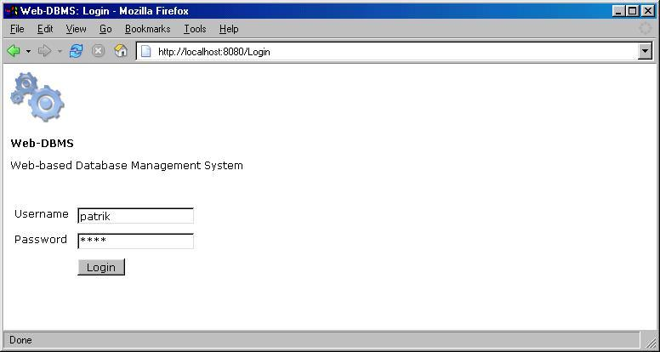

Slide 6
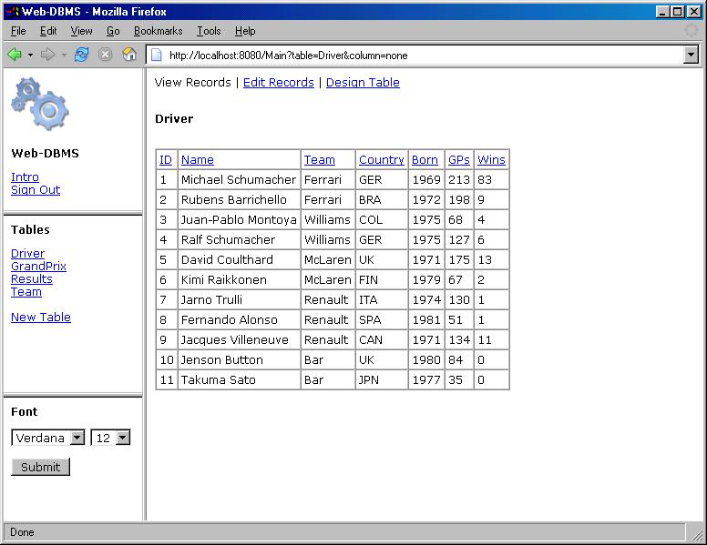

Slide 7
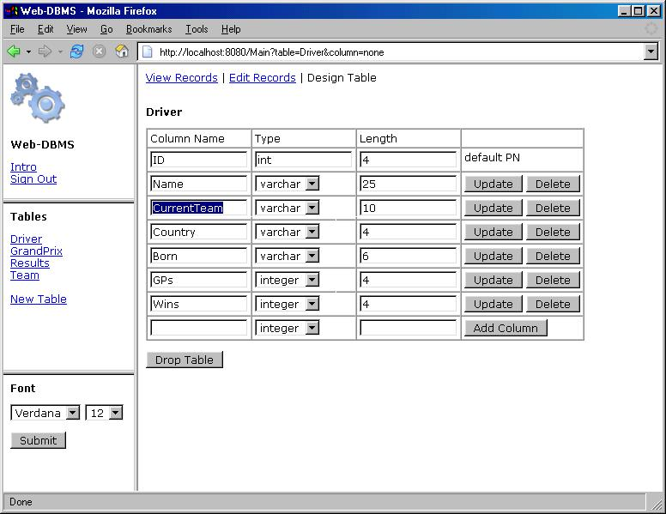

Slide 8
Overview of client server architecture
Client/Server
In a client/server system, the server is a relatively large computer in a central location that manages a resource used by many people. When individuals need to use the resource, they connect over the network from their computers, or clients, to the server

Slide 9
Client
Client machines:
Run own copy of an operating system.
Run one or more applications using the client machine's CPU, memory.
Application communicates with DBMS server running on server machine through a Database Driver
Database driver (middleware) makes a connection to the DBMS server over a network.
Examples of clients: PCs with MS Windows operating system. Forms and reports developed e.g. Oracle Developer/2000, etc.

Slide 10
Server
Server Machines:
Run own copy of an operating system.
Run a Database Management System that manages a database.
Provides a Listening daemon that accepts connections from client machines and submits transactions to DBMS on behalf of the client machines.
Examples: Sun Sparc server running UNIX operating system. RDBMS such as Oracle Server, Sybase, Informix, DB2, etc. PC with Windows NT operating system.

Slide 11
Middleware:
Small portion of software that sits between client and server.
Establishes a connection from the client to the server and passes commands (e.g., SQL) between them.
Examples: For Oracle: SQL*Net (or Net8) running on both client and server. For Sybase: Sybase Open Client and Open Server. For IBM DB2: Client Application Enablers

Slide 12
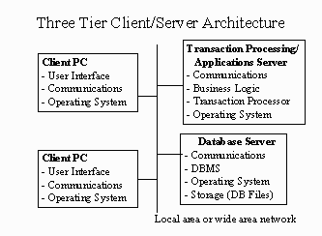

Slide 13
Business rules may be enforced at:
The client application - so called "Fat Clients".
Entirely on the database server - so called "Thin Clients"
A Mix of both.
We can also call this a "Two Tier" or "Two Level" Client/Server Architecture

Slide 14
Advantages of C/S Architecture
Advantages of client/server:
Processing of the entire Database System is spread out over clients and server.
DBMS can achieve high performance because it is dedicated to processing transactions (not running applications).
Client Applications can take full advantage of advanced user interfaces such as Graphical User Interfaces.

Slide 15
Disadvantages of C/S Architecture
Disadvantages of client/server:
Implementation is more complex because one needs to deal with middleware and the network.
It is possible the network is not well suited for client/server communications and may become saturated.
Additional burden on DBMS server to handle concurrency control, etc.
As more business rule logic is programmed into the client side applications, they can become unwieldy. Stored procedures and triggers can help in this case.

Slide 16
Database architecture
The database architecture is the set of specifications, rules, and processes that dictate how data is stored in a database and how data is accessed by components of a system. It includes data types, relationships, and naming conventions.
OR
The database architecture describes the organization of all database objects and how they work together. It affects integrity, reliability, scalability, and performance. The database architecture involves anything that defines the nature of the data, the structure of the data, or how the data flows.

Slide 17
It includes:
Datatypes
Null values
Relationships
Primary key
Foreign key
Indexes
Views
Concurrency (Concept of row level and column level locks)
Triggers, Procedures, User defined functions
Naming conventions

Slide 18
Database Architecture SQL Server 2000
Microsoft® SQL Server™ 2000 data is stored in databases. The data in a database is organized into the logical components visible to users. A database is also physically implemented as two or more files on disk.
When using a database, you work primarily with the logical components such as tables, views, procedures, and users. The physical implementation of files is largely transparent. Typically, only the database administrator needs to work with the physical implementation.

Slide 19
Each instance of SQL Server has four system databases (master, model, tempdb, and msdb) and one or more user databases. Some organizations have only one user database, containing all the data for their organization.
Some organizations have different databases for each group in their organization, and sometimes a database used by a single application.
For example, an organization could have one database for sales, one for payroll, one for a document management application, and so on. Sometimes an application uses only one database; other applications may access several databases.

Slide 20
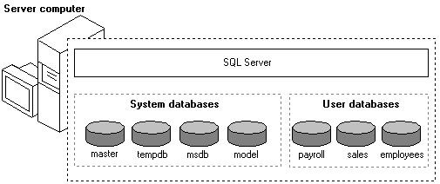

Slide 21
An instance of the SQL Server Standard or Enterprise Edition is capable of handling thousands of users working in multiple databases at the same time(Concurrency control).
When connecting to an instance of SQL Server, your connection is associated with a particular database on the server. This database is called the current database.
SQL Server 2000 allows you to detach databases from an instance of SQL Server, then reattach them to another instance, or even attach the database back to the same instance.

Slide 22
Web Architecture
Architecture Principles: Web Architecture principles help to design technologies by providing guidance and articulating the issues around some specific choices.
Identifiers : We share things by their names. URL, URI, IRI is the way to name things on the Web and manipulate them. Some additional addressing needs in the Web Services stack motivated some additional layers.
Protocols : Protocols are the vehicle for exchanging our ideas. HTTP is the core protocol of the Web. W3C is also working on XML Protocols and SOAP in relation to Web Services.

Slide 23
Meta Formats : XML, the Extensible Markup Language, is used to build new formats at low cost (due to widely available tools to manipulate content in those new formats). RDF(“Resource Description Framework”), and OWL allow people to define vocabularies (“ontologies”) of terms as part of the Semantic Web.
Protocol and Meta Format Considerations : Documents on the Web are loosely joined pieces by identifiers. It creates a maze of rich interactions between protocols and formats.
Internationalization

Slide 24
3-Tier
External level (user view, one or more- partially hidden, partially shown to the user).
Logical level (conceptual view – in the form of tables)
Internal level ( actual storage)

Slide 25
N-Tier Architecture
N-tier application architecture provides a model for developers to create a flexible and reusable application. By breaking up an application into tiers, developers only have to modify or add a specific layer, rather than have to rewrite the entire application over, if they decide to change technologies or scale up.
In the term "N-tier," "N" implies any number -- like 2-tier, or 4-tier; basically, any number of distinct tiers used in your architecture. Application architectures are part of Layer 7 of the OSI model.

Slide 26
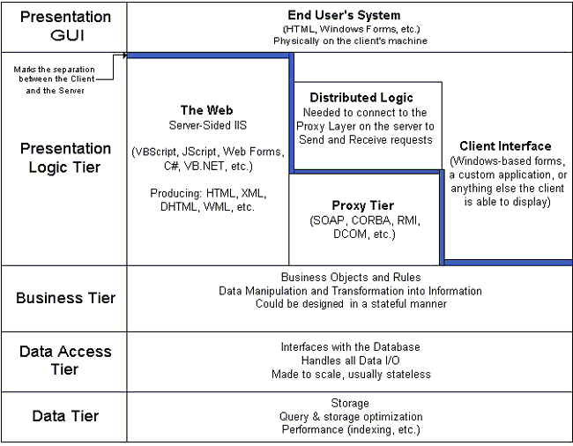

Slide 28
Client Tier :Web Browser
Presentation Tier : Render the HTML - Coldfusion/Flash/Ruby/PHP,etc.
Business Logic Tier :Run the processes and calculations as needed - Coldfusion/Flash/Ruby/PHP,etc.
Data Integration Tier :(Queries from my Development Language, Stored Procedures, etc.)
Data Tier : (Database - MySQL, etc)

Slide 29
Presentation logic layer
The presentation layer is also sometimes referred to as the client layer. It consists of components that serve to present data to the end user. This data might include Windows or online buttons and forms, boxes for editing or texts, grids, labels, and more. In short, the presentation layer is a key component of any N-Tier system; without it, as the name infers, nothing will be presented to the end user, no matter how well the system functions otherwise.

Slide 30
What is SOAP?
SOAP stands for Simple Object Access Protocol
SOAP is a communication protocol
SOAP is for communication between applications
SOAP is a format for sending messages
SOAP communicates via Internet
SOAP is platform independent
SOAP is language independent
SOAP is based on XML
SOAP is simple and extensible
SOAP allows you to get around firewalls
SOAP is a W3C recommendation

Slide 31
Why SOAP?
It is important for application development to allow Internet communication between programs.
Today's applications communicate using Remote Procedure Calls (RPC) between objects like DCOM and CORBA, but HTTP was not designed for this. RPC represents a compatibility and security problem; firewalls and proxy servers will normally block this kind of traffic.
A better way to communicate between applications is over HTTP, because HTTP is supported by all Internet browsers and servers. SOAP was created to accomplish this.
SOAP provides a way to communicate between applications running on different operating systems, with different technologies and programming languages.

Slide 32
Business Logic - SOAP
SOAP is an XML-based messaging protocol. It defines a set of rules for structuring messages that can be used for simple one-way messaging but is particularly useful for performing RPC-style (Remote Procedure Call) request-response dialogues.
It is not tied to any particular transport protocol though HTTP is popular. Nor is it tied to any particular operating system or programming language so theoretically the clients and servers in these dialogues can be running on any platform and written in any language as long as they can formulate and understand SOAP messages.
As such it is an important building block for developing distributed applications that exploit functionality published as services over an intranet or the internet.

Slide 33
The SOAP developer's approach to a problem is to encapsulate the database request logic for the service in a method (or function) in C or VB or Java etc, then set up a process that listens for requests to the service; such requests being in SOAP format and containing the service name and any required parameters.
The transport layer might be HTTP though it could just as easily be SMTP or something else. Now, the listener process, which for simplicity is typically written in the same language as the service method, decodes the incoming SOAP request and transforms it into an invocation of the method.
It then takes the result of the method call, encodes it into a SOAP message (response) and sends it back to the requester. Conceptually, this arrangement looks like the following:

Slide 35
Advantages of SOAP
You may have an n-tier architecture where some of your business logic is coded outside the database and the services you intend to write need access to that business logic.
There is one significant advantage of SOAP being XML-based: the fact that it is human readable and writable. This means you can easily read and manipulate the messages that are going over the wire. This is extremely useful when debugging.

Slide 36
Mobile Database
A mobile database is a database that can be connected to by a mobile computing device over a mobile network. The client and server have wireless connections.
For any mobile architecture, things to be considered are:
Users are not attached to a fixed geographical location
Mobile computing devices: low-power, low-cost, portable
Wireless networks
Mobile computing constraints

Slide 37
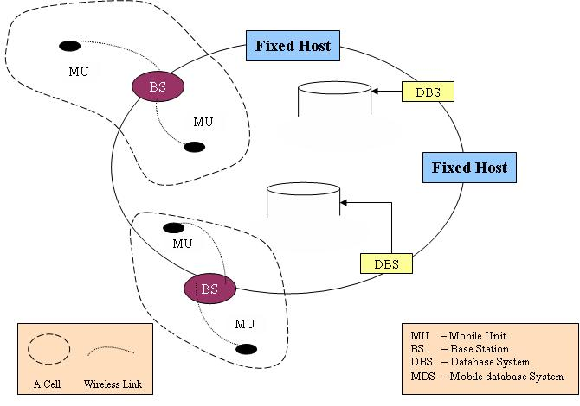

Slide 38
Need for mobile databases
Mobile users must be able to work without a wireless connection due to poor or even non-existent connections.
Applications must provide significant interactivity.
Applications must be able to access local device/vehicle hardware, such as printers, bar code scanners, or GPS units (for mapping or Automatic Vehicle Location systems).
Bandwidth must be conserved (a common requirement on wireless networks that charge per megabyte or data transferred).
Users don't require access to truly live data, only recently modified data.
Limited life of power supply(battery)
The changing topology of network

Slide 39
Assignment
What are multimedia databases?
What is MANET?
Business logic Vs presentation logic

