Slide 1
ASP.NET (INTRODUCTION)
Dr. S. S. Yambal

Slide 2
Introduction
ASP.NET is a web application framework developed and marketed by Microsoft to allow programmers to build dynamic web sites. It allows you to use a full-featured programming language such as C# or VB.NET to build web applications easily.

Slide 3
What is ASP.NET?
ASP.NET is a web development platform, which provides a programming model, a comprehensive software infrastructure and various services required to build up robust web applications for PC as well as mobile devices.
ASP.NET works on top of the HTTP protocol, and uses the HTTP commands and policies to set a browser-to-server bilateral communication and cooperation.

Slide 4
ASP.NET is a part of Microsoft .Net platform. ASP.NET applications are compiled codes, written using the extensible and reusable components or objects present in .Net framework. These codes can use the entire hierarchy of classes in .Net framework.
ASP.NET application codes can be written in any of the following languages:
C#
Visual Basic.Net
Jscript
J#

Slide 5
ASP.NET Web Forms Model
ASP.NET web forms extend the event-driven model of interaction to the web applications. The browser submits a web form to the web server and the server returns a full markup page or HTML page in response.
All client side user activities are forwarded to the server for stateful processing. The server processes the output of the client actions and triggers the reactions.

Slide 6
Now, HTTP is a stateless protocol. ASP.NET framework helps in storing the information regarding the state of the application, which consists of:
Page state
Session state
The page state is the state of the client, i.e., the content of various input fields in the web form. The session state is the collective information obtained from various pages the user visited and worked with, i.e., the overall session state.

Slide 7
The ASP.NET Component Model
The ASP.NET component model provides various building blocks of ASP.NET pages. Basically it is an object model, which describes:
Server side counterparts of almost all HTML elements or tags such as <form> and <input>.
Server controls, which help in developing complex user-interface. For example, the Calendar control or the Gridview control.
ASP.NET is a technology, which works on the .Net framework that contains all web-related functionalities. The .Net framework is made of an object-oriented hierarchy. An ASP.NET web application is made of pages. When a user requests an ASP.NET page, the IIS delegates the processing of the page to the ASP.NET runtime system

Slide 8
Objects and ASP
The ASP.NET runtime transforms the .aspx page into an instance of a class, which inherits from the base class page of the .Net framework. Therefore, each ASP.NET page is an object and all its components i.e., the server-side controls are also objects.

Slide 9
Components of .Net Framework
The following table describes the components of the .Net framework and the job they perform:
(1) Common Language Runtime or CLR
It performs memory management, exception handling, debugging, security checking, thread execution, code execution, code safety, verification, and compilation. The code that is directly managed by the CLR is called the managed code. When the managed code is compiled, the compiler converts the source code

Slide 10
into a CPU independent intermediate language (IL) code. A Just-In-Time (JIT) compiler compiles the IL code into native code, which is CPU specific.
(2) .Net Framework Class Library
It contains a huge library of reusable types, classes, interfaces, structures, and enumerated values, which are collectively called types.

Slide 11
(3) Common Language Specification
It contains the specifications for the .Net supported languages and implementation of language integration.
(4) Common Type System
It provides guidelines for declaring, using, and managing types at runtime, and cross-language communication.
(5) Metadata and Assemblies
Metadata is the binary information describing the program, which is either stored in a portable executable file (PE) or in the memory. Assembly is a logical unit consisting of the assembly manifest, type metadata, IL code, and a set of resources like image files.

Slide 12
(6) Windows Forms
Windows forms contain the graphical representation of any window displayed in the application.
(7) ASP.NET and ASP.NET AJAX
ASP.NET is the web development model and AJAX is an extension of ASP.NET for developing and implementing AJAX functionality. ASP.NET AJAX contains the components that allow the developer to update data on a website without a complete reload of the page.

Slide 13
(8) ADO.NET
It is the technology used for working with data and databases. It provides access to data sources like SQL server, OLE DB, XML etc. The ADO.NET allows connection to data sources for retrieving, manipulating, and updating data.
(9) Windows Workflow Foundation (WF)
It helps in building workflow-based applications in Windows. It contains activities, workflow runtime, workflow designer, and a rules engine.

Slide 14
(10)Windows Presentation Foundation
It provides a separation between the user interface and the business logic. It helps in developing visually stunning interfaces using documents, media, two and three dimensional graphics, animations, and more.
(11) Windows Communication Foundation (WCF)
It is the technology used for building and executing connected systems.
(12) Windows CardSpace
It provides safety for accessing resources and sharing personal information on the internet.

Slide 15
(13) LINQ
It imparts data querying capabilities to .Net languages using a syntax which is similar to the tradition query language SQL.

Slide 16
ASP.NET provides an abstraction layer on top of HTTP on which the web applications are built. It provides high-level entities such as classes and components within an object-oriented paradigm.
Visual Studio is an integrated development environment for writing, compiling, and debugging the code. It provides a complete set of development tools for building ASP.NET web applications, web services, desktop applications, and mobile applications.

Slide 17
The primary window in the Visual Studio IDE is the Web Forms Designer window. Other supporting windows are the Toolbox, the Solution Explorer, and the Properties window. You use the designer to design a web form, to add code to the control on the form so that the form works according to your need, you use the code editor.

Slide 18
Projects and Solutions
A typical ASP.NET application consists of many items: the web content files (.aspx), source files (.cs files), assemblies (.dll and .exe files), data source files (.mdf files), references, icons, user controls and miscellaneous other files and folders. All these files that make up the website are contained in a Solution.

Slide 19
Solutions may contain one or more projects. A project contains content files, source files, and other files like data sources and image files. Generally, the contents of a project are compiled into an assembly as an executable file (.exe) or a dynamic link library (.dll) file.

Slide 20
Typically a project contains the following content files:
Page file (.aspx)
User control (.ascx)
Web service (.asmx)
Master page (.master)
Site map (.sitemap)
Website configuration file (.config)

Slide 21
ASP LIFE CYCLE
ASP.NET life cycle specifies how:
ASP.NET processes pages to produce dynamic output
The application and its pages are instantiated and processed
ASP.NET compiles the pages dynamically
ASP.NET life cycle could be divided into two groups:
Application Life Cycle
Page Life Cycle

Slide 22
ASP.NET Application Life Cycle
The application life cycle has the following stages:
1. User makes a request for accessing application resource, a page. Browser sends this request to the web server.
2. A unified pipeline receives the first request and the following events take place:
i. An object of the class ApplicationManager is created.
ii. An object of the class HostingEnvironment is created to provide information regarding the resources.
iii. Top level items in the application are compiled.

Slide 23
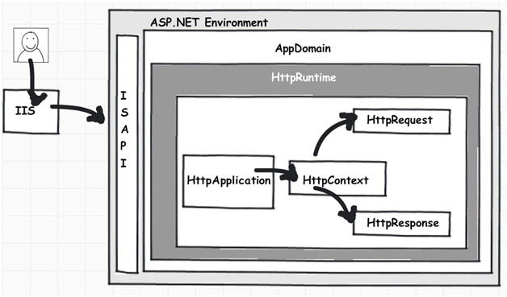

Slide 24
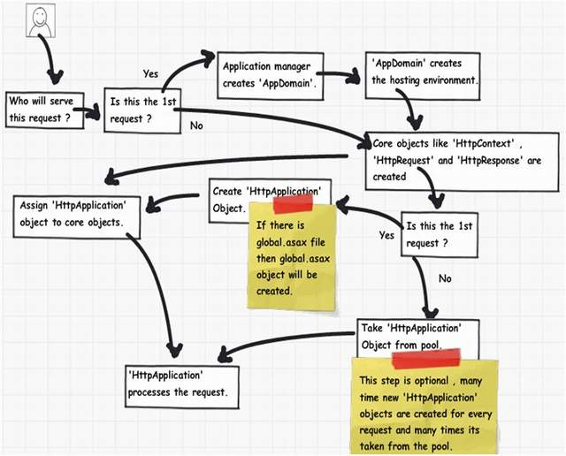

Slide 25
3. Response objects are created. The application objects such as HttpContext, HttpRequest and HttpResponse are created and initialized.
4. An instance of the HttpApplication object is created and assigned to the request. It is this object that is used to process each subsequent request sent to the application.
5. The request is processed by the HttpApplication class. Different events are raised by this class for processing the request.

Slide 26
Page Class
The key namespace for Web Forms and Web services is System.Web. Support for Web Forms is in the namespace System.Web.UI. Support for server controls such as textboxes and buttons is in the namespace System.Web.UI.WebControls.
The class that dynamically generates the output for an .aspx page is the Page class, in the System.Web.UI namespace, and classes derived from Page.

Slide 27
Inheriting from page class
The elements in the .aspx file, the code in the code-behind file (or script block), and the base Page class work together to generate the page output. This cooperation is achieved by ASP.NET’s dynamically creating a class for the .aspx file, which is derived from the code-behind class, which in turn is derived from Page.

Slide 28
PAGE PROPERTIES
The Page class has a number of important properties. Some of the most useful are listed below.
● EnableViewState indicates whether the page maintains view state for itself and its controls. You can get or set this property. The default is true, view state is maintained.
● ErrorPage specifies the error page to which the browser should be redirected in case an unhandled exception occurs.

Slide 29
● IsPostBack indicates whether the page is being loaded in response to a postback from the client or is being loaded for the first time.
● IsValid indicates whether page validation succeeded.
● Request gets the HTTP Request object, which allows you to access data from incoming HTTP requests.
● Response gets the HTTP Response object, which allows you to send response data to a browser.
● Session gets the current Session object, which is provided by ASP.NET for storing session state.
● Trace gets a TraceContext object for the page, which you can use to write out trace information.

Slide 30
ViewState
View state is the method that the ASP.NET page framework uses to preserve page and control values between round trips. When the HTML markup for the page is rendered, the current state of the page and values that must be retained during postback are serialized into base64-encoded strings. This information is then put into the view state hidden field or fields.

Slide 31
View state is used automatically by the ASP.NET page framework to persist information that must be preserved between postbacks. This information includes any non-default values of controls.
You can also use view state to store application data that is specific to a page.

Slide 32
Features
View state is a repository in an ASP.NET page that can store values that have to be retained during postback. The page framework uses view state to persist control settings between postbacks.
You can use view state in your own applications to do the following:
Keep values between postbacks without storing them in session state or in a user profile.

Slide 33
Store the values of page or control properties that you define.
Create a custom view state provider that lets you store view state information in a SQL Server database or in another data store.
For example, you can store information in view state that your code can access during the page load event the next time that the page is sent to the server. For usage recommendations, see ASP.NET State Management Recommendations.

Slide 34
A Web application is stateless. A new instance of the Web page class is created every time that the page is requested from the server. This would ordinarily mean that all information in the page and in its controls would be lost with each round trip. For example, by default if a user enters information into a text box on an HTML Web page, that information is sent to the server. However, it is not returned to the browser in the response.
To overcome this intrinsic limitation of Web programming, the ASP.NET page framework includes several state-management features to preserve page and control values between round trips to the Web server. One of these features is view state.
By default, the ASP.NET page framework uses view state to preserve page and control values between round trips. When the HTML for the page is rendered, the current state of the page and values that must be retained during postback are serialized into base64-encoded strings. They are then put into a hidden field or fields in the page.
You can access view state in your code by using the page's ViewState property. The ViewState property is a dictionary that contains key/value pairs that contain the view state data.

Slide 35
Important tip
When we display the page the first time the output reflects the fact that both the text box and the label are empty, since we have entered no information. IsPostBack is false.

Slide 36
Page Directive
An .aspx file may contain a page directive defining various attributes that can control how ASP.NET processes the page.
A page directive contains one or more attribute/value pairs of the form
attribute=”value” within the page directive syntax
<@ Page…….@>

Slide 37
Our example program HelloCodebehind.aspx illustrates an .aspx page that does not have any code within it. The code-behind file HelloCodebehind.aspx.cs that has the code is specified using the Src attribute.
<!-- HelloCodebehind.aspx -->
<%@ Page Language=“C#" Src="HelloCodebehind.aspx.cs"
Inherits=MyWebPage %>

Slide 38
Inherits The Inherits directive specifies the page class from which the .aspx page class will inherit.
Debug The Debug attribute indicates whether the page should be compiled with debug information. If true, debug information is enabled, and the browser can provide detailed information about compile errors. The default is false.
ErrorPage The ErrorPage attribute specifies a target URL to which the browser will be redirected in the event that an unhandled exception occurs on the page.

Slide 39
Trace The Trace attribute indicates whether tracing is enabled. A value of true turns tracing on. The default is false.
(ASP.NET tracing enables you to follow a page's execution path, display diagnostic information at run time, and debug your application.)

Slide 40
ASP.NET Page Life Cycle
When a page is requested, it is loaded into the server memory, processed, and sent to the browser. Then it is unloaded from the memory. At each of these steps, methods and events are available, which could be overridden according to the need of the application. In other words, you can write your own code to override the default code.
The Page class creates a hierarchical tree of all the controls on the page. All the components on the page, except the directives, are part of this control tree. You can see the control tree by adding trace= "true" to the page directive.

Slide 41
The page life cycle phases are:
Initialization
Instantiation of the controls on the page
Restoration and maintenance of the state
Execution of the event handler codes
Page rendering

Slide 42
Following are the different stages of an ASP.NET page:
Page request
When ASP.NET gets a page request, it decides whether to parse and compile the page, or there would be a cached version of the page; accordingly the response is sent.
Starting of page life cycle
At this stage, the Request and Response objects are set. If the request is an old request or post back, the IsPostBack property of the page is set to true. The UICulture property of the page is also set.

Slide 43
Page initialization
At this stage, the controls on the page are assigned unique ID by setting the UniqueID property and the themes are applied. For a new request, postback data is loaded and the control properties are restored to the view-state values.
Page load
At this stage, control properties are set using the view state and control state values.

Slide 44
Validation
Validate method of the validation control is called and on its successful execution, the IsValid property of the page is set to true.
Postback event handling.
If the request is a postback (old request), the related event handler is invoked.

Slide 45
Page rendering
At this stage, view state for the page and all controls are saved. The page calls the Render method for each control and the output of rendering is written to the OutputStream class of the Response property of Page.
Unload
The rendered page is sent to the client and page properties, such as Response and Request, are unloaded and all cleanup done.

Slide 46
ASP.NET Page Life Cycle Events
At each stage of the page life cycle, the page raises some events, which could be coded. An event handler is basically a function or subroutine, bound to the event, using declarative attributes such as Onclick or handle.

Slide 47
Following are the page life cycle events:
PreInit
PreInit is the first event in page life cycle. It checks the IsPostBack property and determines whether the page is a postback. It sets the themes and master pages, creates dynamic controls, and gets and sets profile property values. This event can be handled by overloading the OnPreInit method or creating a Page_PreInit handler.
Init
Page Init event occurs after the Init event of all the individual controls on the web form. Use this event to read or initialize control properties. Init event initializes the control property and the control tree is built.The server controls are loaded and initialized from the web forms view state. (restoration of view_state happens here)

Slide 48
InitComplete
InitComplete event allows tracking of view state. All the controls turn on view-state tracking.
LoadViewState
LoadViewState event allows loading view state information into the controls.
LoadPostData
During this phase, the contents of all the input fields are defined with the <form> tag are processed.

Slide 49
PreLoad
PreLoad occurs before the post back data is loaded in the controls. This event can be handled by overloading the OnPreLoad method or creating a Page_PreLoad handler.
Load
The Load event is raised for the page first and then recursively for all child controls. The controls in the control tree are created. This event can be handled by overloading the OnLoad method or creating a Page_Load handler.
(Until here are all the page-level events)
Control Events: After the page load event, the control events like button’s click, dropdownlist’s selected index changed events are raised.)

Slide 50
LoadComplete
The loading process is completed, control event handlers are run, and page validation takes place. This event can be handled by overloading the OnLoadComplete method or creating a Page_LoadComplete handler.
PreRender
The PreRender event occurs just before the output is rendered. By handling this event, pages and controls can perform any updates before the output is rendered.
PreRenderComplete
As the PreRender event is recursively fired for all child controls, this event ensures the completion of the pre-rendering phase.

Slide 51
SaveStateComplete
State of control on the page is saved. Personalization, control state and view state information is saved. The HTML markup is generated. This stage can be handled by overriding the Render method or creating a Page_Render handler.
UnLoad
The UnLoad phase is the last phase of the page life cycle. It raises the UnLoad event for all controls recursively and lastly for the page itself. Final cleanup is done and all resources and references, such as database connections, are freed. This event can be handled by modifying the OnUnLoad method or creating a Page_UnLoad handler.

Slide 52
Write Simple programs in .NET.
Write parts of C# framework.
What is a DLL?
Explain API.

