Slide 1
Unit -IV
Dr. S. S. Yambal

Slide 2
SYSTEM DESIGN
System Design Process – transforms the analysis model into design model
Process:
1) Decomposition (guided by design goals)
2) Hardware/software platform mapping (deployment diagram)
3) Persistent data (DB)
4) Overall control flow (activity/collaboration diagram)
5) Access control policy
6) Boundary conditions
Transitional activities from system spec (RAD) to final system construction
A) system design
B) object design
C) implementation

Slide 3
System design – addresses the internal structure or software architecture of the system, and how the internal functions are impacted by the external/operating environment, e.g., OS, DB, hardware platform
Results of system design –
optimized design goals (derived from the non-functional requirements)
the software architecture (guided by several issues)

Slide 4
System Design includes:
System decomposition
Services and interfaces
Coupling and coherence
Layers and partitions

Slide 5
SD gives:
SDD: System Design Document as output.

Slide 6
Assignment
What is UML?

Slide 7
Design
Physical design
Architectural design
Interface design
Database and file design
Program design

Slide 8
Structured Design
Projects move methodically from one to the next step.
Generally, a step is finished before the next one begins

Slide 9
System Design
Design Objectives: System design is to deliver the requirements as specified in the feasibility report. The main objectives of the design are
1. Practicality 2. Efficiency 3. Cost 4. Flexibility 5. Security

Slide 10
System design contains Logical Design & Physical Designing, logical designing describes the structure & characteristics or features, like output, input, files, database & procedures. The physical design, which follows the logical design, actual software & a working system. There will be constraints like Hardware, Software, Cost, Time & Interfaces.

Slide 11
Structured Design
Structured design is a data flow methodology. The graphical representation of data flow, communication & defining the modules & their relationship with each is known as Structure Chart. This method decomposes & modularizes the system so that the complexity & manageability will come down. Thus reducing the intuitive reasoning & promotes the maintainable provable systems.

Slide 12
This type of design follows top-down & hierarchy, which will have one single entry & single exit, The advantages of this method are :
1. Critical interfaces are tested first 2. Early versions of the design, through incomplete are useful enough to resemble the real system 3. Structuring provides control & improve morale 4. The procedural characteristics define the order that determines processing.

Slide 13
Major System Design Activities are
1. DB design 2. Program design 3. System & program test preparation 4. System Interface Specification 5. Audit Consideration 6. Audit control & Documentation control

Slide 14
Major design process parts are
1. O/p design 2. I/p design 3. File Design 4. Procedure design - Computer design - Non-computer design 5. Control design

Slide 15
System Specifications is a document, which will have a result of system design process, it serves as a Blue print for the project development & maintenance.

Slide 16
Input Design Objectives
The quality of system input determines the quality of system output.
Well-designed input objectives:
Effectiveness.
Accuracy.
Ease of use.
Consistency.
Simplicity.
Attractiveness.

Slide 17
Input Design Objectives
Control the amount of input: minimise the quantity of data for input (labour costs) and avoid duplication in data collection (several forms containing the same data) and data entry.
Avoid processing delays (lengthy credit approval) due to extra steps in data preparation and entry (computing sales totals), by designing appropriate procedures, source documents, turnaround documents and data entry methods.

Slide 18
Input Design Objectives
Avoid errors in data: ensure accuracy through controlling the amount of input, designing forms that ensure accurate completion, selecting the appropriate data entry medium, and using input validation techniques.
Keep the process simple: do not include too many error controls.

Slide 19
Data Capture
Capture
variable data: data items that change for each transaction (customer name)
identification data: key (product code)
DO NOT capture
constant data: data that is the same for each entry
details that the system can retrieve: (product name)
details that the system can calculate: (total cost)

Slide 20
Form Design
Make forms easy to fill out: to reduce errors, speed completion, facilitate data entry
form flow (top to bottom, left to right)
form sections: logical grouping of info
form captions: Captions tell the person completing the form what to put on a blank line, space, or box.
ensure that forms meet the intended purpose: effectiveness (specialty forms)
assure accurate completion: (row & column totals)
keep forms attractive: uncluttered, enough space to fill, fonts and align weights to separate categories
ask each item of data only once

Slide 21
Seven Sections of a Form
The seven sections of a form are:
Heading.
Identification and access.
Instructions.
Body.
Signature and verification.
Totals.
Comments.

Slide 22
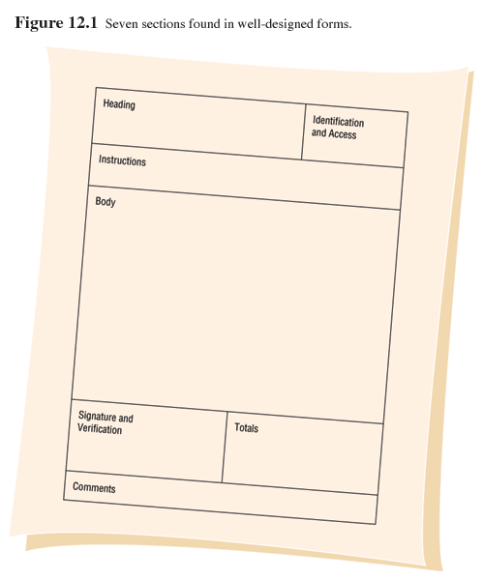
Seven Sections of a Form

Slide 23
Attractive Forms
To be more attractive, forms should look uncluttered, and elicit information in the expected order.
Aesthetic forms or usage of different fonts and line weights within the same form can help make it more attractive.

Slide 24
Computer Form Design Software
Numerous microcomputer form design software is available.
Features of electronic form design software:
Ability to design paper, electronic, or Web- based forms.
Form design using templates.
Form design by cutting and pasting familiar shapes and objects.

Slide 25
Computer Form Design Software (Continued)
Features of electronic form design software
Facilitates completion through the use of software.
Enables broadcasting of electronic forms.
Permits sequential routing of forms.
Assists form tracking.
Encourages automatic delivery and processing.
Establishes security for electronic forms.

Slide 26
Controlling Business Forms
Controlling forms include:
Making sure that each form in use fulfills its specific purpose.
Deciding on reproducing forms in the most economical way
Establishing stock control and inventory procedures that make forms available when needed, at the lowest possible cost
Preventing duplication of information collected and the forms that collect it.
Designing effective forms.

Slide 27
Input Validation
Checking the transaction: to ensure that the transaction is not invalid (incomplete, unauthorised, out of order)
Batch Controls: batch size, batch count, batch totals
Transaction Validation:
inventory system should not accept the addition of a new item with the same stock number as an existing one.
transactions having no relation to the system may also be submitted (payroll transaction to inventory system)
acceptable input may be submitted by an unauthorised user

Slide 28
Input Validation
Sequence Tests: serial numbers to identify
missing items (cheques)
the order of transactions (deposits vs withdrawals)
Completeness Tests: automatic guidance in POS systems; keyboard locks or systems waits indefinitely until correct data are entered.

Slide 29
Input Validation
Checking the transaction data
Existence Tests:
some fields are designed not to be left blank (quantity of item in a sales order), whilst others can be empty (patient insurance number)
Limit and Range Tests: to verify the reasonabless of data. Limit tests validate either minimum or maximum values; range tests validate both.

Slide 30
Input Validation
Combination Tests: validate that several items jointly have acceptable values; the value of one element determines whether other values are correct.
Duplicate Processing: process data more than once, either on different equipment or in different ways.

Slide 31
Modifying the Transaction Data
Automatic Correction of Errors
Check Digits:
transcription errors
transposition errors

Slide 32
User Interface
A user interface is a point in the system where a human being interacts with a computer. The interface can incorporate hardware, software, procedures, and data. The interaction can be direct; for example, a user might access a computer through a screen and a keyboard. Printed reports and forms designed to capture data for subsequent input are indirect user interfaces.

Slide 33
Types of user interfaces
Command Interfaces
Menu Interfaces
Object oriented Interfaces
Expert System Interfaces (utilize natural language processing (NLP))
Web form interfaces

Slide 34
User interface design criteria
In the past, when computers were expensive and people were (relatively) cheap, users were expected to interact with the computer on the machine’s terms, but that is no longer true. Given today’s technology, a user interface must be designed to allow the user to perform his or her job as effectively as possible. Machine efficiency should, of course, be considered, but only if it does not conflict with the primary objective.
Generally, a good interface is easy to use, easy to maintain, easy to learn, and incorporates readily available on-line help. Also, a good interface never leaves the user hanging, providing (as a minimum) a clear exit path from any operation.

Slide 35
The user interface design process
End user involvement is valuable throughout the system development life cycle, but it is essential during interface design. By definition, supporting the end user is the ultimate objective of any information system. To the end user, the user interface is the system. Consequently, user interface design must be user-centered.

Slide 36
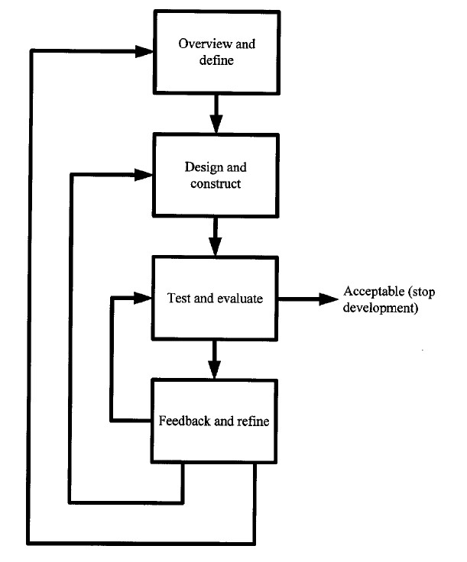

Slide 37
Key terms
Command-based interface — A user interface that relies on cryptic commands and/or specific keystrokes to identify the desired action.
Direct user interface — A user interface through which a user directly accesses a computer (for example, via a screen and a keyboard).
End user — Any person who needs the output generated by the computer and/or who interacts with the computer at an operational level.
Ergonomics — The study of the relationship between human beings and their workplaces.

Slide 38
Expert system interface — A user interface that utilizes natural language processing.
Graphic user interface (GUI) — A user interface that features windows, icons, menus, and pointers; generally, the user points to the desired element and clicks a mouse button to trigger the associated action. The Apple Macintosh and Microsoft Windows interfaces are common examples.
Icon — A graphic symbol that represents a processing option, a file, or an executable routine.
Indirect user interface — A user interface that does not involve direct computer access; for example, a printed report or a form designed to capture data for subsequent input.
Menu interface — A user interface in which the list of the options available to the user is displayed in a table or menu.

Slide 39
Natural language processing — Hardware and/or software that allows people to communicate with a computer in much the same way they communicate with each other; voice recognition is an example.
Object-oriented interface — A user interface that features windows, icons, menus, and pointers; generally, the user points to the desired element and clicks a mouse button to trigger the associated action; also called an icon-based interface, a graphic user interface, or a WIMP interface.
Prototype — A working physical model of a system or a subsystem.
User interface — A point in the system where a human being interacts with a computer.
Web-form interface — A user interface that follows the metaphor established by the Internet and the World Wide Web.

