Slide 1
Unit I
Dr. S. S. Yambal

Slide 2
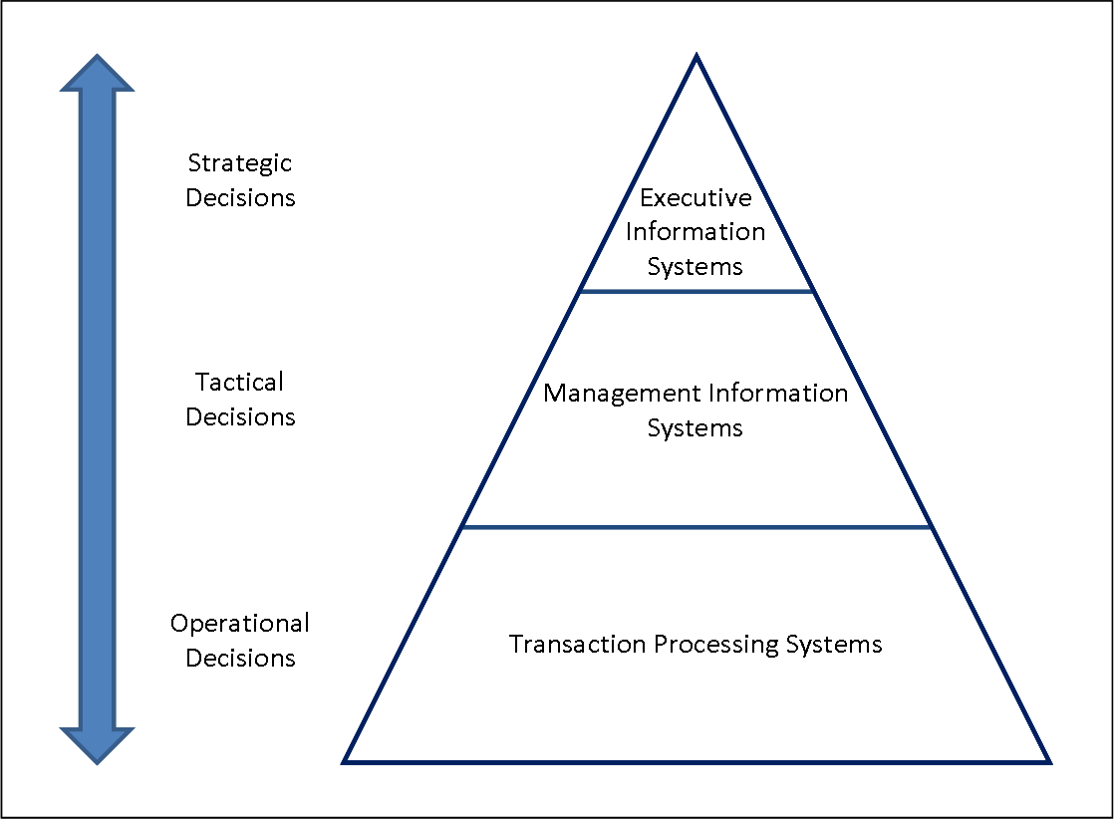
Different kinds of Information System

Slide 3
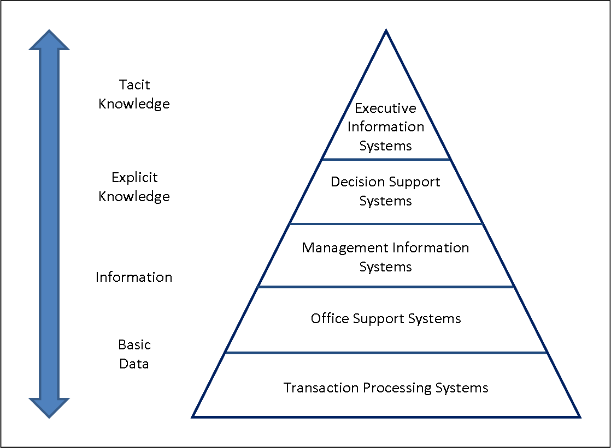

Slide 4
Classification by System Objectives
Transaction Processing Systems (TPS): Their objective is to process transactions in order to update records and generate reports, i.e., to perform score-keeping functions.
Process Control System (PCS): These systems are designed to make routine decision that control operational processes.
Decision Support Systems (DSS): Their objective is to support the managerial decisions. Usually, these systems are based on a model of the decision-making domain, and utilize techniques from management science, finance or other functional areas of business in order to build such models. These systems are also used often for attention-directing purposes, i.e., for directing the attention of managers to a problematic aspect of operations.

Slide 5
Expert Systems (ES): These systems incorporate expertise in order to aid managers in diagnosing problems or in problem solving.
Executive Information System (EIS): These are MIS tailored to the strategic information needs of the top managers.
Business Information Systems (BIS): As a future managerial end user, it is very important to realize that information systems directly support both operations and management activities in business functions of accounting, finance, human resource management, marketing, and operations management. Such business information systems are needed by all business functions.

Slide 6
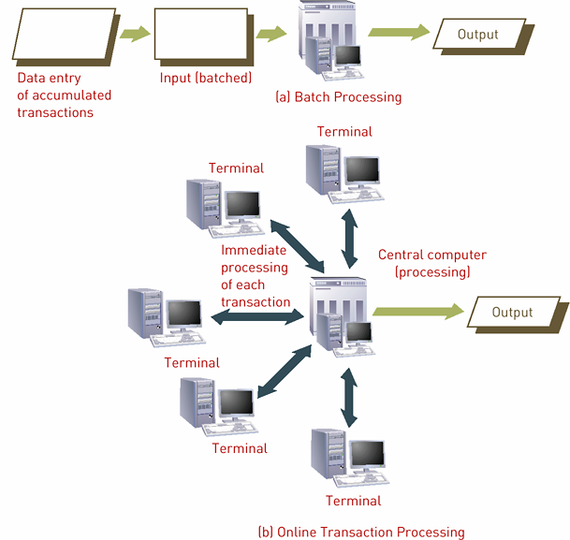

Slide 7
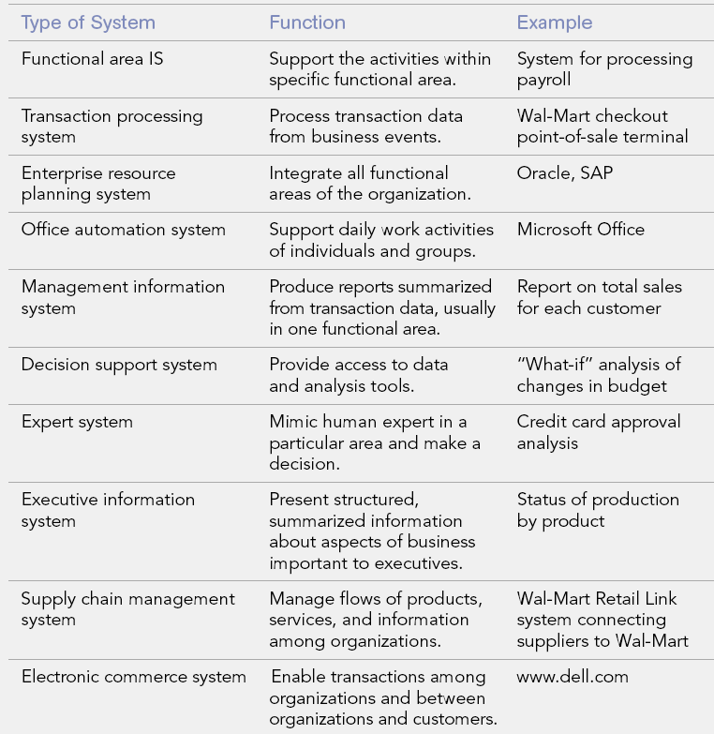
Types of organizational Information System

Slide 8
SDLC
Process of examining a business situation to improve it through better procedures and methods

Slide 9
Its two major parts
System Analysis
System Design

Slide 10
System Analysis
Process of gathering and interpreting facts, diagnosing problems, and using the information to recommend improvements in the system.
Study current problems, operations, and information flow
Assess future need and change requirement
Analyze suitable alternatives
Management finalizes

Slide 12
System Design
Process of planning a new business system or one to replace/complement existing one.

Slide 13
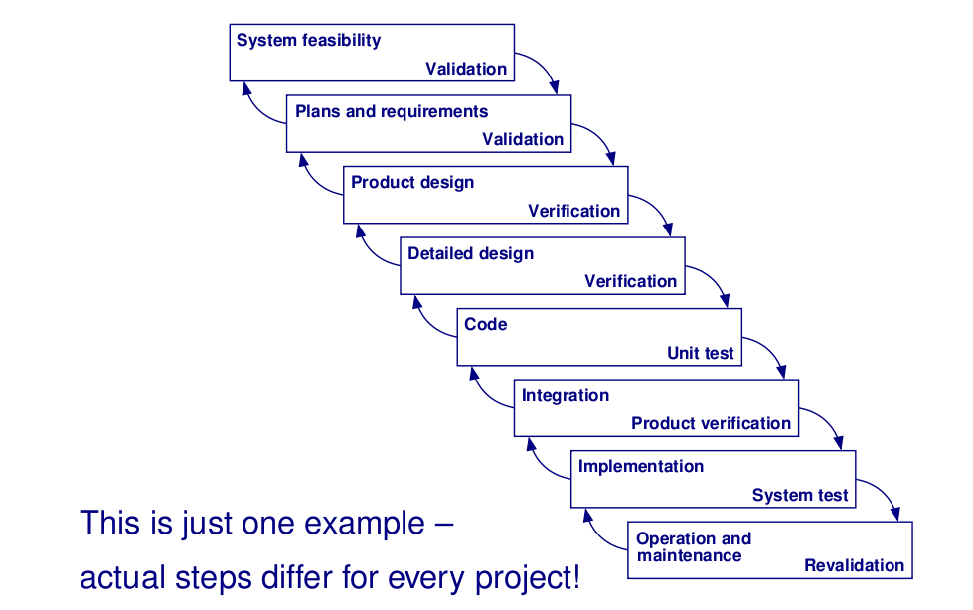
Phases

Slide 14
Feasibility study tries to find out
- if it’s possible to build a certain system
- and if it’s possible to do so at a reasonable price
Output: decision to go ahead or stop project

Slide 15
Requirements
Requirements definition:
-System’s services, constraints, and goals are established
- Heavy consultation of end users/customers
Output: system specification

Slide 16
Design
System and software design:
- Partitions requirements into hardware or software systems
- Establishes overall system architecture
Output: design documentation

Slide 17
Implementation
Implementation and unit testing:
- Actual code gets written or generated
-Verifying that each part meets specification
Output: set of programs or program units

Slide 18
Integration
Integration and system testing
- Individual program units are put together
- System is tested as a whole (interaction between units)
Output: system that is ready to be delivered

Slide 19
Operation
Operation and maintenance
- Should be longest life cycle phase
- System is installed and put into use
- Correcting errors that were not caught before
- Improving system in the light of changes
Output: improved or enhanced system

Slide 20
Role of the Systems Analyst
The company must decide whether to use an outsourcing option, develop software in-house, acquire a software package, develop user applications, or select some combination of these solutions
The decision will affect the remaining SDLC phases and your involvement as a systems analyst
Management usually makes a determination after receiving written recommendation from the IT staff
When selecting hardware and software, systems analysts often work as an evaluation and selection team.

Slide 21
A team approach ensures that critical factors are not overlooked and that a sound choice is made
A team must include users, who will participate in the selection process and feel a sense of ownership in the new system
The primary objective of the evaluation and selection team is to eliminate system alternatives that will not meet requirements, rank the system alternatives that are feasible, and present the viable alternatives to management for a final decision
At the end of the systems analysis phase of the SDLC, you must apply financial analysis tools and techniques to evaluate development strategies and decide how the project will move forward

Slide 22
The systems analyst’s role in the software development process depends on the specific development strategy
By inventorying equipment already on hand and on order, systems analysts will be able to better determine if new, modified, or current computer hardware is to be recommended
Computer hardware can be acquired through purchase, lease, or rental
factors to consider in deciding which option is best for a particular installation include initial versus long term costs, whether the business can afford to tie up capital in computer equipment, and whether the business desires full control and responsibility for the computer equipment

Slide 23
System analyst needs to become an expert in the business area the system will support or should even actually do some or part of the task to get a feel for what is done (e.g., in order to automate order-entry, may need to know how orders are processed)

Slide 24
Models

Slide 25
Waterfall Model
Requirements – defines needed information, function, behavior, performance and interfaces.
Design – data structures, software architecture, interface representations, algorithmic details.
Implementation – source code, database, user documentation, testing.

Slide 26
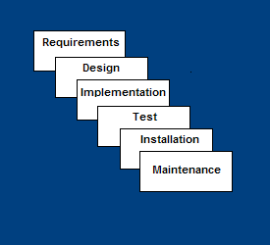

Slide 27
Strengths of waterfall model
Easy to understand, easy to use
Provides structure to inexperienced staff
Milestones are well understood
Sets requirements stability
Good for management control (plan, staff, track)
Works well when quality is more important than cost or schedule

Slide 28
List the deficiencies of waterfalll model.(hint: use internet)

Slide 29
Rapid Application Model (RAD)
Requirements planning phase (a workshop utilizing structured discussion of business problems)
User description phase – automated tools capture information from users
Construction phase – productivity tools, such as code generators, screen generators, etc. inside a time-box. (“Do until done”)
Cutover phase -- installation of the system, user acceptance testing and user training

Slide 30
RAD Strengths
Reduced cycle time and improved productivity with fewer people means lower costs
Time-box approach mitigates cost and schedule risk
Customer involved throughout the complete cycle minimizes risk of not achieving customer satisfaction and business needs
Focus moves from documentation to code (WYSIWYG).
Uses modeling concepts to capture information about business, data, and processes.

Slide 31
RAD Weaknesses
Accelerated development process must give quick responses to the user
Risk of never achieving closure
Hard to use with legacy systems
Requires a system that can be modularized
Developers and customers must be committed to rapid-fire activities in an abbreviated time frame.

Slide 32
When to use RAD
Reasonably well-known requirements
User involved throughout the life cycle
Project can be time-boxed
Functionality delivered in increments
High performance not required
Low technical risks
System can be modularized

Slide 33
Spiral Model
Adds risk analysis, and 4gl RAD prototyping to the waterfall model
Each cycle involves the same sequence of steps as the waterfall process model

Slide 34
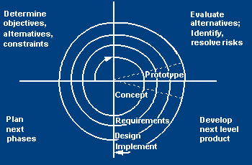

Slide 35
Spiral Quadrant Determine objectives, alternatives and constraints
Objectives: functionality, performance, hardware/software interface, critical success factors, etc.
Alternatives: build, reuse, buy, sub-contract, etc.
Constraints: cost, schedule, interface, etc.

Slide 36
Spiral Quadrant Evaluate alternatives, identify and resolve risks
Study alternatives relative to objectives and constraints
Identify risks (lack of experience, new technology, tight schedules, poor process, etc.
Resolve risks (evaluate if money could be lost by continuing system development

Slide 37
Spiral Quadrant Develop next-level product
Typical activites:
Create a design
Review design
Develop code
Inspect code
Test product

Slide 38
Spiral Quadrant Plan next phase
Typical activities
Develop project plan
Develop configuration management plan
Develop a test plan
Develop an installation plan

Slide 39
Spiral Model Strengths
Provides early indication of insurmountable risks, without much cost
Users see the system early because of rapid prototyping tools
Critical high-risk functions are developed first
The design does not have to be perfect
Users can be closely tied to all lifecycle steps
Early and frequent feedback from users
Cumulative costs assessed frequently

Slide 40
Spiral Model Weaknesses
Time spent for evaluating risks too large for small or low-risk projects
Time spent planning, resetting objectives, doing risk analysis and prototyping may be excessive
The model is complex
Risk assessment expertise is required
Spiral may continue indefinitely
Developers must be reassigned during non-development phase activities
May be hard to define objective, verifiable milestones that indicate readiness to proceed through the next iteration

Slide 41
When to use Spiral Model
When creation of a prototype is appropriate
When costs and risk evaluation is important
For medium to high-risk projects
Long-term project commitment unwise because of potential changes to economic priorities
Users are unsure of their needs
Requirements are complex
New product line
Significant changes are expected (research and exploration)

Slide 42
Joint Application Design
Expedites investigation of system requirements
JAD is a technique to define system requirements in a single session by having all the necessary people participating together
Compare: Normal interview and discussion approach takes a lots of time and effort (meet with users, document the discussion, build models, review and revise them, place unresolved issues on an open-items list – all of those on iterative basis!)- May require many meetings (months)
JAD idea is to compress all these activities into a shorter series of meetings with users and team members (An individual JAD session may last from a day to a week)
Critical factor is to have all important stakeholders present

Slide 43
JAD Advantages and Disadvantages
JAD Advantages and Disadvantages
- More expensive and can be cumbersome especially the group is too large relative to the size of project.
- Allows key users to participate effectively
- When properly used, JAD can result in a more accurate statement of system requirements, a better understanding of common goals, and a stronger commitment to the success of the new system.

Slide 44
Joint Application Design Participants
JAD session leader
Trained in group dynamics and facilitating group discussion
Must ensure agenda and objectives are met
Often system analyst appointed as leader but better if someone actually trained to lead group decision making
May not be the expert in the business area though
Users
Managers are good to have at the meeting since important decisions have to be made
If executives cannot be at the meeting, they at least should be contactable (or visit once a day)
Technical staff
A representative from the technical support group should be present (e.g. for info. regarding networks, operating environments etc.)
Project team members
System analysts
User experts
Assist in discussion, clarify points, build models and document the results
Members of the project team are the experts on ensuring the objectives are met

Slide 45
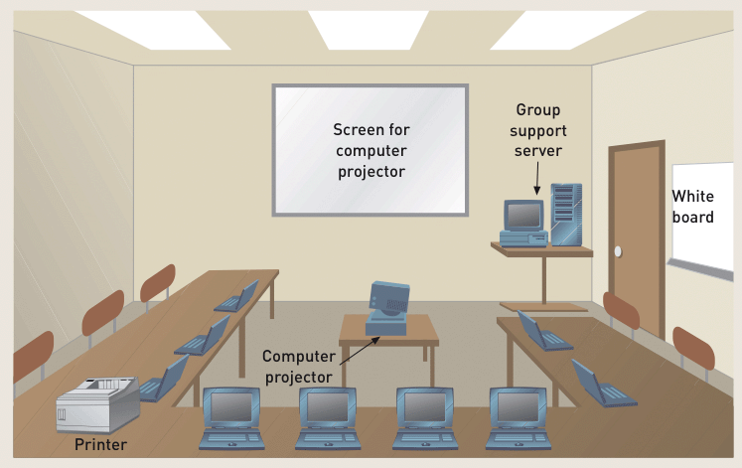
A JAD Facility

Slide 46
Joint Application Design Facilities
Conducted in special room
Limit interruptions
May be off-site
Resources
Overhead projector, white board, flip charts, work material
Electronic support (laptops)‏
CASE tools
Group support systems (GSS)‏

Slide 47
Assignment
Write a note on object oriented methodology.

