Slide 1
Stored Procedure in C#
Dr. S. S. Yambal

Slide 2
VALIDATION
Goto validation tab in toolbox
Place RangeValidator near ID and set ControlToValidate, MaximumValue, MinimumValue and ErrorMessage as per need.
RequiredFieldValidator near Name and Set ControlToVaidate and ErrorMessage properties
RegularExpressionValidator near email and set ControlToValidate and ValidationExpression properties along with ErrorMessage.

Slide 3
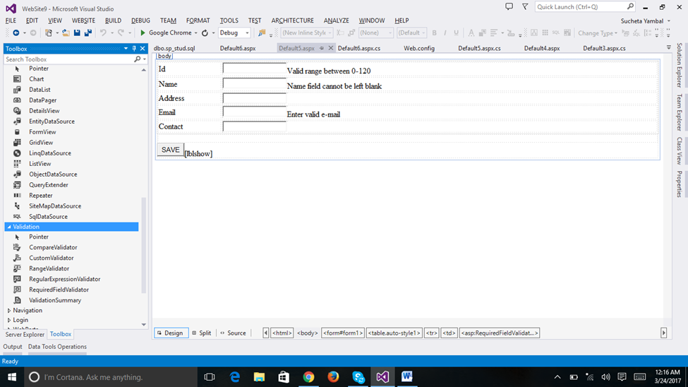

Slide 4
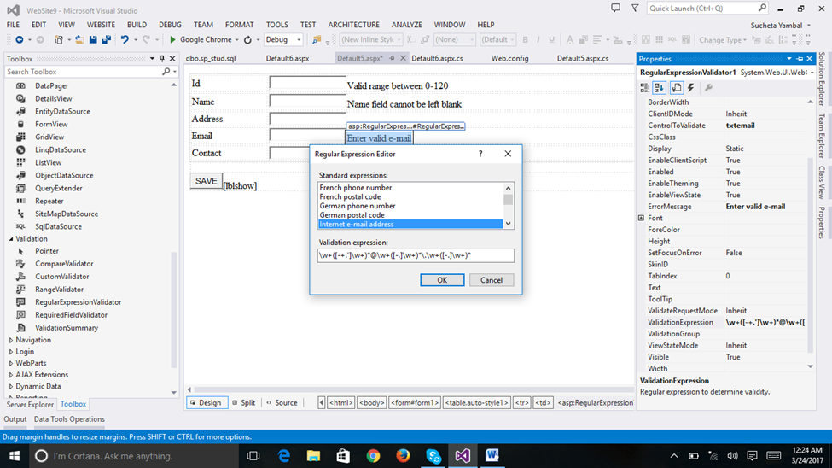

Slide 5
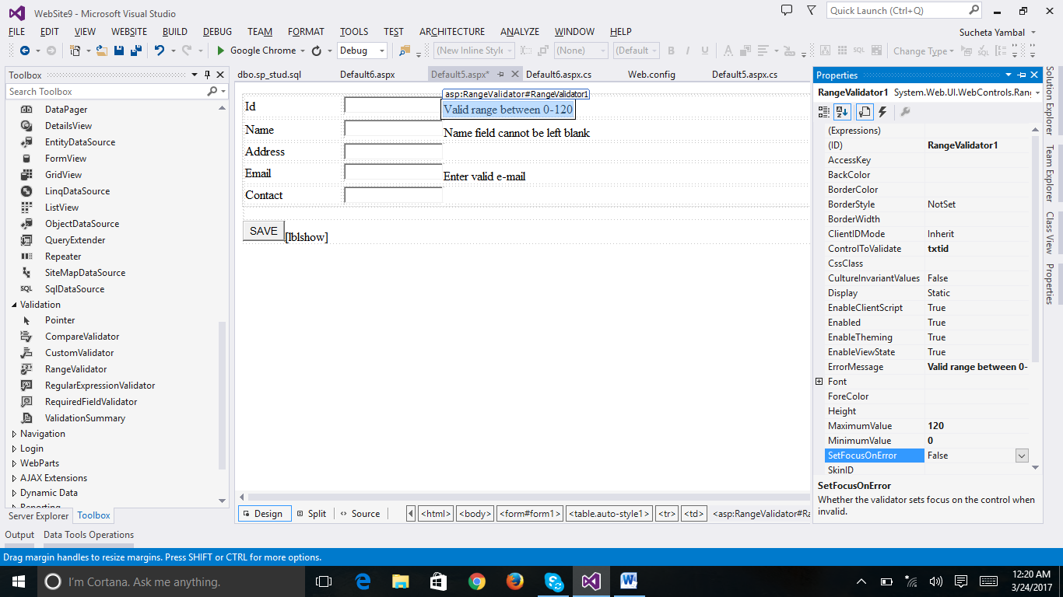

Slide 6
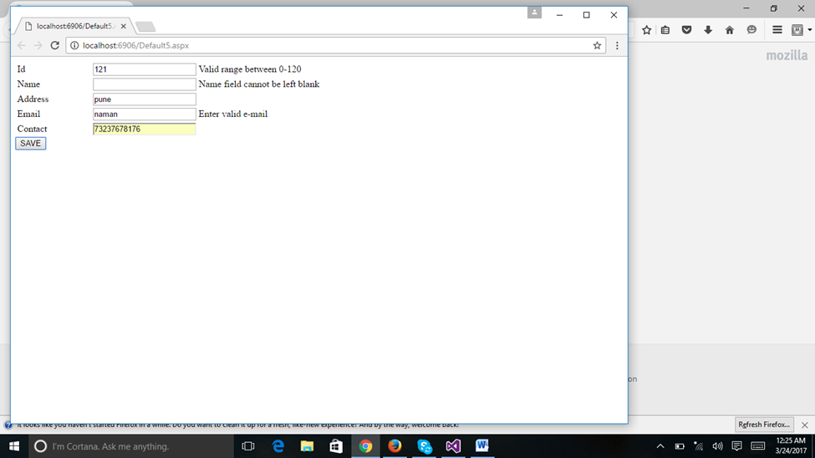

Slide 7
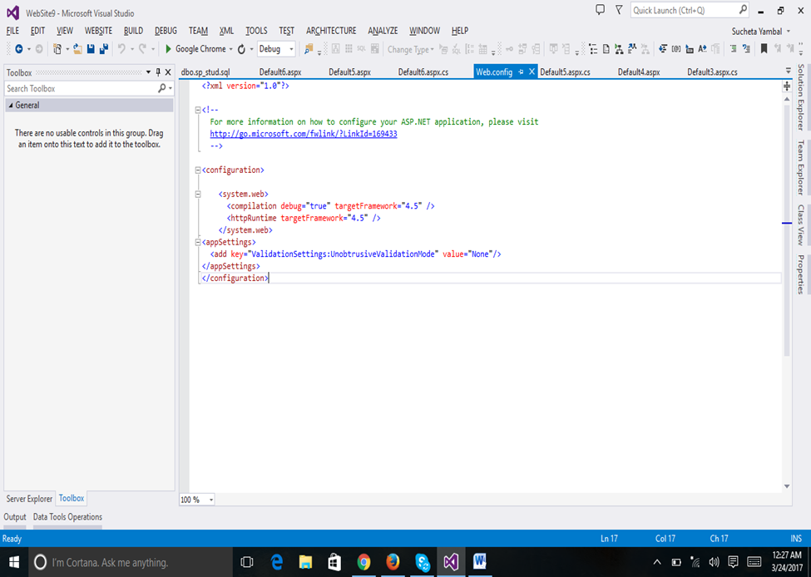
The code runs as it is in 2010 but for 2013 write following code in Web.Config file

Slide 8
DATAGRID VIEW
In ToolBox goto – Data Tab -> Double click on GridView control
Goto properties ans set its name as DgvStud

Slide 9
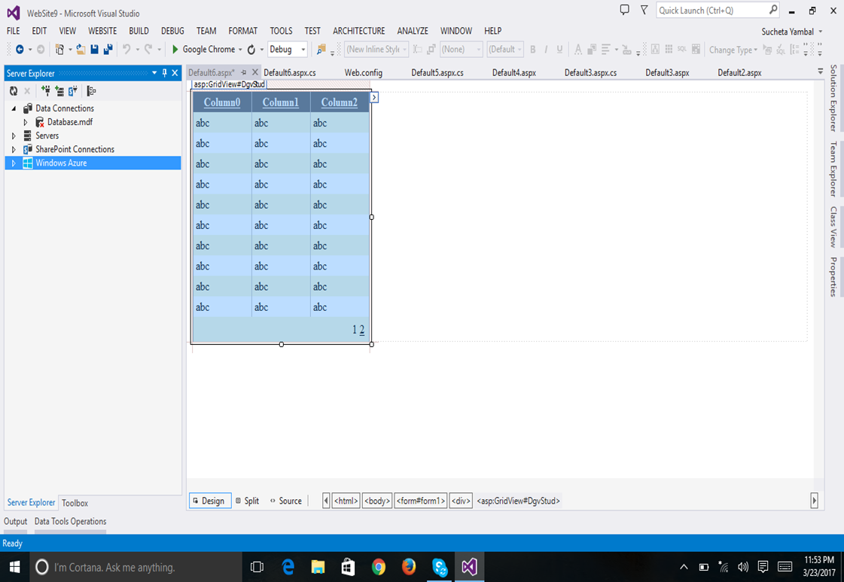

Slide 10
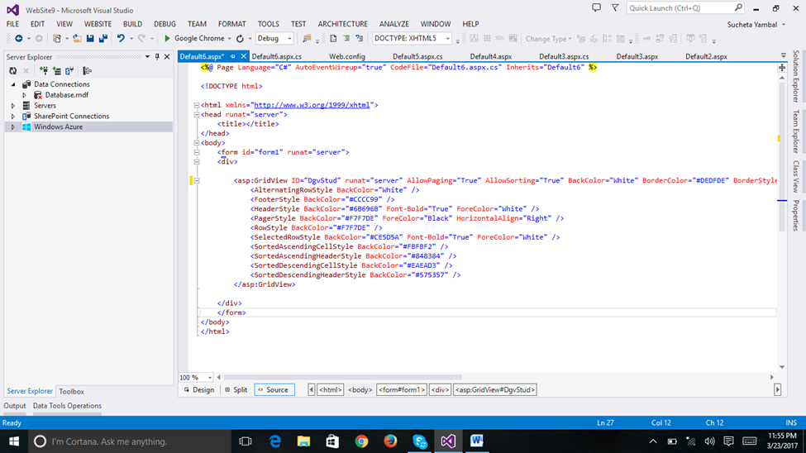
Source View looks like

Slide 11
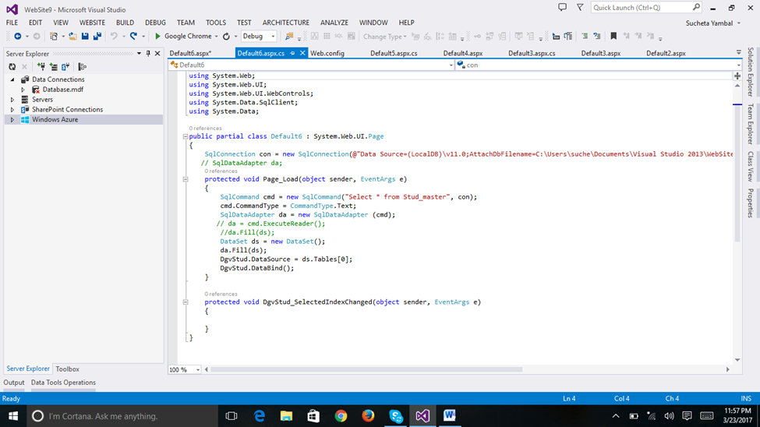
Write following code in aspx.cs file

Slide 12
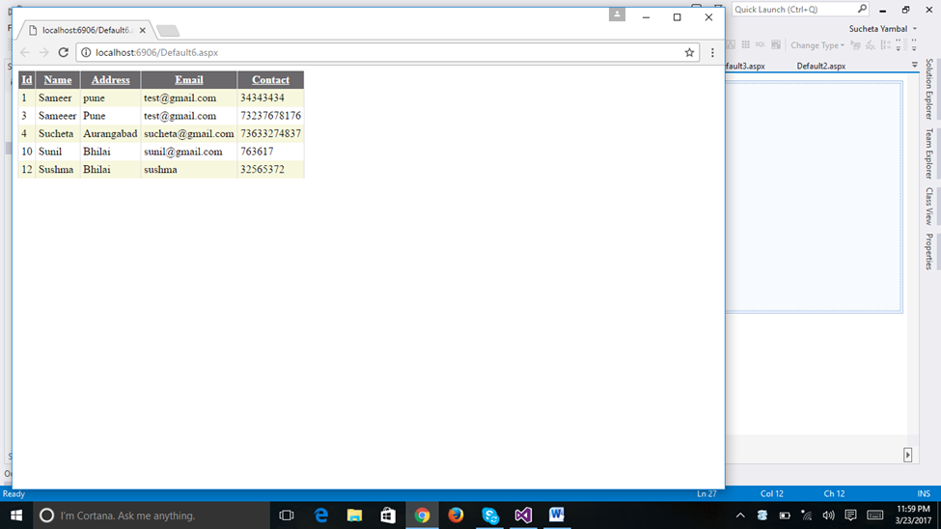
And the result in browser looks like:

Slide 13
Introduction
Stored procedures (sprocs) are generally an ordered series of Transact-SQL statements bundled into a single logical unit. They allow for variables and parameters, as well as selection and looping constructs. A key point is that sprocs are stored in the database rather than in a separate file.

Slide 14
PROS
Advantages over simply sending individual statements to the server include:
Referred to using short names rather than a long string of text; therefore, less network traffiic is required to run the code within the sproc.
Pre-optimized and precompiled, so they save an incremental amount of time with each sproc call/execution.
Encapsulate a process for added security or to simply hide the complexity of the database.
Can be called from other sprocs, making them reusable and reducing code size.

Slide 15
Parameterization
A stored procedure gives us some procedural capability, and also gives us a performance boost by using mainly two types of parameters:
Input parameters
Output parameters
From outside the sproc, parameters can be passed in either by position or reference.

Slide 16
Declaring Parameters
The name
The datatype
The default value
The direction
The syntax is :
@parameter_name [AS] datatype [= default|NULL] [VARYING] [OUTPUT|OUT]

Slide 17
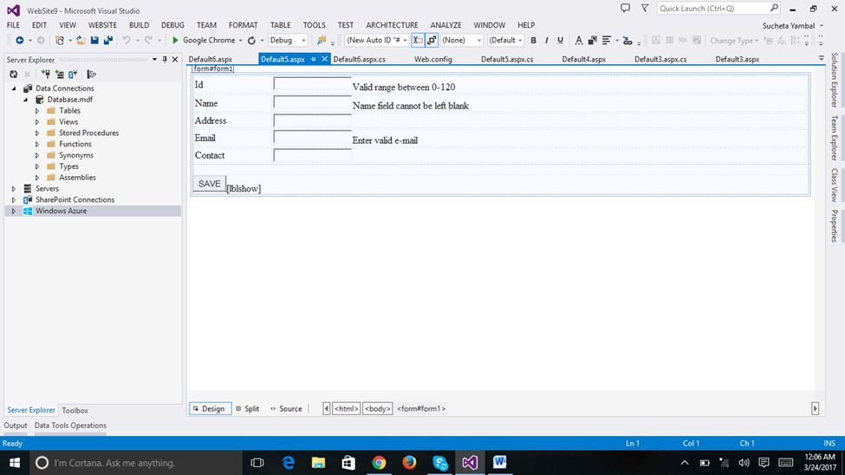
Design following form

Slide 18
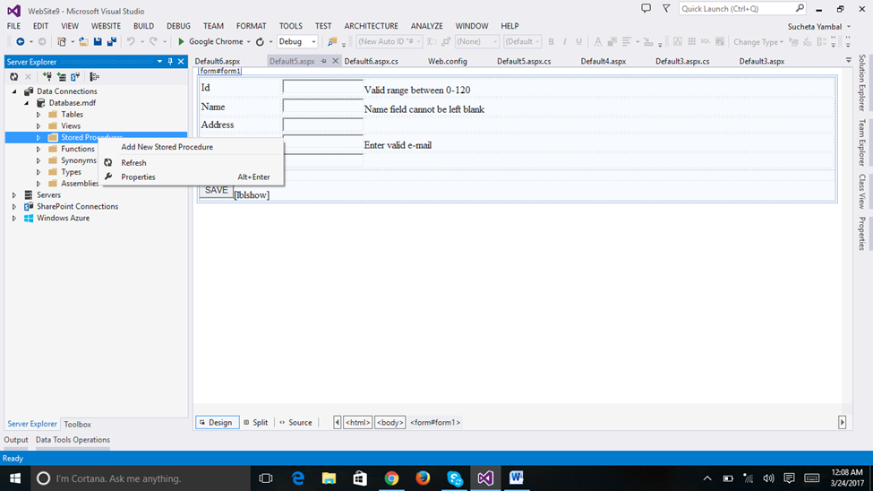

Slide 19
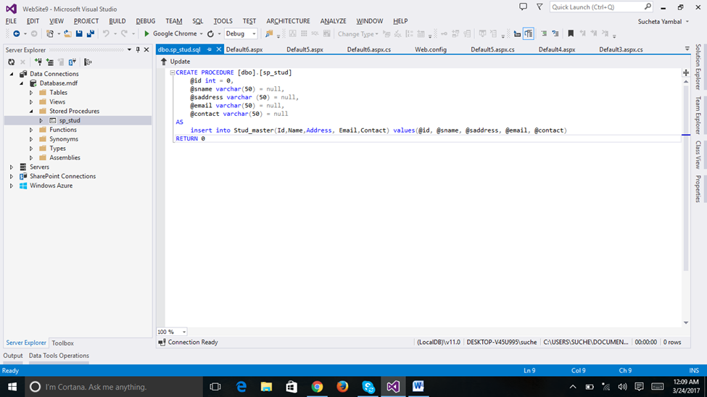
Select Add New Stored Procedure
And write following code and say update database

Slide 20
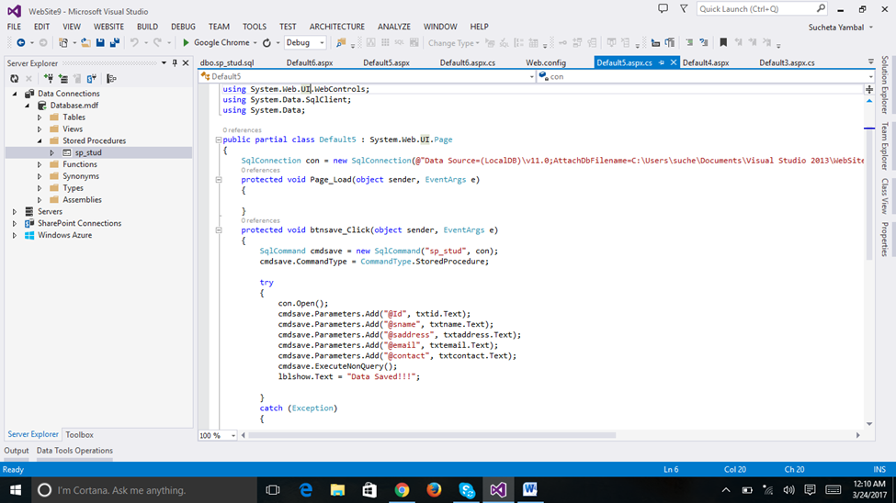
Goto form again and type following in aspx.cs file

Slide 21
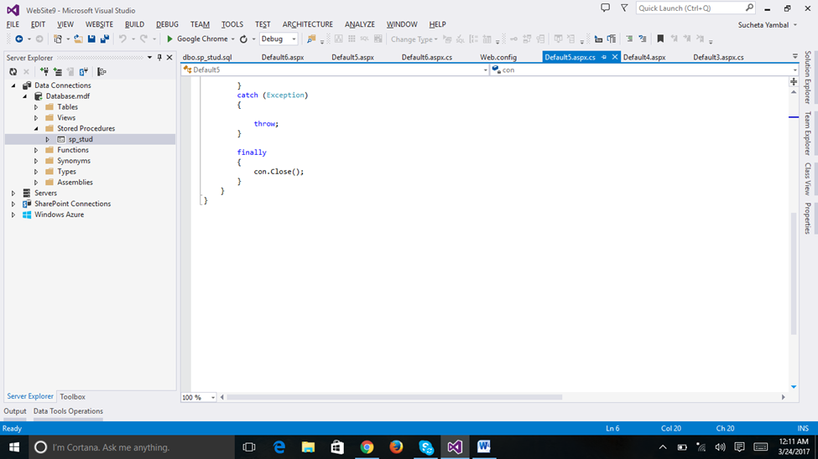

Slide 22
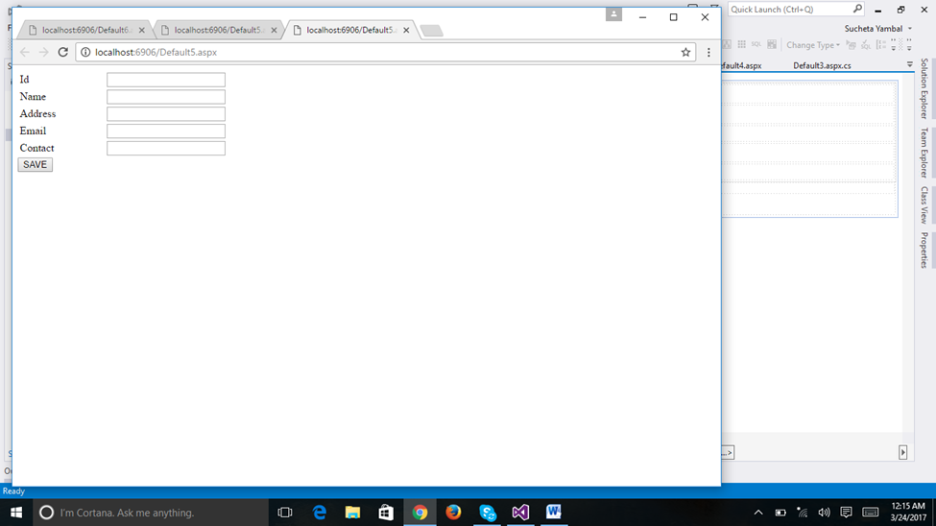
Running the code in browser will show following form

