Slide 1
Syntax Analysis-Part 1 Context Free Grammer
By
Dr C.Namrata Mahender

Slide 2
Ambiguity
E -> E+E | E*E| (E) | id
Rewrite the rules
E-> E’+E|E’
E’->id * E’|id |(E) * E’ |(E)
Solve id *id +id

Slide 3
Abstract syntax tree
A data structure
Compress only conclusions are given

Slide 4
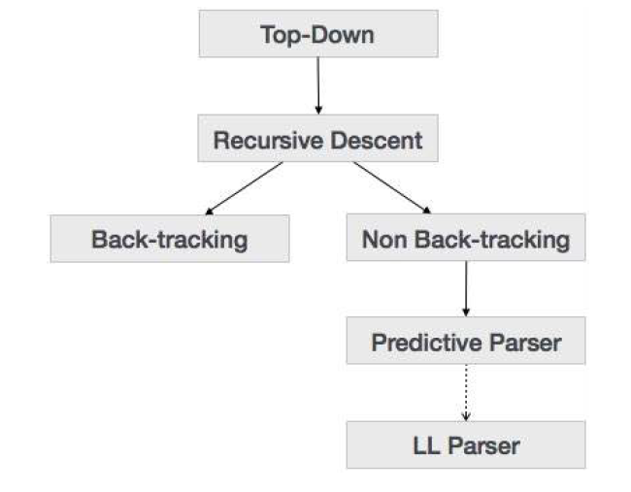
Top –Down Parser
Notes:
E =T|T+E
T=INT|INT*T|(E)

Slide 5
Recursive Descent parser

Slide 6
Recursive Descent parser

Slide 7
Recursive Descent parser

Slide 8
Recursive Descent parser

Slide 9
Recursive Descent parser

