Slide 1
Syntax Analysis-Part 1
Context Free Grammer
By
Dr C.Namrata Mahender

Slide 2
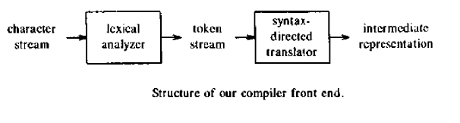
A grammar-oriented compiling technique, known as syntax directed translation, is very helpful for organizing a compiler front end.

Slide 3

Context-free Grammar (CFG)
Syntax Definition :
A Context free grammar or Backus Norm Form is used to specify the syntax of a language .
  For e.g.
Such a rule is called production

Slide 4
Context-free Grammar (CFG)
It is a set of recursive rewriting rules (or productions) used to generate patterns of strings.
A CFG consists of the following components:
  a set of terminal symbols, which are the characters of the alphabet that appear in the strings generated by the grammar.
  a set of nonterminal symbols, which are placeholders for patterns of terminal symbols that can be generated by the nonterminal symbols.
  a set of productions, which are rules for replacing (or rewriting) nonterminal symbols (on the left side of the production) in a string with other nonterminal or terminal symbols (on the right side of the production).
  a start symbol, which is a special nonterminal symbol that appears in the initial string generated by the grammar.

Slide 5
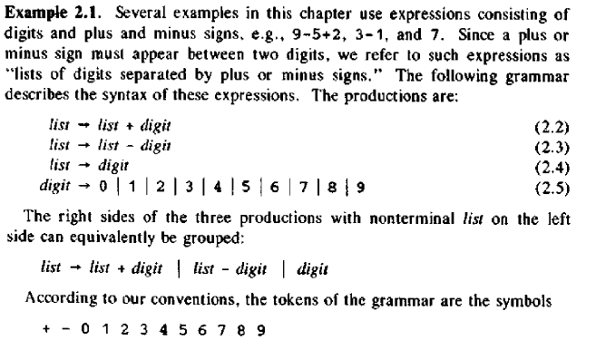
Context-free Grammar (CFG)

Slide 6
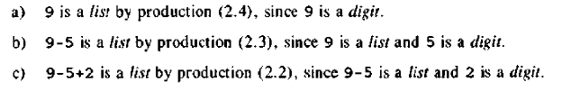
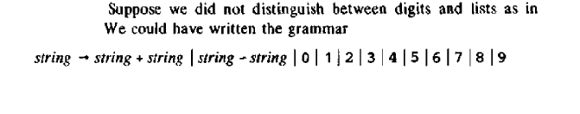
Context-free Grammar (CFG)
Example 9-5+2
Draw Parse tree
Draw Parse tree

Slide 7

Associativity Of Operators
Left Association : +,-,*,/
Right Association :=
Precedence Of Operators

Slide 8
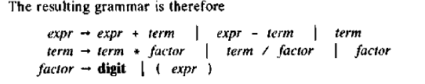
Associativity & Precedence Of Operators
Shown in increasing order

Slide 9
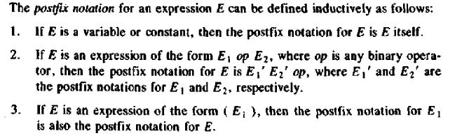
Post -Fix Notation

Slide 10
Context-free Grammar (CFG)
To generate a string of terminal symbols from a CFG :
  Begin with a string consisting of the start symbol;
  Apply one of the productions with the start symbol on the left hand size, replacing the start symbol with the right hand side of the production;
  Repeat the process of selecting nonterminal symbols in the string, and replacing them with the right hand side of some corresponding production, until all nonterminals have been replaced by terminal symbols.

Slide 11
Context-free Grammar (CFG)
<expression> --> number
<expression> --> ( <expression> )
<expression> --> <expression> + <expression>
<expression> --> <expression> - <expression>
<expression> --> <expression> * <expression>
<expression> --> <expression> / <expression>

Slide 12
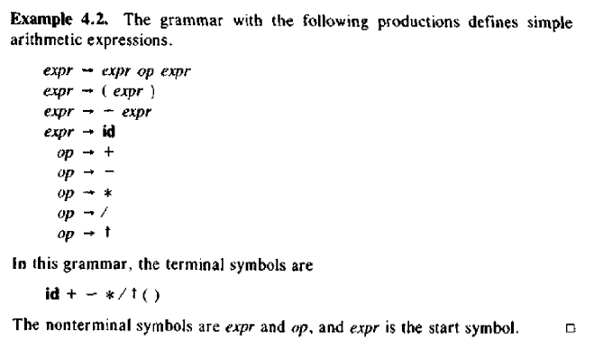
Context-free Grammar (CFG)

Slide 13
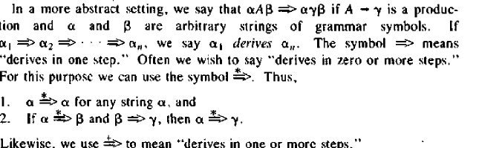
Context-free Grammar (CFG)
This lead to two forms of derivation : Left sentential form and right sentential form of grammar(canonical derivation)

Slide 14
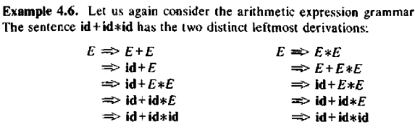
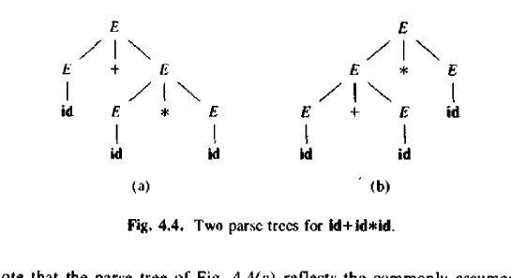
Context-free Grammar (CFG)

Slide 15
Type of Parser
Top-down
Bottom-up

Slide 16
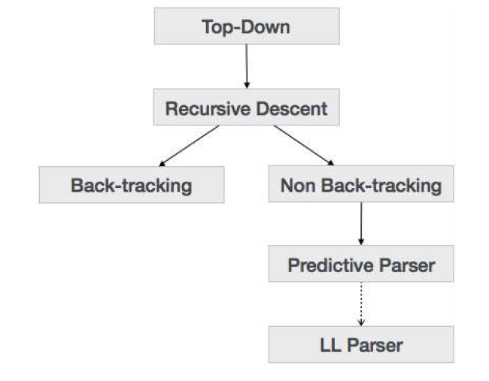
Top –Down Parser
Notes:
E =T|T+E
T=INT|INT*T|(E)

Slide 17


