Slide 1
Syntax Analysis-Part 1
By
Dr C.Namrata Mahender

Slide 2
Analysis
The analysis phase of a compiler breaks up a source program into constituent pieces and produces an internal representation for it, called intermediate code.
The synthesis phase translates the intermediate code into the target program.
Analysis is organized around the "syntax" of the language to be compiled.
The syntax of a programming language describes the proper form of its programs,
The semantics of the language defines what its programs mean; [what each program does when it executes].

Slide 3
Every programming language has rules that prescribe the syntactic structure of well-formed programs
The syntax of programming language constructs can be described by context-free grammars
Grammars offer significant advantages to both language designers and compiler writers.
A grammar gives a precise, yet easy-to-understand, syntactic specification of a programming language.
From certain classes of grammars construction of an efficient parser can be easy and automated (if a source program is syntactically well Formed).

Slide 4
As an additional benefit, the parser construction process can reveal syntactic ambiguities and other difficult-to-parse constructs that might otherwise go undetected in the initial design phase of a language and its compiler.
A properly designed grammar imparts a structure to a programming language (that is useful for the translation of source programs into correct object code and for the detection of errors)
Languages evolve over a period of time, acquiring new constructs and performing additional tasks. These new constructs can be added to a language more easily when there is an existing implementation based on a grammatical description of the language.

Slide 5
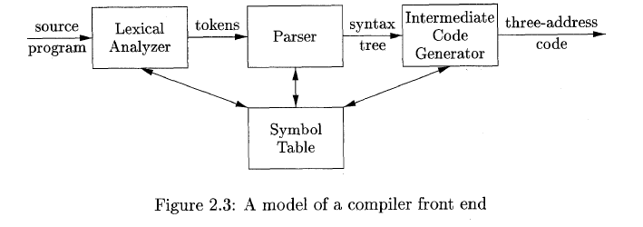

Slide 6
Error Handler
The error handler in a parser has simple-to-state goals:
It should ,report the presence of errors clearly and accurately.
It should recover from each error quickly enough to be able to detect subsequent errors.
It should not significantly slow down the processing of correct programs,
In short:
Find the error
Diagnosis
Error recovery

Slide 7
ERROR RECOVERY
What should happen when your parser finds an error in the user’s input?
stop immediately and signal an error
record the error but try to continue

Slide 8
Error recovery:
Error recovery: process of adjusting input stream so that the parser can
continue after unexpected input
Possible adjustments:
delete tokens
insert tokens
substitute tokens
Classes of recovery:
local recovery: adjust input at the point where error was detected (and also possibly immediately after)
global recovery: adjust input before point where error was detected.
*Error recovery is possible in both top down and bottom-up parsers

Slide 9
Error-recovery strategies
Panic mode
Phrase level/Statement mode
Error productions
Global correction

Slide 10
Error-recovery strategies
Panic mode
When a parser encounters an error anywhere in the statement, it ignores the rest of the statement by not processing input from erroneous input to delimiter, such as semi-colon. This is the easiest way of error-recovery and also, it prevents the parser from developing infinite loops.
Statement mode
When a parser encounters an error, it tries to take corrective measures so that the rest of inputs of statement allow the parser to parse ahead. For example, inserting a missing semicolon, replacing comma with a semicolon etc. Parser designers have to be careful here because one wrong correction may lead to an infinite loop.

Slide 11
Error-recovery strategies
Error productions
Some common errors are known to the compiler designers that may occur in the code. In addition, the designers can create augmented grammar to be used, as productions that generate erroneous constructs when these errors are encountered.
Global correction
The parser considers the program in hand as a whole and tries to figure out what the program is intended to do and tries to find out a closest match for it, which is error-free. When an erroneous input (statement) X is fed, it creates a parse tree for some closest error-free statement Y. This may allow the parser to make minimal changes in the source code, but due to the complexity (time and space) of this strategy, it has not been implemented in practice yet.

