Slide 1
Syntax Analysis-Part 1
SLR
By
Dr C.Namrata Mahender

Slide 2
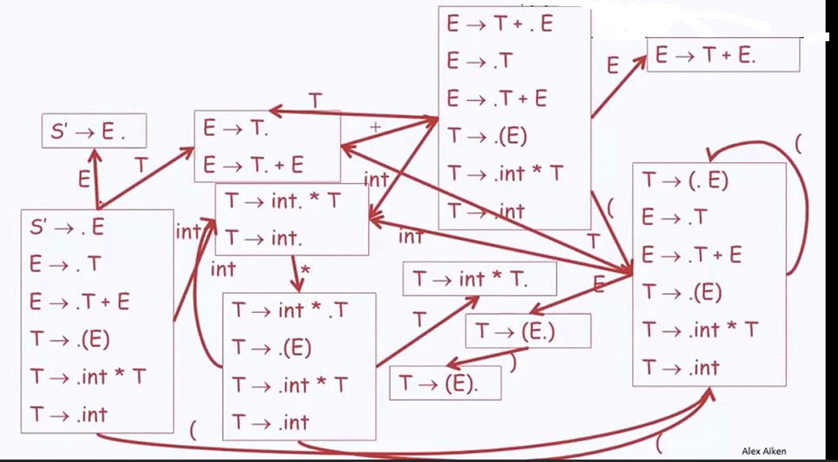
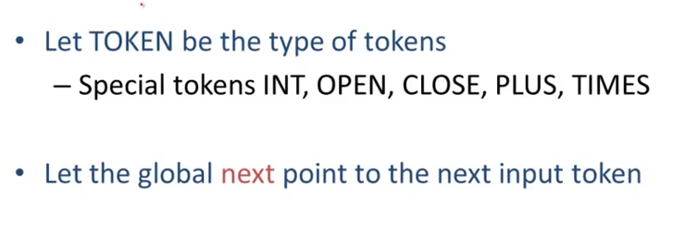
Valid Items

Slide 3
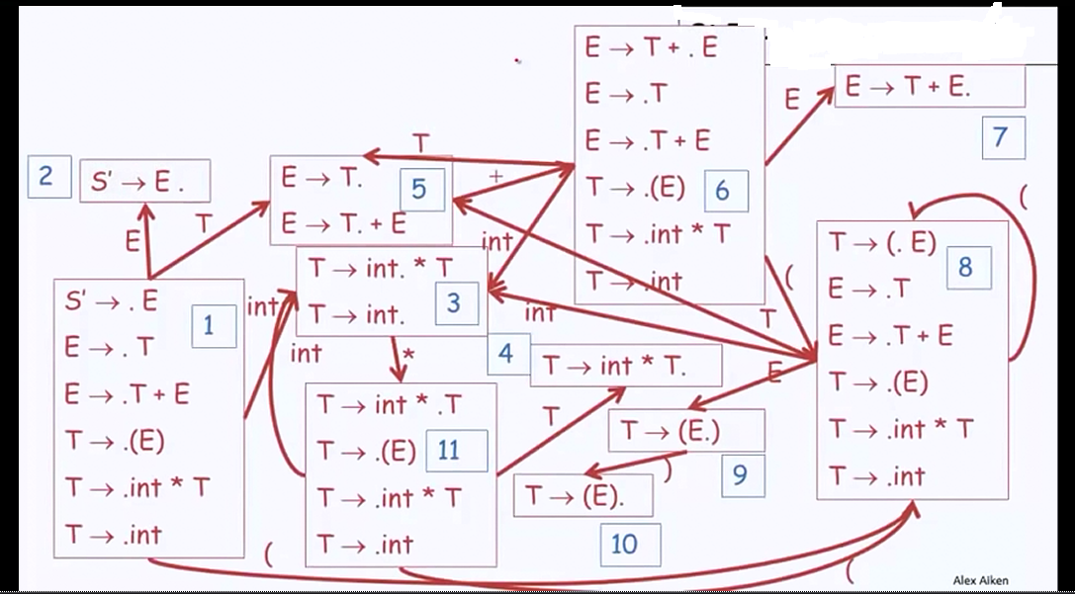

Numbering

Slide 4
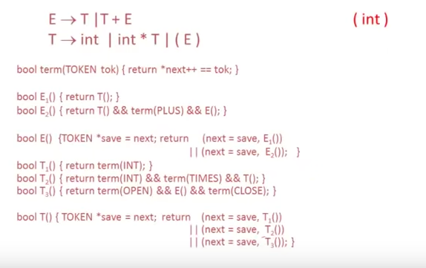
Algorithm Recursive Descent

Slide 5

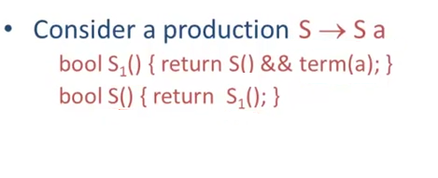

Left Recursion
Not possible by Recursive descent parser

Slide 6
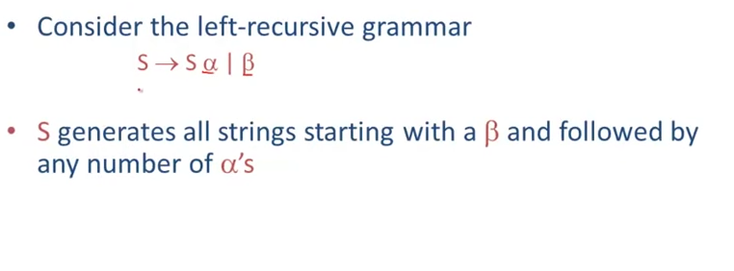

Left Recursion

Slide 7
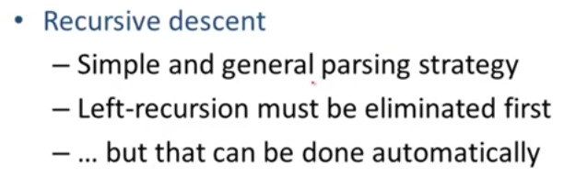

Left Recursion

Slide 8
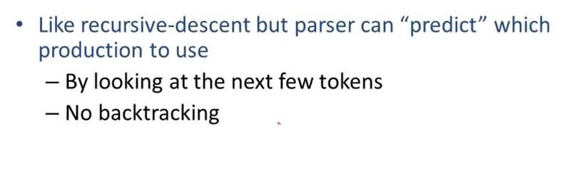
Predictive parser
        L-Left to right
        L-left most
        K=(tokens loolahead) number ,generally(1)

Slide 9
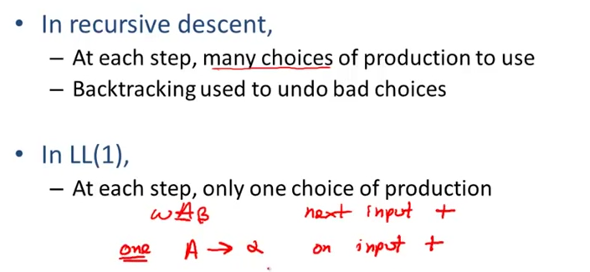

Predictive parser
May no production
Or only atmost one thus

Slide 10
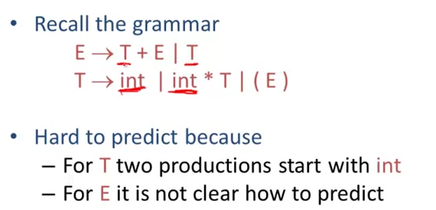
Predictive parser
To solve this do Left factoring

Slide 11
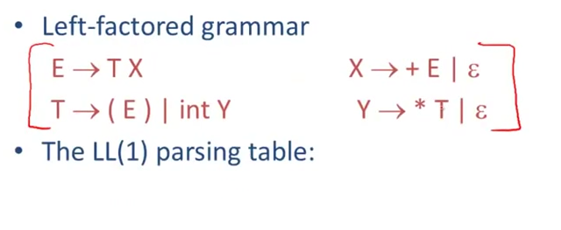

Predictive parser

Slide 12
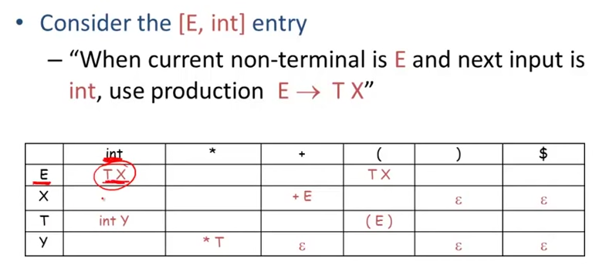
Predictive parser

Slide 13
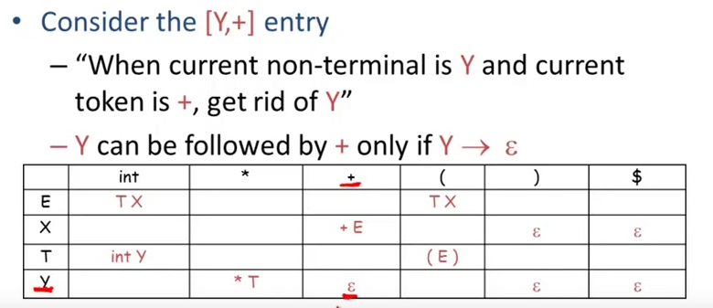
Predictive parser

Slide 14
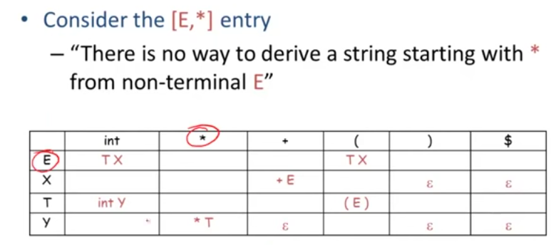
Predictive parser
Example :int * int

Slide 15
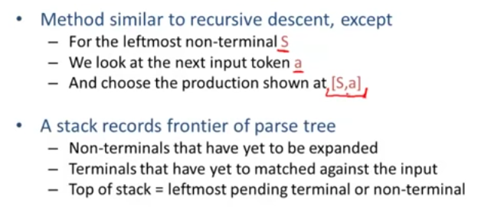

Predictive parser

Slide 16
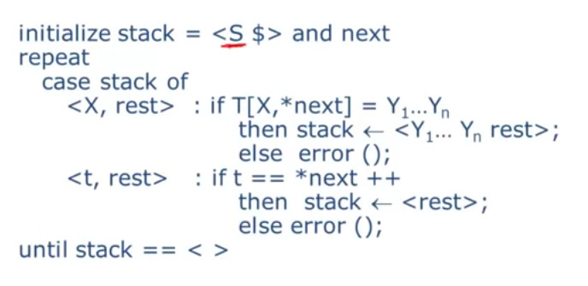
Predictive parser

Slide 17
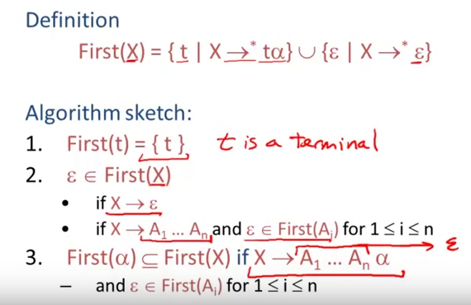
Predictive parser

Slide 18
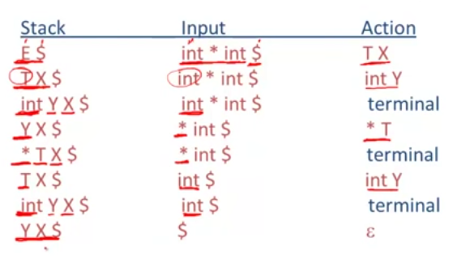

Slide 19


