Slide 1
ECONOMICS OF INFORMATION TECHNOLOGY
Dr. Dhanashri Mahajan
Professor, Department of Economics
Dr. Babasaheb Ambedkar
Marathwada University
Aurangabad

Slide 2
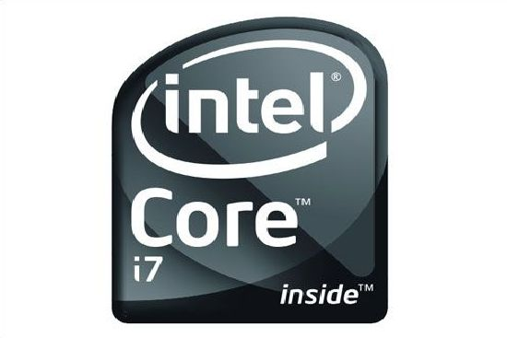
Moore’s Law
Capacity of microprocessor in electronic devices doubles every 24 months
Cost of production is constant
Reduces average cost of production at a fast rate
Becomes less costly & so accessible
Firm can chalk out a long term plan

Slide 3
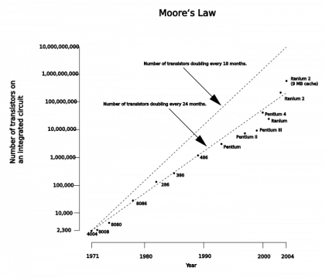

Slide 4
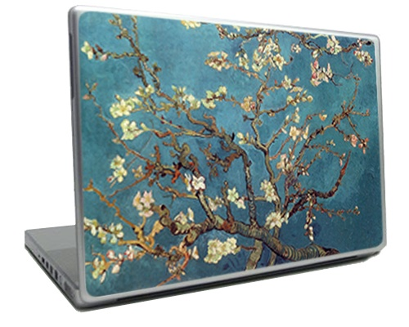
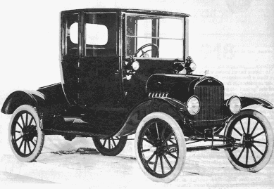
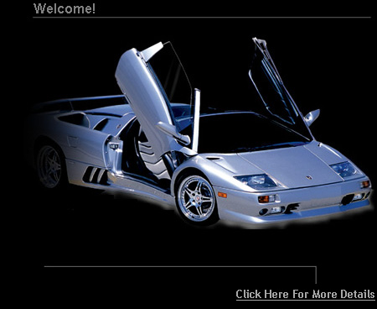
1.Personalization of Products: (price & product discrimination )
-A car can be designed as per the requirement of the customer
-Front page of an on – line newspaper can be personalized
-A PC can be personalized.
-Product stands out of the rest.
- The customer has to pay extra

Slide 5
2. Competing Against Yourself:
In case of DVDs, there is a common version,
whereas there is a collector’s version of say
“Morning Ragas” etc. which is made available at a higher price.

Slide 6
3.To Lock – in Customers:
One common example of
locking in is in the case of ink – jet printers.
When we buy a particular brand, we get locked – in. The printer comes relatively cheap but the ink – cartridges that are compatible to the specific printer brand are expensive.
In fact, because ink – jet printers
are expensive, the printer comes
cheap.

Slide 7
4.Natural Monopolies:
In case of many firms:
fixed cost is high
marginal cost is low or even zero.
These are called “Natural Monopolies” in Economics.
they prevent entry of new firms
If other firms manage to enter, then the customers stand to gain

Slide 8
5.Standard Wars:
To establish standards a firm may guarantee low price or even no price - Microsoft has guaranteed free access to internet explorer to all those who buy the Windows Operating System.

Slide 9
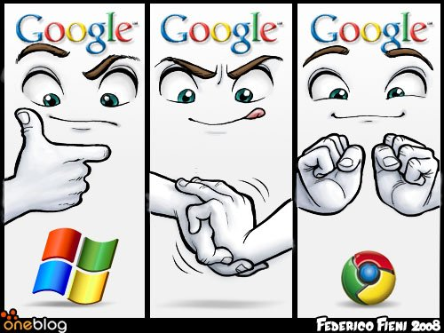

Slide 11
6. System Effects: * IT firms sometimes collide, sometimes negotiate and at other times compete with each other and affect prices. * There is no use of software without hardware. * There is no use of a single fax machine without a network of other fax machines.

Slide 12
7. Strategic Marketing
Microsoft has made the Windows System compatible and created competition in the field of hardware
-Reduced the prices of hardware
-Increased the demand for the Window System
The Result: increased competition in the field of complementary products, and also indirect increase in
demand for the main product

Slide 13
Small Is Beautiful & Choice of Technique
Technology
1000 $ Technology 1$ Technology
100 $ Technology

Slide 14
THANK YOU

