Slide 1
Union Budget 2013-14
Cartoon Budget 2013-14
कार्टून बजट 2013-14
Presented by
Dr. Pawar Ashok Shankarrao
Director,
Vasantrao Naik Research Centre
Professor.
Dept. of Economics
Dr. Babaasaheb Ambedkar
Marathwada.University, Aurangabad. (MS-India)-431004
E-mail: pawarashok40@gmail.com
Mob.No: 09421758357/

Slide 2
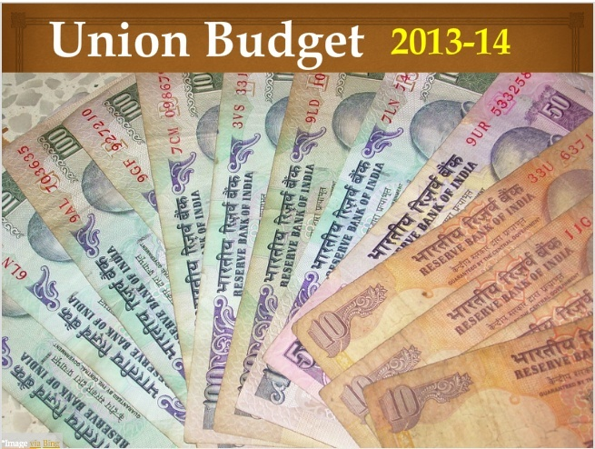
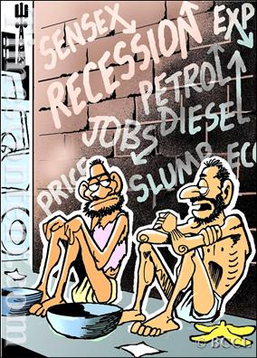
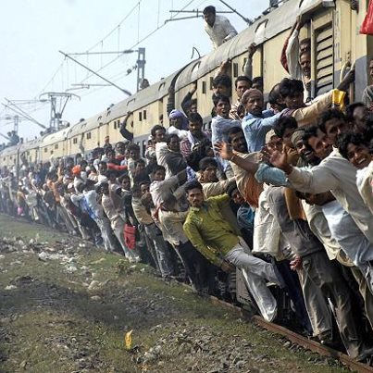
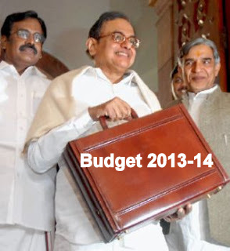

Slide 4
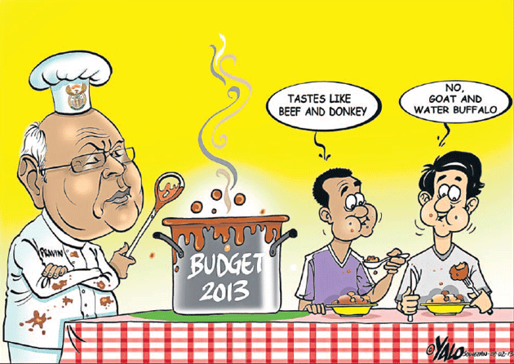

Slide 5
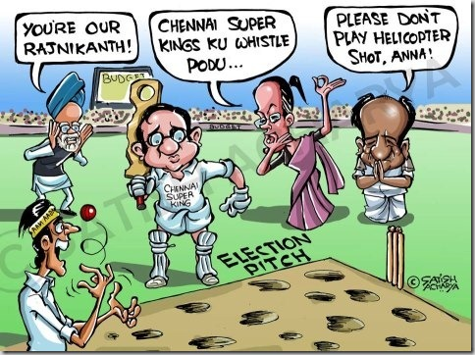

Slide 7
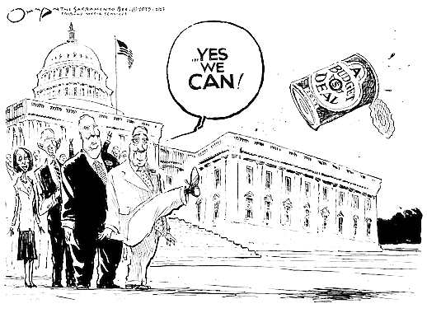

Slide 8
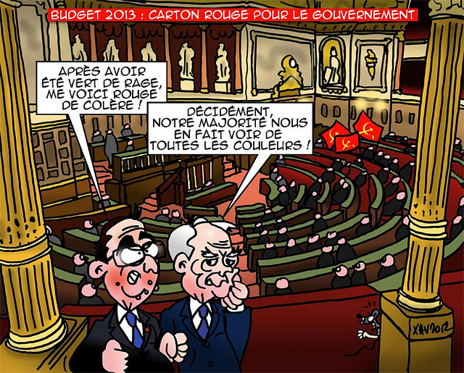

Slide 9
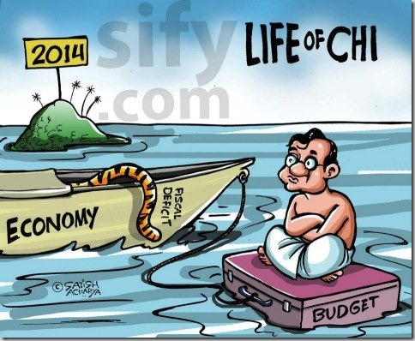

Slide 11
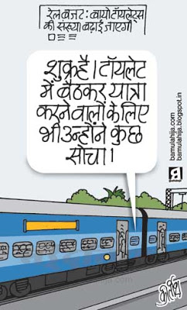

Slide 12
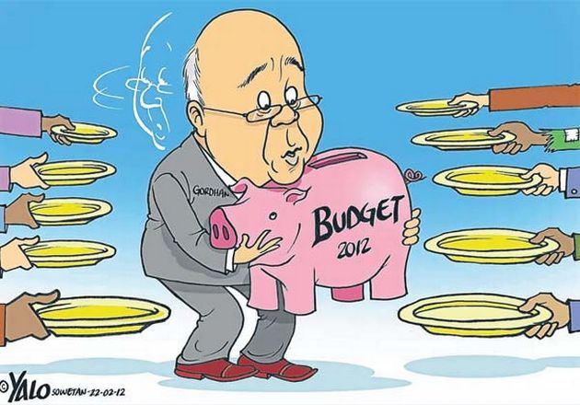

Slide 13
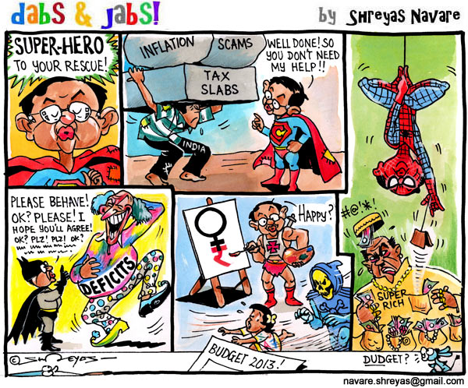

Slide 14
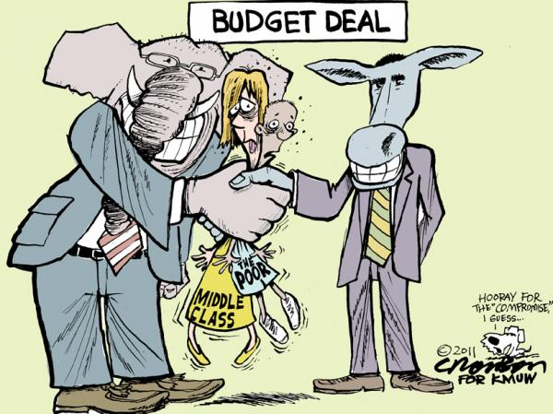

Slide 15
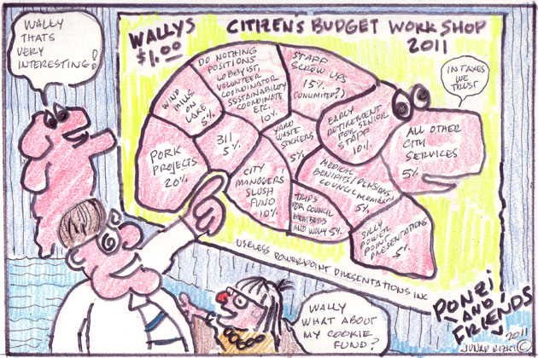

Slide 16
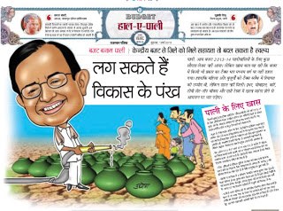

Slide 18
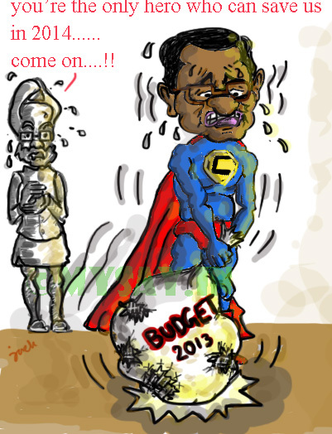

Slide 19
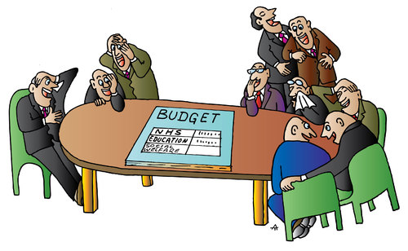

Slide 20
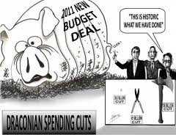

Slide 23
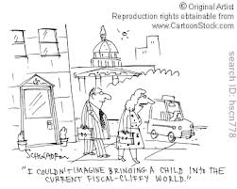

Slide 24
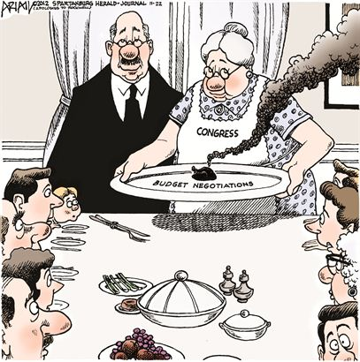

Slide 25
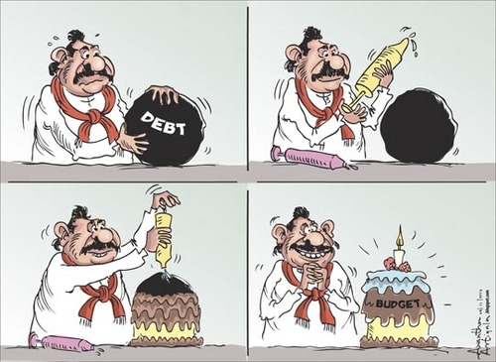

Slide 27
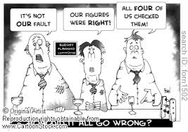

Slide 30
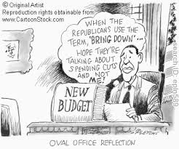

Slide 31
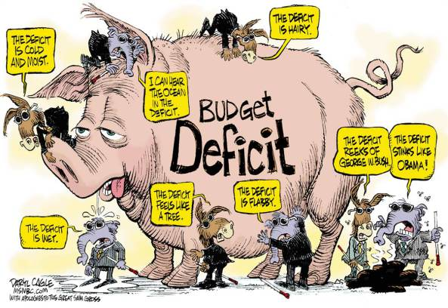

Slide 32
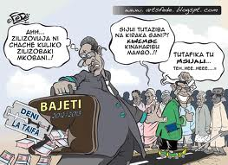

Slide 33
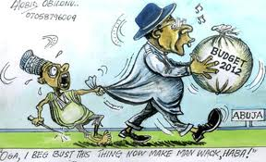

Slide 36
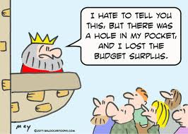

Slide 40
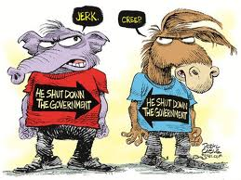

Slide 41
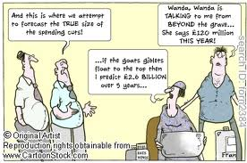

Slide 43
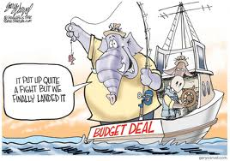

Slide 44
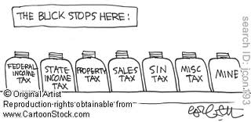

Slide 57
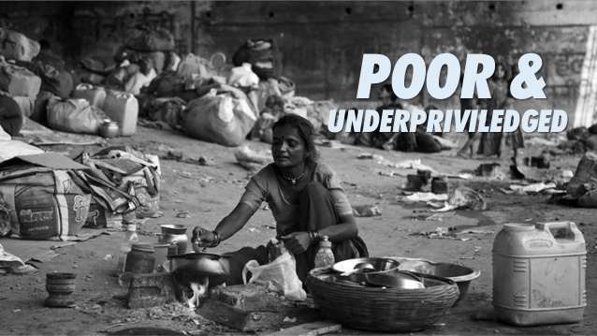

Slide 72
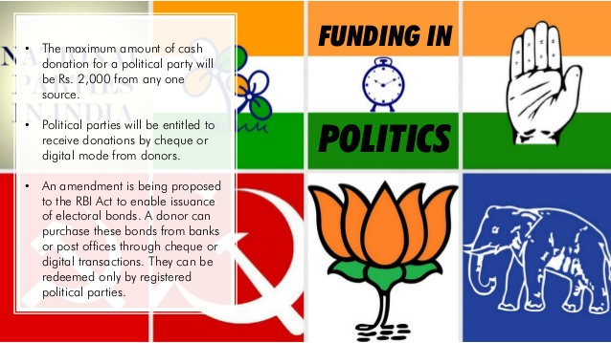

Slide 81
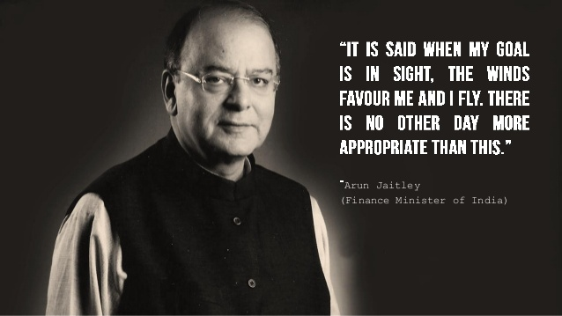

Slide 82
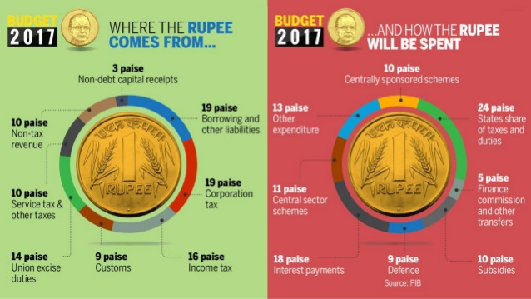

Slide 113
Process of Budget:-

Slide 115
Income Tax Slabs AND Rates for AY 2013-14 (FY 2012-13)
This page contains Income Tax rates and slabs for various categories of Indian Income Tax payers in a user friendly format. Please send your suggestions / feedback to finotax@gmail.com to enable us to make it more useful.
Individuals (Below 60 years) & HUFs
Senior Citizens (Above 60 years but below 80 years)
Very Senior Citizens (Above 80 years)
AOPs & BOIs
Co-operative Society
Firm
Local Authority
Domestic Company
Other Company

Slide 116
A. Individuals and HUFs
Education Cess: 3% of the Income-tax.
II. Individual resident who is of the age of 60 years or more but below the age of 80 years at any time during the previous year.
 | Income Slabs | Income Tax Rate
i. | Where the total income does not exceed Rs. 2,50,000/-. | NIL
ii. | Where the total income exceeds Rs. 2,50,000/- but does not exceed Rs. 5,00,000/- | 10% of the amount by which the total income exceeds Rs. 2,50,000/-.
iii. | Where the total income exceeds Rs. 5,00,000/- but does not exceed Rs. 10,00,000/- | Rs. 25,000/- + 20% of the amount by which the total income exceeds Rs. 5,00,000/-.
iv. | Where the total income exceeds Rs. 10,00,000/- | Rs. 125,000/- + 30% of the amount by which the total income exceeds Rs. 10,00,000/-.
Education Cess: 3% of the Income-tax.

Slide 117
III. Individual resident who is of the age of 80 years or more at any time during the previous year.
 | Income Slabs | Income Tax Rate
i. | Where the total income does not exceed Rs. 5,00,000/-. | NIL
ii. | Where the total income exceeds Rs. 5,00,000/- but does not exceed Rs. 10,00,000/- | 20% of the amount by which the total income exceeds Rs. 5,00,000/-.
iii. | Where the total income exceeds Rs. 10,00,000/- | Rs. 100,000/- + 30% of the amount by which the total income exceeds Rs. 10,00,000/-.
Education Cess: 3% of the Income-tax

Slide 118
B. Association of Persons (AOP) and Body of Individuals (BOI)
i. Income-tax:
 | Income Slabs | Income Tax Rate
i. | Where the total income does not exceed Rs. 2,00,000/-. | NIL
ii. | Where the total income exceeds Rs. 2,00,000/- but does not exceed Rs. 5,00,000/-. | 10% of amount by which the total income exceeds Rs. 2,00,000/-
iii. | Where the total income exceeds Rs. 5,00,000/- but does not exceed Rs. 10,00,000/-. | Rs. 30,000/- + 20% of the amount by which the total income exceeds Rs. 5,00,000/-.
iv. | Where the total income exceeds Rs. 10,00,000/-. | Rs. 130,000/- + 30% of the amount by which the total income exceeds Rs. 10,00,000/-.
ii. Education Cess: 3% of the Income-tax.

Slide 119
C. Co-operative Society
i. Income-tax:
ii. Surcharge: Nil
 | Income Slabs | Income Tax Rate
i. | Where the total income does not exceed Rs. 10,000/-. | 10% of the income.
ii. | Where the total income exceeds Rs. 10,000/- but does not exceed Rs. 20,000/-. | Rs. 1,000/- + 20% of income in excess of Rs. 10,000/-.
iii. | Where the total income exceeds Rs. 20,000/- | Rs. 3.000/- + 30% of the amount by which the total income exceeds Rs. 20,000/-.
iii. Education Cess: 3% of the Income-tax.

Slide 120
D. Firm
i. Income-tax: 30% of total income.
ii. Surcharge: Nil
iii. Education Cess: 3% of the total of Income-tax and Surcharge.
E. Local Authority
i. Income-tax: 30% of total income.
ii. Surcharge: Nil
iii. Education Cess: 3% of Income-tax.
F. Domestic Company
i. Income-tax: 30% of total income.
ii. Surcharge: The amount of income tax as computed in accordance with above rates, and after being reduced by the amount of tax rebate shall be increased by a surcharge at the rate of 5% of such income tax, provided that the total income exceeds Rs. 1 crore.
iii. Education Cess: 3% of the total of Income-tax and Surcharge.

Slide 121
G. Company other than a Domestic Company
i. Income-tax:
@ 50% of on so much of the total income as consist of (a) royalties received from Government or an Indian concern in pursuance of an agreement made by it with the Government or the Indian concern after the 31st day of March, 1961 but before the 1st day of April, 1976; or (b) fees for rendering technical services received from Government or an Indian concern in pursuance of an agreement made by it with the Government or the Indian concern after the 29th day of February, 1964 but before the 1st day of April, 1976, and where such agreement has, in either case, been approved by the Central Government.
@ 40% of the balance
ii. Surcharge: The amount of income tax as computed in accordance with above rates, and after being reduced by the amount of tax rebate shall be increased by a surcharge at the rate of 2% of such income tax, provided that the total income exceeds Rs. 1 crore.
iii. Education Cess: 3% of the total of Income-tax and Surcharge.

Slide 122
Disclaimer:
All efforts are made to keep the content of this site correct and up-to-date. But, this site does not make any claim regarding the information provided on its pages as correct and up-to-date. The contents of this site cannot be treated or interpreted as a statement of law. In case, any loss or damage is caused to any person due to his/her treating or interpreting the contents of this site or any part thereof as correct, complete and up-to-date statement of law out of ignorance or otherwise, this site will not be liable in any manner whatsoever for such loss or damage.

Slide 123
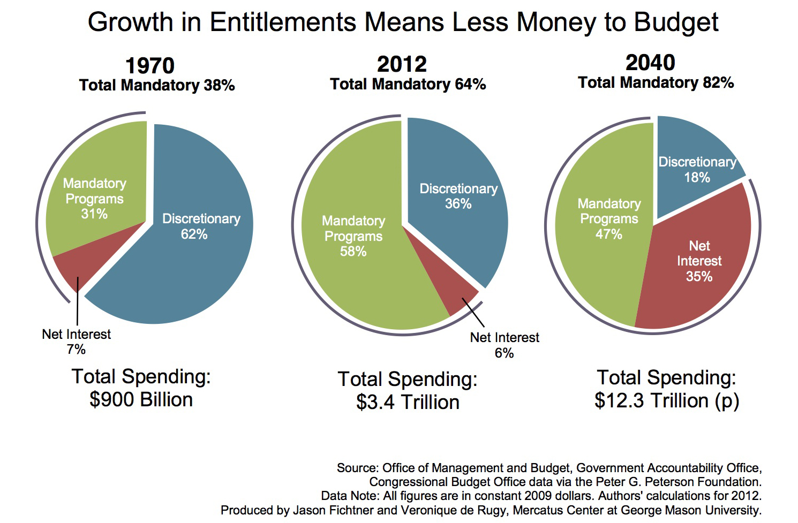

Slide 124
What is Union Budget?
केंद्रीय बजट क्या है?
The dictionary meaning of budget is a systematic plan for the expenditure of a usually fixed resource during a given period.
Thus, Union Budget, which is a yearly affair, is a comprehensive display of the Government’s finances. It is the most significant economic and financial event in India. The Finance Minister puts down a report that contains Government of India’s revenue and expenditure for one fiscal year. The fiscal year runs from April 01 to March 31.
बजट के शब्दकोश अर्थ एक निश्चित अवधि के दौरान आमतौर पर एक निश्चित संसाधन के खर्च के लिए एक व्यवस्थित योजना है. इस प्रकार, केंद्रीय बजट है, जो एक वार्षिक मामला है सरकार के वित्त के लिए एक व्यापक प्रदर्शन है. यह भारत में सबसे महत्वपूर्ण आर्थिक और वित्तीय घटना है. वित्त मंत्री ने एक रिपोर्ट है कि एक वित्तीय वर्ष के लिए भारत के राजस्व और व्यय के सरकार में शामिल डालता है. वित्तीय वर्ष 01 अप्रैल से 31 मार्च तक चलता है.

Slide 125
The Union budget is preceded by an Economic Survey which outlines the broad direction of the budget and the economic performance of the country. The Budget is the most extensive account of the Government`s finances, in which revenues from all sources and expenses of all activities undertaken are aggregated. It comprises the revenue budget and the capital budget. It also contains estimates for the next fiscal year called budgeted estimates.
केंद्रीय बजट एक आर्थिक सर्वेक्षण में जो बजट का व्यापक दिशा और देश के आर्थिक प्रदर्शन की रूपरेखा से पहले है.
बजट सरकार` वित्त, जिसमें सभी गतिविधियों के सभी स्रोतों और खर्च से राजस्व एकत्रित कर रहे हैं के सबसे व्यापक खाते है. यह राजस्व बजट और पूंजी बजट शामिल है. यह भी अगले वित्त वर्ष के बजट का अनुमान है बुलाया वर्ष के लिए अनुमान शामिल है.

Slide 126
Barring a few exceptions -- like elections – Finance Minister presents the annual Union Budget in the Parliament on the last working day of February. The budget has to be passed by the Lok Sabha before it can come into effect on April 01.
कुछ अपवादों को छोड़ दें - चुनावों की तरह वित्त मंत्री ने संसद में वार्षिक केंद्रीय बजट फरवरी के अंतिम कार्य दिवस पर प्रस्तुत करता है. बजट लोक सभा द्वारा पारित होने से पहले यह 01 अप्रैल को प्रभाव में आ सकता है.

Slide 127
Definition:-
A budget is a financial document used to project future income and expenses. The budgeting process may be carried out by individuals or by companies to estimate whether the person/company can continue to operate with its projected income and expenses.
परिभाषा: - एक बजट एक वित्तीय दस्तावेज़ के लिए भविष्य की आय और व्यय परियोजना के लिए इस्तेमाल किया है. व्यक्तियों या कंपनियों द्वारा बजट प्रक्रिया से बाहर किया जा सकता है के लिए अनुमान है कि व्यक्ति / कंपनी अपनी अनुमानित आय और खर्च के साथ संचालित करने के लिए जारी कर सकते हैं.
An estimate of costs, revenues, and resources over a specified period, reflecting a reading of future financial conditions and goals.
लागत, राजस्व, और संसाधनों का एक निर्धारित अवधि में एक अनुमान है, भविष्य की वित्तीय स्थिति और लक्ष्यों का एक पढ़ने को दर्शाती है.

Slide 128
One of the most important administrative tools, a budget serves also as a
(1). plan of action for achieving quantified objectives,
(2). standard for measuring performance, and
(3). device for coping with foreseeable adverse situations.
सबसे महत्वपूर्ण प्रशासनिक उपकरणों में से एक, एक बजट के रूप में भी कार्य करता है (1). कार्रवाई की मात्रा निर्धारित उद्देश्यों को प्राप्त करने के लिए योजना, (2). प्रदर्शन को मापने के लिए मानक है, और (3). निकट प्रतिकूल परिस्थितियों के साथ मुकाबला करने के लिए डिवाइस.

Slide 129
According to Tayler,
"Budget is a financial plan of government for a definite period".
According to Rene Stourm,
"A budget is a document containing a preliminary approved plan of public revenues and expenditure".
Tayler के लिए अनुसार, "बजट में सरकार की एक निश्चित अवधि के लिए एक वित्तीय योजना है." Rene Stourm के अनुसार, "एक बजट वाले दस्तावेज़ सार्वजनिक राजस्व और व्यय के लिए एक प्रारंभिक योजना को मंजूरी दी है."

Slide 130
Why do we produce budgets?
हम बजट क्यों करते हैं?
Budget helps to aid the planning of actual operations by forcing managers to consider how the conditions might change and what steps should be taken now and by encouraging managers to consider problems before they arise. It also helps co-ordinate the activities of the organization by compelling managers to examine relationships between their own operation and those of other departments. Other essentials of budget include:
बजट प्रबंधकों कैसे की स्थिति को बदल सकता है पर विचार करने के लिए मजबूर है और क्या कदम अब लिया जाना चाहिए और प्रबंधकों को प्रोत्साहित करने के लिए समस्याओं पर विचार से पहले ही पैदा वास्तविक आपरेशनों के नियोजन में सहायता करने के लिए मदद करता है. यह भी मदद करता है सम्मोहक प्रबंधकों द्वारा संगठन के लिए अपने स्वयं के संचालन और अन्य विभागों के उन लोगों के बीच संबंधों की जांच के कार्यकलापों का समन्वयन. बजट के अन्य अनिवार्य शामिल हैं:

Slide 131
To control resources
To communicate plans to various responsibility center managers.
To motivate managers to strive to achieve budget goals.
To evaluate the performance of managers
To provide visibility into the company's performance
संसाधनों पर नियंत्रण
विभिन्न जिम्मेदारी सेंटर प्रबंधकों योजनाओं को संवाद.
प्रबंधकों को प्रेरित करने के लिए बजट के लक्ष्यों को प्राप्त करने का प्रयास करते हैं.
प्रबंधकों के प्रदर्शन का मूल्यांक
कंपनी के प्रदर्शन में दृश्यता प्रदान

