Slide 1
​ ‘There is nothing training cannot do. Nothing is above its reach. It can turn bad morals to good; it can destroy bad principles and recreate good ones; it can lift men to angels.’
Date: 17/01/2018 to 20/01/2018
Trainer: Neha Manchanda
Value added services for DDUKK dept. initiative by:
Dr . BAMU
&

Slide 2
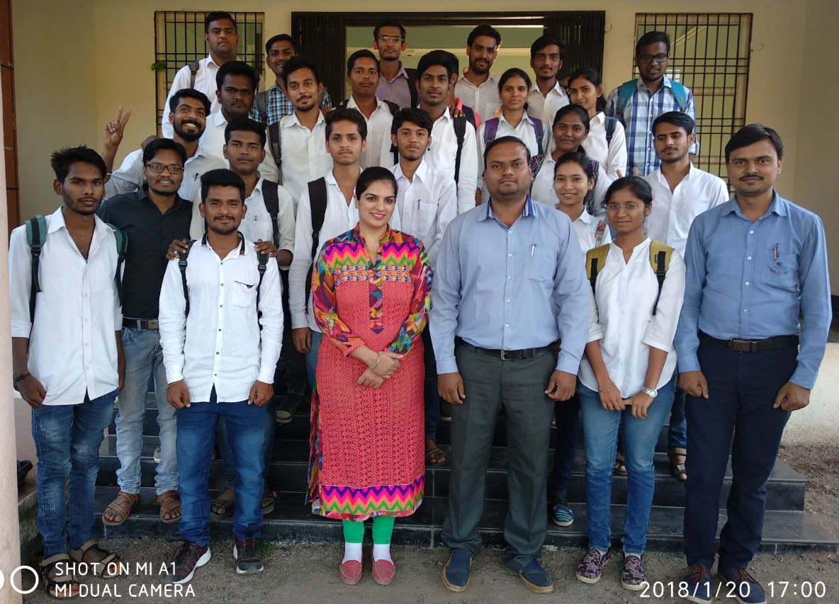
Contents
Company details
Outline of training
Need for training
Activities in training
Effects of training
Feedback
Photo gallery
Remarks and conclusion
Thank you

Slide 3
Company details
Founded in the year 2012, eSpoir consultancy has set out to be the leading firm for its innovative concept of spoken English catering to all segments of the society.
It is a team of professional trainers who have trained individuals, groups and corporate to effectively present their ideas in a clear, concise and convincing manner.
Our presentation skills, soft skills, communication skills training workshop will help individuals reach their goals faster.
Our vision is to make society more confident and progressive.

Slide 4
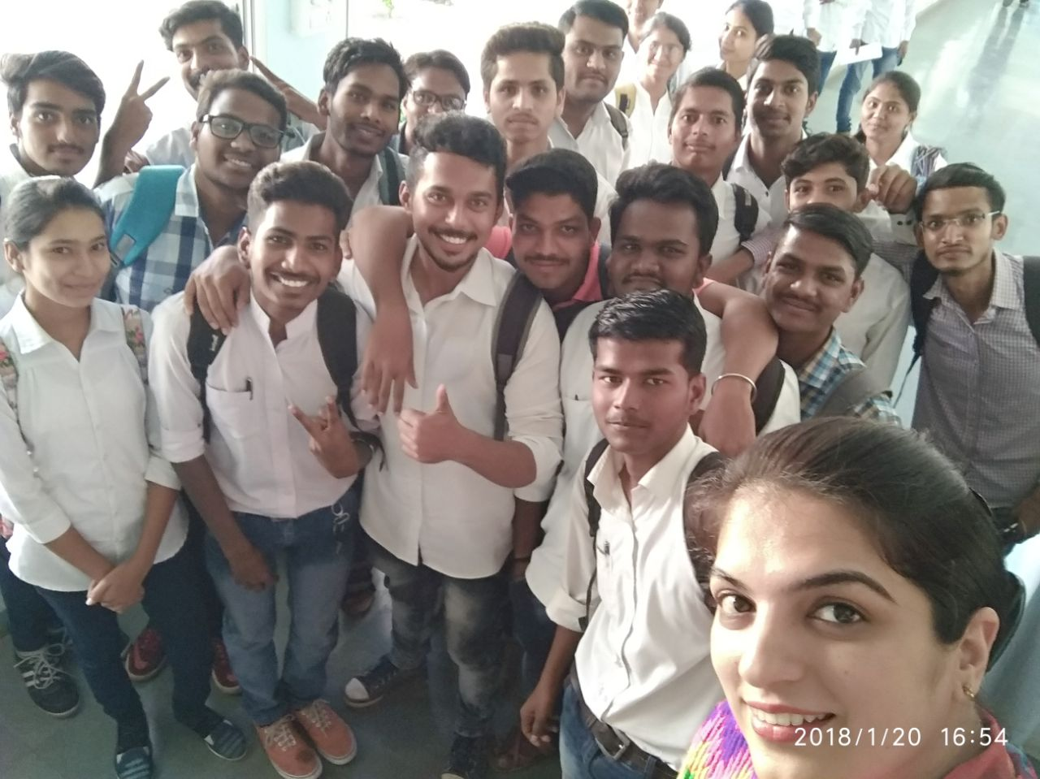
Outline of training
Spoken English
Life skills
Behavioural skills
Soft skills
Communication skills
Stress management
Personality development
Self motivation
Team work

Slide 5
Outline of training
4 Days session includes:
Day 1—Communication skills & Personality development
Day 2—Interview techniques & group discussions
Day 3—Motivation & personal grooming
Day 4—Life skills & Behavioural skills

Slide 6
Need of training
This training is the first step from campus to corporate.
It will help students get a feel of corporate atmosphere for one’s self learning, self reliance & independence
To help students capable to choose right path for the future and not just to follow the crowd
To make them confident, strong and presentable
To understand the corporate world and explore the possibilities in reaching their goals and grooming their personalities before they actually step in the real world
To inculcate clear idea about themselves and their future
Enhance entrepreneurship skills

Slide 7
Activities performed during training
The training created an environment based on fun and interactive sessions
Mock group discussions & Interviews were done
Various indoor & outdoor games were played for clarity of subject.
Audio visual sessions of different speakers
Case studies and industry practices across the world.

Slide 8
Effects of training
Proper grooming of body language.
Practice to answer many tricky interview techniques, group discussions, e-mail writing, aptitude personality development and corporate etiquette.
Search for better alternatives for their job profile
Promote and nurture greater consistency of their job
Students feel much more confident.

Slide 9
Feedback
Thank you for the course. - Pawan
Thank you for everything you were doing for us, I want to communicate more and more. - Priya
Wonderful learning in this training session. - Alsalihi
This training will help us to be successful in our life. - Pradeep

Slide 10
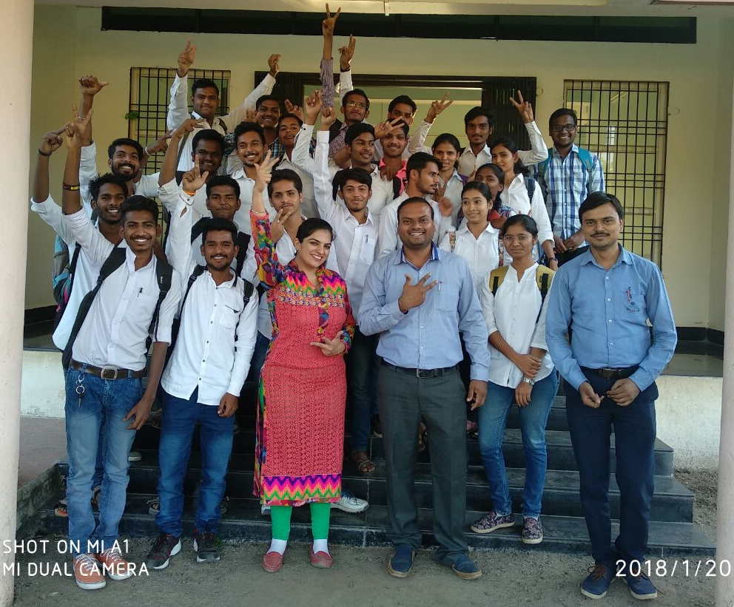
Photo gallery

Slide 11
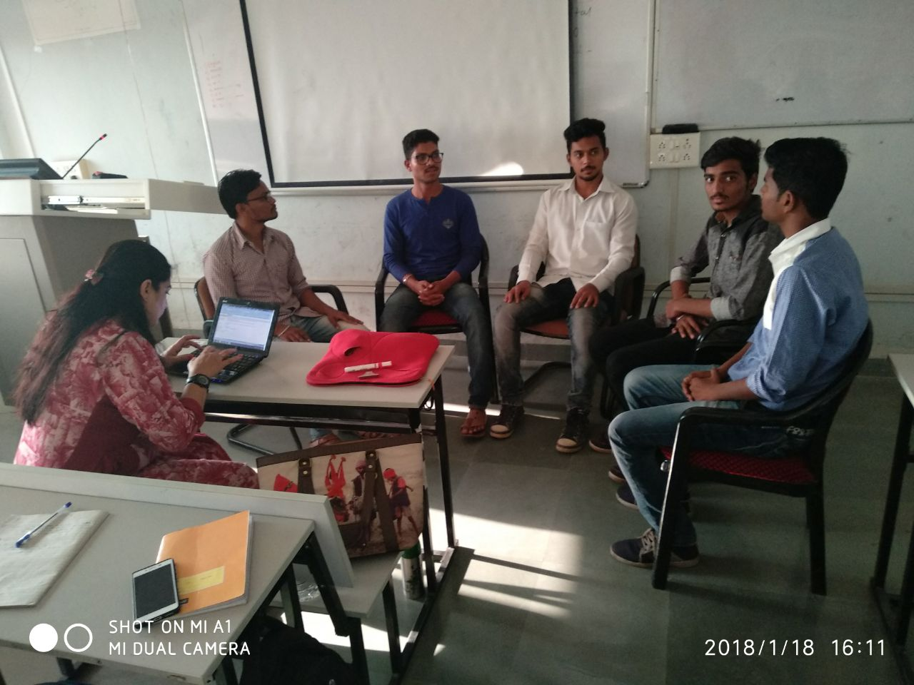
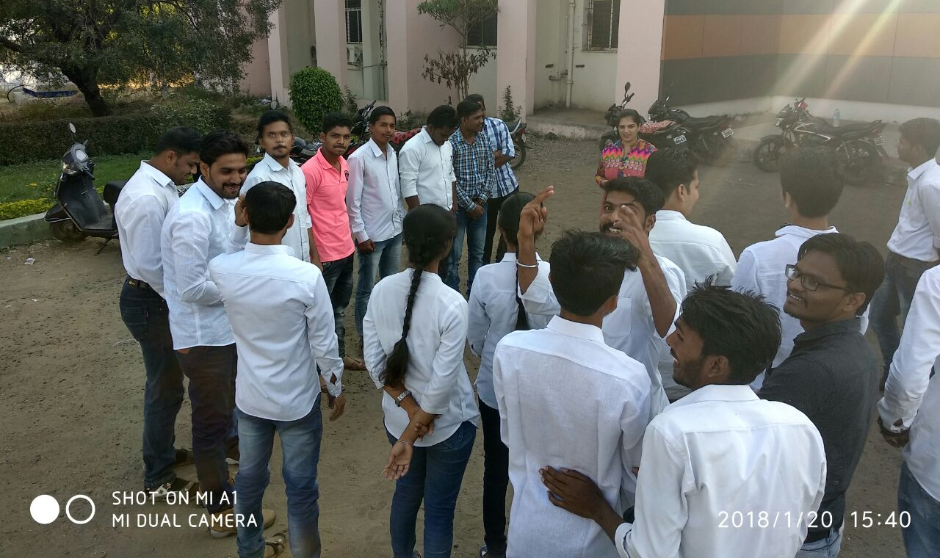
Activities performed by students

Slide 12
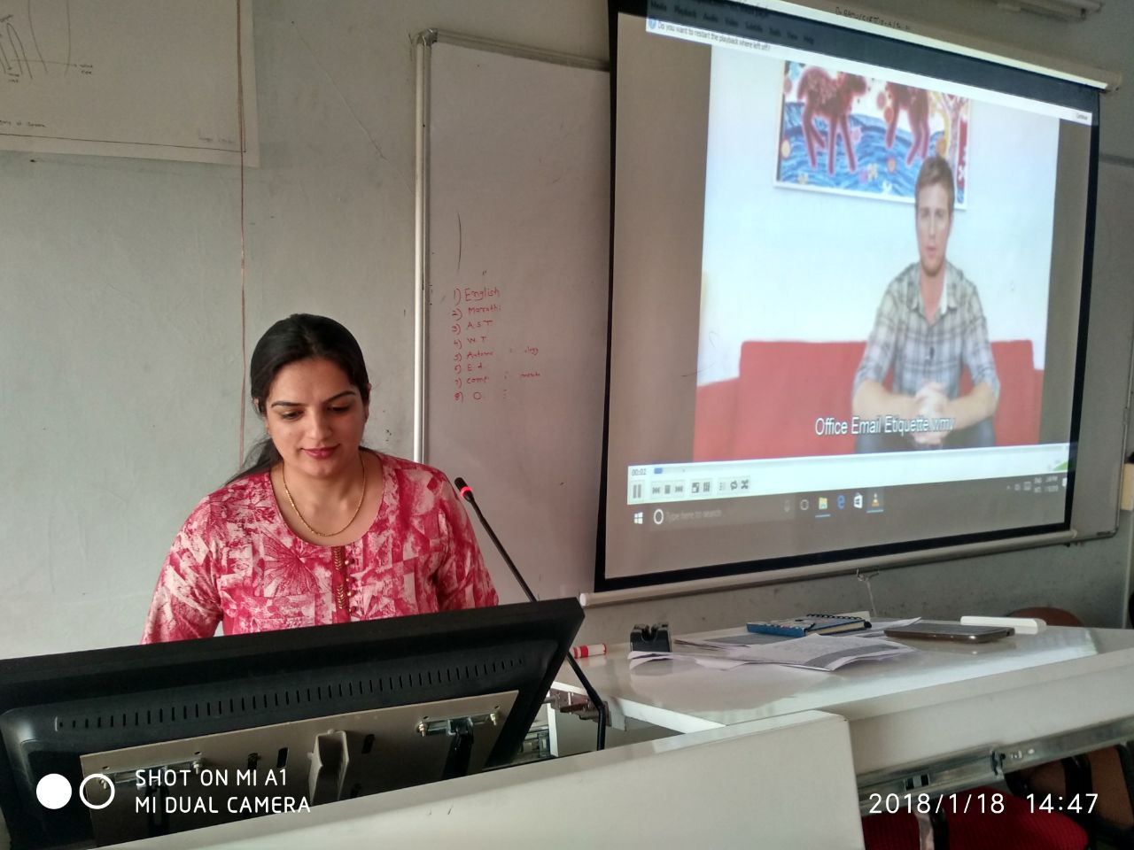
Audio – Visual aides & its importance:

Slide 13
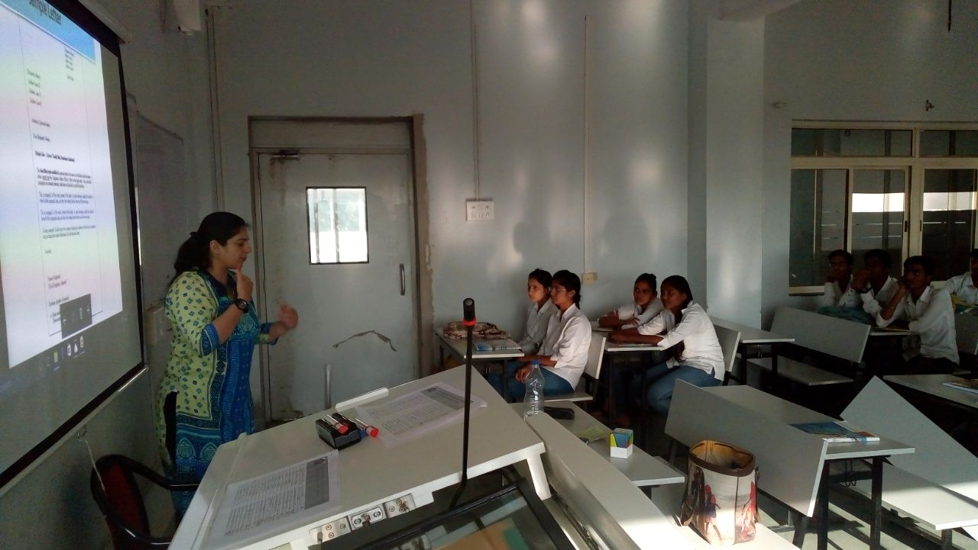
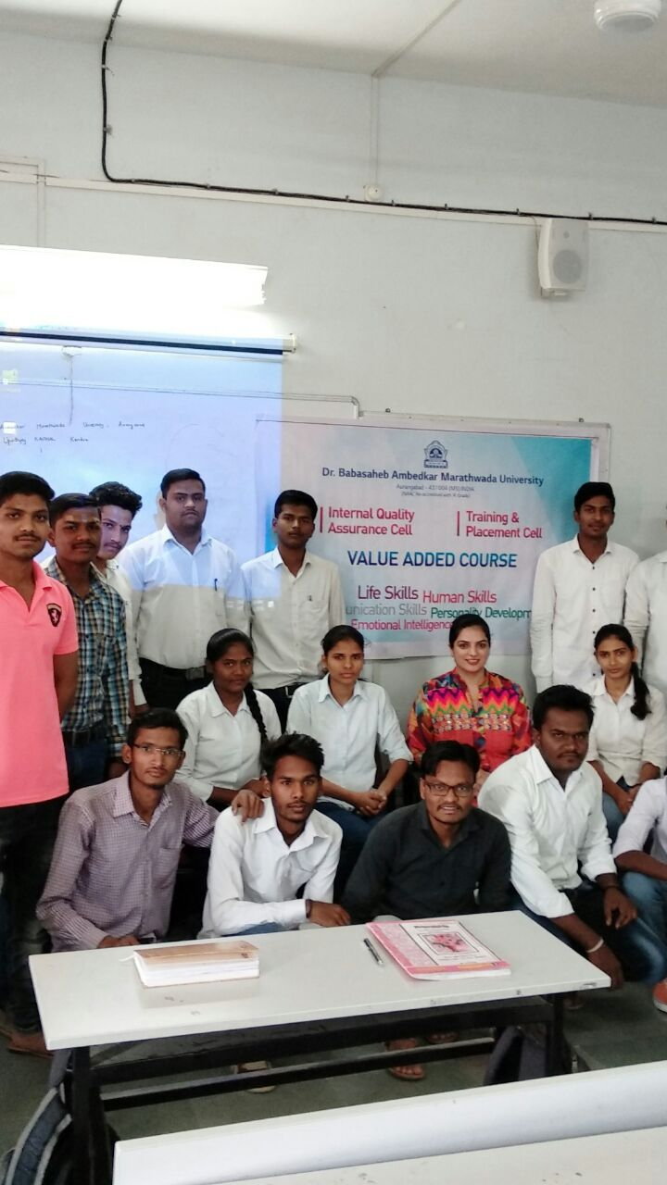
Concept explanation

Slide 14
Remarks and congratulations
Students improved their communication skill and hence ready to face the corporate world.
They understand their hidden potential.
They will explore multiple opportunities in their career.
They underst00d the importance of Value Added Services.

Slide 15
We at eSpoir consultancy want to extend our gratitude to Dr. BAMU and the DDUKK department for giving us an opportunity to serve the students for creating their future…

